Slide 1
Example 1.7 The Electric Field Due to a Charged Rod
A rod of length $𝓵$
has a uniform positive charge per unit length $λ$
and a total charge Q.
Calculate the electric field at a point P that is located along the long axis of the rod and a distance a from one end (Fig. 1.17).
Q
Figure 1.17 (Example 1.7) The electric field at P due to a uniformly charged rod lying along the x axis.

Slide 2
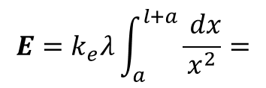
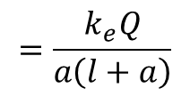
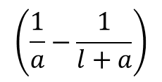
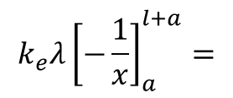
Solution
Let us assume that the rod is lying along the $x$axis,
that $dx$ is the length of one small segment,
and that $dq$ is the charge on that segment.
Because the rod has a charge per unit length λ ,
the charge $dq$on the small segment is
$$dq= λ dx.$$
The field $dE$ at P due to this segment is in the negative $x$ direction (because the source of the field carries a positive charge), and its magnitude is
$$dE=k_{e}\int{\frac{dq}{x^{2}}=k_{e}\int{\frac{λ dx}{x^{2}}}}$$
Because every other element also produces a field in the negative $x −direction$, the problem of
summing their contributions
The magnitude of the field at $P$ due to the segment of charge $dq is { k}_{e}dq/x^{2}$. The total field at $P$ is the vector sum over all segments of the rod.
$$E=k_{e}λ\int_{a}^{l+a}{\frac{ dx}{x^{2}}=}$$
$$k_{e}λ{\left[−\frac{1}{x}\right]}_{a}^{l+a}=$$
$$\left(\frac{1}{a}−\frac{1}{l+a}\right)$$
$$=\frac{k_{e}Q}{a\left(l+a\right)}$$
$$k_{e}λ$$
where we have used the fact that the total charge $Q = λ l$

Slide 3
What If ? Suppose we move to a point P very far away from the rod. What is the nature of the electric field at such a point?
Answer If P is far from the rod $(a ≫𝓵),$ then $𝓵$ ! in the denominator of the final expression for $E$ can be neglected, and
$E= k_{e}Q/a^{2}$.
This is just the form you would expect for a point charge. Therefore, at large values of $\frac{a}{𝓵} ,$ the charge distribution appears to be a point charge of magnitude Q—we are so far away
from the rod that we cannot distinguish that it has a size. The use of the limiting technique ( $\frac{a}{𝓁}→∞$ ) often is a good method for checking a mathematical expression.

Slide 4
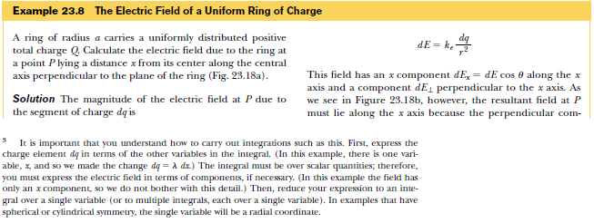
https://www.youtube.com/watch?v=Ta1q5_d-7yM

Slide 5
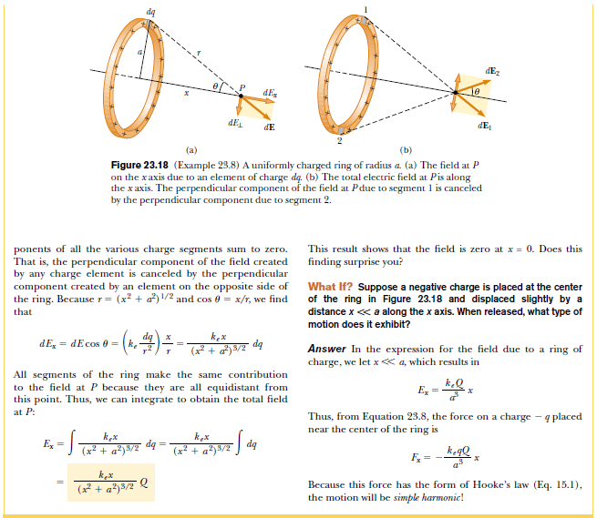
https://www.youtube.com/watch?v=Ta1q5_d-7yM

Slide 6
Example 1.8 The Electric Field of a Uniform Ring of Charge
A ring of radius a carries a uniformly distributed positive total charge Q . Calculate the electric field due to the ring at a point P lying a distance $x−$ from its center along the central axis perpendicular to the plane of the ring (Fig. 1.18a).
Solution
The magnitude of the electric field at P due to the segment of charge dq is this field has an x component $dE_{x}= dE cosθ$ along the x axis and a component ${dE}_{±}$ perpendicular to the x axis. As we see in Figure 1.18b, however, the resultant field at P must lie along the x axis because the perpendicular components of all the various charge segments sum to zero.
Figure 1.18 (Example 1.8) A uniformly charged ring of radius a. (a) The field at P on the x axis due to an element of charge dq . (b) The total electric field at P is along the x axis. The perpendicular component of the field at P due to segment 1 is canceled by the perpendicular component due to segment 2.

Slide 7
That is, the perpendicular component of the field created by any charge element is canceled by the perpendicular component created by an element on the opposite side of the ring.
Because ${r= (x^{2}+ a^{2})}^{1/2}$
and $cos θ= x/r$, we find that
All segments of the ring make the same contribution to the field at P because they are all equidistant from this point. Thus, we can integrate to obtain the total field at P:
This result shows that the field is zero at x = 0. Does this finding surprise you?
What If? Suppose a negative charge is placed at the center of the ring in Figure 1.18 and displaced slightly by a distance x $≪$ a along the x axis. When released, what type of motion does it exhibit?

Slide 8
Answer In the expression for the field due to a ring of charge, we let $x≪a$ which results in
Thus, from Equation 1.8, the force on a
charge -q placed near the center of the ring is
Because this force has the form of Hooke’s law
(Eq. 15.1), the motion will be simple harmonic!

Slide 9
https://www.youtube.com/watch?v=i68CGhgGkxs

Slide 10
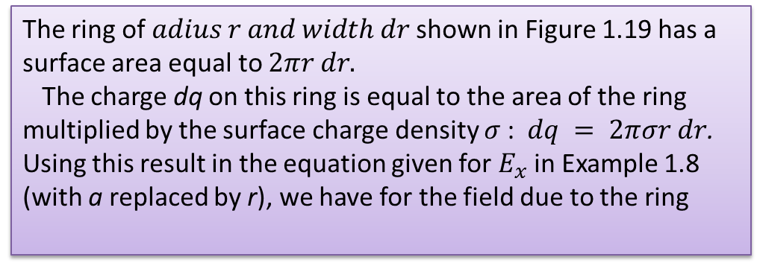
Example 1.9 The Electric Field of a Uniformly Charged Disk
A disk of radius R has a uniform surface charge density $σ$. Calculate the electric field at a point P that lies along the central perpendicular axis of the disk and a distance x from the center of the disk (Fig. 1.19).
Solution If we consider the disk as a set of concentric rings, we can use our result from Example 1.8—which gives the field created by a ring of radius a—and sum the contributions of all rings making up the disk. By symmetry, the field at an axial point must be along the central axis.
The ring of $adius r and width dr$ shown in Figure 1.19 has a surface area equal to $2πr dr.$
The charge dq on this ring is equal to the area of the ring multiplied by the surface charge density $σ$: $dq = 2πσr dr$. Using this result in the equation given for $E_{x}$ in Example 1.8 (with a replaced by r), we have for the field due to the ring
Figure 1.19 (Example 1.9) A uniformly charged disk of radius R. The electric field at an axial point P is directed along the central axis, perpendicular to the plane of the disk.
$${dE}_{x} =\frac{k_{e} x}{{(x^{2}+ r^{2} )}^{3/2}} dq=\frac{k_{e} x}{{(x^{2}+ r^{2} )}^{3/2}}(2πr dr σ)$$
To obtain the total field at P, we integrate this expression over the limits $r = 0 to r = R$, noting that x is a constant.

