Slide 1
This result is valid for all values of $x >0$. We can calculate the field close to the disk along the axis by assuming that $R≫ x$ ; thus, the expression in parentheses reduces to unity to give us the near-field approximation:
where $ε_{0}$ is the permittivity of free space. In the next chapter we shall obtain the same result for the field created by a uniformly charged infinite sheet.
https://www.youtube.com/watch?v=i68CGhgGkxs

Slide 2
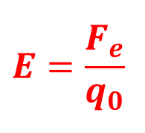
1.6 Electric Field Lines
$$E=\frac{F_{e}}{q_{0}}$$
We have defined the electric field mathematically through Eq1.7.
A convenient way of visualizing electric field patterns is to draw curved lines that are parallel to the electric field vector at any point in space. These lines, called electric field lines and first introduced by Faraday, are related to the electric field in a region of space in the following manner:
The electric field vector E is tangent to the electric field line at each point. The line has a direction, indicated by an arrow head, that is the same as that of the electric field vector.
The number of lines per unit area through a surface perpendicular to the lines is proportional to the magnitude of the electric field in that region. Thus, the field lines are close together where the electric field is strong and far apart where the field is weak.
These properties are illustrated in Figure 1.20. The density of lines through surface A is greater than the density of lines through surface B. Therefore, the magnitude of the electric field is larger on surface A than on surface B. Furthermore, the fact that the lines at different locations point in different directions indicates that the field is non uniform.
Figure 1.20; Electric field lines penetrating two surfaces. The Magnitude of the field is greater on surface A than on surface B.

Slide 3
1.6 Electric Field Lines
Is this relationship between strength of the electric field and the density of field lines consistent with Equation 1.9, $E=k_{e}\frac{q}{r^{2}}\hat{r}$the expression we obtained for E using Coulomb’s law? To answer this question, consider an imaginary spherical surface of radius r concentric with a point charge. From symmetry, we see that the magnitude of the electric field is the same everywhere on the surface of the sphere. The number of lines N that emerge from the charge is equal to the number that penetrate the spherical surface.
Hence, the number of lines per unit area on the sphere is N/4πr² (where the surface area of the sphere is 4πr² . Because E is proportional to the number of lines per unit area, we see that E varies as 1/r² ; this finding is consistent with Equation 1.9.
Figure 1.21 The electric field lines for a point charge. (a) For a positive point charge, the lines are directed radially outward. (b) For a negative point charge, the lines are directed radially inward. Note that the figures show only those field lines that lie in the plane of the page. (c) The dark areas are small pieces of thread suspended in oil, which align with the electric field produced by a small charged conductor at the center.

Slide 4
The rules for drawing electric field lines are as follows:
• The lines must begin on a positive charge and terminate on a negative charge. In the case of an excess of one type of charge, some lines will begin or end infinitely far away.
• The number of lines drawn leaving a positive charge or approaching a negative
charge is proportional to the magnitude of the charge.
• No two field lines can cross.
We choose the number of field lines starting from any positively charged object to be 𝐶 |𝑞| and the number of lines ending on any negatively charged object to be 𝐶|𝑞| , where C is an arbitrary proportionality constant.
Once C is chosen, the number of lines is fixed. For example, if object 1 has charge Q1 and object 2 has charge Q2, then the ratio of number of lines is
N₂/N₁= Q₂/Q₁

Slide 5
The electric field lines for two point charges of equal magnitude but opposite signs (an lectric dipole) are shown in Figure 1.22.
Because the charges are of equal magnitude, the number of lines that begin at the positive charge must equal the number that terminate at the negative charge.
At points very near the charges, the lines are nearly radial. The high density of lines between the charges indicates a region of strong electric field
Figure 1.22 (a) The electric field lines for two point charges of equal magnitude and opposite sign (an electric dipole). The number of lines leaving the positive charge equals the number terminating at the negative charge. (b) The dark lines are small pieces of thread suspended in oil, which align with the electric field of a dipole.
Figure 1.23 (a) The electric field lines for two positive point charges. (b) Pieces of thread suspended in oil, which align with the electric field created by two equal-magnitude positive charges.
Figure 1.24; The electric field lines for a point charge +2q and a second point charge -q. Note that two lines leave +2q for every one that terminates on -q.

Slide 6
1.7 Motion of Charged Particles in a Uniform Electric Field
the electric force exerted on the charge is $qE$ according to Equation 1.8.
When a particle of charge $q$ and mass m is placed in an electric field E,
If this is the only force exerted on the particle, it must be the net force and causes the particle to accelerate according to Newton’s second law. Thus,
𝑭=𝒒𝑬=𝒎𝒂
The acceleration of the particle is
𝒂=𝒒𝑬/𝒎 𝟏. 𝟏𝟐
therefore If 𝑬 is uniform (that is, constant in magnitude and direction), then the acceleration is constant.
If the particle has a positive charge, its acceleration is in the direction of the electric field.
If the particle has a negative charge, its acceleration is in the direction opposite the electric field.

Slide 7
Example 1.10 An Accelerating Positive Charge
A positive point charge $q$of mass $m$ is released from rest in a uniform electric field $E$ directed along the $x axis$, as shown in Figure 1.25. Describe its motion.
Figure 1.25 1. (Example 1.10) A positive point charge q in a uniform electric field E undergoes constant acceleration in the direction of the field.

Slide 8
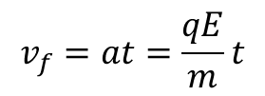
Solution The acceleration is constant and is given by $qE/m$. The motion is simple linear motion along the $x axis$ Therefore, we can apply the equations of kinematics in one dimension (see Chapter 2):
$$x_{f}=x_{i}+v_{i}t+\frac{1}{2}at^{2}$$
$$v_{f}=v_{i}+at$$
${v_{f}}^{2}={v_{i}}^{2}+2a\left(x_{f}−x_{i}\right)$
Choosing the initial position of the charge as $x_{i} =0$ and assigning $v_{i}=0$ because the particle starts from rest, the position of the particle as a function of time is
$$x_{f}=\frac{1}{2}at^{2}=\frac{qE}{2m}t^{2}$$
The speed of the particle is given by
$$v_{f}=at=\frac{qE}{m}t$$
The third kinematic equation gives us
$${v_{f}}^{2}={2ax}_{f}=\left(\frac{2qE}{m}\right)x_{f}$$
from which we can find the kinetic energy of the charge after it has moved a distance $∆x= x_{f}−x_{i} : K=\frac{1}{2}m{v_{f}}^{2}=\frac{1}{2}m\left(\frac{2qE}{m}\right)∆x=qE∆x$
We can also obtain this result from the work–kinetic energy theorem because the work done by the electric force is $F_{e}∆x=qE∆x and W=∆K.$

Slide 9
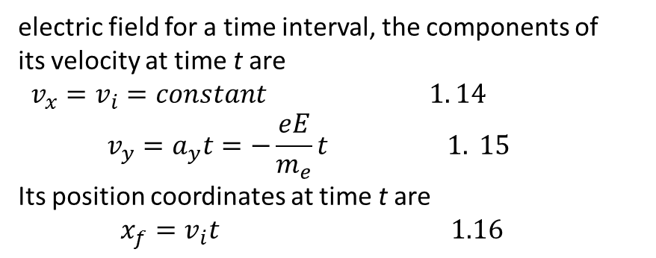
The electric field in the region between two oppositely charged flat metallic plates is approxim-atelly uniform (Fig. 1.26).
Suppose an electron of charge $−$e is projected horizontally into this field from the origin with an initial velocity $v_{i}i$ at time $t = 0$.
Because the electric field $E$ in Figure 1.26 is in the positive y direction, the acceleration of the electron is in the negative y direction.
$a=−\frac{eE}{m_{e}}\hat{j} 1.13$
Because the acceleration is constant, we can apply the equations of kinematics in two dimensions (see Chapter 4) with $v_{xi}= v_{i }$and $v_{yi}= 0$. After the electron has been in the
electric field for a time interval, the components of its velocity at time t are
$v_{x}=v_{i}=constant 1. 14$
$$v_{y}=a_{y}t=−\frac{eE}{m_{e}}t 1. 15$$
Its position coordinates at time t are
$${x_{f}=v}_{i}t 1.16$$
$y_{f}=\frac{1}{2}a_{y}t^{2}=−\frac{1}{2}\frac{eE}{m_{e}}t^{2}$ 1.17
Substituting the value $t= x_{f}/v_{i}$ from Equation 1.16 into Equation 1.17, we see that$y_{f}$ is proportional to ${x_{f}}^{2}$. Hence, the trajectory is a parabola.
Active Figure 1.26 An electron is projected horizontally into a uniform electric field produced by two charged plates. The electron undergoes a downward acceleration (opposite E), and its motion is parabolic while it is between the plates.

Slide 10
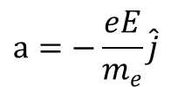
Example 1.11 An Accelerated Electron
An electron enters the region of a uniform electric field as shown in Figure 1.26, with$v_{i}=$3.00 $×$ 10⁶ m/s and E = 200 N/C. The horizontal length of the plates is$l= 0.100 m$. (A) Find the acceleration of the electron while it is in the electric field.
Solution The charge on the electron has an absolute value of $1.60 × {10}^{−19} C$, and $m_{e}= 9.11 × {10}^{−31} kg$. Therefore, Equation 1.13 gives
$$a=−\frac{eE}{m_{e}}\hat{j}$$
(B) If the electron enters the field at time t = 0, find the time at which it leaves the field.
Solution The horizontal distance across the field is l = 0.100 m. Using Equation 1.16 with $xf= l$, we find that the time at which the electron exits the electric field is
$t=\frac{𝓁}{v_{i}}$
(C) If the vertical position of the electron as it enters the field is y_{i} = 0, what is its vertical position when it leaves the field? Solution Using Equation1.17 and the results from parts and (B), we find that
If the electron enters just below the negative plate in Figure 1.26 and the separation between the plates is less than the value we have just calculated, the electron will strike the positive plate.

Slide 11
The Cathode Ray Tube
The example we just worked describes a portion of a cathode ray tube (CRT). This tube, illustrated in Figure 1.27, is commonly used to obtain a visual display of electronic information in oscilloscopes, radar systems, television receivers, and computer monitors. The CRT is a vacuum tube in which a beam of electrons is accelerated and deflected under the influence of electric or magnetic fields. The electron beam is
produced by an assembly called an electron gun located in the neck of the tube. These electrons, if left undisturbed, travel in a straight-line path until they strike the front of the CRT, the “screen,’’ which is coated with a material that emits visible light when bombarded with electrons.
In an oscilloscope, the electrons are deflected in various directions by two sets of plates placed at right angles to each other in the neck of the tube.
Figure 1.27 Schematic diagram of a cathode ray tube. Electrons leaving the cathode C are accelerated to the anode A. In addition to accelerating electrons, the electron gun is also used to focus the beam of electrons, and the plates deflect the beam.
The placing of positive charge on one horizontal plate and negative charge on the other creates an electric field between the plates and allows the beam to be steered from side to side. The vertical deflection plates act in the same way, except that changing the charge on them deflects the beam vertically.

Slide 12
Problem:
5
7
9
10
11
12

