Slide 1
Chapter 2- L₂

Slide 2
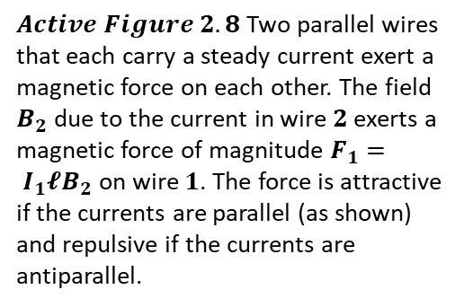
$2.2$ The Magnetic Force Between Two Parallel Conductors
In Chapter $1$ we described the magnetic force that acts on a current-carrying conductor placed in an external magnetic field.
Because a current in a conductor sets up its own magnetic field, it is easy to understand that two current-carrying conductors exert magnetic forces on each other.
Such forces can be used as the basis for defining the ampere and the coulomb.
Consider two long, straight, parallel wires separated by a distance a and carrying currents $I_{1}$ and $I_{2}$ in the same direction, as in Figure ( 2.8 ). We can determine the force exerted on one wire due to the magnetic field set up by the other wire.
Wire $2$, which carries a current $I_{2}$ and is identified arbitrarily as the source wire, creates a magnetic field $B_{2}$ at the location of wire $1$, the test wire. The direction of $B_{2}$ is perpendicular to wire $1$, as shown in Figure$2.8$.
According to Equation $1.3$, the magnetic force on a length $𝓵$ of wire $1 is { F}_{1}= I_{1}𝓁B_{2}$
Because $𝓵$ is perpendicular to $B_{2}$ in this situation, the magnitude of $F_{1}$ is $F_{1}= I_{1}𝓁B_{2}$.
$Active Figure 2.8$Two parallel wires that each carry a steady current exert a magnetic force on each other. The field $B_{2}$ due to the current in wire $2$ exerts a magnetic force of magnitude $F_{1}= I_{1}𝓵B_{2}$ on wire $1$. The force is attractive if the currents are parallel (as shown) and repulsive if the currents are antiparallel.
Because the magnitude of B₂ is given by Equation $2.5$, we see that
$F_{1}= I_{1}𝓵B_{2}=I_{1}𝓵\left(\frac{μ_{0}I_{2}}{2πa}\right)=\frac{μ_{0}{I_{1}I}_{2}}{2πa}𝓵$ (2.11)

Slide 3
The direction of $F1$ is toward wire $2$ because $𝓁×{ B}_{2}$ is in that direction. If the field set up at wire $2$ by wire $1$is calculated, the force F₂ acting on wire 2 is found to be equal in magnitude and opposite in direction to $F_{1}$.
This is what we expect because Newton’s third law must be $obeye{d.}^{1}$
When the currents are in opposite directions (that is, when one of the currents is reversed in Fig. $2.8$), the forces are reversed and the wires repel each other.
Hence, parallel conductors carrying currents in the same direction attract each other, and parallel conductors carrying currents in opposite directions repel each other.
Because the magnitudes of the forces are the same on both wires, we denote the magnitude of the magnetic force between the wires as simply $F_{B}$.
We can rewrite this magnitude in terms of the force per unit length: $\frac{F_{B}}{𝓵}=\frac{μ_{0}{I_{1}I}_{2}}{2πa}𝓵$ ($2.12$)
The force between two parallel wires is used to define the ampere as follows:
When the magnitude of the force per unit length between two long parallel wires that carry identical currents and are separated by $1 m is 2 x{10}^{−7} N/m$, the current in each wire is defined to be $1 A$.
The SI unit of charge, the coulomb, is defined in terms of the ampere:
When a conductor carries a steady current of $1 A$, the quantity of charge that flows through a cross section of the conductor in $1 s is 1 C$.
The value $2 × {10}^{−7} N/m$ is obtained from Equation $2.12$ with $I_{1}=I_{2}= 1 A$ and $=1 m$ . Because this definition is based on a force, a mechanical measurement can be used to standardize the ampere.

Slide 4
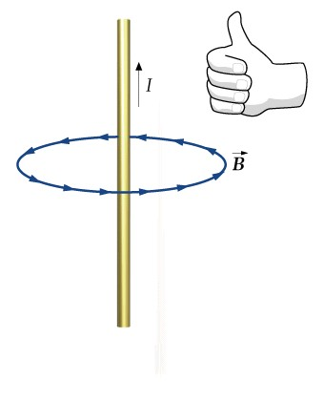
$$2.3 Amperes Law$$
Oersted’s 1819 discovery about deflected compass needles demonstrates that a current-carrying conductor produces a magnetic field.
Figure (2.9a) shows how this effect can be demonstrated in the classroom. Several compass needles are placed in a horizontal plane near a long vertical wire. When no current is present in the wire, all the needles point in the same direction (that of the Earth’s magnetic field), as expected.
When the wire carries a strong, steady current, the needles all deflect in a direction tangent to the circle, as in Figure $2.9b$.
These observations demonstrate that the direction of the magnetic field produced by the current in the wire is consistent with the right-hand rule described in Figure $2.4$.
Because the compass needles point in the direction of B, we conclude that the lines of $B$ form circles around the wire, as discussed in the preceding section. By symmetry, the magnitude of B is the same everywhere on a circular path centered on the wire and lying in a plane perpendicular to the wire.
By varying the current I and distance a from the wire, we find that B is proportional to the current and inversely proportional to the distance from the wire, as Equation $2.5$ describes.
$B=\frac{μ_{0}I}{2πa}$ $(2.5)$

Slide 5
$$\text{Now} \text{let} \text{us} \text{evaluate} \text{the} \text{product} B. ds \text{for} \text{a} \text{small} \text{length} \text{element} ds \text{on} \text{the} \text{circular} \text{path} \text{defined} \text{by} \text{the} \text{compass} \text{needles}\text{, }\text{and} \text{sum} \text{the} \text{products} \text{for} \text{all} \text{elements} \text{over} \text{the} \text{closed} \text{circular} {path}^{}.$$
Along this path, the vectors $ds and B$ are parallel at each point (see Fig$. 2.9$b), so
$B. ds=Bds$ $A. B=AB\sin{θ}$
Furthermore, the magnitude of B is constant on this circle and is given by Equation $2.5.$
$B=\frac{μ_{0}I}{2πa}$ $(2.5)$
Therefore, the sum of the products $Bds$ over the closed path, which is equivalent to the line integral of $B. ds$, is
$$\oint{B. ds=B}\oint{ds}=\frac{μ_{0}I}{2πr}\left(2πr\right)=μ_{0}I$$
where $\oint{ds}= 2πr$is the circumference of the circular path.
The general case, known as Ampère’s law, can be stated as follows
The line integral of $B. ds$ around any closed path equals $μ_{0}I$, where $I$ is the total steady current passing through any surface bounded by the closed path.
$\oint{B. ds}=μ_{0}I$ $\left(2.13\right)$ (Ampère’s law)
$μ_{0}$permeability
Its use is similar to that of Gauss’s law in calculating electric fields for highly symmetric charge distributions. $\oint{E. ds}=\frac{q}{ε_{o}}$ $(Gauss^{′}s law)$
$ε_{o}$ permittivity

Slide 6
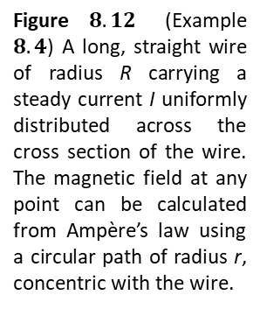
$$\text{Example}\text{ 2.4: }\text{The} \text{Magnetic} \text{Field} \text{Created} \text{by} \text{a} \text{Long} \text{Current}\text{−}\text{Carrying} \text{Wire}$$
A long, straight wire of radius $R$ carries a steady current I that is uniformly distributed through the cross section of the wire (Fig. $2.12$). Calculate the magnetic field a distance $r$from the center of the wire in the regions $r ≥ R$and $r < R.$
Solution: Figure $2.12$ helps us to conceptualize the wire and the current. Because the wire has a high degree of symmetry, we categorize this as an Ampère’s law problem.
Figure $8.12$ (Example $8.4$) A long, straight wire of radius R carrying a steady current I uniformly distributed across the cross section of the wire. The magnetic field at any point can be calculated from Ampère’s law using a circular path of radius r, concentric with the wire.
For the $r ≥ R$ case, we should arrive at the same result we obtained in Example$2.1$, in which we applied the Biot–Savart law to the same situation.
To analyze the problem, let us choose for our path
of integration $circle 1$in Figure $2.12$.
From symmetry, B must be constant in magnitude and parallel to $ds$at every point on this circle.
Because the total current passing through the plane of the circle is $I$, Ampère’s law gives
$$\oint{B.ds}=μ_{0}I$$
$$B\oint{ds=μ_{0}I}$$
$$B\left(2πr\right)=μ_{0}I$$
Note how much easier it is to use Ampère’s law than to use the Biot–Savart law. This is often the case in highly symmetric situations.
$B=\frac{μ_{0}I}{2πr}$ $\left( for r ≥ R \right) \left(2.14\right)$
which is identical in form to Equation $2.5$.

Slide 7
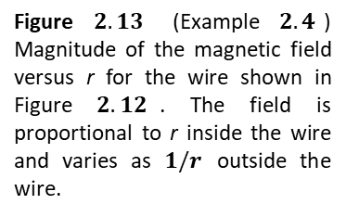
$$\text{Now} \text{consider} \text{the} \text{interior} \text{of} \text{the} \text{wire}\text{, }\text{where} r < R.$$
Here the current $\acute{I }$ passing through the plane of $circle 2$ is less than the total current $I$.
Because the current is uniform over the cross section of the wire, the fraction of the current enclosed by circle $2$ must equal the ratio of the area $πr^{2}$enclosed by circle $2$ to the cross-sectional area $πR^{2}$ of the ${wire:}^{}$
$$\frac{\acute{I }}{πr^{2}}=\frac{I}{πR^{2}}$$
$$\frac{\acute{I }}{I}=\frac{πr^{2}}{πR^{2}} \acute{I }=\frac{r^{2}}{R^{2}}I$$
Following the same procedure as for circle $1,$ we apply Ampère’s law to circle $2$:
$$\oint{B.ds}=B\oint{ds=B\left(2πr\right)=μ_{0}\acute{I}}=μ_{0} \left(\frac{r^{2}}{R^{2}}I \right)$$
$B\left(2πr\right)=μ_{0} \left(\frac{r^{2}}{R^{2}}I \right)$ - $B=\left(\frac{μ_{0}I}{{2πR}^{2}}\right)r$ $for r<R (2.15)$
To finalize this problem, note that this result is similar in form to the expression for the electric field inside a uniformly charged sphere .
The magnitude of the magnetic field versus $r$for this configuration is plotted in Figure $2.13$. Note that inside the wire, $B → 0$as $r → 0$.
Figure $2.13$ (Example $2.4$) Magnitude of the magnetic field versus r for the wire shown in Figure $2.12$. The field is proportional to r inside the wire and varies as $1/r$ outside the wire.
Furthermore, we see that Equations $2.14 and 2.15$ give the same value of the magnetic field at $r= R$, demonstrating that the magnetic field is continuous at the surface of the wire.

Slide 8
$$Example 2.5 \text{The} \text{Magnetic} \text{Field} \text{Created} \text{by} \text{a} \text{Toroid}$$
A device called a toroid (Fig. $2.14$) is often used to create an almost uniform magnetic field in some enclosed area. The device consists of a conducting wire wrapped around a ring (a torus) made of a non conducting material. For a toroid having N closely spaced turns of wire, calculate the magnetic field in the region occupied by the torus, a distance r from the center.
Solution: To calculate this field, we must evaluate $\oint{B. ds}$over the circular amperian loop of radius $r$ in the plane of Figure 2$.14$. By symmetry, we see that the magnitude of the field is constant on this circle and tangent to it, so $\oint{B. ds}=\oint{B ds}$.
Furthermore, the wire passes through the loop $N$ times, so that the total current through the loop is $NI$. Therefore, the right side of Equation $2.13$is$μ_{0}NI$ in this case.
Ampère’s law applied to the circle gives
$\oint{B. ds}=B\oint{ds=B\left(2πr\right)=μ_{0}NI}$
$B$ $=\frac{μ_{0}NI}{2πr}$ $\left(2.16\right)$
This result shows that $B$ varies as $1/r$ and hence is non uniform in the region occupied by the torus.
However, if $r$ is very large compared with the cross-sectional radius a of the torus, then the field is approximately uniform inside the torus. For an ideal toroid, in which the turns are closely spaced, the external magnetic field is close to zero. It is not exactly zero, however.

Slide 9
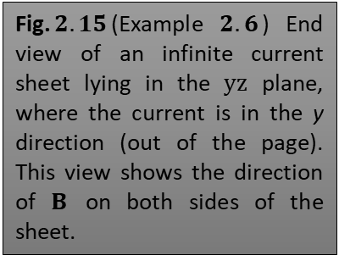
$$\text{Example} 2\text{.6 }\text{Magnetic} \text{Field} \text{Created} \text{by} \text{an} \text{Infinite} \text{Current} \text{Sheet}$$
So far we have imagined currents carried by wires of small cross section. Let us now consider an example in which a current exists in an extended object. A thin, infinitely large sheet lying in the $yz plane$ carries a current of linear current density $J_{s }$. The current is in the y direction, and $J_{s}$ represents the current per unit length measured along the$z axis$. Find the magnetic field near the sheet.
Solution : To evaluate the line integral in Ampère’s law, we construct a rectangular path through the sheet, as in Figure $2.15$. The rectangle has dimensions $𝓵$ and $𝔀$, with the sides of length 𝓁 parallel to the sheet surface.
We apply Ampère’s law over the rectangle and note that the two sides of length $𝔀$ do not contribute to the line integral because the component of $B$ along the direction of these paths is zero.
Assuming a field that is constant in magnitude and parallel to the plane of the sheet, we obtain $\oint{B.ds}=μ_{0}I$ but, $I={ J}_{s}𝓁$
$\oint{B.ds}=μ_{0}{ J}_{s}𝓁$ but, the field consist with to 2 $𝓵$ then;
$$2B𝓵=μ_{0}{ J}_{s}𝓵$$
$${B=μ}_{0}\frac{{ J}_{s}}{2}$$
This result shows that the magnetic field is independent of distance from the current sheet, as we suspected.
Fig.$2.15$(Example $2.6$) End view of an infinite current sheet lying in the $yz$ plane, where the current is in the y direction (out of the page). This view shows the direction of $B$ on both sides of the sheet.
$\text{The} \text{expression} \text{for} \text{the} \text{magnitude} \text{of} \text{the} \text{magnetic} \text{field} \text{is} \text{similar} \text{in} \text{form} \text{to} \text{that} \text{for} \text{the} \text{magnitude} \text{of} \text{the} \text{electric} \text{field} \text{due} \text{to} \text{an} \text{infinite} \text{sheet} \text{of} \text{charge}\text{ :}$
$$E=\frac{σ}{2ε}$$

