Slide 1

$$Chapter 2$$
Sources of the Magnetic Field

Slide 2
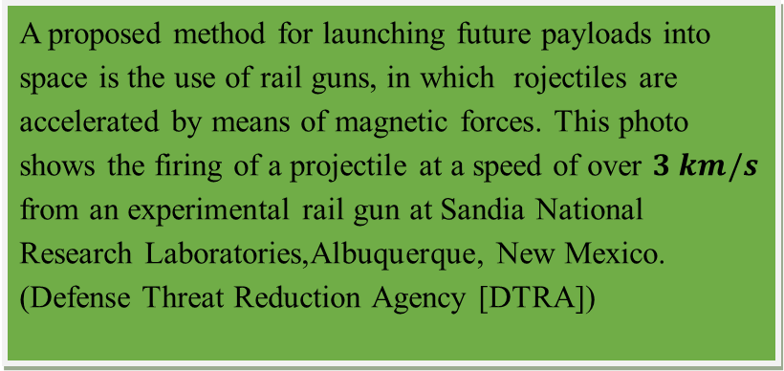

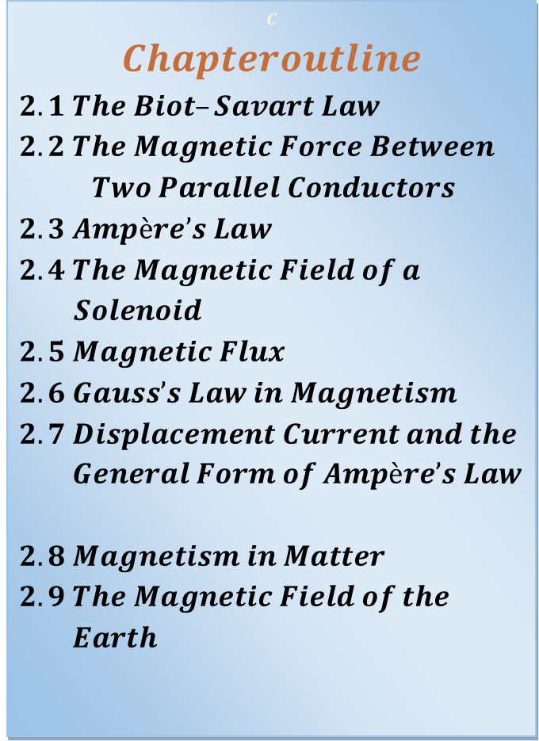
$$Chapter 2$$
Sources of the Magnetic Field
$$C$$
$$Chapteroutline$$
$2.1 The Biot–Savart Law$
$$2.2 The Magnetic Force Between$$
$Two Parallel Conductors$
$2.3 Ampère’s Law$
$$2.4 The Magnetic Field of a$$
$Solenoid$
$2.5 Magnetic Flux$
$2.6 Gauss’s Law in Magnetism$
$$2.7 Displacement Current and the$$
$General Form of Ampère’s Law$
$2.8 Magnetism in Matter$
$$2.9 The Magnetic Field of the$$
$Earth$
A proposed method for launching future payloads into space is the use of rail guns, in which rojectiles are accelerated by means of magnetic forces. This photo shows the firing of a projectile at a speed of over $3 km/s$ from an experimental rail gun at Sandia National Research Laboratories,Albuquerque, New Mexico. (Defense Threat Reduction Agency [DTRA])

Slide 3
$Introduction$
In the preceding chapter, we discussed the magnetic force exerted on a charged particle moving in a magnetic field.
To complete the description of the magnetic interaction, this chapter explores the origin of the magnetic field—moving charges.
We begin by showing how to use the law of Biot and Savart to calculate the magnetic field produced at some point in space by a small current element.
Using this formalism and the principle of superposition, we then calculate the total magnetic field due to various current distributions.
Next, we show how to determine the force between two current-carrying conductors, which leads to the definition of the ampere.
We also introduce Ampère’s law, which is useful in calculating the magnetic field of a highly symmetric configuration carrying a steady current.
This chapter is also concerned with the complex processes that occur in magnetic materials. All magnetic effects in matter can be explained on the basis of atomic magnetic moments, which arise both from the orbital motion of electrons and from an intrinsic property of electrons known as spin.

Slide 4
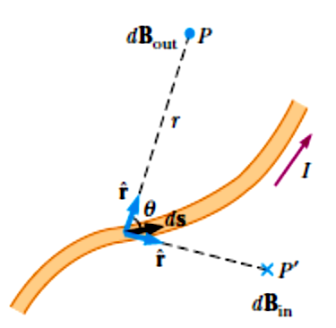
2.𝟏 The Biot–Savart Law
• Shortly after Oersted’s discovery in 𝟏𝟖𝟏𝟗 that a compass needle is deflected by a current-carrying conductor,
Jean-Baptiste Biot (𝟏𝟕𝟕𝟒–𝟏𝟖𝟔𝟐) and Félix Savart (𝟏𝟕𝟗𝟏–𝟏𝟖𝟒𝟏) performed quantitative experiments on the force exerted by an electric current on a nearby magnet.
From their experimental results, Biot and Savart arrived at a mathematical expression that gives the magnetic field at some point in space in terms of the current that produces the field.
That expression is based on the following experimental observations for the magnetic field 𝒅𝑩 at a point P associated with a length element 𝑑𝑠 of a wire carrying a steady current 𝐼
(𝑭𝒊𝒈. 2.𝟏):
Biot and Savart: each “current element” I ds (a very short length ds of wire, carrying current I) produces a field dB throughout space:
𝑭𝒊𝒈𝒖𝒓𝒆 2.𝟏 The magnetic field dB at a point due to the current I through a length element ds is given by the Biot–Savart law. The direction of the field is out of the page at P and into the page at 𝑷 ́

Slide 5
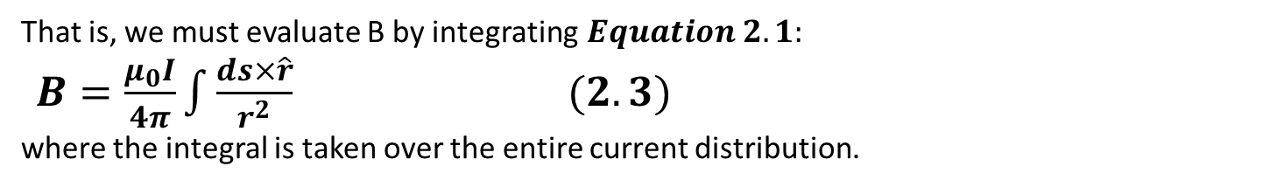
•The vector 𝒅𝑩 is perpendicular both to 𝒅𝒔 (which points in the direction of the current) and to the unit vector 𝑟 ̂ directed from 𝒅𝒔 toward 𝑷.
• The magnitude of 𝒅𝑩 is inversely proportional to 𝒓^𝟐 , where 𝑟 is the distance from 𝒅𝒔 to 𝑷.
• The magnitude of 𝒅𝑩 is proportional to the current and to the magnitude 𝒅𝒔 of the length element 𝒅𝒔.
• The magnitude of 𝒅𝑩 is proportional to 𝑠𝑖𝑛𝜃, where 𝜃 is the angle between the vectors 𝒅𝒔 and 𝒓ˆ.
These observations are summarized in the mathematical expression known today as the Biot–Savart law:
$dB=\frac{μ_{0}}{4π}\frac{Ids×\hat{r}}{r^{2}}$ $(2.1)$ Biot–Savart law
where $μ_{0}$ is a constant called the permeability of free space:
$μ_{0}=4π×{10}^{−7} T.\frac{m}{A} (2.2)$ Permeability of free space
Note that the field 𝒅𝑩 in Equation 2.𝟏 is the field created by the current in only a small length element 𝒅𝒔 of the conductor.
To find the total magnetic field 𝑩 created at some point by a current of finite size, we must sum up contributions from all current elements 𝑰 𝒅𝒔 that make up the current.
That is, we must evaluate B by integrating$Equation 2.1:$
$B=\frac{μ_{0}I}{4π}\int{\frac{ds×\hat{r}}{r^{2}}}$ $(2.3)$
where the integral is taken over the entire current distribution.

Slide 6
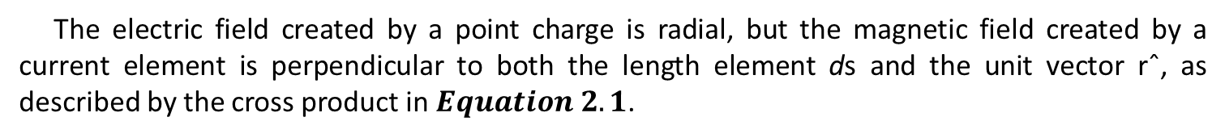
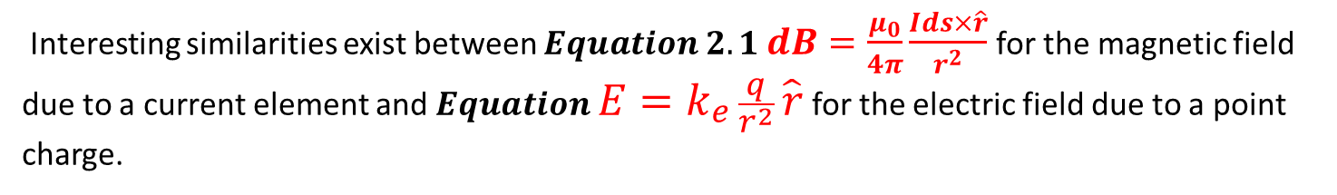
Although we developed the Biot–Savart law for a current-carrying wire, it is also valid for a current consisting of charges flowing through space, such as the electron beam in a television set. In that case, 𝒅𝒔 represents the length of a small segment of space in which the charges flow.
Interesting similarities exist between $Equation 2.1$ $dB=\frac{μ_{0}}{4π}\frac{Ids×\hat{r}}{r^{2}}$for the magnetic field due to a current element and $Equation E=k_{e}\frac{q}{r^{2}}\hat{r}$ for the electric field due to a point charge.
The magnitude of the magnetic field varies as the inverse square of the distance from the source, as does the electric field due to a point charge.
However, the directions of the two fields are quite different.
The electric field created by a point charge is radial, but the magnetic field created by a current element is perpendicular to both the length element ds and the unit vector rˆ, as described by the cross product in $Equation 2.1$.
Another difference between electric and magnetic fields is related to the source of the field. An electric field is established by an isolated electric charge.
The Biot–Savart law gives the magnetic field of an isolated current element at some point, but such an isolated current element cannot exist the way an isolated electric charge can.
A current element must be part of an extended current distribution because we must have a complete circuit in order for charges to flow.

Slide 7
Characteristics | Electric Field | Magnetic Field
Field generation | Electric field E caused by electric charges is radial. charge, either moving or stationary (produced by voltage) | Magnetic field B caused by moving electric charges and magnets (produced by current element is perpendicular to both the length element ds and the unit vector rˆ)
the source of the field | Electric field is established by an isolated electric charge. | The Biot–Savart law gives the magnetic field of an isolated current element at some point, but such an isolated current element cannot exist the way an isolated electric charge can. Magnetic poles, on the other side, cannot be isolated
Attract / Repel | Unlike charges behavior is "attract each other" whereas Like charges behavior is "repel each other" | Like poles behavior is "repel each other" whereas unlike poles behavior is "attract each other"
Polarity | + and - | North and South
Laws | Follows Gauss’s law (if there is a symmetry) | Follows Ampere’s law (if there is a symmetry)
Distance (r) relation | Electric field is proportional to 1/r² | Magnetic field is proportional to 1/r²
Electric / Magnetic Lines of force | Electric lines start from a positive charge and terminate to a negative charge | Magnetic lines start from a North pole and terminate to a South pole.
Units | Electric field is measured in Newton per coulomb (N/C) or Volt per meter (V/m) | Magnetic field is measured in Gauss or Tesla
Force | Force is proportional to an electric charge | Force is proportional to charge and speed of charge
Pole | Monopole or Dipole | Dipole Only
Field shielding | Electric fields can be shielded easily by most materials such as trees, and buildings | Magnetic fields generally cannot be shielded easily

Slide 8
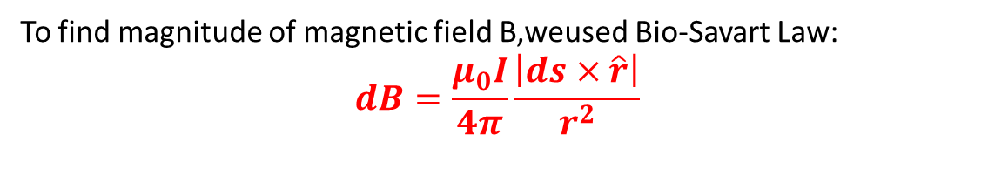

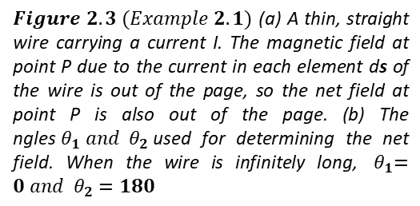
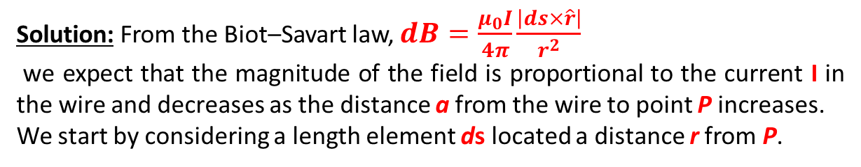
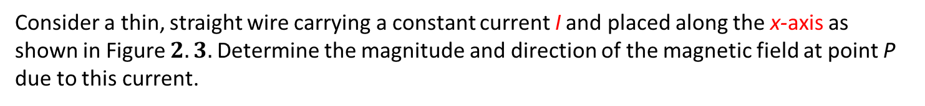
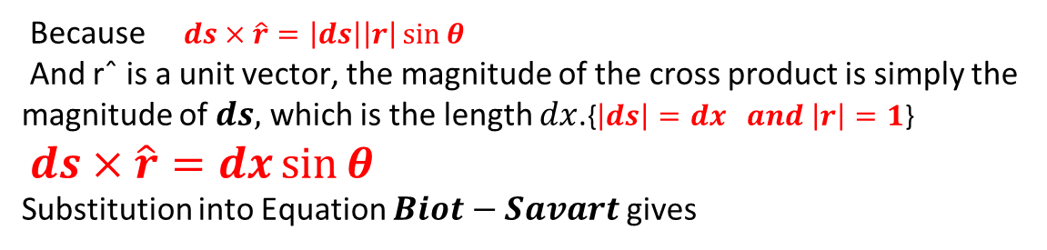
𝑬𝒙𝒂𝒎𝒑𝒍𝒆 2.𝟏 Magnetic Field Surrounding a Thin, Straight Conductor
Consider a thin, straight wire carrying a constant current I and placed along the x-axis as shown in Figure $2.3.$Determine the magnitude and direction of the magnetic field at point P due to this current.
Solution: From the Biot–Savart law, $dB=\frac{μ_{0}I}{4π}\frac{\left|ds×\hat{r}\right|}{r^{2}}$
we expect that the magnitude of the field is proportional to the current I in the wire and decreases as the distance a from the wire to point P increases.
We start by considering a length element ds located a distance r from P.
The direction of the magnetic field at point P due to the current in this element is out of the page because $ds×\hat{r}$ is out of the page.
In fact, because all of the current elements I ds lie in the plane of the page, they all produce a magnetic field directed out of the page at point P. Thus, we have the direction of the magnetic field at point P, and we need only find the magnitude.
To find magnitude of magnetic field B,weused Bio-Savart Law:
$$dB=\frac{μ_{0}I}{4π}\frac{\left|ds×\hat{r}\right|}{r^{2}}$$
Because $ds×\hat{r}=\left|ds\right|\left|r\right|\sin{θ}$
And rˆ is a unit vector, the magnitude of the cross product is simply the magnitude of $ds,$ which is the length $dx$.{$\left|ds\right|=dx and \left|r\right|=1$}
$ds×\hat{r}=dx\sin{θ}$
Substitution into Equation $Biot−Savart$gives
$Figure 2.3 (Example 2.1)$ (a) A thin, straight wire carrying a current I. The magnetic field at point P due to the current in each element ds of the wire is out of the page, so the net field at point P is also out of the page. (b) The ngles${ θ}_{1} and { θ}_{2 }$used for determining the net field. When the wire is infinitely long, ${ θ}_{1}=0 and { θ}_{2}=180$

Slide 9
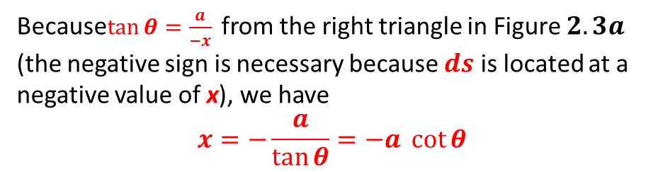
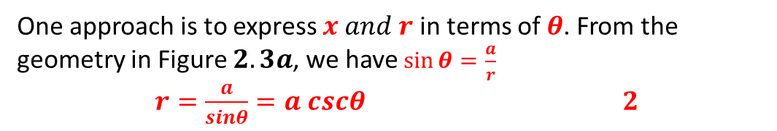
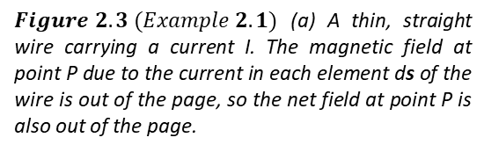

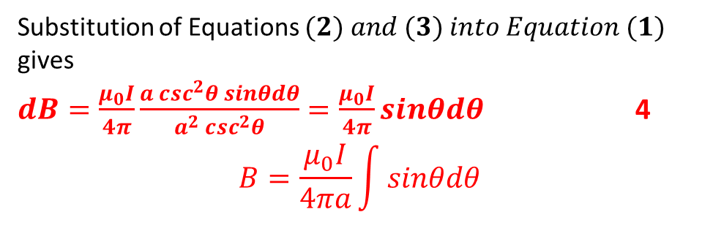

$dB=\frac{μ_{0}I}{4π}\frac{dx sinθ}{r^{2}}$ $1$
To integrate this expression, we must relate the variables $θ$, $x, and r$.
One approach is to express $x and r$ in terms of $θ$. From the geometry in Figure $2.3a$, we have $\sin{θ}=\frac{a}{r}$
$r=\frac{a}{sinθ}=a cscθ$ $2$
Because$\tan{θ}=\frac{a}{−x}$ from the right triangle in Figure $2.3a$ (the negative sign is necessary because $ds$ is located at a negative value of x), we have
$$x=−\frac{a}{\tan{θ}}=−a \cot{θ}$$
$Figure 2.3 (Example 2.1)$ (a) A thin, straight wire carrying a current I. The magnetic field at point P due to the current in each element ds of the wire is out of the page, so the net field at point P is also out of the page.
Taking the derivative of this expression gives
$dx=a \csc^{2}θdθ$ $3$
Substitution of Equations $(2) and (3) into Equation (1)$ gives
$dB=\frac{μ_{0}I}{4π}\frac{a \csc^{2}θ sinθdθ}{a^{2} \csc^{2}θ}=\frac{μ_{0}I}{4π}sinθdθ$ 4
$$B=\frac{μ_{0}I}{4πa}\int{sinθdθ}$$

Slide 10
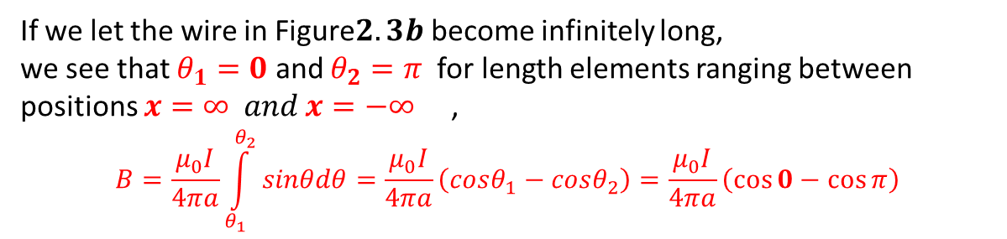
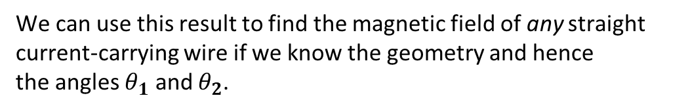
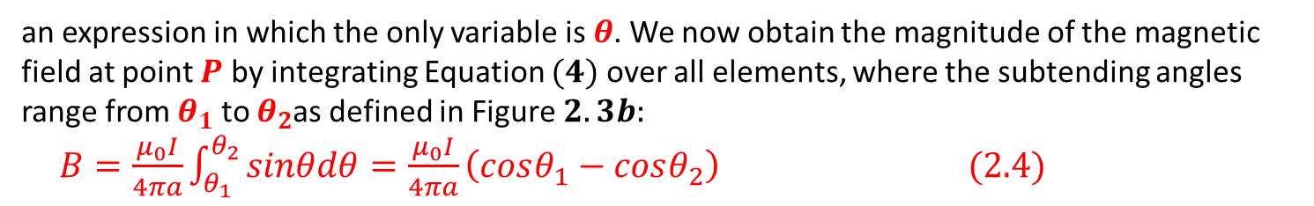
an expression in which the only variable is $θ$. We now obtain the magnitude of the magnetic field at point $P$ by integrating Equation $(4)$ over all elements, where the subtending angles range from $θ_{1}$ to $θ_{2}$as defined in Figure $2.3b:$
$B=\frac{μ_{0}I}{4πa}\int_{θ_{1}}^{θ_{2}}{sinθdθ=\frac{μ_{0}I}{4πa}\left(cosθ_{1}−cosθ_{2}\right)}$ $(2.4)$
We can use this result to find the magnetic field of any straight
current-carrying wire if we know the geometry and hence
the angles $θ_{1}$ and $θ_{2}$.
Consider the special case of an infinitely long, straight wire.
If we let the wire in Figure$2.3b$ become infinitely long,
we see that $θ_{1}=0$ and $θ_{2}=π$ for length elements ranging between positions $x=∞ and x=−∞$ ,
$$B=\frac{μ_{0}I}{4πa}\int_{θ_{1}}^{θ_{2}}{sinθdθ=\frac{μ_{0}I}{4πa}\left(cosθ_{1}−cosθ_{2}\right)}=\frac{μ_{0}I}{4πa}\left(\cos{0}−\cos{π}\right)$$
$Equation 2.4$ becomes $B=\frac{μ_{0}I}{4πa}\left(2\right)=\frac{μ_{0}I}{2πa}$ $(2.5)$
The result of Example $2.1$is important because a current in the form of a long, straight wire occurs often. Figure $2.4$ is a perspective view of the magnetic field surrounding a long, straight current-carrying wire. Because of the symmetry of the wire, the magnetic field lines are circles concentric with the wire and lie in planes perpendicular to the wire.
The magnitude of B is constant on any circle of radius a and is given by Equation $2.5$. A convenient rule for determ-ining the direction of $B$is to grasp the wire with the right hand, positioning the thumb along the direction of the current. The four fingers wrap in the direction of the magnetic field.
Another observation we can make in Figure $2.4$ is that the magnetic field line shown has no beginning and no end. It forms a closed loop. This is a major difference between magnetic field lines and electric field lines, which begin on positive charges and end on negative charges. We will explore this feature of magnetic field lines further in Section $2.6.$

Slide 11
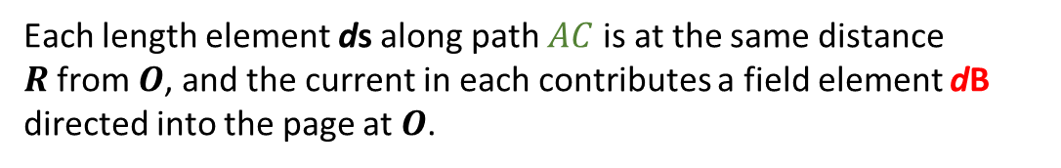
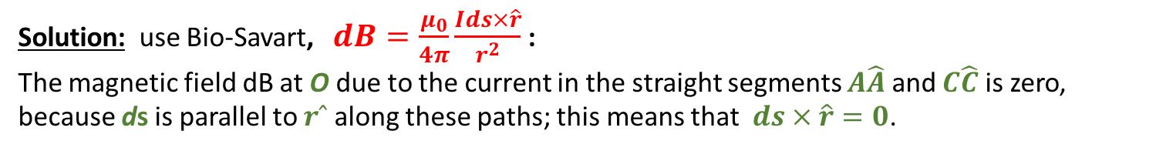
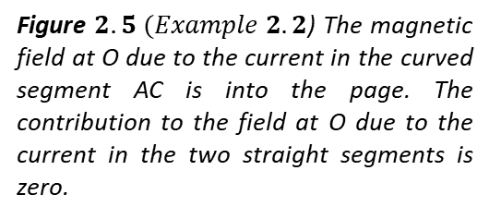
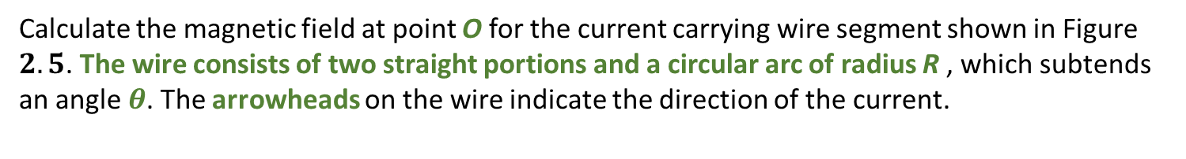
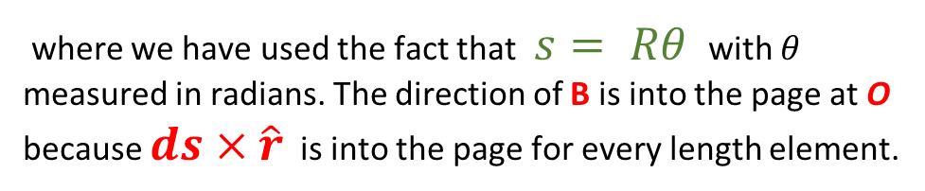
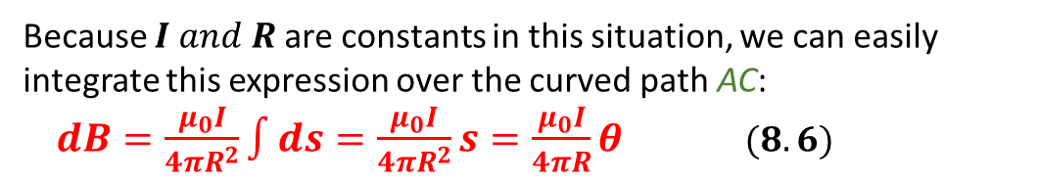
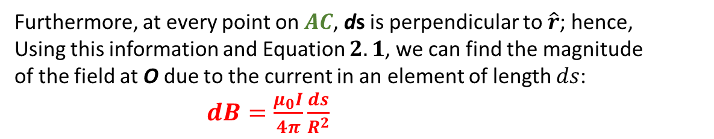
𝑬𝒙𝒂𝒎𝒑𝒍𝒆 2.2 Magnetic Field Due to a Curved Wire Segment
Calculate the magnetic field at point O for the current carrying wire segment shown in Figure $2.5$. The wire consists of two straight portions and a circular arc of radius R , which subtends an angle $θ$. The arrowheads on the wire indicate the direction of the current.
Solution: use Bio-Savart, $dB=\frac{μ_{0}}{4π}\frac{Ids×\hat{r}}{r^{2}}$:
The magnetic field dB at O due to the current in the straight segments $A\hat{A}$ and $C\hat{C}$ is zero, because ds is parallel to $rˆ$ along these paths; this means that $ds×\hat{r}=0$.
Each length element ds along path $AC$ is at the same distance $R$from $O$, and the current in each contributes a field element dB directed into the page at $O$.
Furthermore, at every point on $AC$, ds is perpendicular to $\hat{r}$; hence, Using this information and Equation $2.1$, we can find the magnitude of the field at O due to the current in an element of length $ds$: $dB=\frac{μ_{0}I}{4π}\frac{ds}{R^{2}}$
Because $I and R$ are constants in this situation, we can easily
integrate this expression over the curved path AC:
$dB=\frac{μ_{0}I}{4πR^{2}}\int{ds}=\frac{μ_{0}I}{4πR^{2}}s=\frac{μ_{0}I}{4πR}θ$ $(8.6)$
Figure $2.5 (Example 2.2$) The magnetic field at O due to the current in the curved segment AC is into the page. The contribution to the field at O due to the current in the two straight segments is zero.
where we have used the fact that $s= Rθ$ with $θ$ measured in radians. The direction of B is into the page at O because $ds×\hat{r}$ is into the page for every length element.
Notes:
$$ds×\hat{r}=\left(ds\right)\left(1\right)sin {90}^{0}=ds$$

Slide 12
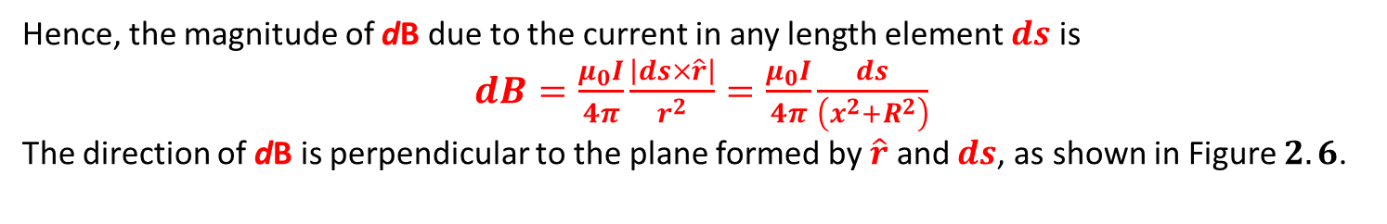
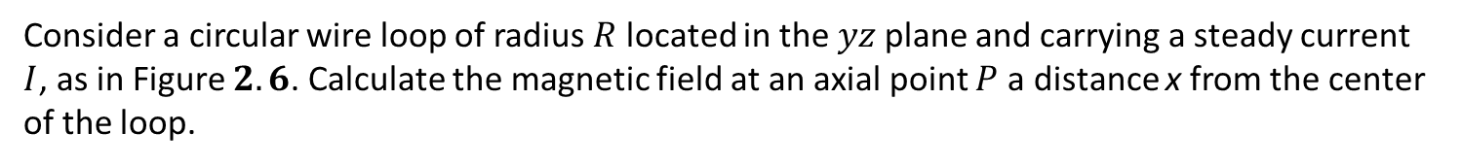
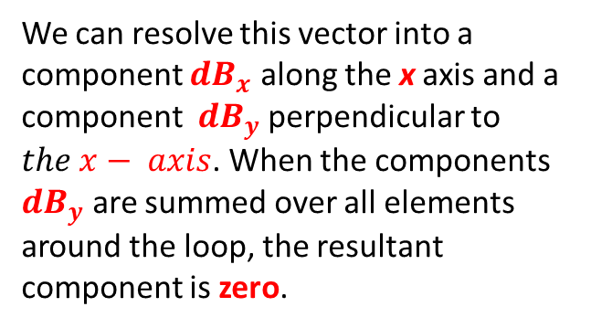
𝑬𝒙𝒂𝒎𝒑𝒍𝒆 2.3 Magnetic Field on the Axis of a Circular Current Loop
Consider a circular wire loop of radius $R$ located in the$yz$ plane and carrying a steady current $I$, as in Figure $2.6$. Calculate the magnetic field at an axial point $P$ a distance x from the center of the loop.
Solution: In this situation, every length element $ds$is perpendicular to the vector $\hat{r}$ at the location of the element. Thus, for any element.$ds×\hat{r}=\left(ds\right)\left(1\right)sin {90}^{0}=ds$ .
Furthermore, all length elements around the loop are at the same distance r from P, where $r^{2}=x^{2}+R^{2}$.
Hence, the magnitude of dB due to the current in any length element $ds$ is
$dB=\frac{μ_{0}I}{4π}\frac{\left|ds×\hat{r}\right|}{r^{2}}=\frac{μ_{0}I}{4π}\frac{ds}{\left(x^{2}+R^{2}\right)}$
The direction of dB is perpendicular to the plane formed by $\hat{r}$ and $ds$, as shown in Figure $2.6$.
We can resolve this vector into a component $dB_{x}$ along the x axis and a component $dB_{y}$ perpendicular to $the x− axis$. When the components $dB_{y}$ are summed over all elements around the loop, the resultant component is zero.
Figure $2.6$(Example $2.3$) Geometry for calculating the magnetic field at a point P lying on the axis of a current loop. By symmetry, the total field B is along this axis.

Slide 13
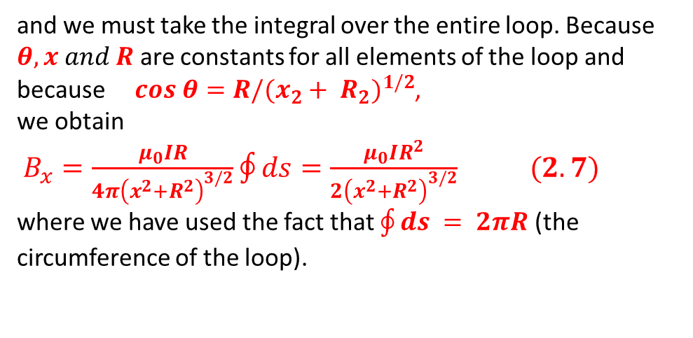
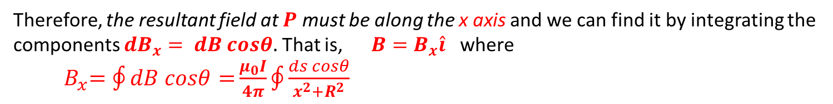
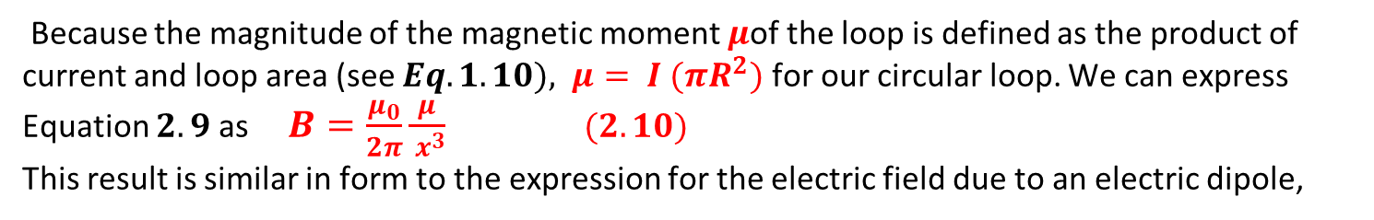
Therefore, the resultant field at $P$ must be along the x axis and we can find it by integrating the components ${dB}_{x}= dB cosθ.$ That is, $B=B_{x}\hat{i}$ where ${ B}_{x}=\oint{dB cosθ=}\frac{μ_{0}I}{4π}\oint{\frac{ds cosθ}{x^{2}+R^{2}}}$
and we must take the integral over the entire loop. Because $θ, x and R$ are constants for all elements of the loop and because $cos θ=R/(x_{2}+ R_{2})^{1/2}$,
we obtain
$B_{x}=\frac{μ_{0}IR}{4π{\left(x^{2}+R^{2}\right)}^{3/2}}\oint{ds}=\frac{μ_{0}IR^{2}}{2{\left(x^{2}+R^{2}\right)}^{3/2}}$ $(2.7)$
where we have used the fact that $\oint{ds} = 2πR$ (the circumference of the loop).
To find the magnetic field at the center of the loop, we set $x=0$ in
Equation$2.7$. At this special point, therefore, $B=\frac{μ_{0}I }{2R} at x=0$ $(2.8)$
What If? What if we consider points on the x axis very far from the loop? How does the magnetic field behave at these distant points?
Answer In this case, in which $x ≫ R$, we can neglect the term $R^{2}$ in the denominator of $Equation 2.7$ and obtain $B=\frac{μ_{0}IR^{2} }{2x^{3}}$ for $\left( x>>R \right)$ $\left(2.9\right)$
Because the magnitude of the magnetic moment $μ$of the loop is defined as the product of current and loop area (see $Eq. 1.10), μ= I (πR^{2})$ for our circular loop. We can express Equation $2.9$ as $B=\frac{μ_{0}}{2π}\frac{μ}{{ x}^{3}}$ $(2.10)$
This result is similar in form to the expression for the electric field due to an electric dipole,

