Slide 1
Ex. 6: Hanging Drop Technique
Key concepts:
Wet mount technique
Motility
Bacterial flagella and their arrangement

Slide 2
Motility Determination: Hanging Drop Method
Materials needed:
Bacterial culture
Cover glasses
Petroleum
Jelly
(Vasoline)
Depression
slides
Toothpicks

Slide 3
Step 1: Preparing Cover Glass
Using a toothpick, place a small dab of Vaseline in each corner of a clean cover glass.
Handle the cover glass by its edges to avoid fingerprints.
Aseptically transfer a loopful of a liquid bacterial culture into the center of the cover glass. Do not spread the drop!
Alternatively, if you have a solid culture . . . .

Slide 4
Step 2: Attaching Depression Slide
Vaseline attaching cover glass to depression slide
Carefully lower depression slide with depression facing down.
Notes:
With the concave side facing down, position the depression slide over the cover glass. Slowly lower the slide, while centering the drop in the depression. Gently press the depression slide against the cover glass just enough to allow the Vaseline to make the attachment.

Slide 5
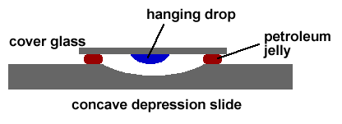
Step 3: Invert Depression Slide
Quickly invert depression slide. Drop will now be suspended from the cover glass inside the concave hollow.
Suspended
drop

Slide 6
Step 4: Examine under Microscope
Edge of drop
Drop
10x objective
With 10x objective and using course adjustment knob, focus on the edge of the hanging drop.
To increase contrast ,move condenser all the way down and keep light as low as possible by closing iris diaphragm.

Slide 7
Bacteria
With 40x objective, focus on isolated cells near inside edge of drop. Flagella are not visible with light microscope. Motile cells move independently. All other cells seem to vibrate in place (Brownian motion).
Observe slide immediately after preparation as motility decreases over time. Also, as drop dries out and recedes, water currents will appear to herd and move bacteria in the same direction – this has nothing to do with motility!

Slide 8
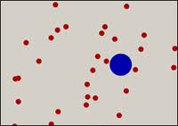
Brownian Motion
Discovered by British scientist Robert Brown in 1827.
Using microscope, he noticed pollen grains suspended in water jiggled.
Later determined to be the action of collisions with surrounding molecules.
Temp. ↑ ⇒ Motion intensity ?
Particle size ↑ ⇒ Motion intensity ?

Slide 9
True Motility
Proteus vulgaris: Highly motile

Slide 10
Step 5: Proper Disposal and Cleaning of Wet Mounts
Cover glass: dispose of in ….???
Depression slide: spray with H₂O₂ . Let sit for 1 min. Clean off with Kim wipe. Kim wipe disposed of how?
Wipe depression slide off with 70% alcohol to remove all Vasoline. Kim wipe disposed of how?

Slide 11
In-house movie clip on the Hanging Drop Technique
the end

