Slide 1
Calculus 2020-2021
Chapter four
Application of Derivatives
Ivan Dler Ali
Salahaddin University- College of Education –Mathematics Department
evan.ali1@su.edu.krd

Slide 2
Extreme values

Slide 3
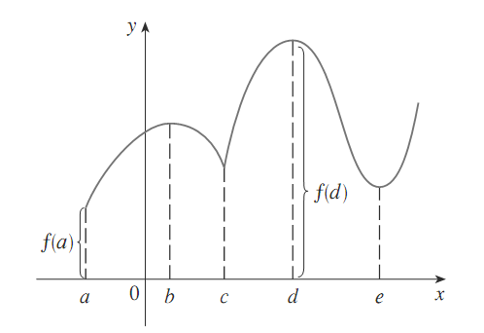
Example 1:
Minimum value $f(a)$ and Maximum value $f(d)$

Slide 4
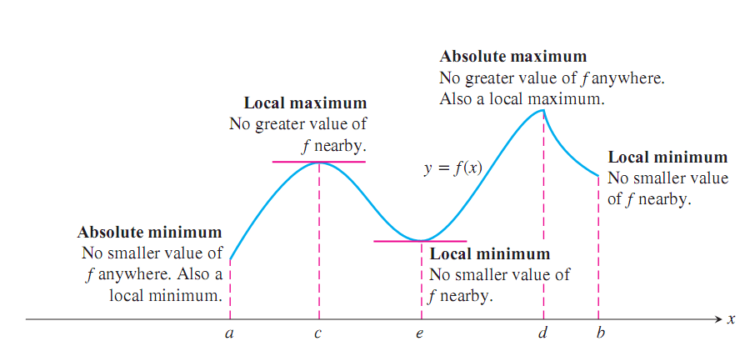

Slide 5
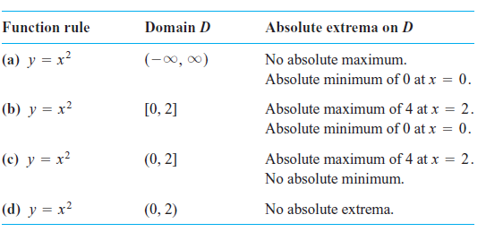
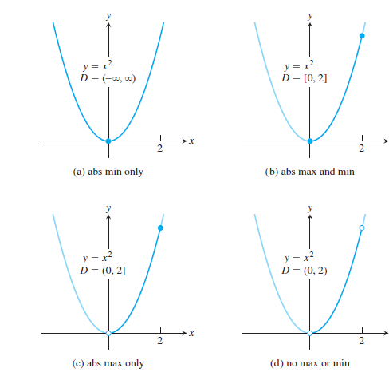
Function with the same defining rule or formula can have different maximum value or minimum value depending on the domain

Slide 6
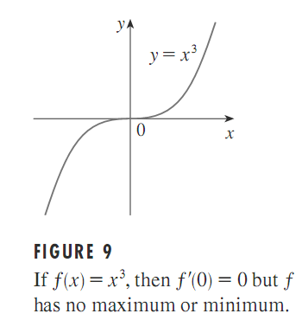
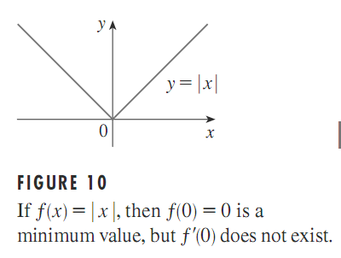

Slide 7
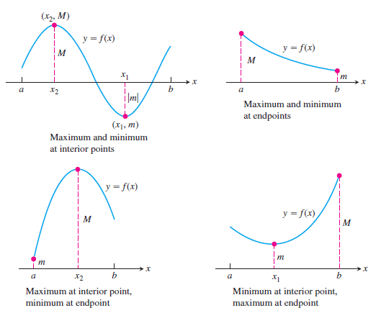

Slide 8
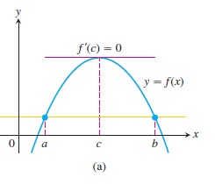
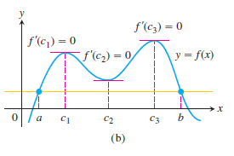
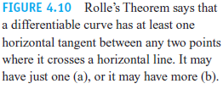
We will begin with a special case of the Mean Value Theorem, Called Roll’s Theorem.

Slide 9
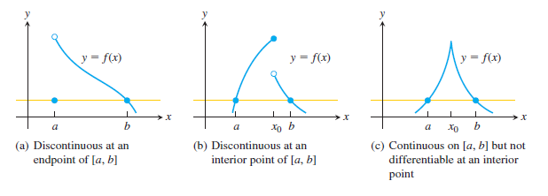

Slide 10
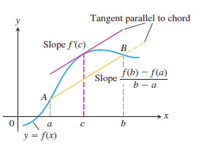
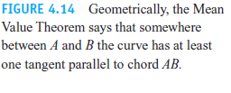

Slide 11
Thank you

