Slide 1
Calculus 2020-2021
Chapter one
Section one
Inquality and Abslute value
Ivan Dler Ali
Salahaddin University- College of Education –Mathematics Department
evan.ali1@su.edu.krd

Slide 2
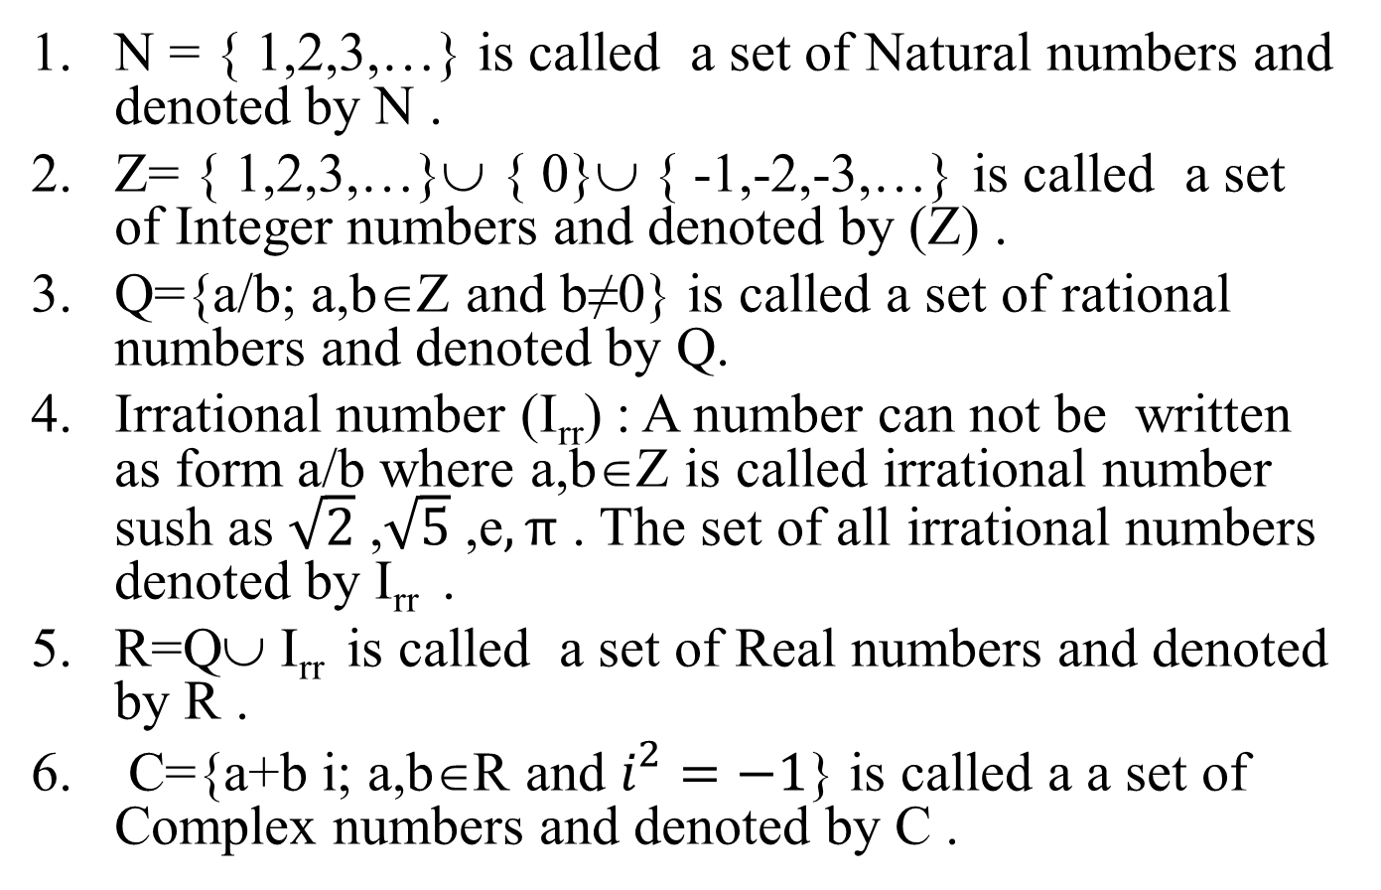
This section reviews the basic ideas you need to start calculus. Classifying the number
N = { 1,2,3,…} is called a set of Natural numbers and denoted by N .
Z= { 1,2,3,…}∪ { 0}∪ { -1,-2,-3,…} is called a set of Integer numbers and denoted by (Z) .
Q={a/b; a,b∈Z and b≠0} is called a set of rational numbers and denoted by Q.
Irrational number (I_{rr}) : A number can not be written as form a/b where a,b∈Z is called irrational number sush as $\sqrt{2}$ ,$\sqrt{5}$ ,e$, π$ . The set of all irrational numbers denoted by I_{rr} .
R=Q∪ I_{rr} is called a set of Real numbers and denoted by R .
C={a+b i; a,b∈R and $i^{2}=−1$} is called a a set of Complex numbers and denoted by C .

Slide 3
Order properties: The order properties allow us to compare the size to any real numbers . The order properties are:
For any a and b , either a≤b or b≤a
If a≤b and b≤a then a=b
If a≤b and b≤c then a≤c
If a≤b then a+c≤b+c
If a≤b and 0≤c then ac≤bc
If a≤b and c<0 then ac ≥ bc
a<b ⇒ a+c<b+c and a-c<b-c for every real number c
a<b and c >0⇒ ac<bc
If a<b and c<0 then ac > bc
If a and b are both positive or both negative , then
if a<b , then 1/b<1/a
(ii) a<x<b , then 1/b<1/x< 1/a

Slide 4
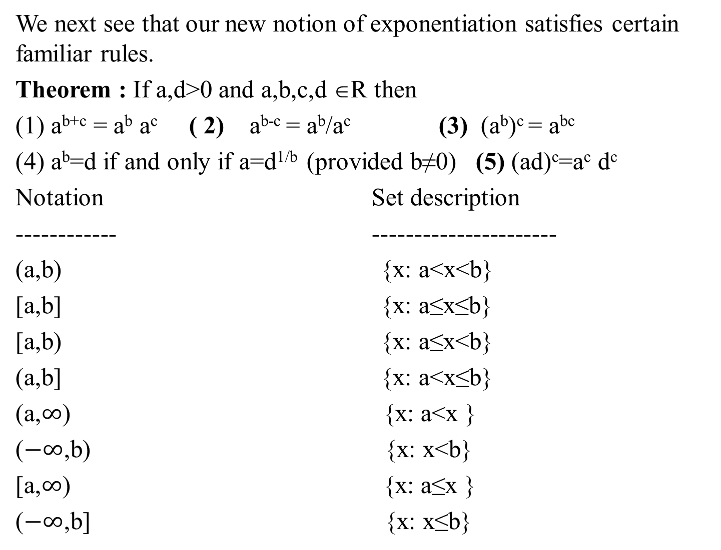
We next see that our new notion of exponentiation satisfies certain familiar rules.
Theorem : If a,d>0 and a,b,c,d ∈R then
(1) a^{b+c} = a^{b} a^{c} ( 2) a^{b-c} = a^{b}/a^{c} (3) (a^{b})^{c} = a^{bc}
(4) a^{b}=d if and only if a=d^{1/b} (provided b≠0) (5) (ad)^{c}=a^{c} d^{c}
Notation Set description
------------ ----------------------
(a,b) {x: a<x<b}
[a,b] {x: a≤x≤b}
[a,b) {x: a≤x<b}
(a,b] {x: a<x≤b}
(a,$∞$) {x: a<x }
($−∞$,b) {x: x<b}
[a,$∞$) {x: a≤x }
($−∞$,b] {x: x≤b}

Slide 5
Absolute value : The absolute value of a number x, denoted by $\left|x\right|$, is defined by the formula
$\left|x\right|$=x if x≥0
$\left|x\right|$=-x if x<0
Remark: If a any positive real number, then :
$\left|x\right|$=a if and only if x=a or x=-a
$\left|x\right|$<a if and only if –a<x<a
$\left|x\right|$≤a if and only if –a≤x≤a
|x|>a if and only if x>a or –x>a
$\left|x\right|$≥a if and only if x≥a or –x≥a
$\sqrt{a^{2}}$ =$\left|a\right|$, for every real number a

Slide 6
Theorem : if x,y∈R , then show that
1. $\left|x\right|$²=x²
2. $\left|xy\right|$=$\left|x\right|\left|y\right|$
3.$\left|x/y\right|$=$\left|x\right|/\left|y\right|$
Proof : (i) If x≥0 then $\left|x\right|$=x thus $\left|x\right|$²=x² .
1.If x<0 then $\left|x\right|$=-x thus $\left|x\right|$²=x² . In both case we get $\left|x\right|$²=x²
2.$\left|xy\right|$²=(xy)²=x² y²=$\left|x\right|$² $\left|y\right|$²=($\left|x\right|$ $\left|y\right|$)² we take square root of both sides we get$\left|xy\right|$=$\left|x\right|\left|y\right|$
3. $\left|x/y\right|$²=(x/y)²=x²/ y²=$\left|x\right|$² $/\left|y\right|$²=($\left|x\right|/$ $\left|y\right|$)² we take square root of both sides we get $\left|x/y\right|$=$\left|x\right|/\left|y\right|$
Theorem : For all real numbers x,y show that
(i) $\left|x+y\right|≤\left|x\right|+\left|y\right|$ (ii) $\left|x−y\right|$≥$\left|\left|x\right|−\left|y\right|\right|$
Proof: (i)$\left|x+y\right|$²=(x+y)²=x²+y²+2xy≤${\left|x\right|}^{2}+{\left|x\right|}^{2}+2\left|x\right|\left|y\right|$=($\left|x\right|+\left|y\right|)$².
Since $\left|x+y\right|$ and $\left|x\right|$+$\left|y\right|$ are both non negative numbers, so we take square root of booth sides we get $\left|x+y\right|≤\left|x\right|+\left|y\right|$
(ii) $\left|x−y\right|$²=(x-y)²=x²+y²-2xy≥${\left|x\right|}^{2}+{\left|x\right|}^{2}−2\left|x\right|\left|y\right|$=($\left|x\right|−\left|y\right|)$²
we take square root of both sides we get $\left|x−y\right|$≥$\left|\left|x\right|−\left|y\right|\right|$.

Slide 7
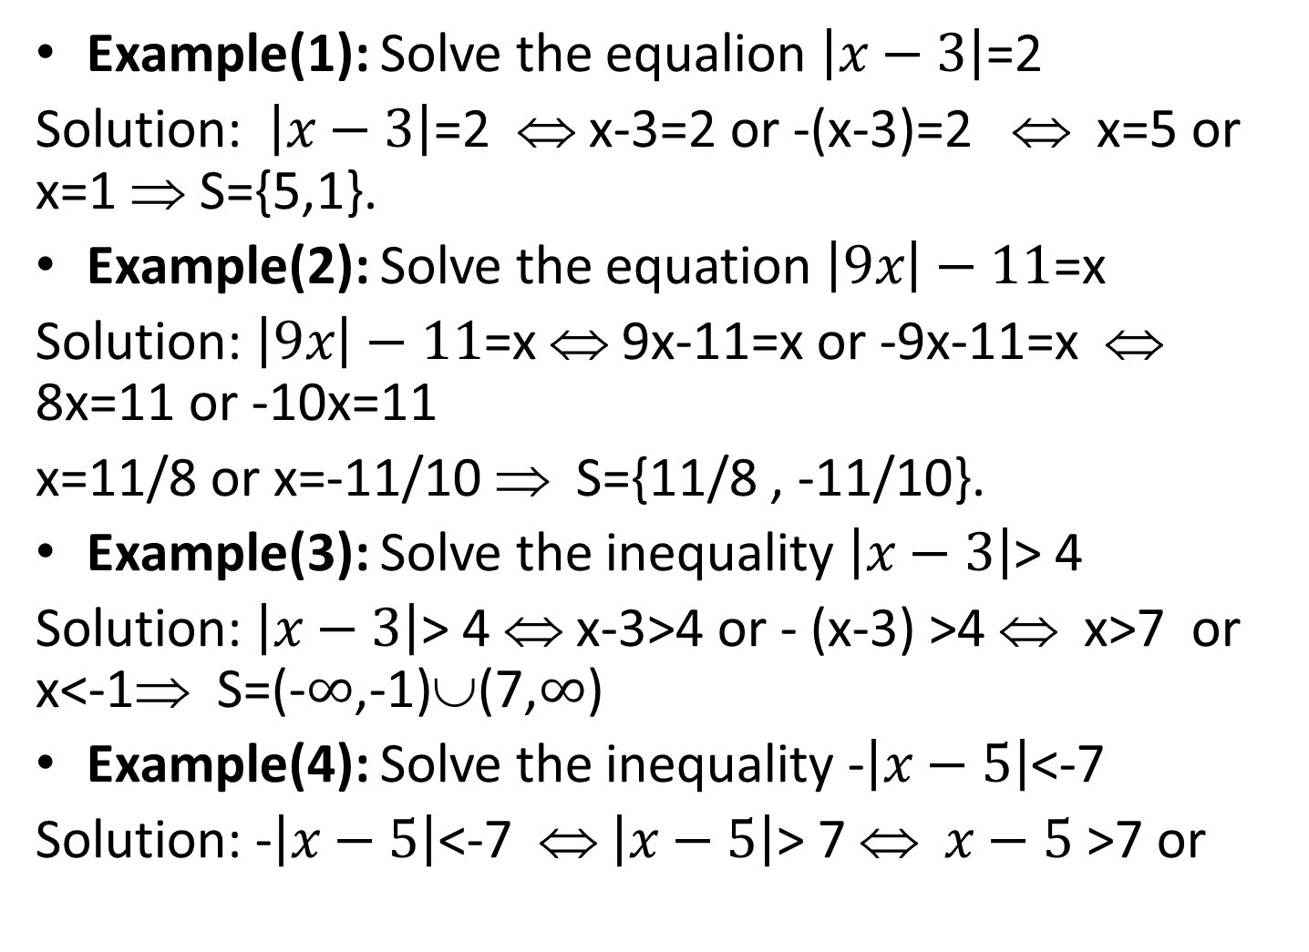
Example(1): Solve the equalion $\left|x−3\right|$=2
Solution: $\left|x−3\right|$=2 ⇔ x-3=2 or -(x-3)=2 ⇔ x=5 or x=1 ⇒ S={5,1}.
Example(2): Solve the equation$\left|9x\right|−11$=x
Solution: $\left|9x\right|−11$=x ⇔ 9x-11=x or -9x-11=x ⇔ 8x=11 or -10x=11
x=11/8 or x=-11/10 ⇒ S={11/8 , -11/10}.
Example(3): Solve the inequality $\left|x−3\right|$> 4
Solution: $\left|x−3\right|$> 4 ⇔ x-3>4 or - (x-3) >4 ⇔ x>7 or x<-1⇒ S=(-$∞$,-1)∪(7,$∞$)
Example(4): Solve the inequality -$\left|x−5\right|$<-7
Solution: -$\left|x−5\right|$<-7 ⇔ $\left|x−5\right|$> 7 ⇔ $x−5$ >7 or

Slide 8
Exercise H.w: Solve the inequalities in excersize 1-5
(1) $\left|6x−3\right|$<5 (2) $\left|3−1/x\right|$< ½
(3) $\left|(x+1)/2\right|$>1 (4) 3$<\left|x+1\right|$< 6
(5) $\left|x+4\right|$<$\left|2x−6\right|$ (6) x²-x = 0
(7) (x-2) (x-6) ≥0 (8) (x-1) (4-x) ≤ 0

Slide 9
Thank you

