Slide 1

Calculus
2020-2021
Chapter one
Section Two
Functions
Ivan Dler Ali
Salahaddin University- College of Education –Mathematics Department
evan.ali1@su.edu.krd

Slide 2
Function: Let A and B be two non empty sets.A correspondence which associates each element x∈A with unique element y∈B, is called a function or mapping and generally denoted by f:A→B.Moreover Ais called domain and Bis called co-domain.
f(A) = { y∈B ; there exist x∈A such that
f(x)=y }={ y∈B ; f(x)=y , for some x∈A } will be called range or image of f ,denoted by f(A).
Example: Let A={1,2,3,4} , B ={ 1,2,3,4,5} and f:A→B defined by f(x) =x+1 , then
f(A) = { 2,3,4,5}

Slide 3
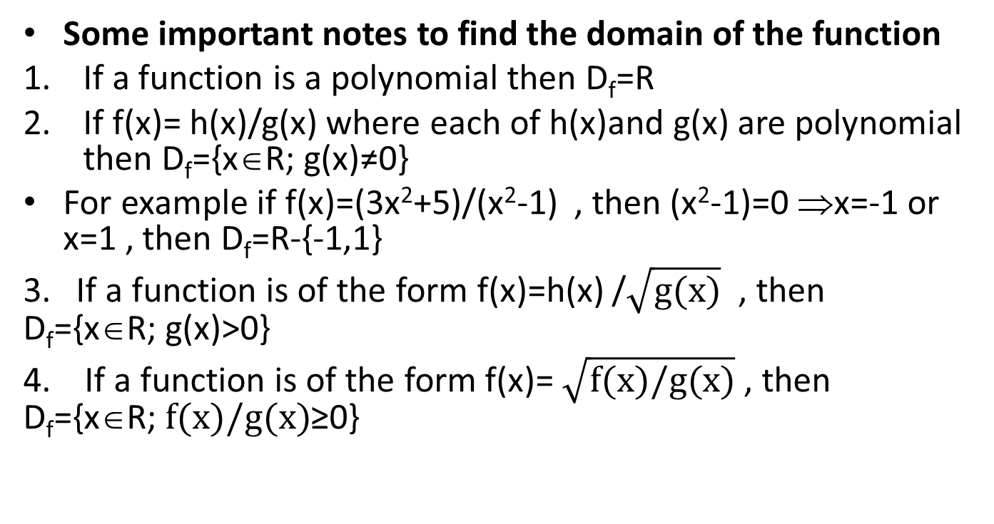
Some important notes to find the domain of the function
If a function is a polynomial then D_{f}=R
If f(x)= h(x)/g(x) where each of h(x)and g(x) are polynomial then D_{f}={x∈R; g(x)≠0}
For example if f(x)=(3x²+5)/(x²-1) , then (x²-1)=0 ⇒x=-1 or x=1 , then D_{f}=R-{-1,1}
3. If a function is of the form f(x)=h(x) /$\sqrt{g(x)}$ , then D_{f}={x∈R; g(x)>0}
4. If a function is of the form f(x)= $\sqrt{f(x)/g(x)}$ , then D_{f}={x∈R; $f(x)/g(x)$≥0}

Slide 4
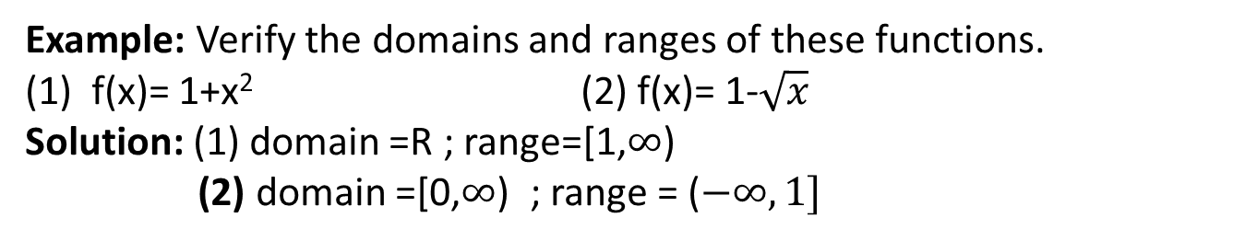
Example: Verify the domains and ranges of these functions.
(1) f(x)= 1+x² (2) f(x)= 1-$\sqrt{x}$
Solution: (1) domain =R ; range=[1,$∞$)
(2) domain =[0,$∞$) ; range = ($−∞,1]$
Some type of functions
1. Identifying Functions; There are a number of important types of functions frequently encountered in calculus. We identify and briefly summarize them here.
2.Linear Functions: A function of the form f(x)= mx+b, for constants m and b, is
called a linear function.

Slide 5
3.Power Functions : A function f(x)=x^{n} where a is a constant, is called a power function.
4.Polynomials :A function p is a polynomial if p(x)= a_{n} x^{n}+ a_{n-1} x^{n-1}+…+ a₁ x¹+a₀ where n is a nonnegative integer and the numbers a₀, a₁,..., a_{n} are real constants.
5. Algebraic Functions: An algebraic function is a function constructed from polynomials using algebraic operations (addition, subtraction, multiplication, division, and taking roots)
6. Trigonometric Functions: such as sine and cosine functions

Slide 6
7. Exponential Functions: Functions of the form f(x)= a^{x} , where the base a>0 is a positive constant and a≠ 1, are called exponential functions.
8. Logarithmic Functions: These are the functions f(x)= log_{a}^{x} , where the base a≠ 1is a positive constant
9. Rational Functions : A rational function is a quotient or ratio of two polynomials: f(x)=p(x)/q(x) where p and q are polynomials. The domain of a rational function is the set of all real x for which q(x)≠0.
10. Transcendental Functions:
These are functions that are not algebraic. They include the trigonometric, inverse trigonometric, exponential, and logarithmic functions.

Slide 7
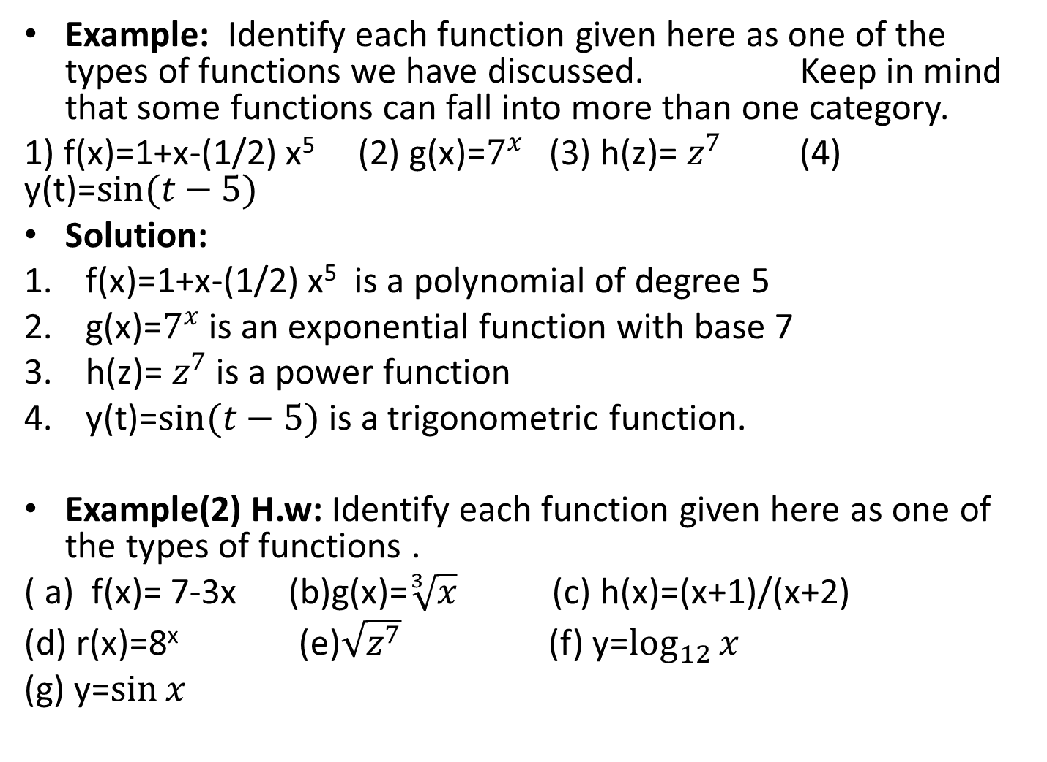
Example: Identify each function given here as one of the types of functions we have discussed. Keep in mind that some functions can fall into more than one category.
1) f(x)=1+x-(1/2) x⁵ (2) g(x)=$7^{x}$ (3) h(z)=$z^{7}$ (4) y(t)=$\sin{(t−5)}$
Solution:
f(x)=1+x-(1/2) x⁵ is a polynomial of degree 5
g(x)=$7^{x}$ is an exponential function with base 7
h(z)=$z^{7}$ is a power function
y(t)=$\sin{(t−5)}$ is a trigonometric function.
Example(2) H.w: Identify each function given here as one of the types of functions .
( a) f(x)= 7-3x (b)g(x)=$\sqrt[3]{x}$ (c) h(x)=(x+1)/(x+2)
(d) r(x)=8^{x} (e)$\sqrt{z^{7}}$ (f) y=$\log_{12}{x}$
(g) y=$\sin{x}$

Slide 8
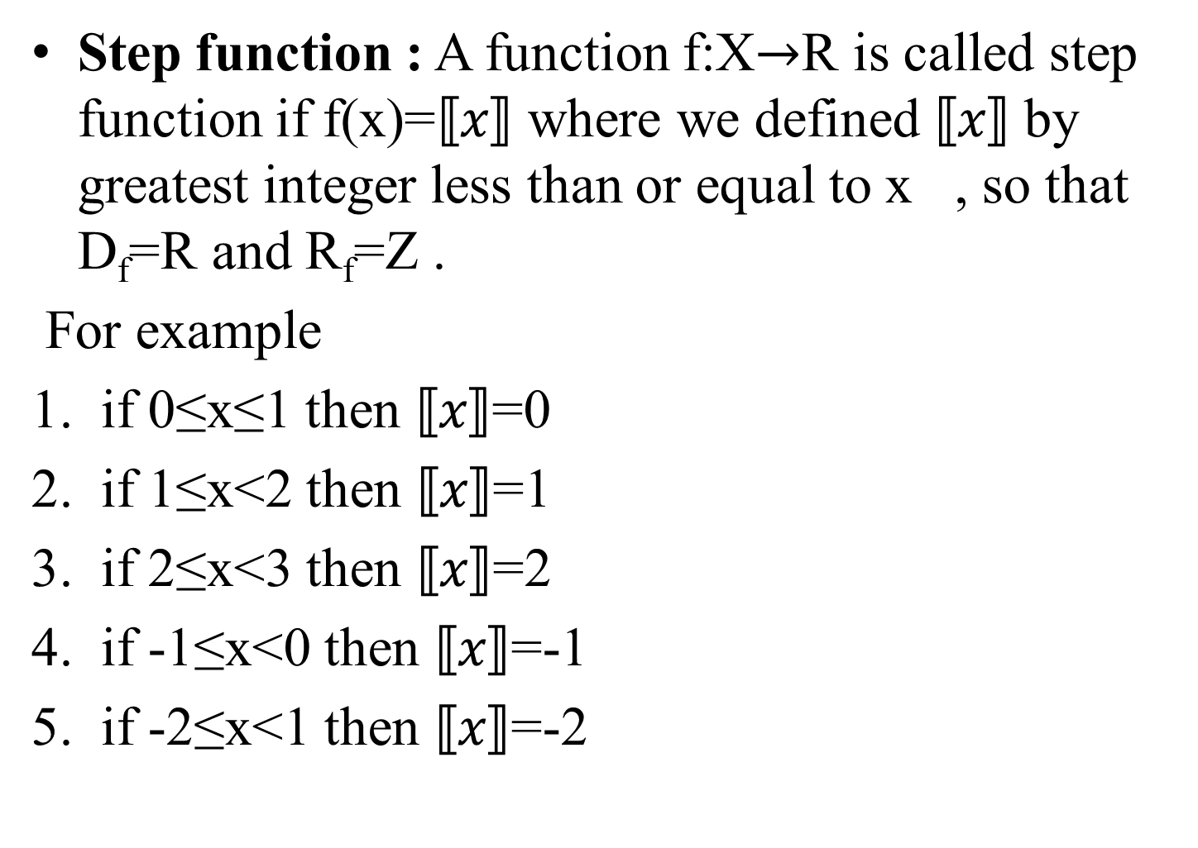
Step function : A function f:X$→$R is called step function if f(x)=$⟦x⟧$ where we defined$⟦x⟧$ by greatest integer less than or equal to x , so that D_{f}=R and R_{f}=Z .
For example
if 0≤x≤1 then $⟦x⟧$=0
if 1≤x<2 then $⟦x⟧$=1
if 2≤x<3 then $⟦x⟧$=2
if -1≤x<0 then $⟦x⟧$=-1
if -2≤x<1 then $⟦x⟧$=-2

Slide 9
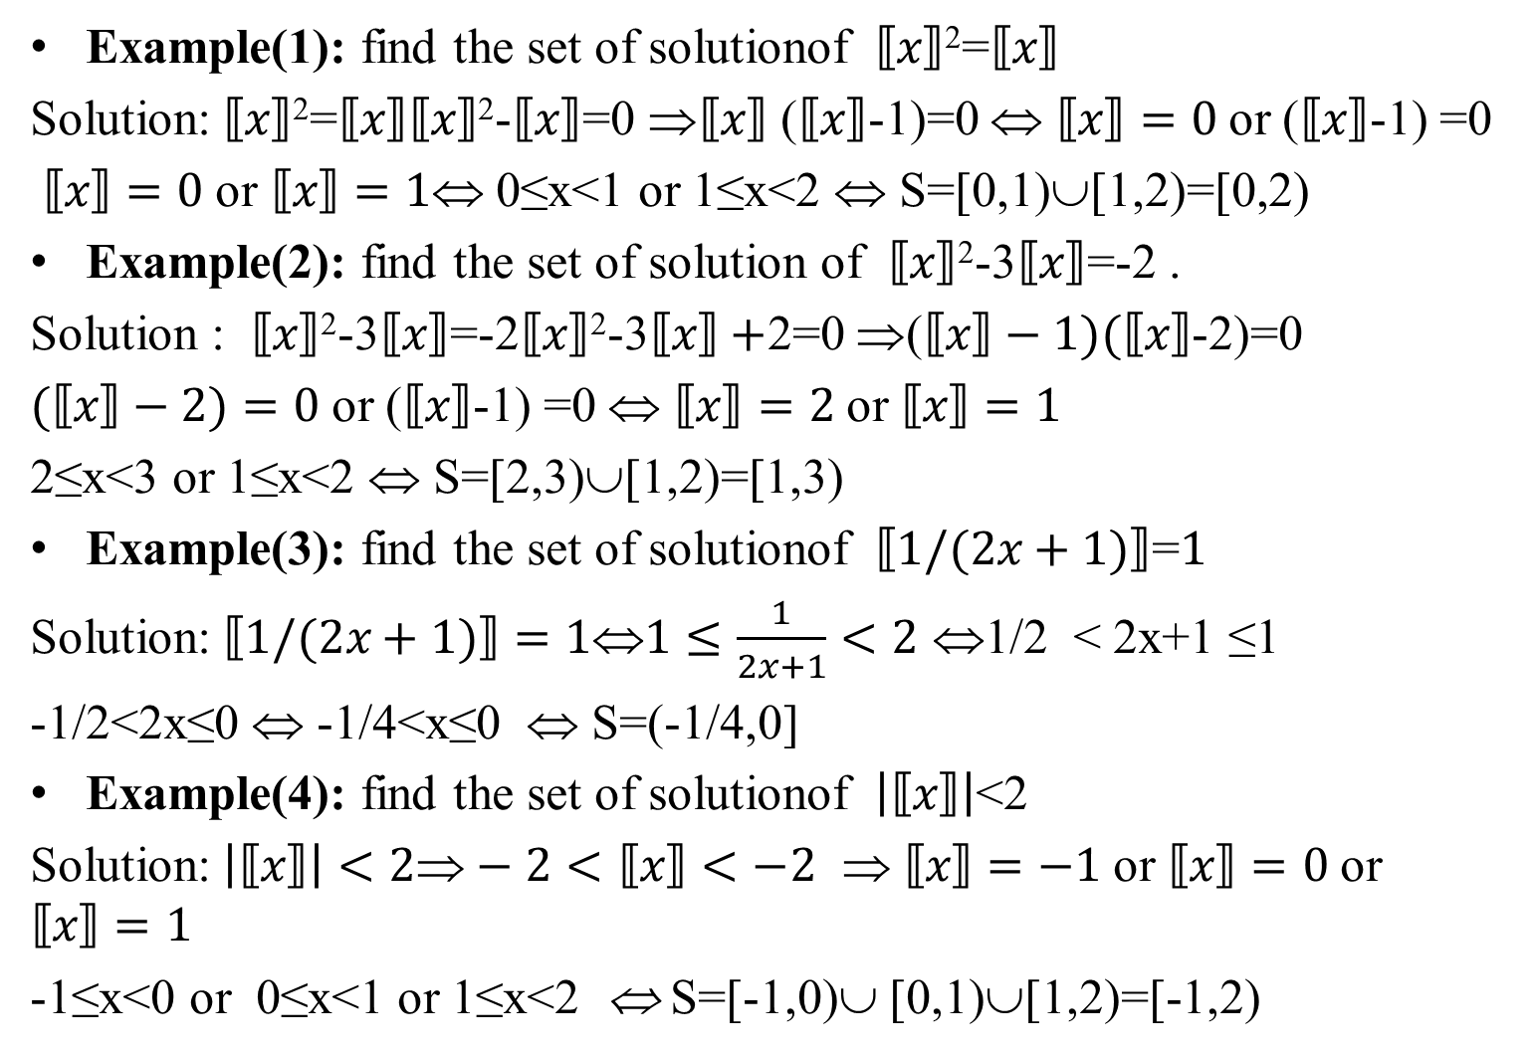
Example(1): find the set of solutionof $⟦x⟧$²=$⟦x⟧$
Solution:$⟦x⟧$²=$⟦x⟧⟦x⟧$²-$⟦x⟧$=0 ⇒$⟦x⟧$ ($⟦x⟧$-1)=0 ⇔ $⟦x⟧=0$or ($⟦x⟧$-1) =0
$⟦x⟧=0$or $⟦x⟧=1$⇔ 0≤x<1 or 1≤x<2 ⇔ S=[0,1)∪[1,2)=[0,2)
Example(2): find the set of solution of $⟦x⟧$²-3$⟦x⟧$=-2 .
Solution : $⟦x⟧$²-3$⟦x⟧$=-2$⟦x⟧$²-3$⟦x⟧+$2=0 ⇒($⟦x⟧−1)(⟦x⟧$-2)=0
$(⟦x⟧−2)=0$or ($⟦x⟧$-1) =0 ⇔ $⟦x⟧=2$or $⟦x⟧=1$
2≤x<3 or 1≤x<2 ⇔ S=[2,3)∪[1,2)=[1,3)
Example(3): find the set of solutionof $⟦1/(2x+1)⟧$=$1$
Solution:$⟦1/(2x+1)⟧=1⇔1≤\frac{1}{2x+1}<2$ ⇔1/2 < 2x+1 ≤1
-1/2<2x≤0 ⇔ -1/4<x≤0 ⇔ S=(-1/4,0]
Example(4): find the set of solutionof $\left|⟦x⟧\right|$<2
Solution:$\left|⟦x⟧\right|<2⇒−2<⟦x⟧<−2$ $ ⟦x⟧=−1$or $⟦x⟧=0$or $⟦x⟧=1$
-1≤x<0 or 0≤x<1 or 1≤x<2 ⇔ S=[-1,0)∪ [0,1)∪[1,2)=[-1,2)

Slide 10
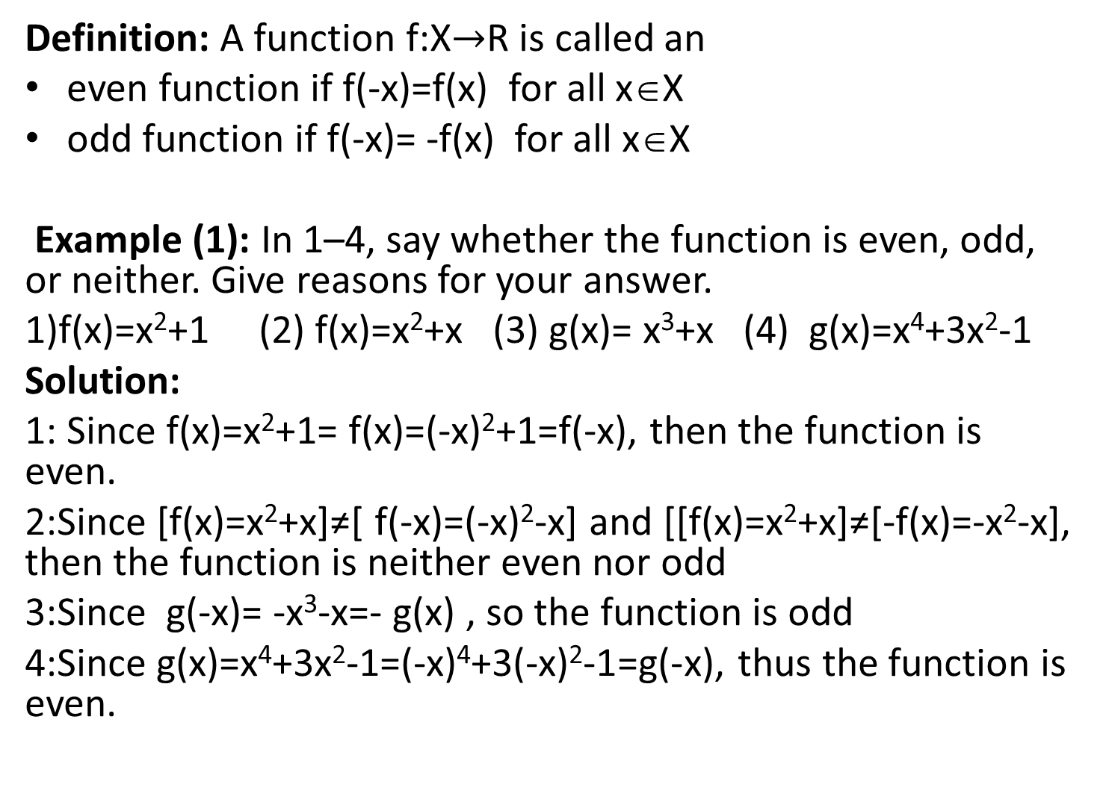
Definition: A function f:X$→$R is called an
even function if f(-x)=f(x) for all x∈X
odd function if f(-x)= -f(x) for all x∈X
Example (1): In 1–4, say whether the function is even, odd, or neither. Give reasons for your answer.
1)f(x)=x²+1 (2) f(x)=x²+x (3) g(x)= x³+x (4) g(x)=x⁴+3x²-1
Solution:
1: Since f(x)=x²+1= f(x)=(-x)²+1=f(-x), then the function is even.
2:Since [f(x)=x²+x]≠[ f(-x)=(-x)²-x] and [[f(x)=x²+x]≠[-f(x)=-x²-x], then the function is neither even nor odd
3:Since g(-x)= -x³-x=- g(x) , so the function is odd
4:Since g(x)=x⁴+3x²-1=(-x)⁴+3(-x)²-1=g(-x), thus the function is even.

Slide 11
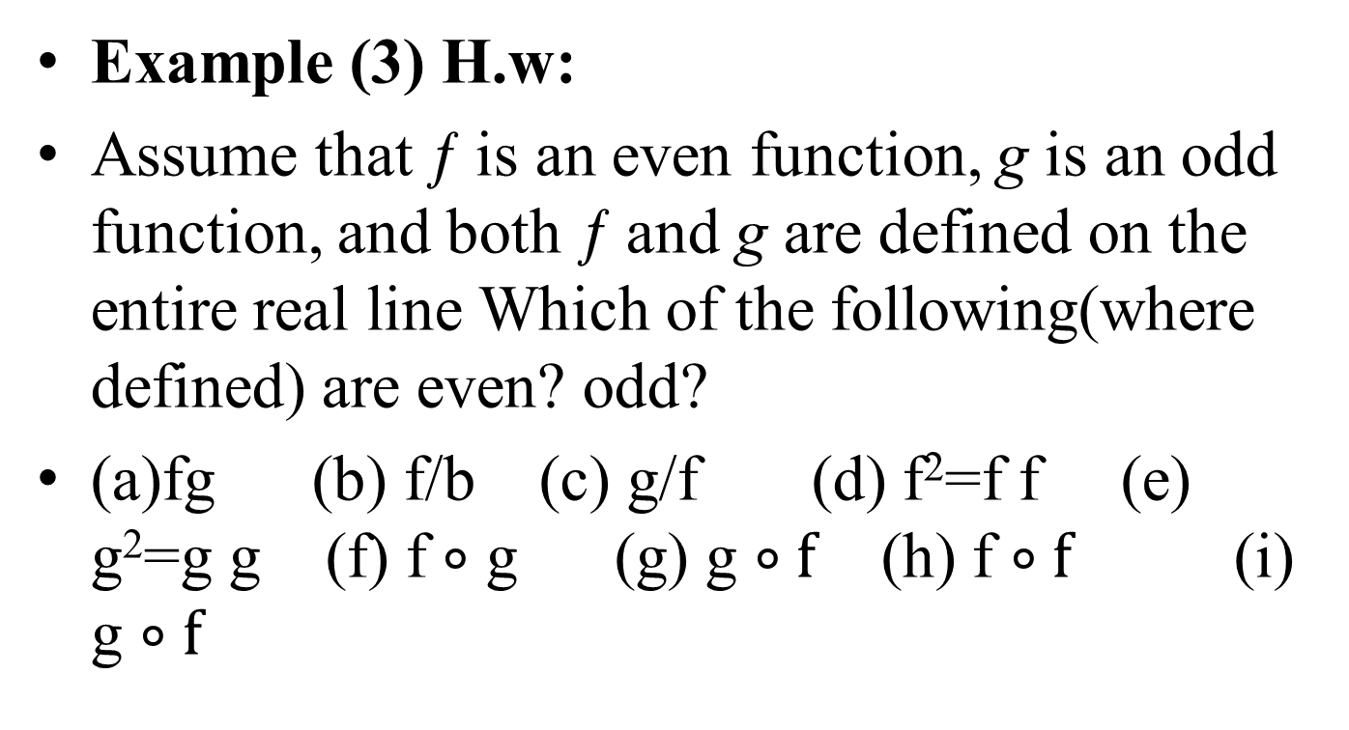
Example (3) H.w:
Assume that ƒ is an even function, g is an odd function, and both ƒ and g are defined on the entire real line Which of the following(where defined) are even? odd?
(a)fg (b) f/b (c) g/f (d) f²=f f (e) g²=g g (f) f$∘$ g (g) g $∘f$ (h) f $∘f$ (i) g $∘f$

Slide 12
Thank you

