Slide 1

Calculus
2020-2021
Chapter one
Section Three
Limit
Ivan Dler Ali
Salahaddin University- College of Education –Mathematics Department
evan.ali1@su.edu.krd

Slide 2
Definition:

Slide 3
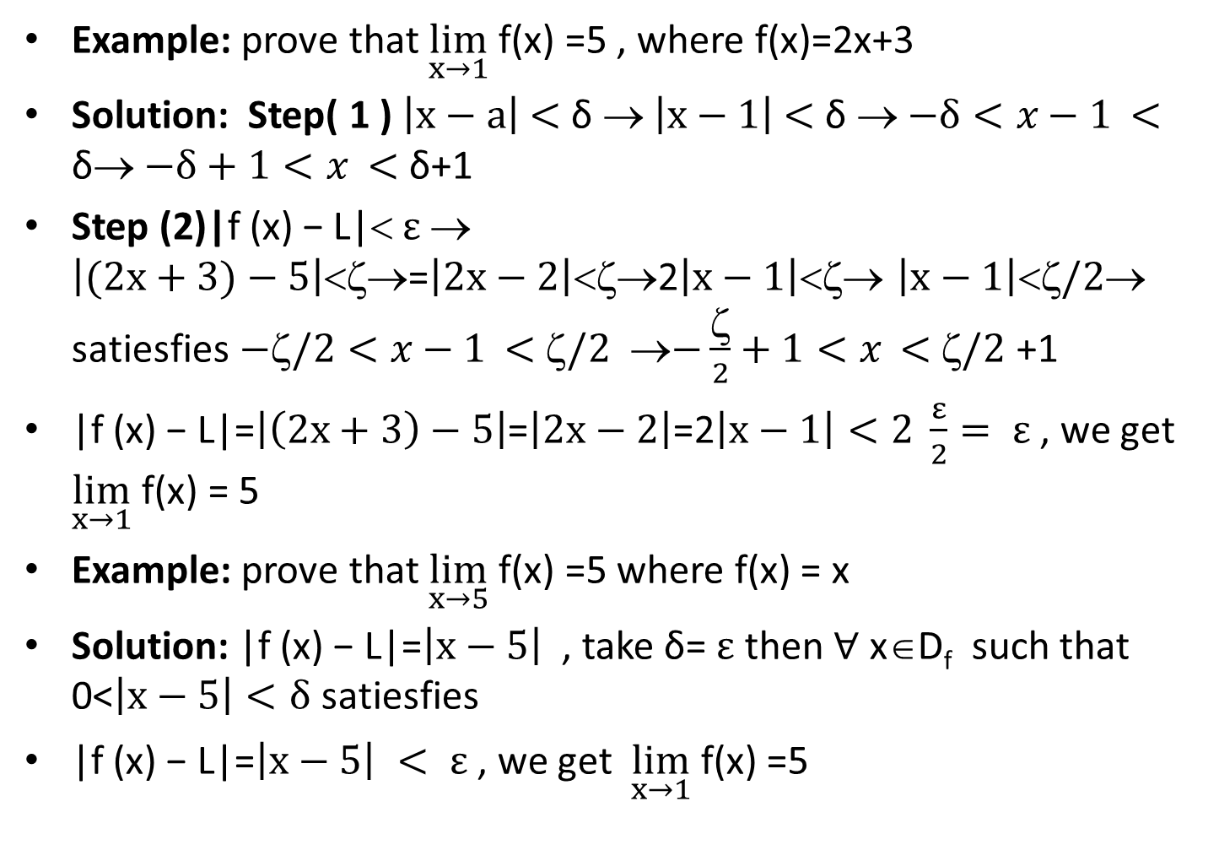
Example: prove that $\lim_{x→1}$ f(x) =5 , where f(x)=2x+3
Solution: Step( 1 ) $\left|x−a\right|$ $<$ δ →$\left|x−1\right|$ $<$ δ →$−δ<x−1$ $<$ δ→$−δ+1<x$ $<$ δ+1
Step (2)|f (x) − L|<$ε$ → $\left|(2x+3)−5\right|$<ζ→=$\left|2x−2\right|$<ζ→2$\left|x−1\right|$<ζ→ $\left|x−1\right|<ζ/2$→ satiesfies$−/2<x−1$ $<$ $/2$ →$−\frac{ζ}{2}+1<x$ $<$ $/2$ +1
|f (x) − L|=$\left|\left(2x+3\right)−5\right|$=$\left|2x−2\right|$=2$\left|x−1\right|<2 \frac{ε}{2}= ε$ , we get $\lim_{x→1}$ f(x) = 5
Example: prove that $\lim_{x→5}$ f(x) =5 where f(x) = x
Solution: |f (x) − L|=$\left|x−5\right|$ , take δ= $ε$ then $∀$ x∈D_{f} such that 0<$\left|x−5\right|<δ$ satiesfies
|f (x) − L|=$\left|x−5\right| < ε$ , we get $\lim_{x→1}$ f(x) =5

Slide 4
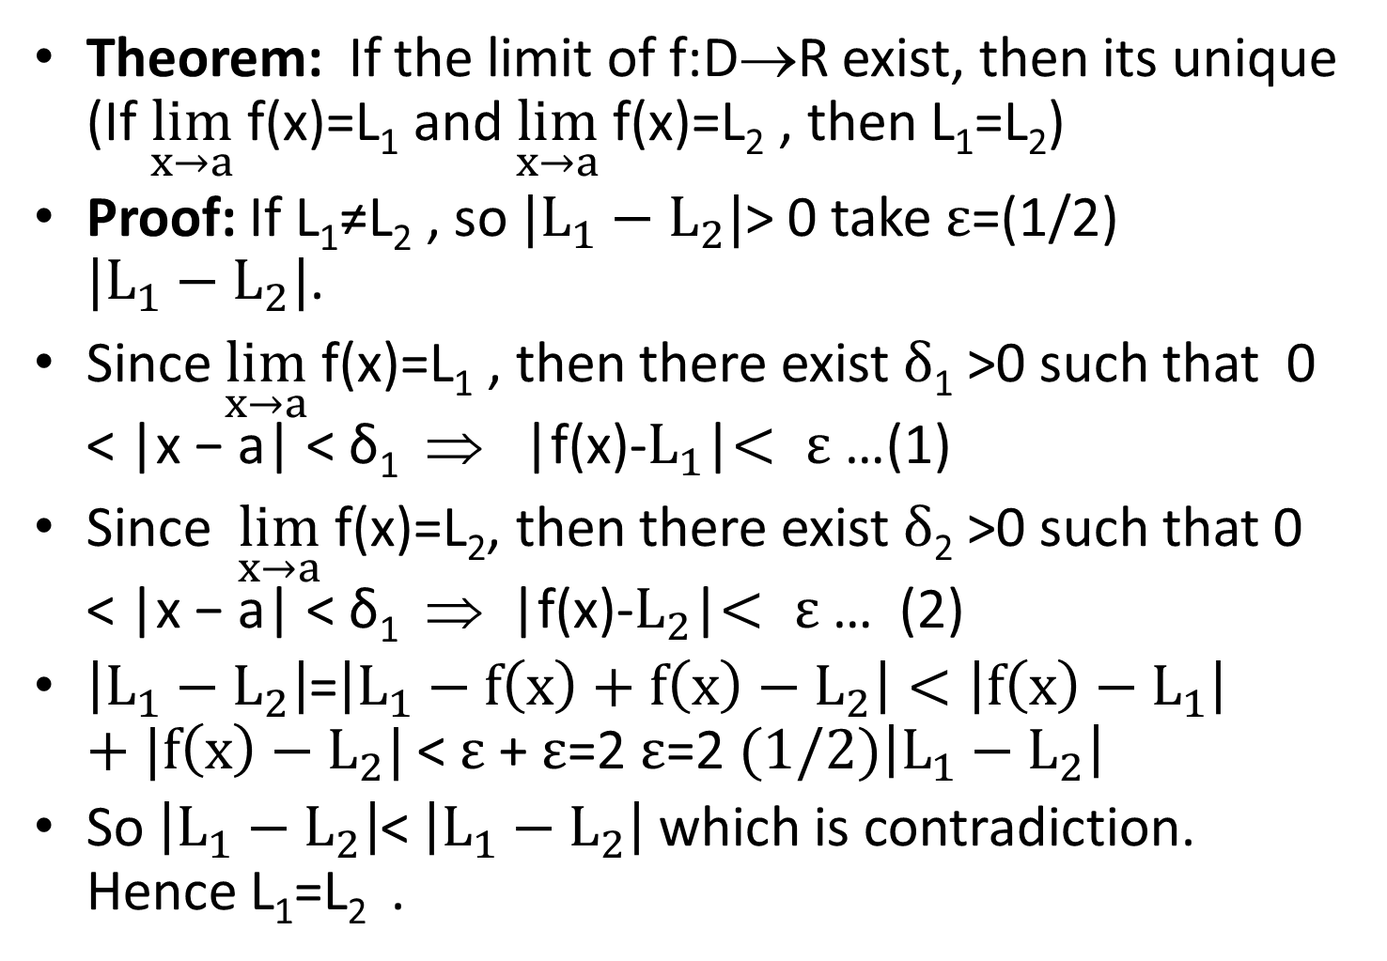
Theorem: If the limit of f:D→R exist, then its unique (If $\lim_{x→a}$ f(x)=L₁ and $\lim_{x→a}$ f(x)=L₂ , then L₁=L₂)
Proof: If L₁≠L₂ , so $|L_{1}−L_{2}|$> 0 take $ε$=(1/2) $|L_{1}−L_{2}|$.
Since $\lim_{x→a}$ f(x)=L₁ , then there exist $δ$₁ >0 such that 0 < |x − a| < δ₁ ⇒ |f(x)-$L_{1}$|$< ε$ …(1)
Since $\lim_{x→a}$ f(x)=L₂, then there exist $δ$₂ >0 such that 0 < |x − a| < δ₁ ⇒ |f(x)-$L_{2}$|$< ε$ … (2)
$\left|L_{1}−L_{2}\right|$=$\left|L_{1}−f\left(x\right)+f\left(x\right)−L_{2}\right|<\left|f\left(x\right)−L_{1}\right|+|f\left(x\right)−L_{2}|$ < $ε$ +$ε$=2$ε$=2$(1/2)\left|L_{1}−L_{2}\right|$
So $\left|L_{1}−L_{2}\right|$< $\left|L_{1}−L_{2}\right|$ which is contradiction. Hence L₁=L₂ .

Slide 5
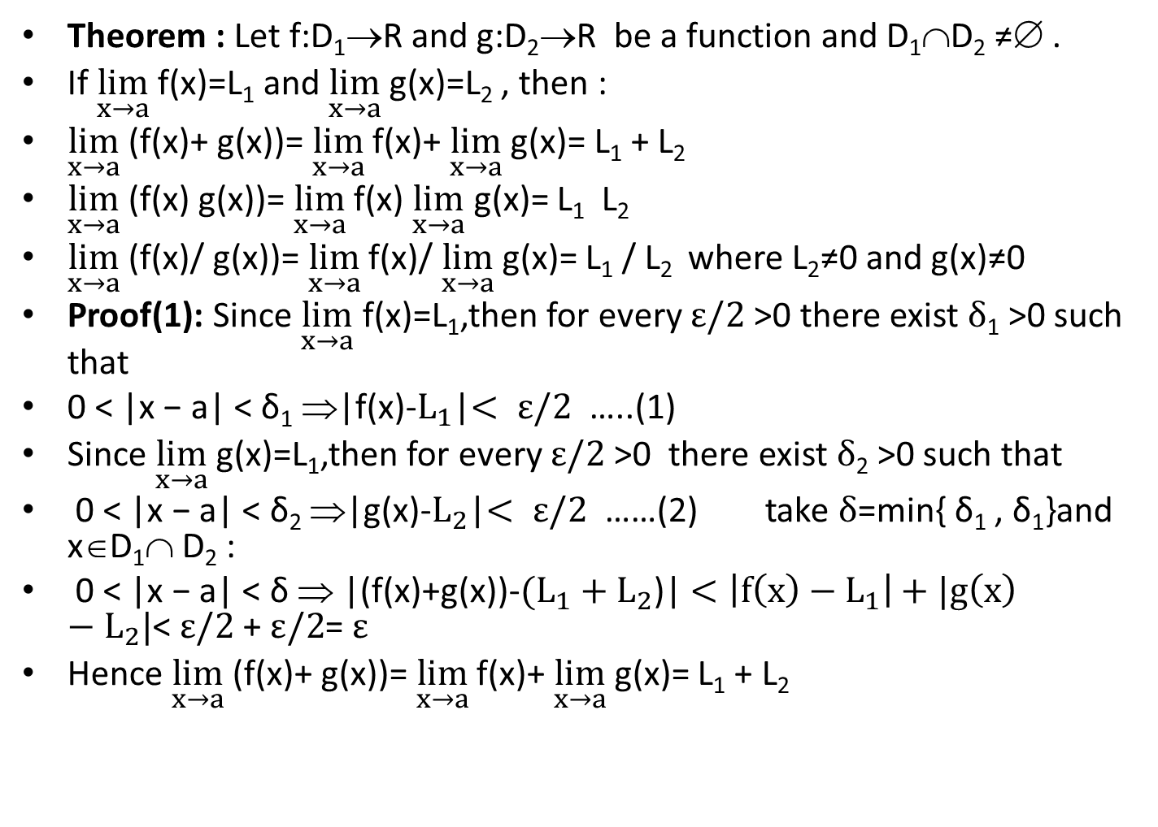
Theorem : Let f:D₁→R and g:D₂→R be a function and D₁∩D₂ ≠∅ .
If $\lim_{x→a}$ f(x)=L₁ and $\lim_{x→a}$ g(x)=L₂ , then :
$\lim_{x→a}$ (f(x)+ g(x))=$\lim_{x→a}$ f(x)+ $\lim_{x→a}$ g(x)= L₁ + L₂
$\lim_{x→a}$ (f(x) g(x))=$\lim_{x→a}$ f(x) $\lim_{x→a}$ g(x)= L₁ L₂
$\lim_{x→a}$ (f(x)/ g(x))=$\lim_{x→a}$ f(x)/ $\lim_{x→a}$ g(x)= L₁ / L₂ where L₂≠0 and g(x)≠0
Proof(1): Since $\lim_{x→a}$ f(x)=L₁,then for every $ε/2$ >0 there exist $δ$₁ >0 such that
0 < |x − a| < δ₁ ⇒|f(x)-$L_{1}$|$< ε/2$ …..(1)
Since $\lim_{x→a}$ g(x)=L₁,then for every $ε/2$ >0 there exist $δ$₂ >0 such that
0 < |x − a| < δ₂ ⇒|g(x)-$L_{2}$|$< ε/2$ ……(2) take $δ$=min{ δ₁ , δ₁}and x∈D₁∩ D₂ :
0 < |x − a| < δ ⇒ |(f(x)+g(x))-$(L_{1}+L_{2}$)|$<\left|f\left(x\right)−L_{1}\right|+|g\left(x\right)−L_{2}|$<$ε/2$ +$ε/2$=$ε$
Hence$\lim_{x→a}$ (f(x)+ g(x))=$\lim_{x→a}$ f(x)+ $\lim_{x→a}$ g(x)= L₁ + L₂

Slide 6
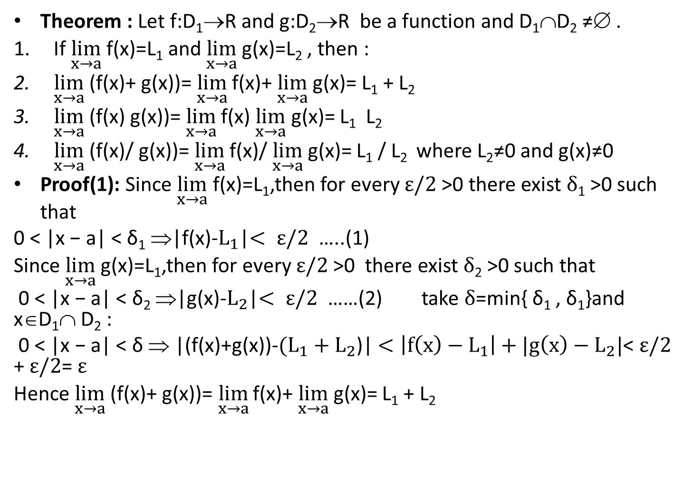
Theorem : Let f:D₁→R and g:D₂→R be a function and D₁∩D₂ ≠∅ .
If $\lim_{x→a}$ f(x)=L₁ and $\lim_{x→a}$ g(x)=L₂ , then :
$\lim_{x→a}$ (f(x)+ g(x))=$\lim_{x→a}$ f(x)+ $\lim_{x→a}$ g(x)= L₁ + L₂
$\lim_{x→a}$ (f(x) g(x))=$\lim_{x→a}$ f(x) $\lim_{x→a}$ g(x)= L₁ L₂
$\lim_{x→a}$ (f(x)/ g(x))=$\lim_{x→a}$ f(x)/ $\lim_{x→a}$ g(x)= L₁ / L₂ where L₂≠0 and g(x)≠0
Proof(1): Since $\lim_{x→a}$ f(x)=L₁,then for every $ε/2$ >0 there exist $δ$₁ >0 such that
0 < |x − a| < δ₁ ⇒|f(x)-$L_{1}$|$< ε/2$ …..(1)
Since $\lim_{x→a}$ g(x)=L₁,then for every $ε/2$ >0 there exist $δ$₂ >0 such that
0 < |x − a| < δ₂ ⇒|g(x)-$L_{2}$|$< ε/2$ ……(2) take $δ$=min{ δ₁ , δ₁}and x∈D₁∩ D₂ :
0 < |x − a| < δ ⇒ |(f(x)+g(x))-$(L_{1}+L_{2}$)|$<\left|f\left(x\right)−L_{1}\right|+|g\left(x\right)−L_{2}|$<$ε/2$ +$ε/2$=$ε$
Hence$\lim_{x→a}$ (f(x)+ g(x))=$\lim_{x→a}$ f(x)+ $\lim_{x→a}$ g(x)= L₁ + L₂

Slide 7
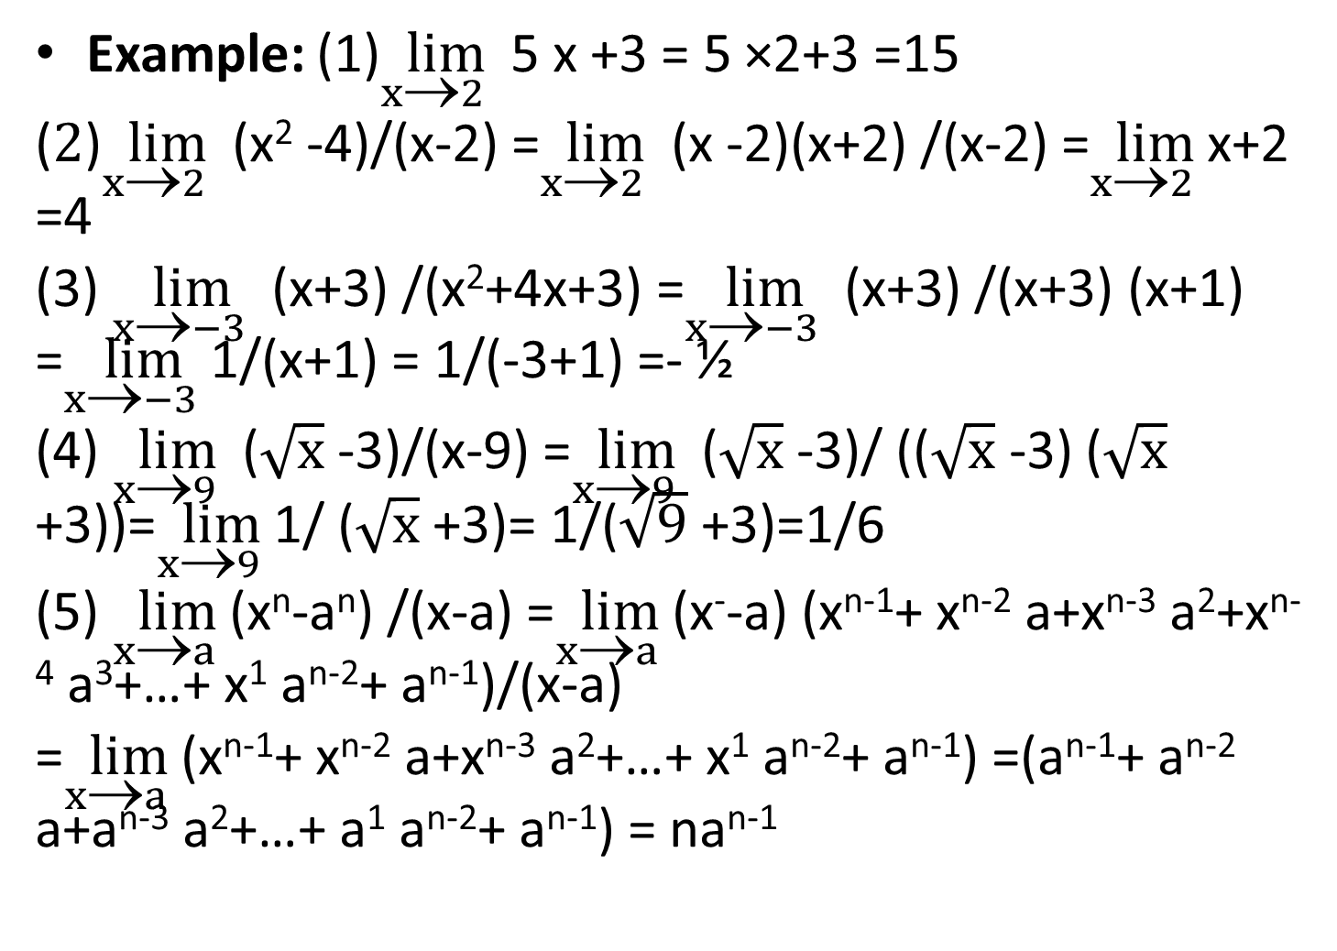
Example: (1)$\lim_{x→2}$ 5 x +3 = 5 ×2+3 =15
($2$)$\lim_{x→2}$ (x² -4)/(x-2) =$\lim_{x→2}$ (x -2)(x+2) /(x-2) =$\lim_{x→2}$ x+2 =4
(3)$\lim_{x→−3}$ (x+3) /(x²+4x+3) =$\lim_{x→−3}$ (x+3) /(x+3) (x+1) =$\lim_{x→−3}$ 1/(x+1) = 1/(-3+1) =- ½
(4)$\lim_{x→9}$ ($\sqrt{x}$ -3)/(x-9) =$\lim_{x→9}$ ($\sqrt{x}$ -3)/ (($\sqrt{x}$ -3) ($\sqrt{x}$ +3))=$\lim_{x→9}$ 1/ ($\sqrt{x}$ +3)= 1/($\sqrt{9}$ +3)=1/6
(5)$\lim_{x→a}$ (x^{n}-a^{n}) /(x-a) =$\lim_{x→a}$ (x⁻-a) (x^{n-1}+ x^{n-2} a+x^{n-3} a²+x^{n-4} a³+…+ x¹ a^{n-2}+ a^{n-1})/(x-a)
=$\lim_{x→a}$ (x^{n-1}+ x^{n-2} a+x^{n-3} a²+…+ x¹ a^{n-2}+ a^{n-1}) =(a^{n-1}+ a^{n-2} a+a^{n-3} a²+…+ a¹ a^{n-2}+ a^{n-1}) = na^{n-1}

Slide 9
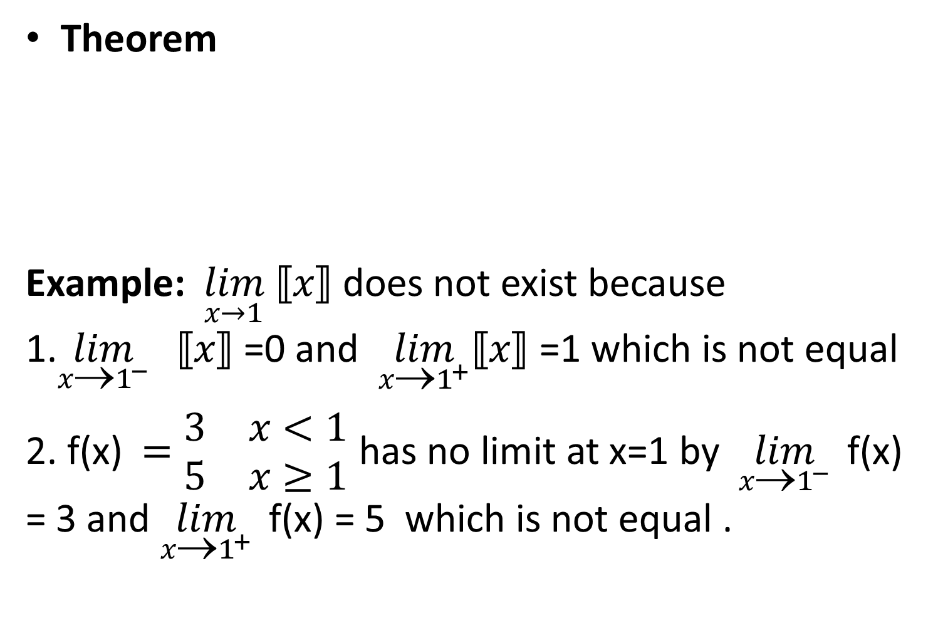
Theorem
Example: $\lim_{x→1}$ $⟦x⟧$ does not exist because 1.$\lim_{{x→1}^{−}}{ ⟦x⟧}$ =0 and $\lim_{{x→1}^{+}}{⟦x⟧}$ =1 which is not equal
2. f(x)$=\begin{matrix}3 & x<1 \\ 5 & x≥1\end{matrix}$ has no limit at x=1 by $\lim_{{x→1}^{−}}{ }$f(x) = 3 and $\lim_{{x→1}^{+}}{ }$f(x) = 5 which is not equal .

Slide 10
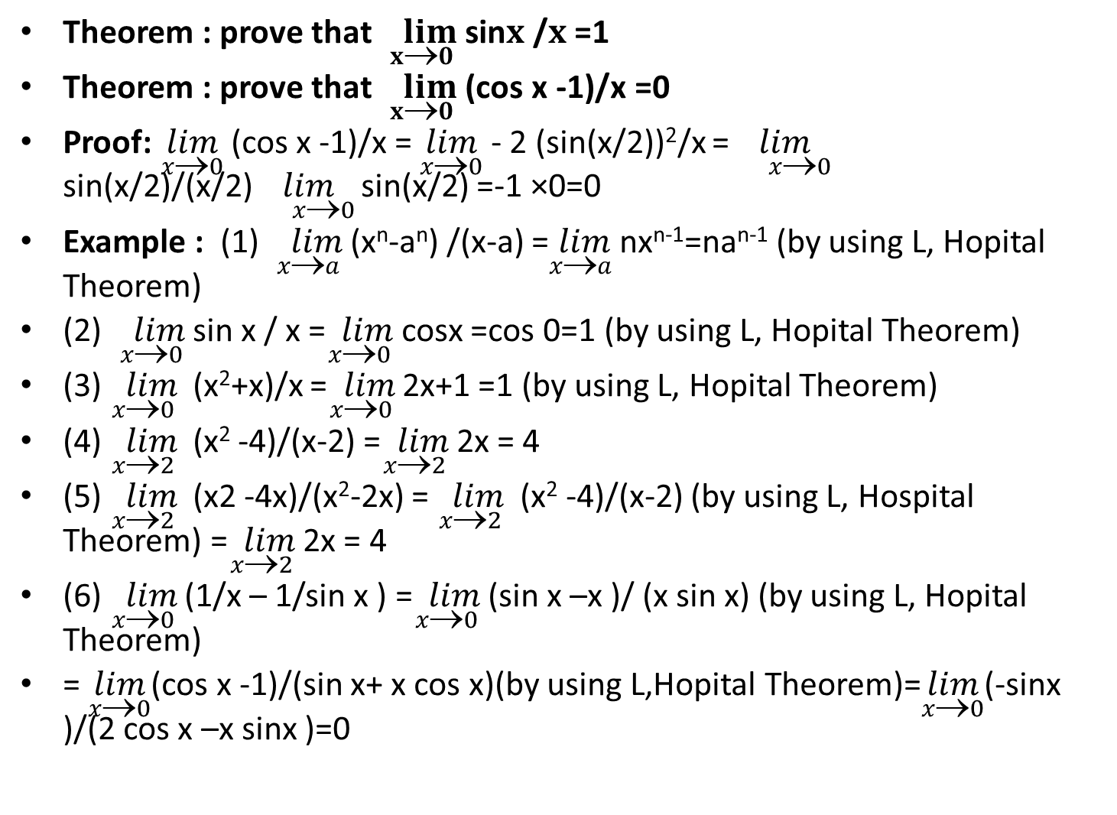
Theorem : prove that $\lim_{x→0}$ sin$x$ /$x$ =1
Theorem : prove that $\lim_{x→0}$ (cos x -1)/x =0
Proof:$\lim_{x→0}$ (cos x -1)/x = $\lim_{x→0}$ - 2 (sin(x/2))²/x =$\lim_{ x→0}$ sin(x/2)/(x/2)$\lim_{ x→0}$ sin(x/2) =-1 ×0=0
Example : (1) $\lim_{x→a}$ (x^{n}-a^{n}) /(x-a) =$\lim_{x→a}$ nx^{n-1}=na^{n-1} (by using L, Hopital Theorem)
(2) $\lim_{x→0}$ sin x / x =$\lim_{x→0}$ cosx =cos 0=1 (by using L, Hopital Theorem)
(3) $\lim_{x→0}$ (x²+x)/x =$\lim_{x0}$2x+1 =1 (by using L, Hopital Theorem)
(4) $\lim_{x→2}$ (x² -4)/(x-2) =$\lim_{x→2}$ 2x = 4
(5) $\lim_{x→2}$ (x2 -4x)/(x²-2x) = $\lim_{x→2}$ (x² -4)/(x-2) (by using L, Hospital Theorem) =$\lim_{x→2}$ 2x = 4
(6)$\lim_{x→0}$ (1/x – 1/sin x ) =$\lim_{x→0}$ (sin x –x )/ (x sin x) (by using L, Hopital Theorem)
= $\lim_{x→0}$(cos x -1)/(sin x+ x cos x)(by using L,Hopital Theorem)=$\lim_{x→0}$(-sinx )/(2 cos x –x sinx )=0

Slide 11
Definition:

Slide 13
Thank you

