Slide 1
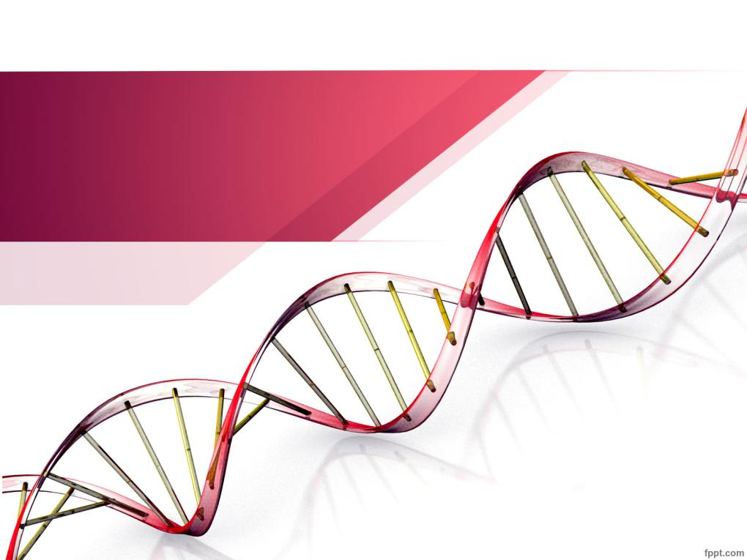
Secondary Structure of DNA
Ministry of Higher Education & Scientific Research
Salahaddin University
College of Science
Biology Department
Lecturer: Dr. Fairuz Hassan Abdullah
Lec.2 Molecular Biology 31.01.2023

Slide 2
Secondary structure of DNA
RNA commonly exists as a single polynucleotide chain, or strand. DNA is more complex and exists as two interwound strands.
The two strands of DNA are bound together mainly by the stacking interactions, hydrogen bonds and hydrophobic effect between the complementary bases.
The hydrogen bonding between bases is referred to as “Watson–Crick” or “complementary” base pairing. Watson–Crick base pairing allows the 1′-carbons on the two strands to be exactly the same distance apart (1.08nm).

Slide 3
This results in the regular, symmetric framework of the DNA double helix. The paired, relatively flat bases tend to stack on top of one another by means of a helical twist (Fig. 5 A). This feature of double-stranded DNA is known as “base stacking.”
This stacking eliminates any gaps between the bases and excludes the maximum amount of water from the interior of the double helix. A double-stranded DNA molecule thus has a hydrophobic core composed of stacked bases. Because the sugars and phosphates are soluble in water they orient towards the outside of the helix where the polar phosphate groups can interact with the polar environment (Fig. 5 B).

Slide 4
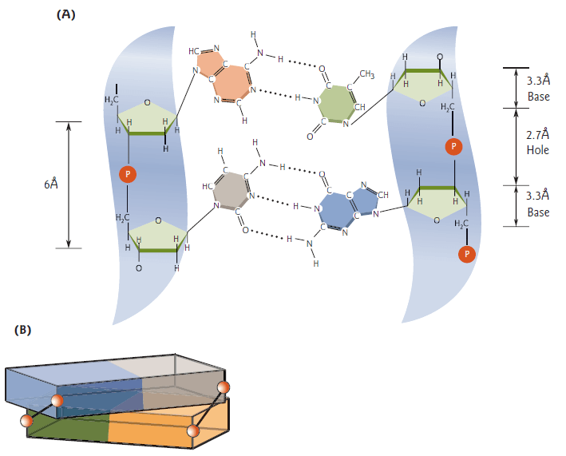
Figure 5: Base stacking.
(A) Two nucleotides in schematic form, a hydrophobic core composed of stacked bases.
(B) Schematic diagram showing how the base pairs (colored rectangles) can stack onto each other without a gap by means of a helical twist.

Slide 5
Structure of the Watson–Crick DNA double helix
Alternating deoxyribose sugars and phosphate groups form the backbone of DNA. The bases are attached to the sugars and are located between the backbones of the DNA strands, lying perpendicular to the long axis of the strands.
As the backbones of the two strands wind around each other, they form a double helix (Fig. 6).

Slide 6
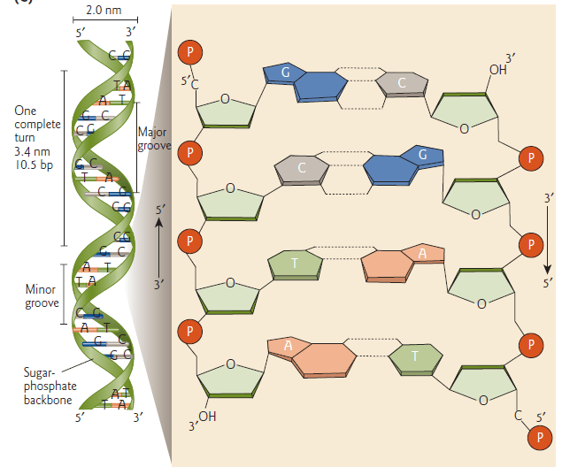
Figure 6: Representation of the DNA double helix.

Slide 7
The ladder terminology that is often used to describe DNA structure implies that there are open spaces between successive “rungs” of base pairs. A better analogy would be a stack of coins, since the bases are stacked right on top of each other.
There is polarity in each strand (5′ → 3′) of the DNA double helix; one end of a DNA strand will have a 5′-phosphate and the other end will have a 3′-hydroxyl group.

Slide 8
Watson and Crick found that hydrogen bonding could only occur if the polarity of the two strands ran in opposite directions. Thus, the two strands of the DNA double helix are antiparallel (5′→3′ and 3′→5′). The DNA double helix is also referred to as double-stranded DNA (dsDNA) or duplex DNA to distinguish it from the single-stranded DNA (ssDNA) found in some viruses.

Slide 9
Major and minor grooves
The two bonds that attach a base pair to its deoxyribose sugar rings are not directly opposite. Therefore, the sugar–phosphate backbone is not equally spaced. This results in what are called the major and minor grooves of DNA (see Fig. 6).
The major groove has a significant role in sequence-specific DNA–protein interactions. Thus, the major groove carries a message (the base sequence of the DNA) in a form that can be read by DNA-binding proteins.
Most transcription factors (proteins involved in regulating gene expression) bind DNA in the major groove. Studies have revealed the basic structure of three fundamental types of DNA double helix: B-, A-, and Z-DNA (Table 1, Fig. 7).

Slide 10
Major and minor grooves
Most transcription factors (proteins involved in regulating gene expression) bind DNA in the major groove. Studies have revealed the basic structure of three fundamental types of DNA double helix: B-, A-, and Z-DNA (Table 1, Fig. 7).

Slide 11
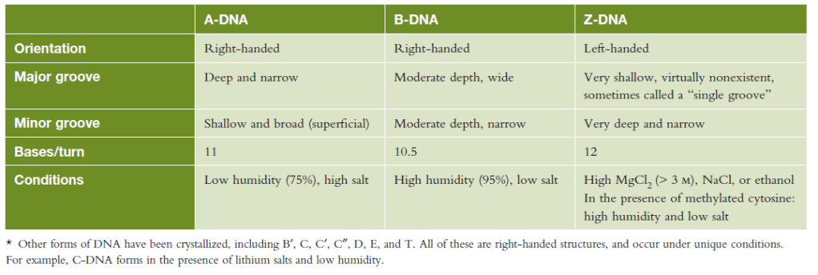
Table 1: Alternative forms of the DNA double helix.*

Slide 12
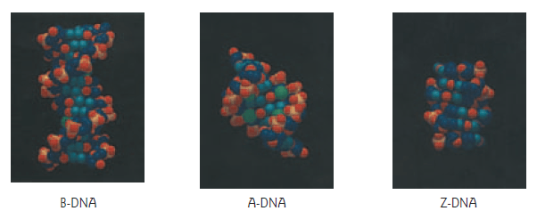
Figure 7: Three types of DNA double helix are displayed in these space-filling models: B-DNA (Watson–Crick DNA), A-DNA, and Z-DNA.

Slide 13
Tertiary structure of DNA
Many naturally occurring DNA molecules are circular, with no free 5′ or 3′ end. Due to the polarity of the strands of the DNA double helix, the 5′ end of one strand can only join its own 3′ end to covalently close a circle.
Thus, circular, double-stranded DNA is essentially two circles of single-stranded DNA twisted around each other. This DNA can become supercoiled.

Slide 14
Supercoils are a twisted, three-dimensional structure which is more favorable energetically. Supercoiling of DNA can be visualized by electron microscopy and occurs both in vivo and in vitro.

Slide 15
Physical properties of DNA
1- Right-handed and left-handed DNA
Most of DNA in the cell is right handed (B- DNA or B-Shape) which is the most stable configuration.
Some regions can form a slightly different Right handed DNA called (A-shape or A-DNA) which is more compacted. The third type called the Z-DNA, which has a zigzag DNA array.

Slide 16
2. Melting temperature of DNA, denaturation and renaturation
Denaturation can be done by heating (>80-90℃). The temperature at which DNA is half denatured is called critical temperature or melting temperature, Tm.
Tm is dependent on the length and composition of the DNA bases and other factors such as pH and denaturing agents.

Slide 17
Heat denaturation of DNA, also called melting, causes the double helix structure to unwind to form single stranded DNA.
When DNA in solution is heated above its melting temperature (usually more than 80°C), the double-stranded DNA unwinds to form single-stranded DNA.
The non-covalent hydrogen bonds between the nucleotide base pairs are weak.

Slide 18
The two complementary strands can be separated (denatured) by means of relatively weak chemical reagents (e.g. alkali, formamide, or urea) or by heating.
The resulting single-stranded molecules are relatively stable. With cooling, complementary single strands can reunite to form double-stranded molecules (Renaturation). Non-complementary single strands do not unite.

Slide 19
3. Hyperchromic property of DNA
Hyperchromic effect of DNA means increasing the UV absorption that occurs when the DNA duplex is denatured, usually by heating or by denaturing agents.
The UV absorption is increased when the two single DNA strands are being separated (denaturation).
When the DNA double helix is treated with denaturing agents, the force holding the double helical structure is disrupted. The double helix then separates into two single strands.

Slide 20
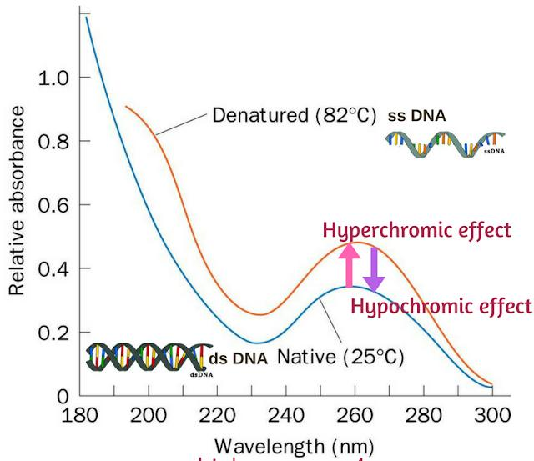
At this time, the base- base interaction will be reduced, increasing the UV absorbance of DNA solution because many bases are in free form and do not form hydrogen bonds with complementary bases (Fig. 8).
Figure 8: DS and SS DNA UV absorbance.

Slide 21
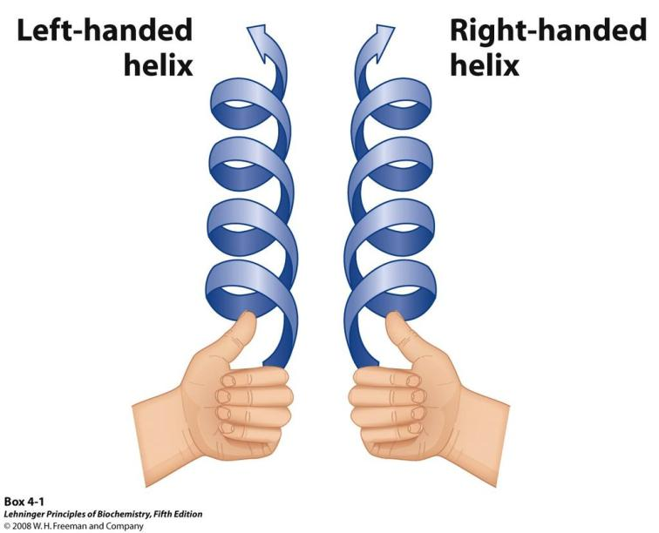
If a clockwise screwing motion moves the helix away from the observer, then it is called a right-handed helix

Slide 22
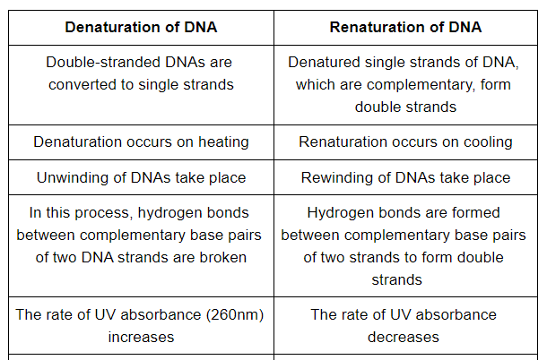

Slide 23
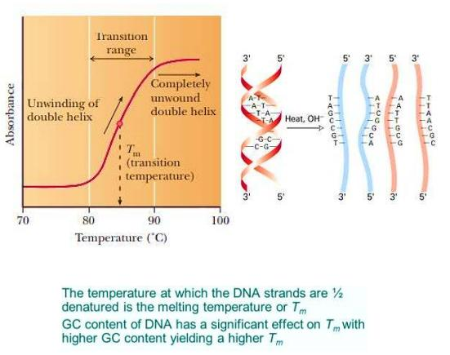

Slide 24
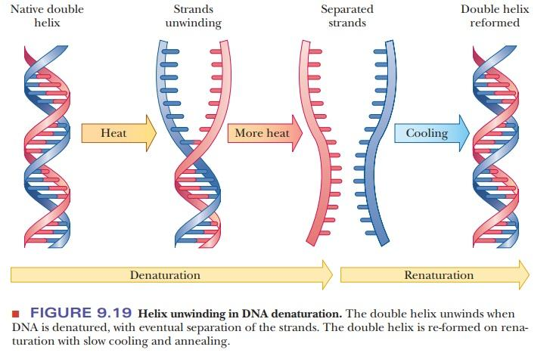

Slide 25
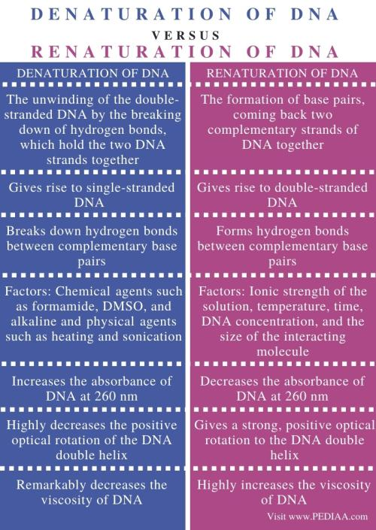

Slide 27
Homework
Q/ Define hyperchromicity and hypochromicity of DNA.

Slide 28
Quiz Questions
A- Define oligonucleotides.

Slide 29
Quiz Questions
B- What are the components of nucleic acids?

