Slide 1
Prokaryotic Transcription
Ministry of Higher Education & Scientific Research
Salahaddin University
College of Science
Biology Department
Lecturer: Dr. Fairuz Hassan Abdullah
Lec.7 Molecular Biology 11.04.2023

Slide 2
The prokaryotes, which include bacteria and archaea, are mostly single-celled organisms that lack membrane-bound nuclei and other organelles.
A bacterial chromosome is a covalently closed circle that, unlike eukaryotic chromosomes, is not organized around histone proteins. The central region of the cell in which prokaryotic DNA resides is called the nucleoid.

Slide 3
Transcription in prokaryotes (and in eukaryotes) requires the DNA double helix to partially unwind in the region of mRNA synthesis. The region of unwinding is called a transcription bubble.
Transcription always proceeds from the same DNA strand for each gene, which is called the template strand. The mRNA product is complementary to the template strand and is almost identical to the other DNA strand, called the non-template strand.

Slide 4
The only difference is that in mRNA, all of the T nucleotides are replaced with U nucleotides.
In an RNA double helix, A can bind U via two hydrogen bonds, just as in A–T pairing in a DNA double helix.
The nucleotide pair in the DNA double helix that corresponds to the site from which the first 5′ mRNA nucleotide is transcribed is called the +1 site, or the initiation site.

Slide 5
Nucleotides preceding the initiation site are given negative numbers and are designated upstream. Conversely, nucleotides following the initiation site are denoted with “+” numbering and are called downstream nucleotides.

Slide 6
Initiation
Prokaryotes do not have membrane-enclosed nuclei. Therefore, the processes of transcription, translation, and mRNA degradation can all occur simultaneously. The bacterial protein can quickly be amplified by multiple transcription and translation events occurring concurrently on the same DNA template. Prokaryotic transcription often covers more than one gene and produces polycistronic mRNAs that specify more than one protein.

Slide 7
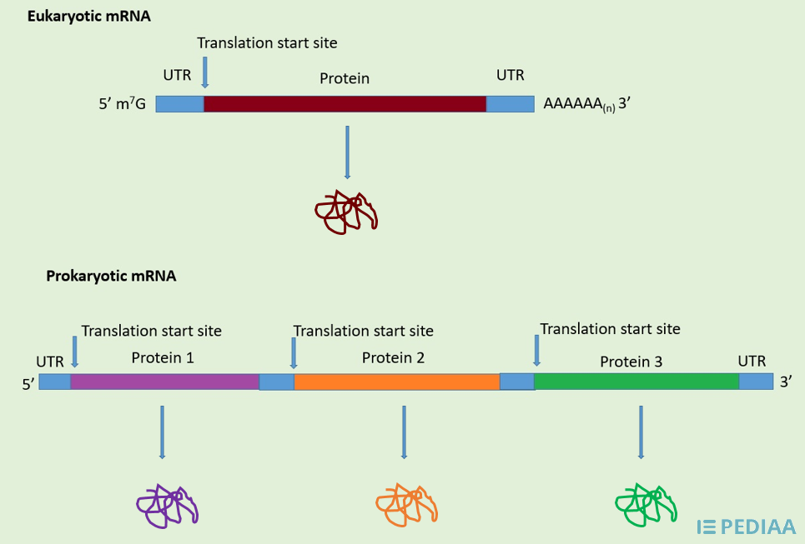

Slide 8
Monocistronic and polycistronic mRNA are two types of mRNA molecules, which can be decoded into polypeptide sequences. Most mRNA are monocistronic while fewer are polycistronic.
The main difference between monocistronic and polycistronic mRNA is that the monocistronic mRNA produces a single protein while polycistronic mRNA produces several proteins that are functionally-related. Furthermore, eukaryotes have monocistronic mRNA while prokaryotes have polycistronic mRNA.

Slide 9
Prokaryotic RNA polymerase
Prokaryotes use the same RNA polymerase to transcribe all of their genes.
In E. coli, the polymerase is composed of five polypeptide subunits, two of which are identical. Four of these subunits, denoted α, α, β, and β′ comprise the polymerase core enzyme. These subunits assemble every time a gene is transcribed, and they disassemble once transcription is complete.

Slide 10
Prokaryotic RNA polymerase
Each subunit has a unique role:
the two α-subunits are necessary to assemble the polymerase on the DNA;
the β-subunit binds to the ribonucleoside triphosphate that will become part of the nascent mRNA molecule; and
the β′ binds the DNA template strand.
The fifth subunit, σ, is involved only in transcription initiation.
The σ subunit, confers transcriptional specificity such that the polymerase begins to synthesize mRNA from an appropriate initiation site. Without σ, the core enzyme would transcribe from random sites. The polymerase comprised of all five subunits is called the holoenzyme.
Prokaryotic Promoters
A promoter is a DNA sequence onto which the transcription machinery binds and initiates transcription. In most cases, promoters exist upstream of the genes they regulate. The specific sequence of a promoter is very important because it determines whether the corresponding gene is transcribed all the time, some of the time, or infrequently. Although promoters vary among prokaryotic genomes, a few elements are conserved. At the -10 and -35 regions upstream of the initiation site, there are two promoter consensus sequences, or regions that are similar across all promoters and across various bacterial species. The -10 consensus sequence, called the -10 region, is TATAAT. The -35 sequence, TTGACA, is recognized and bound by σ. Once this interaction is made, the subunits of the core enzyme bind to the site. The A–T-rich -10 region facilitates unwinding of the DNA template, and several phosphodiester bonds are made. The transcription initiation phase ends with the production of abortive transcripts, which are polymers of approximately 10 nucleotides that are made and released. The σ subunit dissociates from the polymerase after transcription has been initiated.

Slide 11
Prokaryotic RNA polymerase
The σ subunit, confers transcriptional specificity such that the polymerase begins to synthesize mRNA from an appropriate initiation site. Without σ, the core enzyme would transcribe from random sites. The polymerase comprised of all five subunits is called the holoenzyme.

Slide 12
Prokaryotic Promoters
A promoter is a DNA sequence onto which the transcription machinery binds and initiates transcription. In most cases, promoters exist upstream of the genes they regulate.
The specific sequence of a promoter is very important because it determines whether the corresponding gene is transcribed all the time, some of the time, or infrequently.

Slide 13
Although promoters vary among prokaryotic genomes, a few elements are conserved.
At the -10 and -35 regions upstream of the initiation site, there are two promoter consensus sequences, or regions that are similar across all promoters and across various bacterial species.

Slide 14
The -10 consensus sequence, called the -10 region, is TATAAT.
The -35 sequence, TTGACA, is recognized and bound by σ. Once this interaction is made, the subunits of the core enzyme bind to the site.
The A–T-rich -10 region facilitates unwinding of the DNA template, and several phosphodiester bonds are made.

Slide 15
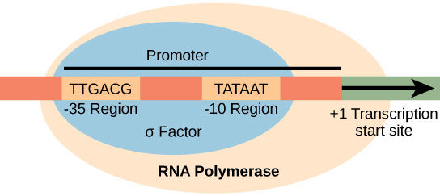
The transcription initiation phase ends with the production of abortive transcripts, which are polymers of approximately 10 nucleotides that are made and released. The σ subunit dissociates from the polymerase after transcription has been initiated.

Slide 16
Elongation
The transcription elongation begins with the release of the σ subunit from the polymerase. The dissociation of σ allows the core enzyme to proceed along the DNA template, synthesizing mRNA in the 5′ to 3′ direction at a rate of approximately 40 nucleotides per second.
As elongation proceeds, the DNA is continuously unwound ahead of the core enzyme and rewound behind it. The base pairing between DNA and RNA is not stable enough to maintain the stability of the mRNA synthesis components. Instead, the RNA polymerase acts as a stable linker between the DNA template and the nascent RNA strands to ensure that elongation is not interrupted prematurely. During elongation, the prokaryotic RNA polymerase tracks along the DNA template, synthesizes mRNA in the 5′ to 3′ direction, and unwinds and rewinds the DNA as it is read.

Slide 17
Nucleotides preceding the initiation site are given negative numbers and are designated upstream. Conversely, nucleotides following the initiation site are denoted with “+” numbering and are called downstream nucleotides.
Initiation
Prokaryotes do not have membrane-enclosed nuclei. Therefore, the processes of transcription, translation, and mRNA degradation can all occur simultaneously. The bacterial protein can quickly be amplified by multiple transcription and translation events occurring concurrently on the same DNA template. Prokaryotic transcription often covers more than one gene and produces polycistronic mRNAs that specify more than one protein.
Prokaryotic RNA polymerase
Prokaryotes use the same RNA polymerase to transcribe all of their genes. In E. coli, the polymerase is composed of five polypeptide subunits, two of which are identical. Four of these subunits, denoted α, α, β, and β′ comprise the polymerase core enzyme. These subunits assemble every time a gene is transcribed, and they disassemble once transcription is complete. Each subunit has a unique role; the two α-subunits are necessary to assemble the polymerase on the DNA; the β-subunit binds to the ribonucleoside triphosphate that will become part of the nascent mRNA molecule; and the β′ binds the DNA template strand. The fifth subunit, σ, is involved only in transcription initiation. The σ subunit, confers transcriptional specificity such that the polymerase begins to synthesize mRNA from an appropriate initiation site. Without σ, the core enzyme would transcribe from random sites. The polymerase comprised of all five subunits is called the holoenzyme.
Prokaryotic Promoters
A promoter is a DNA sequence onto which the transcription machinery binds and initiates transcription. In most cases, promoters exist upstream of the genes they regulate. The specific sequence of a promoter is very important because it determines whether the corresponding gene is transcribed all the time, some of the time, or infrequently. Although promoters vary among prokaryotic genomes, a few elements are conserved. At the -10 and -35 regions upstream of the initiation site, there are two promoter consensus sequences, or regions that are similar across all promoters and across various bacterial species. The -10 consensus sequence, called the -10 region, is TATAAT. The -35 sequence, TTGACA, is recognized and bound by σ. Once this interaction is made, the subunits of the core enzyme bind to the site. The A–T-rich -10 region facilitates unwinding of the DNA template, and several phosphodiester bonds are made. The transcription initiation phase ends with the production of abortive transcripts, which are polymers of approximately 10 nucleotides that are made and released. The σ subunit dissociates from the polymerase after transcription has been initiated.

Slide 18
Nucleotides preceding the initiation site are given negative numbers and are designated upstream. Conversely, nucleotides following the initiation site are denoted with “+” numbering and are called downstream nucleotides.
Initiation
Prokaryotes do not have membrane-enclosed nuclei. Therefore, the processes of transcription, translation, and mRNA degradation can all occur simultaneously. The bacterial protein can quickly be amplified by multiple transcription and translation events occurring concurrently on the same DNA template. Prokaryotic transcription often covers more than one gene and produces polycistronic mRNAs that specify more than one protein.
Prokaryotic RNA polymerase
Prokaryotes use the same RNA polymerase to transcribe all of their genes. In E. coli, the polymerase is composed of five polypeptide subunits, two of which are identical. Four of these subunits, denoted α, α, β, and β′ comprise the polymerase core enzyme. These subunits assemble every time a gene is transcribed, and they disassemble once transcription is complete. Each subunit has a unique role; the two α-subunits are necessary to assemble the polymerase on the DNA; the β-subunit binds to the ribonucleoside triphosphate that will become part of the nascent mRNA molecule; and the β′ binds the DNA template strand. The fifth subunit, σ, is involved only in transcription initiation. The σ subunit, confers transcriptional specificity such that the polymerase begins to synthesize mRNA from an appropriate initiation site. Without σ, the core enzyme would transcribe from random sites. The polymerase comprised of all five subunits is called the holoenzyme.
Prokaryotic Promoters
A promoter is a DNA sequence onto which the transcription machinery binds and initiates transcription. In most cases, promoters exist upstream of the genes they regulate. The specific sequence of a promoter is very important because it determines whether the corresponding gene is transcribed all the time, some of the time, or infrequently. Although promoters vary among prokaryotic genomes, a few elements are conserved. At the -10 and -35 regions upstream of the initiation site, there are two promoter consensus sequences, or regions that are similar across all promoters and across various bacterial species. The -10 consensus sequence, called the -10 region, is TATAAT. The -35 sequence, TTGACA, is recognized and bound by σ. Once this interaction is made, the subunits of the core enzyme bind to the site. The A–T-rich -10 region facilitates unwinding of the DNA template, and several phosphodiester bonds are made. The transcription initiation phase ends with the production of abortive transcripts, which are polymers of approximately 10 nucleotides that are made and released. The σ subunit dissociates from the polymerase after transcription has been initiated.

Slide 19
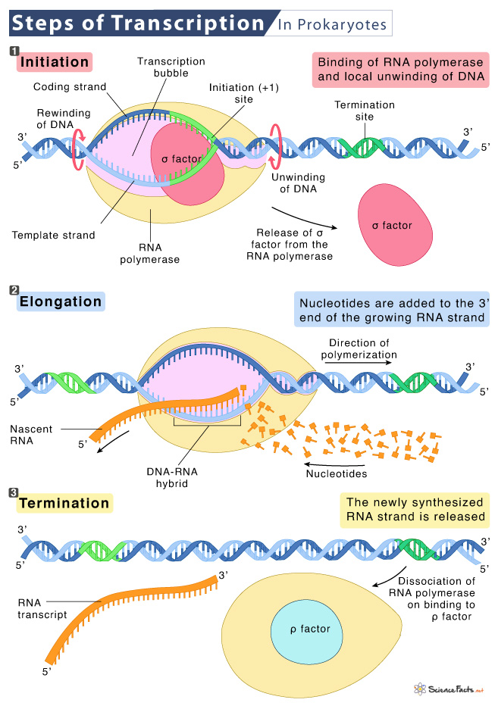

Slide 20
