Slide 1
The Risk Assessment Process
Salahaddin University – Erbil
College of Science
Department of Environmental Science and Health
Mr. Fars Zedan
faris.jarjees@su.edu.krd
2023 - 2024

Slide 5
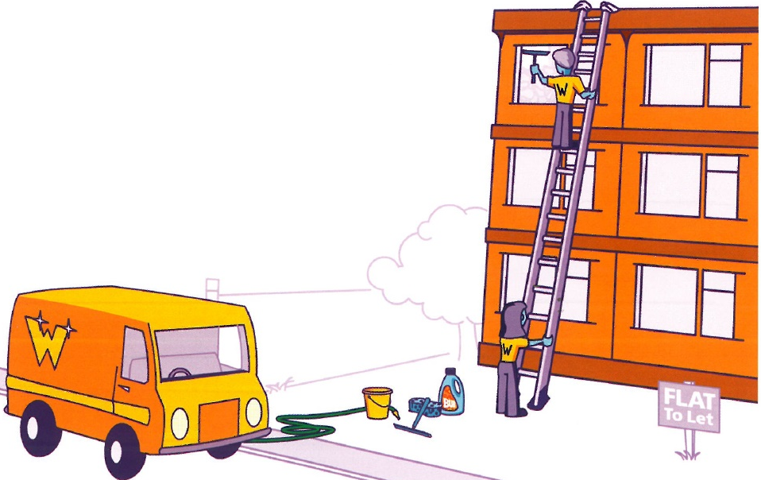

Slide 6
• Step 1: Identify the hazard (Look for the hazards)
This is the process of identifying all the hazards that exist in the workplace. You must be aware of all the possible hazards, but it is the significant ones which are important.
One approach is to take each task and break it down into steps, assessing the hazards associated with each step.
Each step will have its own hazards. The staff actually performing the tasks are likely to be the best people to assess them, although their familiarity with the job may make them less objective about potential hazards.

Slide 8
• Step 2: Estimate the risk (Decide who might be harmed, and how)
This is the process of determining who may be at risk from the hazards, that is the groups of staff and others likely to be affected in the case of an incident involving the hazard.
It is important to consider the wider implications of hazards, not just as they may affect those working in the immediate environment.
We have to be aware of other staff groups, such as maintenance personnel and cleaners, as well as visitors and the public.
Special attention should be given to inexperienced staff, lone workers or temporary staff, and to the particular needs of disabled staff, pregnant women and children.

Slide 9
• Step 3: Evaluate the risks arising from the hazards and decide if existing precautions are adequate or more should be done
This is where we assess the significance of the risks and suggest what should be done to protect people.
Action has to be taken where any existing measures do not appear to be adequate.

Slide 10
Residual Risk
Residual risk is the risk that remains once controls have been put in place.
When a hazard is controlled in some way so as to prevent harm arising, there are always likely to be circumstances when those controls will not be effective and there will therefore be some element of risk remaining.
Residual risk must be at an acceptable or tolerable level.

Slide 11
• Step 4: Record your findings
The significant findings of the assessment should be recorded and kept. There should be a record of all hazards, the risks that they present and what precautions are in place to protect people from harm.
This written record is an important reference for future use, not only as the basis for reviewing risks, but also as information for enforcement officers; or even as evidence in any court proceedings arising from an accident involving the risk.
The record must cover all significant risks and state the current position; for example, "electrical wiring checks carried out in building A and everything found to be satisfactory".

Slide 12
• Step 5: Review your assessment from time to time and revise it if necessary
The way we work is constantly changing, perhaps as a result of new equipment or modifications of existing equipment, building alterations, new procedures, new or modified products, etc.
Sometimes systems and procedures are changed by the staff themselves. They all bring their own hazards, but new hazards can also arise in existing methods of work; the effects of stress is a recent example.
It is important that we continue to be vigilant about hazards and risks and review workplace conditions regularly. How often is "regularly" will depend on the extent of the risks and the degree of change.

Slide 13
Reviewing
An organisation's safety policy may include a number of circumstances when reassessment of relevant risks is necessary.
Factors that would require an automatic review might include:
A change in legislation.
A change in control measures.
Any significant change in work practices and processes.
Installation of new machinery and equipment.
However, it is important to realise that work situations are always changing without necessarily involving these factors. It is important that risk assessment is not seen as a one-off event, but an on-going process.

Slide 14
Identifying Population at Risk
When considering people at risk, it is important to think not only of those carrying out particular activities, but also of all those who may be affected by those activities. This may include other workers who may be in the area, both during working hours (such as maintenance staff, contractors and other staff who just happen to be passing) as well as those who may be present at other times, such as cleaners and security guards. In addition, the position of visitors and other members of the public who may be affected must be assessed.
Any groups who may particularly be at risk must be identified; for example, young or inexperienced workers, those who work alone, and any disabled staff. These people may be subject to different levels of risk, depending on their personal qualities, competence, experience, age, state of health, etc.
Operators, Maintenance Staff, Cleaners, Contractors, Visitors, Public

Slide 15
Revision Questions
What is risk assessment?
State the five steps involved in risk assessment?
What is residual risk?
What conditions might trigger a risk assessment review?
What factors are used to evaluate the risk?
Apart from operators, what particular staff groups require special consideration during a risk assessment?

