Slide 1
Principles of Control in Health and Safety
College of Science
Env. Science and Health Dept.
Slides supplied by Fars Zedan
2023 - 2024
Lecture: 3

Slide 2
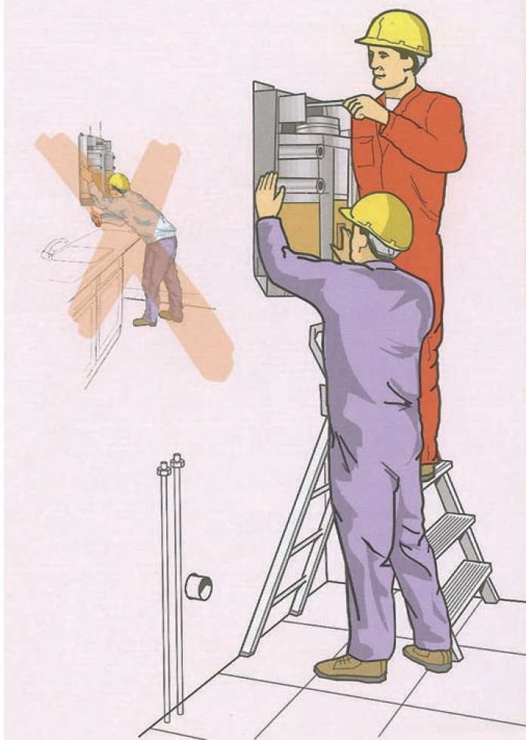
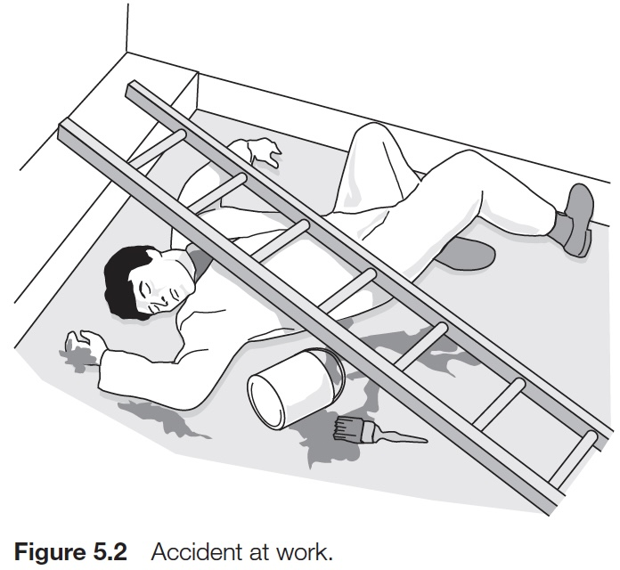

Slide 3
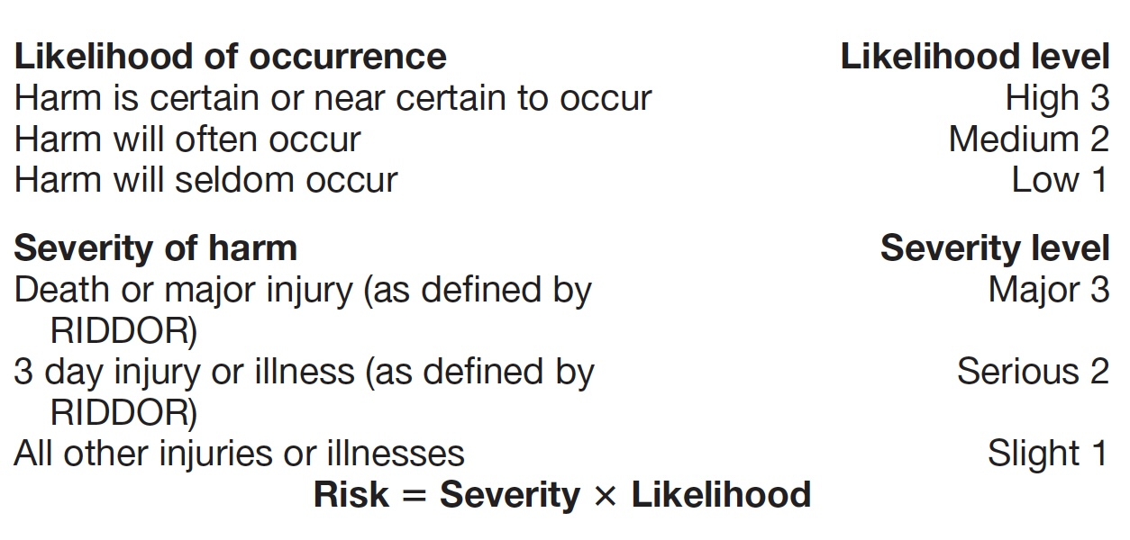
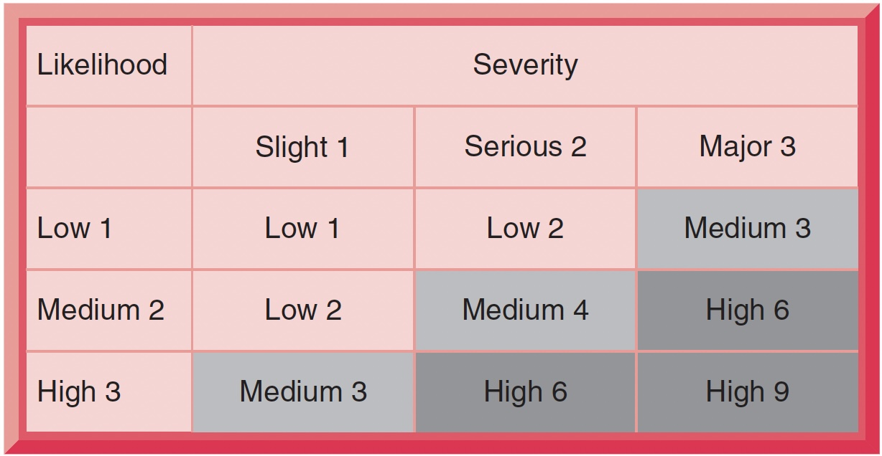

Slide 4
GENERAL PRINCIPLES OF PREVENTION
Avoiding risks (wherever possible).
Evaluating risks which cannot be avoided by carrying out a risk assessment.
Controlling the risks at source, rather than taking measures to control the risk in the wider context of the workplace.
Adapting work to the requirements of the individual. This applies particularly to the design of workplaces, the choice of work equipment and the choice of working and production methods, with a view to reducing repetitive work and work at a fixed pace, in order to minimise effects on health.
Adapting to technical progress.
Replacing the dangerous by the non-dangerous or less dangerous.
Developing a coherent overall prevention policy. This should cover technology, organisation of work, working conditions, social relationships and the influence of factors relating to the working environment.
Giving priority to collective protective measures over individual protective measures.
Giving appropriate instructions to workers. This covers specific and general instructions, including the use of safety signs, training and supervision.

Slide 5
INTRODUCTION
There is a hierarchy of methods of control, starting from elimination of the hazard, through controlling the risk either by technical means applied to the hazard itself, or by rules and procedures which dictate how people work with the hazard; and as a last resort, providing protection for the individual worker through specific job training and personal protective equipment.
Overall Aims
Fundamental strategies for controlling hazards and reducing risk.
The various hazard control and risk reduction methods available.

Slide 6
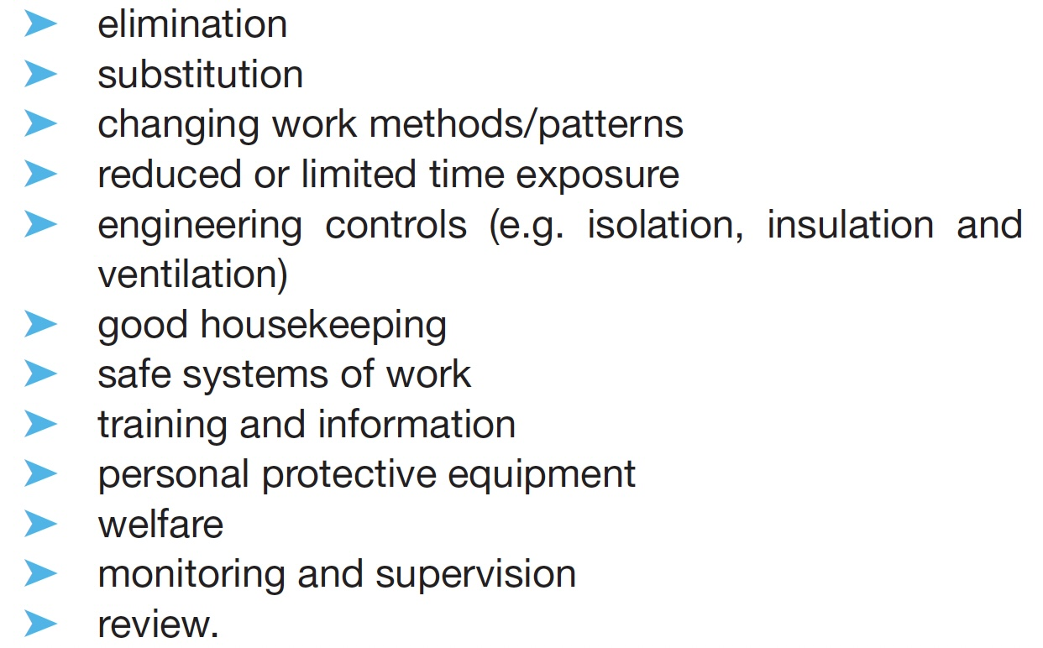
Hierarchy of risk control

Slide 7
Collective and Individual Protective Measures
Collective protective measures are those which protect the whole workplace and everyone who works there, as opposed to individual ones which, naturally, just protect single individuals.
These two approaches give rise to the ideas of a safe place and a safe person:
Safe place - This refers to the environment of the workplace.
collective protective measures in the premises
(including access/egress), plant, processes, materials, systems of work, supervision/training and competent personnel.
Safe person - This applies to an individual who, in relation to his or her work, has received adequate information, instruction and training and who follows safe systems of work, hygiene standards and wearing of PPE.

Slide 8
Elimination/Substitution
The first priority for control of any significant risk to health is to try to eliminate completely the agent responsible.
This is particularly true in the chemical industry, where many highly toxic chemicals are used.
This often involves the substitution of different types of equipment, substance or material for the hazardous one.
For example, hazardous substances can sometimes be replaced with materials which do the same job but present no risk to health. Mechanical devices such as hoists and lifts can be used to avoid manual handling of difficult or heavy loads.
The main objection to hazard elimination is usually the cost, since it may involve a radical change in the way that the work activity is carried out.

Slide 9
Changing Work Methods
A new method might minimise or suppress the generation of the agents of concern; for example,
where harmful emissions of solvents are being generated, brush painting rather than spraying will considerably reduce the level of airborne contaminant.
Similarly, the use of pressing techniques rather than panel beating will minimise noise generation.
Health hazards arising from the way people work, such as keyboard use and manual handling, can often be controlled satisfactorily by redesign of the work method.

Slide 10
Changing Work Patterns
The ill-health effects arising from activities and hazardous substances in the workplace are often related to the length of time of exposure as well as the severity of the hazard.
The combination of these two factors is referred to as the "dose".
such hazards as noise, airborne contaminants, vibration, radiation, heat and manual handling.
We can use a reduction of exposure as a means of minimising possible ill-health effects.
set strict time limits on exposure to prevent harm.
General principle, when a hazard exists from a substance or a physical agent, the cumulative dose should be reduced to as low a level as possible by
organising the work pattern to provide periods of no exposure.
Another method is job rotation, where the exposure of any particular individual is reduced by sharing the dose with other workers.
This method was often used in the nuclear industry

Slide 11
Isolation/Segregation
The aim here is to isolate the hazard physically so that nobody is exposed to risk. Total enclosure or containment is the best form of risk control since no one can then be exposed to the hazard. Examples include:
Total enclosure of a process which generates dust or fumes to prevent the escape of airborne contaminants which could be inhaled by operators in the vicinity.
Acoustic enclosure of a noisy machine to reduce noise levels and consequently the noise exposure to people working nearby.
Guards around moving or other dangerous machines, or parts of them, to prevent operators coming into contact with them.

Slide 12
Revision Questions
What are the general principles of prevention?
State the three principles which underlie the order of the general control hierarchy?
Differentiate between Collective and Individual protective measures?

