Slide 1
Basic Terms in syllabus and curriculum design
MA students in Applied Linguistics
Syllabus and Curriculum Design Module
Prof. Dr. Fatimah Al Bajalani
SUE

Slide 2
Curriculum:
It is an educational program which states:
The educational purpose of the program.
b. The content, teaching procedures and learning
experiences which will be necessary to achieve
the purposes.
c. Some means for assessing whether or not the
educational goals have been achieved.

Slide 3
In a theoretical sense, curriculum refers to what is offered by the school or college.
Practically it covers the knowledge, attitude, behaviour, manner, performance and skills that are taught to a student.
It contains the teaching methods, lessons, assignments, physical and mental exercises, activities, projects, study material, tutorials, presentations, assessments, test series, learning objectives, and so on.

Slide 4
The curriculum is well planned, guided and designed by the government or the educational institution.
It works at both physical and mental development of a student ( Bloom Taxonomy).
It is the overall learning experience that a student goes through during the particular course of study ( a semester or a year).

Slide 5
Syllabus
The documents that consist of topics covered in a
particular subject.
It is determined by the examination board and created by the
professors.
The professors are responsible for the quality of the course.
It is made available to the students by the teachers, either in hard
copy or electronic form to bring their attention towards the subject
and take their study seriously.

Slide 6
A syllabus is considered as a guide to the teacher and the students.
It helps the students to know about the subject in detail, why it is a part of their course of study, what are the expectations from students, consequences of failure, etc.
It contains general rules, policies, instructions, topics covered, assignments, projects, test dates, and so on.
Syllabus is usually accessible to students; the syllabus is given out to students at the beginning of the course or program, particularly in secondary and university education. Therefore, they can use it as a guideline for their studies.

Slide 7
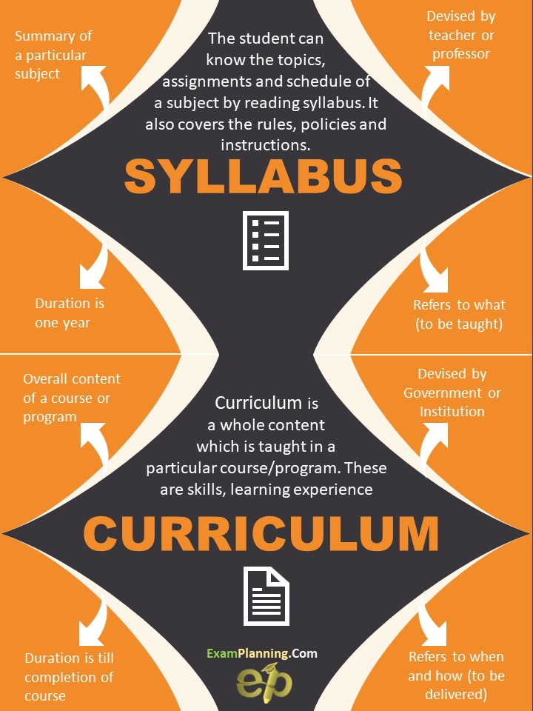

Slide 8
BASIS FOR COMPARISON | SYLLABUS | CURRICULUM
Meaning | Syllabus is the document that contains all the portion of the concepts covered in a subject. | Curriculum is the overall content, taught in an educational system or a course.
Origin | Syllabus is a Greek term. | Curriculum is a Latin term.
Set for | A subject | A course
Nature | Descriptive | Prescriptive-inflexible
Scope | Narrow | Wide
Set out by | Exam board | Government or the administration of school, college or institute.
Term | For a fixed term, normally a year. | Till the course lasts.
Uniformity | Varies from teacher to teacher. | Same for all teachers.

Slide 9
Curriculum is concerned with the planning, implementation, evaluation, management and administration of education programs.
Syllabus focusses more narrowly on the selection and grading of content.

Slide 10
Course
It is an integrated series of teaching-learning experiences whose ultimate aim is to lead the learners to a particular state of knowledge.
Course design is the process by which the raw data about the learning need is interpreted in order to produce an integrated series of teaching and learning experiences whose ultimate aim is to lead the learners to a particular state of knowledge.

Slide 11
Curriculum design
It is the study and development of the goals, contents, implementation and evaluation of an educational system.
In language teaching it can also be called as syllabus design or curriculum development.

Slide 12
Task 1
Draw a diagram showing the similarities and differences between Curriculum and syllabus

Slide 13
Aims
The underlying reasons for or purposes of a course of instruction.
For example, the aims of the teaching of a foreign language in a particular country might be: to teach students to read and write a foreign language,
to improve students’ knowledge of a foreign culture,
to teach conversation in a foreign language, etc.
Aims are long-term goals, described in very general terms.

Slide 14
Objectives
Descriptions of what is to be achieved in a course.
They are more detailed descriptions of exactly what a learner is expected to be able to do at the end of a period of instructions.
This might be a single lesson, a chapter of a book, etc.
For instance, specific objectives of a classroom lesson might be: Use of the linking words and, but, however, although.
These specific objectives contribute to the general objective of paragraph writing.
A description of specific objectives in terms which can be observed and measured is known as BEHAVIOURAL OBJECTIVE.

Slide 15
Aims
Aims are GENERAL and are expressed in a broad way outlining the subject intention.
Aims are what teachers (and learners) want to achieve in a course.
Activity in a class is planned in order to achieve these aims.
Examples
To understand the form or use of the passive,
To practice intensive reading,
To improve the report writing skills of a group of business students.

Slide 16
Objectives:
Objectives are clear and concise statements that describe
what you intend your students to learn by the end of the
lesson.
Objectives are more specific and they are usually teacher’s
goals.
An objective describes what a faculty member will cover in
a course.
Objectives generally are less broad than goals and broader
than student learning outcomes.

Slide 17
Objectives:
Learning objectives is described as what the
student can expect from the teacher at the end
of the course.
Example:
In this course students will be introduced to both theoretical and applied lessons that will help them to be prepared and be qualified teachers of English as a second/ foreign language.
This example shows how the objective is teacher oriented.

Slide 18
Learning Outcomes:
A learning outcome is SPECIFIC and describes exactly what you intend your students to learn.
Learning outcomes are statements that describe the knowledge or skills students should acquire by the end of the particular assignment, class, course, or program.
They help students understand why that knowledge and those skills will be useful to them.

Slide 19
When writing outcomes, it is helpful to use verbs that are measurable or that describe an observable action.
Such verbs help faculty and students avoid misinterpretation.
The best outcomes will include a description of the conditions (“when given x, you will be able to...”) and the acceptable performance level.
The last point is applicable for behavioral objectives also.

Slide 20
The difference between course objectives and learning outcomes - and the reason these terms are so often interrelated with each other - is that the former describes an intended state (what you hope your students will learn), whereas the latter expresses a present or observed state (what your students actually learned).
Aims or goals are where you want to go,
objectives are how you get there,
and outcomes are proof that you have arrived.

Slide 21
Examples of learning outcomes:
By the end of the lesson or unit or course, it is expected
that the students are able to:
Effectively use the available teaching\learning resources,
Deal with theories of second language learning and language acquisition
Relate between a theory, an approach and methods applied in language teaching.

Slide 22
Learning outcomes should be: SMART
What does this acronym stand for?
Specific set out in concrete terms
Measurable able to see achievements
Agreed usually short term
Realistic to suit resources, teacher and learner
Time bound time allowance to be set.

Slide 23
Task 4
Draw a comparison between aims, objectives, learning outcomes

Slide 24
Task 5
Write 2 aims, objectives, learning outcomes

Slide 25
Approach
It refers to theories and philosophy about the nature of language and language learning that serve as the source of practices and principles in Language teaching.
Method
It is the practical realization of an approach. Methods include various procedures and techniques.
Technique
What actually takes place in a classroom, any activity in the classroom that goes with method applied, like imitation, dictation, role play, etc.

Slide 26
Task 6
Find the relation between all the terms presented in this lecture

Slide 27
Task 7
Write an approach, one of its methods, some techniques of this method

Slide 28
Sources
David Nunan, Syllabus design.
Hutchinson and Waters, English for specific purposes.
Richards and Rodgers,2001. Approaches and methods in language teaching.
Edward M. Anthony. Approach, method and technique

Slide 29
Jack C. Richards – John Platt – Heidi Platt, 1992 Longman Dictionary of Language Teaching & Applied Linguistics. ( p.253-254).
Lazgin Khader Barany, 2019Topics in TESOL: Teaching English to Speakers of Other Languages. LAP Lambert academic publishing. P.92-96
https://keydifferences.com/difference-between-syllabus-and-curriculum.html
https://pediaa.com/difference-between-curriculum-and-syllabus/
https://examplanning.com/how-is-syllabus-different-from-curriculum/

Slide 30
Contact information:
Fatimah.hassan@su.edu.krd
Fatimah.hassan@mhe-krg.org
07504609670

Slide 31
Thank you

