Slide 1
khalifa international stadium
By/ Faten Radhwan Yaseen

Slide 2
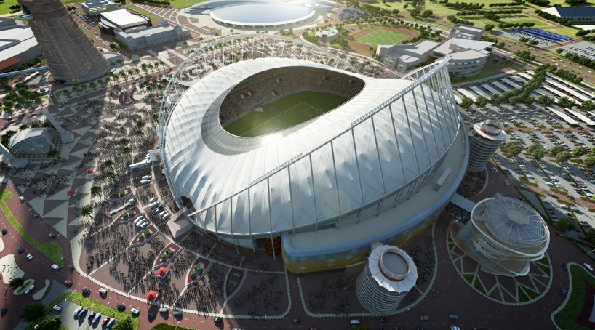
Introduction
the
The 2022 FIFA world cup has unveiled renovation plans for the khalifa international stadium, the third host venue for the global event. the expansion scheme will increase the arena’s seating capacity to 40,000, while innovative cooling technology inside the design will ensure an optimum playing temperature of 26 degrees Celsius.

Slide 3
Cooling system
The Khalifa International Stadium is the largest in the world outdoors to be cooled. For this purpose, “urban refrigeration” has been used, a system that reduces energy consumption and keeps both players and spectators comfortable, regardless of outside temperatures.

Slide 4
Cooling system
Urban refrigeration means that refrigeration technology is 40% more sustainable than conventional techniques. There is an energy center located one kilometer away from the stadium, from where the cooled water is carried by pipe to the place. Once the cold water arrives it cools the air, which is then pushed towards the center of the stadium, the playing field and the seating areas, for about 500 vents around the stands. The cold air, denser, and therefore heavier, remains on the ground and stops the entry of hot air.

Slide 5
Cooling system
The cooling nozzles are specially designed in Qatar, with moving plastic parts that are more durable and allow air to be pushed into the area to be reached. It is a technologically intelligent system that can control temperatures according to the optimal conditions for the number of spectators in the place.

Slide 6
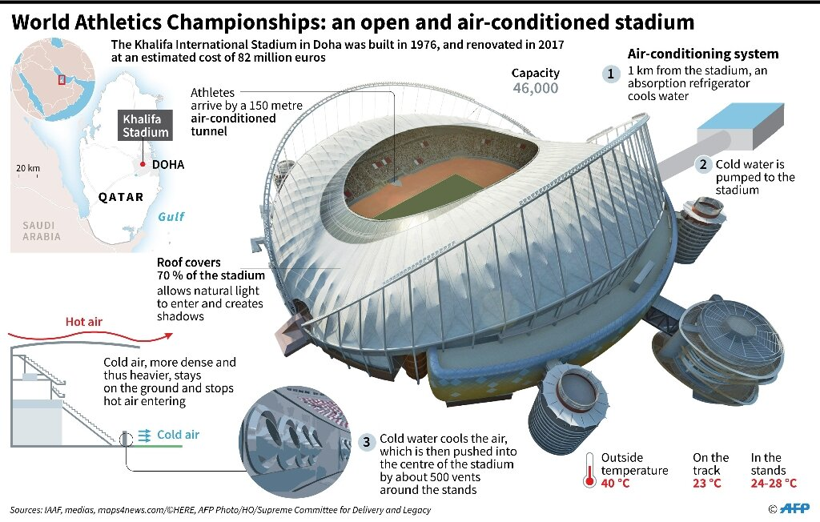

Slide 7
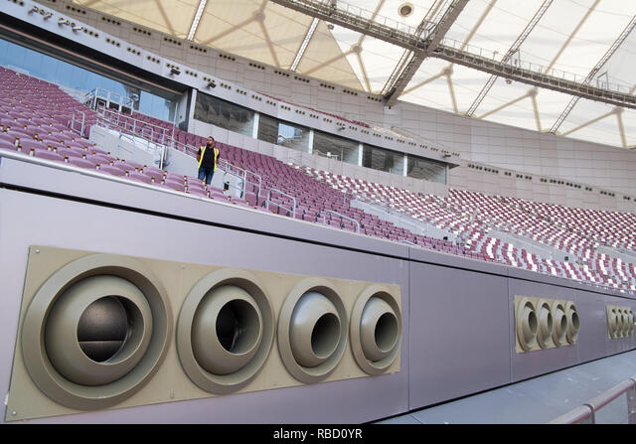

Slide 8
Materials In the expansion and renovation of its structure, mainly reinforced concrete, aluminum and steel were used.

Slide 9
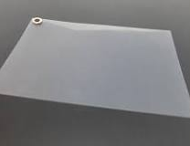
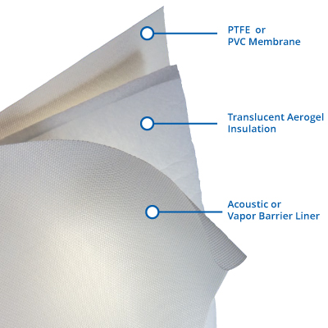
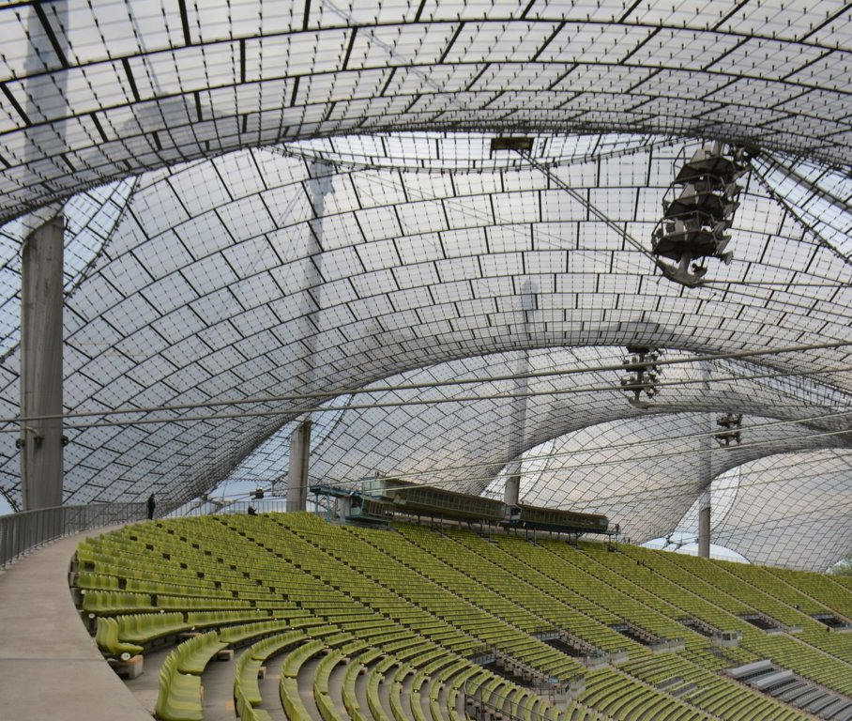
The roof
The new roof covering the stands is supported by circular beams that serve as a framework for the placement of a membrane manufactured with the combination of three products:
452 m2 of PTFE fiberglass membrane.
On a surface of approximately 3,252m2, on the leading edge of the south side of the roof, a single layer ETFE film supported by cables was used.
At the lower edges of the west side, near the compression ring, the Tensotherm ™ system, 2,100m2, an insulated and translucent tensioned membrane system that offers high thermal efficiency was incorporated.
Notes:
عند الحواف السفلية للجانب الغربي، بالقرب من حلقة الضغط، تم دمج نظام Tensotherm™، بمساحة 2100 متر مربع، وهو نظام غشاء مشدود معزول وشفاف يوفر كفاءة حرارية عالية.

Slide 10
It is the first time that these three combined materials are used. With its insulating capabilities, the Tensotherm material helps reduce the heat of the western sun towards the stadium and will provide comfort to the spectators in the face of the scorching heat of the Middle East. These membrane components were manufactured in Japan and the United States. The steel cables that make up the network that supports the panels come from Germany and Italy.

Slide 11
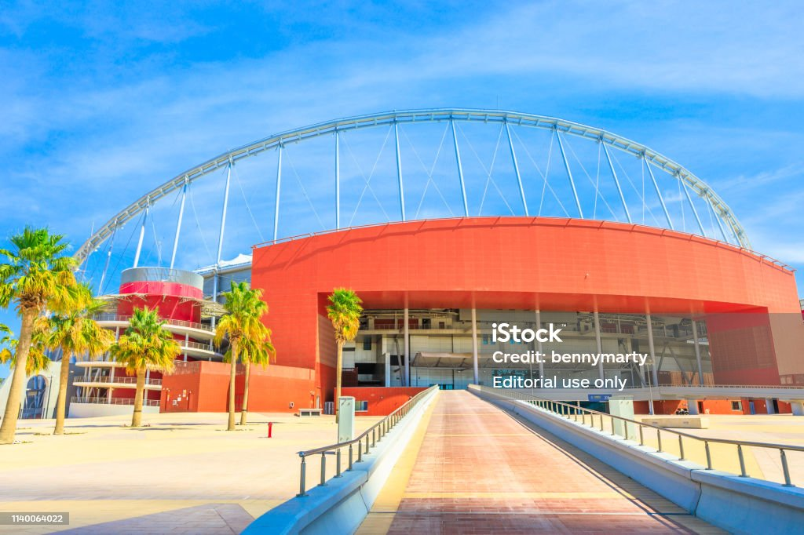
The large canopy of the main entrance is lined with large terracotta colored ceramic pieces that are repeated in some other parts of the stadium’s facade combined with polished aluminum plates.

Slide 12
THANK YOU

