Slide 1
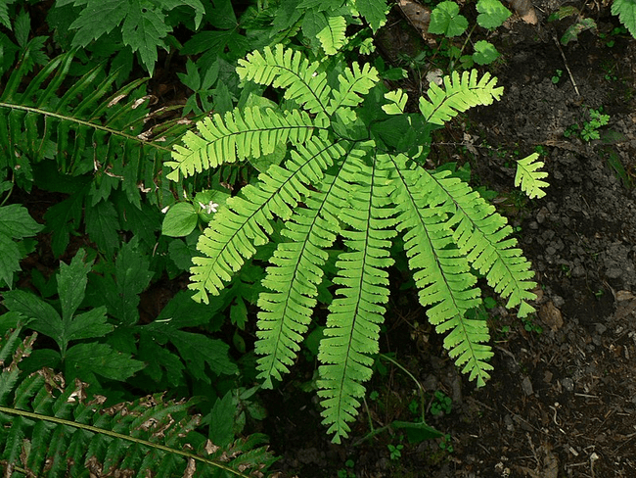
ADIANTUM Sp
Maiden hair Fern.
Prepared By: Fattma Zrar Mohammed

Slide 2
Systematic Position:
Division :- Pteridophyta (Filicophyta) Called ferns
Class :- Pteropsida/Filicopsida
Order :- Filicales
Family :- Adiantaceae
Genus :- Adiantum Sp.

Slide 3
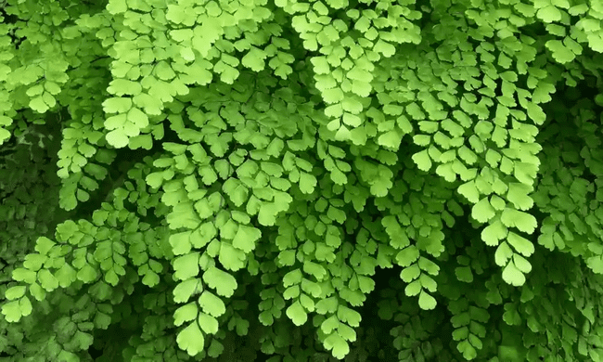
Why Adiantum sp. called Maidenhair Fern ? Or walking
Adiantum is called as "walking fern", due to………..?

Slide 4
They were said to look like the long, dark hair of a maiden. Maidenhair ferns are a large group of perennial, evergreen ferns that can grow to about three feet. Requiring fairly warm and humid conditions, these ferns are found in shaded, moist areas where they grow on rock faces and in crevices of cliffs, on banks and ledges along streams and rivers, or close to natural hot springs

Slide 5
Occurrence and Distribution of Adiantum:
Adiantum is commonly known as ‘Maiden hair fern’ or ‘Walking fern’. They are distributed in the tropical and temperate regions of the world. It grows ubiqui­tously wherever nature offers a moist, shaded locality. There are nearly 200 species.

Slide 6
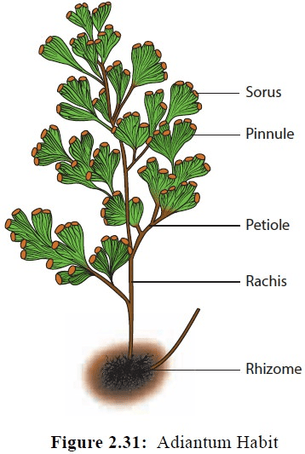

Slide 7
EXTERNAL FEATURES OF ADIANTUM (MAIDEN HAIR FERN)​
Plant body is a sporophyte. It is differentiated into roots, rhizome and leaves.
Roots are produced on the lower side of the rhizome. Primary root is short-lived. Secondary roots are adventitious and branched.
Rhizome may either be creeping or erect. It is scaly, covered with hairs and bears adventitious roots and leaves.

Slide 8
Leaves with a long petiole, are spirally or alternately arranged on the rhizome. Young leaves are circinately coiled. Young rhizome, petiole, rachis and circinately coiled leaves are covered with hairs known as ramenta.
The leaves are compound and are borne on shining black and brittle petiole.
Leaves are often dichotomously branched into many leaflets.
The blade of the leaflets may be entire, and either simply or repeatedly branched. The leaflets are deltoid in shape. When fertile, the leaflet margin remains folded toward the lower side forming a false indusium which encloses many sori.
Leaflet is traversed by dichotomously branched veins which generally do not unite to form a reticulum. The venation is, therefore, of open dichotomous type.

Slide 9
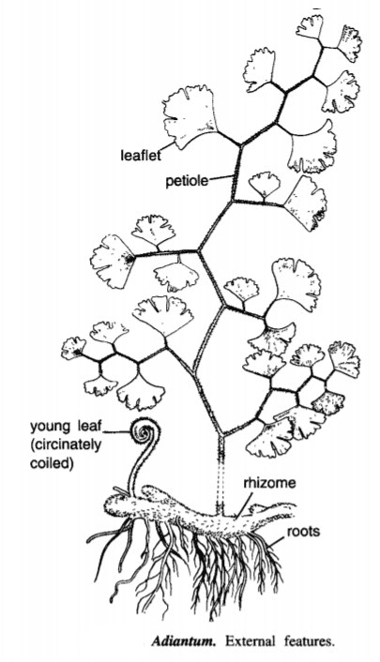

Slide 10
ANATOMY OF ROOT OF ADIANTUM (MAIDEN HAIR FERN)​
The root is almost circular in outline.
It is differentiated into epidermis, cortex and stele.
The epidermis is single layered, cells are thin walled and tangentially elongated. It bears a few unicellular root hairs.
Cortex is inner to the epidermis. It is multilayered and parenchymatous.
Endodermis is single layered and is followed by a single layered pericycle.

Slide 11
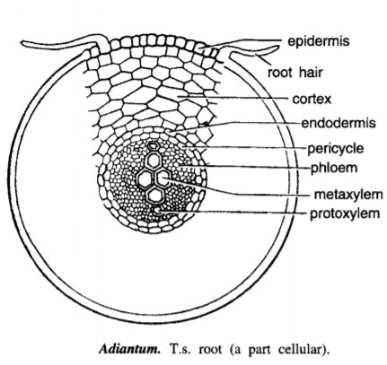

Slide 12
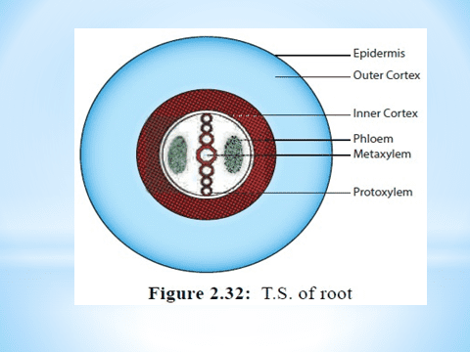

Slide 13
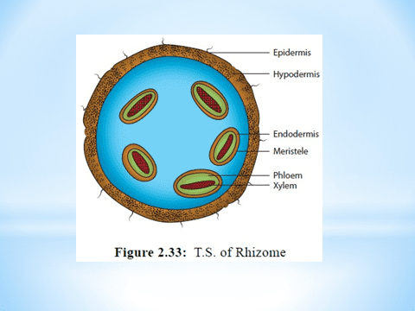

Slide 14
A protostele is present in the centre. It is diarch and exarch.
Xylem elements occur in the centre. Of these, metaxylem elements are present in the centre. Protoxylem groups are situated on the two opposite sides of the metaxylem (Thus xylem groups are exarch and diarch).
Phloem surrounds the xylem on all the sides.

Slide 15
ANATOMY OF RHIZOME OF ADIANTUM (MAIDEN HAIR FERN)​​
Rhizome appears almost circular or guttershaped in a transection.
It shows differentiation into epidermis, hypodermis, ground tissue and stele.
Epidermis is single layered and bears numerous multicellular hairs.
Hypodermis that follows epidermis is a 2-3 layered deep and sclerenchymatous.
Adiantum. T.s. rhizome (outlines : diagrammatic).

Slide 16
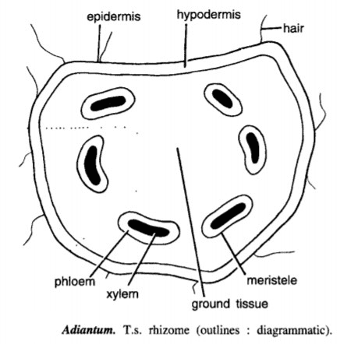

Slide 17
Ground tissue occupies major part of rhizome. It is parenchymatous and many layered deep.
Stele is variable in nature, differing from one region to another. Species with elongated rhizome show actual solenostele (amphiphloic siphonostele). But commonly the stele is gutter shaped and appears as several meristeles arranged in a ring, due to numerous leaf gaps (dictyostele).
Meristeles varying in number, but more often 5-7, lie arranged in ground tissue in a guttershaped ring, thus exhibiting dictyostelic condition. The spaces between neighbouring meristeles are leaf gaps.
Each of the meristeles is surrounded by a distinct, single-layered endodermis subsequently followed by a single layered pericycle.
Xylem elements occupy the central part. Metaxylem and protoxylem are arranged in a way to form mostly mesarch condition.
Phloem surrounds xylem.

Slide 18
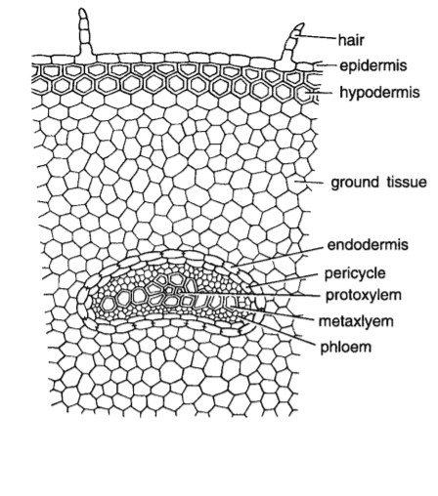

Slide 19
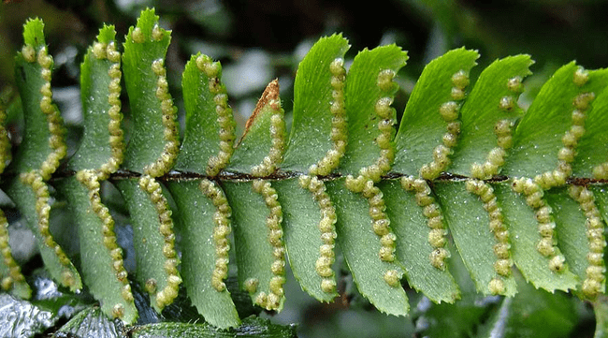
The sporangia:
(the fern's spore-bearing structures) are borne on the underside of the leaf beneath the false indusium, a trait found in all members of Adiantum and not in any species outside it. The sori are round, and are found on veins ending in the false indusium, below the veins' ends.

Slide 20
STRUCTURE OF SORUS OF ADIANTUM (MAIDEN HAIR FERN)​​
The spore producing organs are the sporangia grouped in sori. Each sorus is mixed in nature and shows sporangia of different ages.
Sori are present, along both the sides of the veins, on the dorsal side of the marginal reflexed lobe. This part remains folded towards the lower side and acts as a false indusium which is membranous and brown coloured
Lower part of each leaflet shows many such reflexed lobes along its margins. The reflexed part is traversed by veins in continuation with those in the unfolded part.

Slide 21
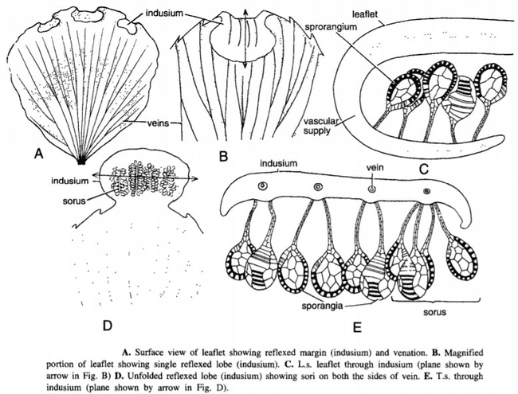

Slide 22
Reproduction
Adiantum is homosporous. The reproduction takes place by the production of spores. The spores are produced in sporangia. A group of sporangia forms sori. The sori are marginal but the reflex margins of the pinna form a protective membranous structure called false indusium. The development of sporangium is of leptosporangiate type.

Slide 23
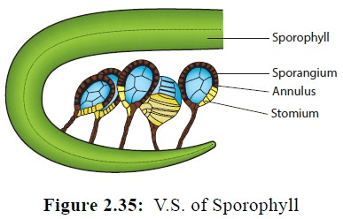

Slide 24
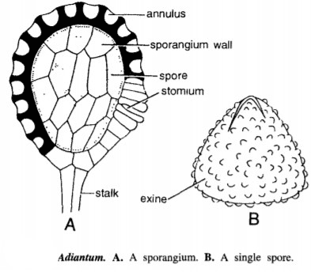

Slide 25
