Slide 1
Lab. 7
Sensory Examination
By: Fattma Z.Mohammed
M.Sc in Environmental Science & Pollution

Slide 2
Sensory Examination
Odor
Taste
Visibility
Color

Slide 3
Sensory examination takes place during the process of sampling, soon after samples are collected, because change can occur during transport and storage, some of the sample’s contents are susceptible to light, chemical reactions, or biological activities.
Sensory Examination Lab 7

Slide 4
The odor is tasted immediately after sampling. The odor strength may be designated as follow: Odor strength: very weak, weak, clear, strong, very strong Odor type: Earthy, mossy, peaty, musty, putrid, reminiscent of manure, fishy, aromatic, or characteristic of particular substance (E.G. Petrol or ammonia). Or qualitative involves smelling a half filed previously shaken bottle.
Sensory Examination Lab 6
Sensory Examination Lab 6
Odor:

Slide 5
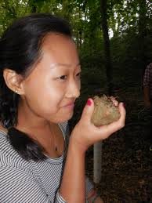
Sensory Examination Lab7

Slide 6
The color can be tested by viewing the sample in daylight, the designation is as follows: * colorless * very weakly colored * strongly colored The corresponding color tone is also given, e.g.: yellowish yellowish brown bwronish yellowish green…etc
Sensory Examination Lab7
Color:

Slide 7
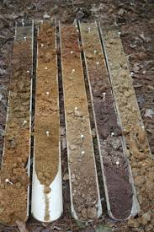
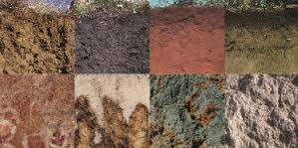
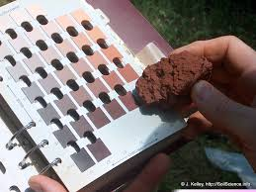
Sensory Examination Lab7

Slide 8
The taste examination is only done when there is certainty that the sample has no infectious bacteria or polluting substance in it. Taste sensation can be designated as follows: Tasteless Salty Bitter Alkaline Sour Astringent Metallic Repulsive The degree of taste may be differentiated by the terms: weak, clear, strong.
Sensory Examination Lab7
Taste:

Slide 9
Secchi disk used to estimate the degree of visibility in freshwater. It is a 20cm diameter circle marked in alternating quadrants of white and black. It is weighted on the bottom so it will sink, and has a rope that is marked in half meter segments.
Sensory Examination Lab 6
Visibility:

Slide 10
Clarity is measured using a Secchi disc attached to a tape measure. The disc is lowered into the water until it disappears; this depth is noted from the tape measure. The disc is lowered a little further and then slowly raised until it reappears, this depth is noted. The average of the two readings is the final Secchi depth visibility depth.
Sensory Examination Lab7

Slide 11
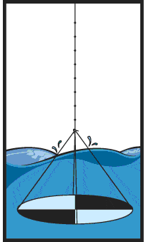
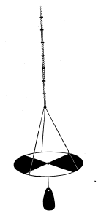
Figures showing visibility of water using Secchi disk
Sensory Examination Lab7
Secchi disc

Slide 12
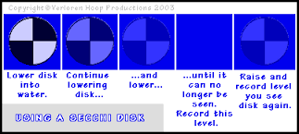
Sensory Examination Lab 6

Slide 13
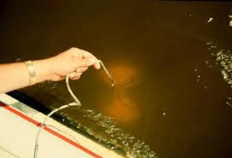
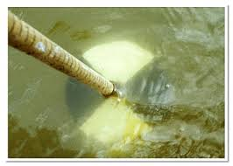
Figures Showing secchi disk
Sensory Examination Lab7

Slide 14
The simple test of turbidity involves filling a clean one litter (1L) glass container about 2/3 full with the water sample, shaking well and comparing against a black and then a white background. The following degrees of turbidity are determined: clear opalescent weakly turbid strongly turbid opaque
Sensory Examination Lab7
Turbidity

Slide 15
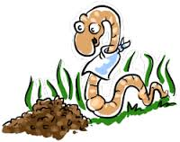
Go to the field, do the above test on soil and water sample, record your result with your team. We will compare the results of each team group in the lab.
Today’s practical part

Slide 16
Next Lab Soil Environment

