Slide 1
Phylum: Mollusca
1/class: Polyplacophora
Chiton sp.
1. Mostly marine, attached to rocks near the sea shore.
2. The body is oval in shape, convex above and flattened below.
3. The mantle covers whole of the dorsal side of the body.
4. The mantle with calcareous shell with eight (8) transverse plates.
5. The foot used for creeping and clinging.

Slide 2
Phylum: Mollusca
2/class: Gastropoda
1/order: Pulmonata
1/Sub-Order: Stylommatophora
1/Family: Helicidae
Helix sp. (The snail)
1. They are nocturnal, herbivorous.
2. The head and foot are not distinguished from each other.
3. Mouth is situated on the front surface the head.
4. The head with two pairs of hollow tentacles which located dorsally, the posterior one are longer than anterior and bearing on the top two eyes.
5. They are hermaphrodite.

Slide 3
Phylum: Mollusca
2/class: Gastropoda
1/order: Pulmonata
1/Sub-Order: Stylommatophora
2/Family: Limacidae
Limax sp. (The slug)
1. The mantle did not cover the whole body.
2. They live in a moist dark places.

Slide 4
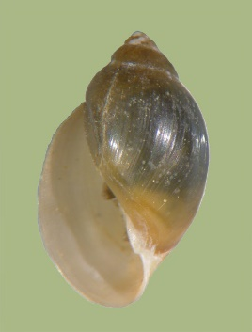
Phylum: Mollusca
2/class: Gastropoda
1/order: Pulmonata
2/Sub-Order: Basommatophora
1/Family: Physidae
Physa sp.
1. They are scavenger, feeding upon unprotected fish eggs and dead fishes.
2. Shell with acute spire.
3. The eyes situated on the base of filiform tentacles

Slide 5
Phylum: Mollusca
2/class: Gastropoda
2/order: Prosobranchiata
1/Sub-Order: Archaeogastropoda
1/Family: Acmaeidae
Acmaea sp.
1. The shell hat like, it is conical in shape and no spiral, smooth and rounded margins.
2. They produce thick mucus which enables to clamp tightly on to rock.
3. Have one gill.
4. Common on rocks in shallow water.

Slide 6
Phylum:: Mollusca
2/class: Gastropoda
2/order: Prosobranchiata
1/Sub-Order: Archaeogastropoda
2/Family: Trochidae
Trochus sp. (Turban shell)
1. Feeding on cyanobacteria, and diatoms.
2. The shell usually conical, it is shape like pyramid.
3. They have no gills

Slide 7
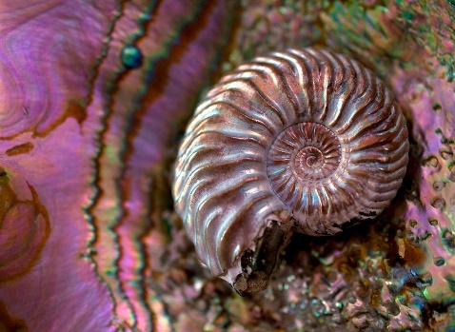
Phylum: Mollusca
2/class: Gastropoda
2/order: Prosobranchiata
1/Sub-Order: Archaeogastropoda
2/Family: Haliotidae
Haliotis sp. (The Abalones)
1. They are generally nocturnal and feeding on algae.
2. The shell ear like, with flat spiral.
3. The mantle has numerous papillae.
4. They have two gills.

Slide 8
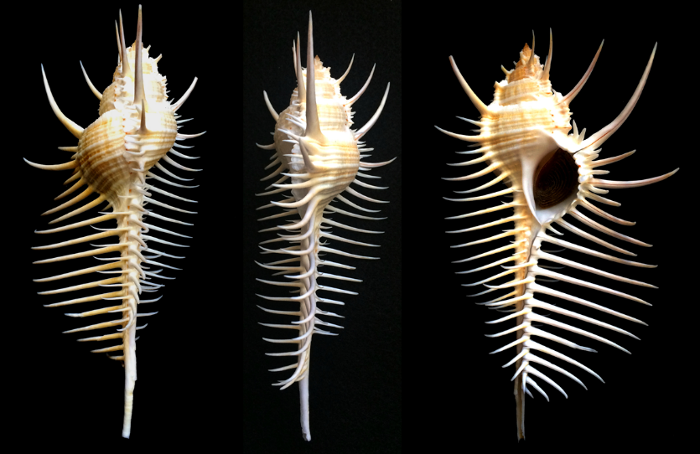
Phylum: Mollusca
2/class: Gastropoda
2/order: Prosobranchiata
2/Sub-Order: Neogastropoda
2/Family: Muricidae
Murex sp.
1. They are carnivorous.
2. The shell is spirally coiled and has a structure called shell siphon.
3. The foot is large and flat.
4. The head is prolonged like proboscis.

