Slide 1
Techniques used in the field of medicinal plants to preparation of crude drugs
Lec.
Salahaddin University-Erbil
College of Science
Chemistry Department
Phytochemistry
Presented by:
Asst. professor. Dr. Fuad O. Abdullah
Notes:
https://www.phytochemicals.info/phytochemicals.php

Slide 2
Techniques commonly used in the field of medicinal plant:
The main steps involved are:
Selection, plant collection and preparation
Extraction
Fractionation and isolation
Identification
Classification
Total synthesis

Slide 3
A. Selection and plant collection and preparation
Plant identification and collection (location, season, plant part, age, ……etc)
Cleaning
Drying
Spreading or hanging the material in shade (must be in the shade to avoid the effect of UV light on light sensitive compounds)
Oven drying
Freeze-drying

Slide 4
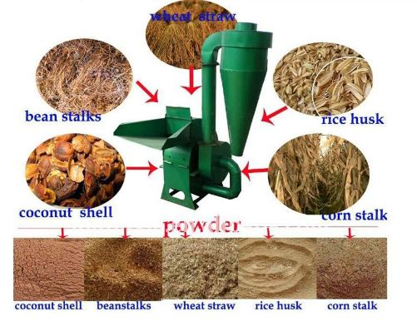
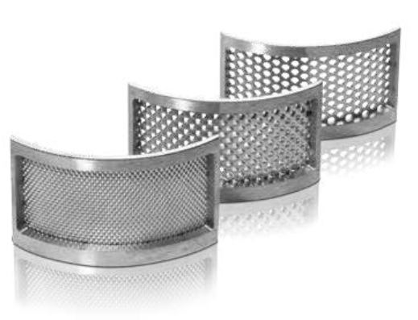
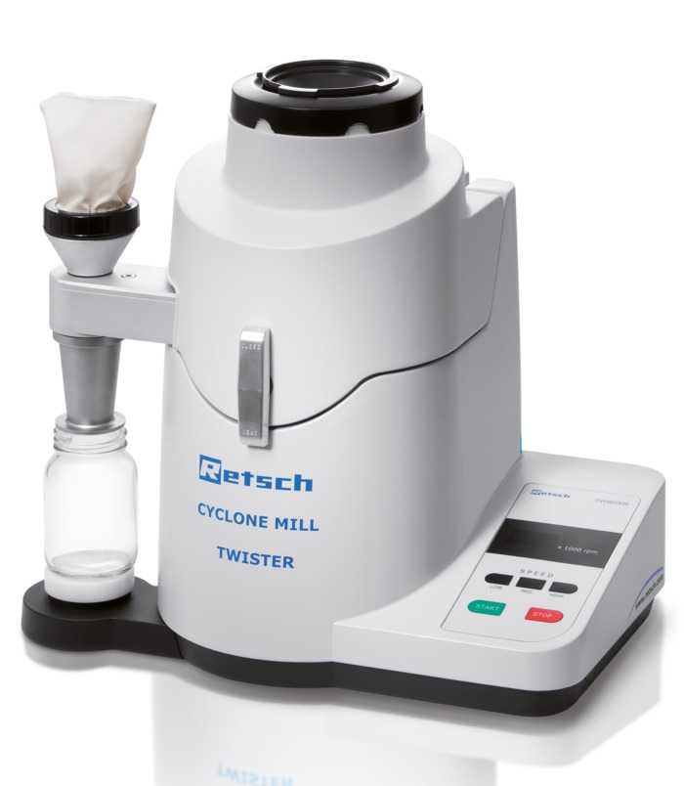
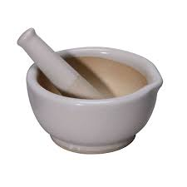
4. Grinding
Mortar and pestle
Mills
Grinders
Blenders
Sieves
Mortar and pestle
Cyclone mill

Slide 5
5. Sample storage
Depending on the compounds targeted in the analysis, plant samples are either
Used directly
Stored dried or frozen (usually -20ºC or other temperature below 0ºC)
With extra attention to volatile compounds.

Slide 6
Extraction
Extraction: is the first step for isolation of the bioactive compounds from natural sources.
Extraction: :Is the first and fundamental operation in natural product science, its aim is to separate the metabolites from the biological matrix which they are enclosed inside
So the question; what is an ideal extraction?
It depends on what compound(s) you are going to obtain. Are you isolating a special compound or special class of compound, or are you isolating all compounds in the material? Method and procedure are different in these cases.
Asst. Prof. Dr. Fuad : https://academics.su.edu.krd/fuad.abdullah
,

Slide 7
Choice of Solvent
You can use any kind of solvent. However, it has to be selected by consideration of the following two factors:.
1) Polarity: There is a rule in solubility “similar polarity between solvents and compounds produces the best fit”.
Asst. Prof. Dr. Fuad : https://academics.su.edu.krd/fuad.abdullah
,
Like dissolve like:
The amount of solute, which can dissolve in a given amount of solvent depends on the nature of the solute and solvent. In general, "Like dissolves like", describes the general principle of solubility (i.e. polar solvents dissolve polar solutes and non-polar solvents dissolve non-polar solutes).

Slide 8
n-Hexane
Petroleum ether
Ethyl ether
Dichloromethane
Chloroform
Ethyl acetate
Acetone
Acetonitrile
Isopropanol
Ethanol
Methanol
Water
lowest polarity
Fats, hydrocarbons, Steroids, carotenoids,……………….... etc
Polarity
Modest polar
Many classes
Asst. Prof. Dr. Fuad : https://academics.su.edu.krd/fuad.abdullah
,
Glycosylated compounds, Saponins, anthocyanins, terpenoids..................etc
highest polarity
Acidic water salt formation
alkaloids
Notes:
The amount of solute, which can dissolve in a given amount of solvent depends on the nature of the solute and solvent. In general, "Like dissolves like", describes the general principle of solubility (i.e. polar solvents dissolve polar solutes and non-polar solvents dissolve non-polar solutes).

Slide 9
2) Boiling point: Solvents can be removed by evaporation under reduced pressure. It is
recommendable to use the solvents of moderate bp 60-100˚C (in small scale) or 70-120˚C
Asst. Prof. Dr. Fuad : https://academics.su.edu.krd/fuad.abdullah
,
(in large scale), for concentration purpose. Water is not recommendable because of its low vapor pressure. Notice! Ether is very volatile, usually too volatile to use as a solvent of large scale extraction.

Slide 10
 In the extraction method the wanted components are dissolved by the use of selective solvents known as menstrum & undissolved part is a marc.
After the extraction unwanted matter is removed.
Extracts are prepared by using ethanol or other suitable solvent.
 Extract : Extracts can be defined as preparations of crude drugs which contain all the constituents which are soluble in the solvent.
Marc: Solid residue obtain after extraction
Menstruum: Solvent used for extraction
Dr. Fuad : https://academics.su.edu.krd/fuad.abdullah
,

Slide 11
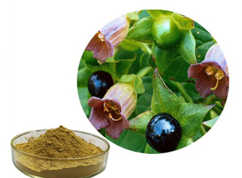
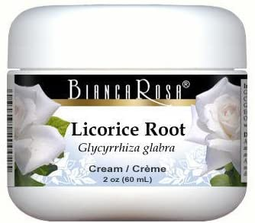
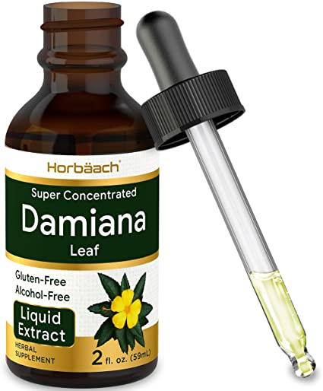
 Type of extracts:
Dry extract (Tab, cap.)
E.g. belladonna extract
Soft (Ointment, suppository)
E.g. glycerrhiza extract.
Liquid : As tincture.
Asst. Prof. Dr. Fuad : https://academics.su.edu.krd/fuad.abdullah
,
Notes:
Suppository: dastwr .. Ointment: malham is liquid

Slide 12
Mechanism of Extraction :
Asst. Prof. Dr. Fuad : https://academics.su.edu.krd/fuad.abdullah
,
solvent
Plant cell
2
1
3

Slide 13
➢ Dissolution of extractive substances out of disintegrated cells. ➢ Dissolution of extractive substances out of intact plant cell by diffusion (requires steeping and swelling)
Asst. Prof. Dr. Fuad : https://academics.su.edu.krd/fuad.abdullah
,
Penetration of the solvent into the plant cells and swelling of the cells.
Diffusion of the dissolved extractive substances out of the cell.
4
Notes:
Steeping: nshew swelling): awsaw Dissolution: darwxan

Slide 14
Plant constituents are usually contained inside the cells. Therefore, The solvent used for extraction must diffuse into the cell to dissolve the desired compounds whereupon the solution must pass the cell wall in the opposite direction and mix with the surrounding liquid
Asst. Prof. Dr. Fuad : https://academics.su.edu.krd/fuad.abdullah
,
An equilibrium is established between the solute inside the cells and the solvent surrounding the fragmented plant tissues
5

Slide 15
Factors affecting extraction process :
1. Nature of drug
2. Solvent
3. Temperature
4. pH
5. Particle size
Asst. Prof. Dr. Fuad : https://academics.su.edu.krd/fuad.abdullah
,
8

Slide 16
Desirable properties of extraction solvent
Efficiency
Low toxicity
Ease of removal
Low reactivity (not causing side reactions, complexation or dissociation of the extract components)
Availability and cost effectiveness

Slide 17
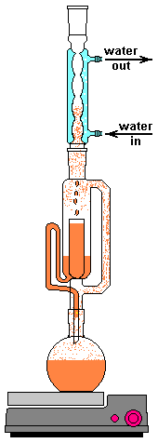
Extraction Techniques
Maceration (soaking): involves mixing the biomass with a suitable solvent in a closed container. The mixture is left overnight (with occasional stirring) and the extract is then strained and the processes is repeated. This approach is time consuming.
Maceration (continuous stirring)
Steam distillation
Soxhlet extraction:
Ultrasound-assisted extraction (Sonication)
Microwave-assisted extraction
Condenser
Sample held in thimble
Extraction solvent
Soxhlet

Slide 18
