Slide 1
Vector Calculus for Mathematics Department
Fuad Wahid
semester II
2023-2024

Slide 2
Lecturer-1 (Multiple Integral)
Double Integral

Slide 3
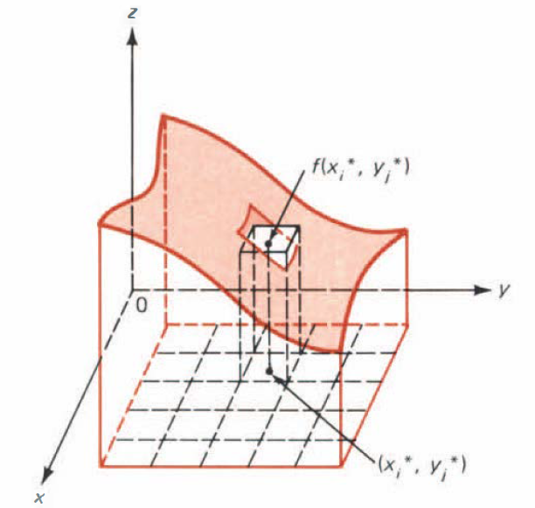
Vectors
Let consider a function $f$ of two variables such that $f(x,y)$ exists throughout a closed region $R$ in the $xy$-plane. Our objective is to define the double integral $\iint_{R}^{ }{f\left(x,y\right)dA}$.
Let $R$ denote the rectangle in $ℝ^{2}$ given by
$$R=\{\left(x,y\right):a≤x≤b and c≤y≤d\}$$
y
$$y=d$$
$$R$$
$$y=c$$
x
$$x=a$$
$$x=b$$

Slide 4
Estimate the volume under the surface and over each subrectangle. Then the volume $V_{ij}$ under the surface andover $R_{ij}$ is approximated by
$$V_{ij}≈f(x_{i}^{∗},y_{j}^{∗})∆x∆y=f(x_{i}^{∗},y_{j}^{∗})∆A$$
Where $∆A=∆x∆y$ is the area of $R_{ij}$. Since we are summing over two variables $i$ and $j$, we need two such signs:
$$V=\sum_{i=1}^{n}{\sum_{j=1}^{m}{V_{ij}}}=\sum_{i=1}^{n}{\sum_{j=1}^{m}{f(x_{i}^{∗},y_{j}^{∗})∆A }}$$
As $∆s→0$
$$V=\lim_{∆s→0}{ }\sum_{i=1}^{n}{\sum_{j=1}^{m}{f(x_{i}^{∗},y_{j}^{∗})∆A\text{.} }}$$

Slide 5
Definition 1 THE DOUBLE INTEGRAL Let $z=f(x,y)$ and let the rectangle $R$ be given. Let $∆A=∆x∆y$. Suppose that
$$\lim_{∆s→0}{ }\sum_{i=1}^{n}{\sum_{j=1}^{m}{f(x_{i}^{∗},y_{j}^{∗})∆A }}$$
exists and is independent of the way in which the points $(x_{i}^{∗},y_{j}^{∗})$ are chosen. Then the double integral of $f$ over $R$ , written ff $\iint_{R}^{ }{f(x,y)∆A}$, is defined by
$$\iint_{R}^{ }{f\left(x,y\right)dA}=\lim_{∆s→0}{ }\sum_{i=1}^{n}{\sum_{j=1}^{m}{f(x_{i}^{∗},y_{j}^{∗})∆A }}$$
If $\lim_{∆s→0}{ }\sum_{i=1}^{n}{\sum_{j=1}^{m}{f(x_{i}^{∗},y_{j}^{∗})∆A }}$exists, then the function $f$ is said to be integrable over $R$.

Slide 6
Definition 2 Let $f$ be a continuous function of two variables such that $f(x,y)≥0$ for every $(x,y)$in a region $R$. The volume $V$ of the solid that lies under the graph of $z=f(x,y)$ and over $R$ is
$$V=\iint_{R}^{ }{f\left(x,y\right)dA}$$
Some properties of double integrals that correspond to those given for definite integrals are listed, without proof, in the next theorem.
Theorem 1
$\iint_{R}^{ }{cf\left(x,y\right)dA}=c\iint_{R}^{ }{f\left(x,y\right)dA}$ for every real number $c$.
$\iint_{R}^{ }{[f\left(x,y\right)+g\left(x,y\right)]dA}=\iint_{R}^{ }{f\left(x,y\right)dA+\iint_{R}^{ }{ }g\left(x,y\right)dA}$

Slide 7
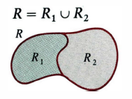
3. If $R$ is the union of two nonoverlapping regions $R_{1}$ and $R_{1}$.
$$\iint_{R}^{ }{f\left(x,y\right)dA}=\iint_{R_{1}}^{ }{f\left(x,y\right)dA}+\iint_{R_{2}}^{ }{f\left(x,y\right)dA}$$
4. If $f\left(x,y\right)≥0$ throughout $R$, then $\iint_{R}^{ }{f\left(x,y\right)dA}≥0.$

Slide 8
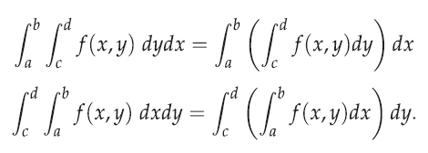
Evaluation of Double Integrals
Definition 3
Example 1: Evaluate $\int_{1}^{\frac{π}{2}}{\int_{0}^{1}{y\sin{x dy dx.}}}$
Example 2: Evaluate $\int_{1}^{4}{\int_{−1}^{2}{\left(2x+6x^{2}y\right)dydx.}}$
Example 3: Find the volume of the solid bounded above by the plane $z=4−x−x$ and below by the rectangle
$$R=\left\{\left(x,y\right):0≤x≤1 and 0≤y≤2\right\}.$$

Slide 9
Example 4: Calculate the volume of the region beneath the surface $z=xy^{2}+y^{3}$ and over the rectangle $R=\left\{\left(x,y\right):0≤x≤2 and 1≤y≤3\right\}.$
H.W: Evaluate the following integrals
$\int_{1}^{3}{\int_{2}^{4}{\left(40−2xy\right)dydx}}$
$\int_{1}^{2}{\int_{0}^{3}{\left(1+8xy\right)dxdy.}}$
Let $R$ denote the rectangle $\left\{\left(x,y\right):−1≤x≤0 and −2≤y≤3\right\}$. Calculate the double integrals
$\iint_{R}^{ }{(x+y)dA}$
$\iint_{R}^{ }{(y^{2}−x^{2})dA}$
$\iint_{R}^{ }{(3x^{2}−5y^{2})dA}$

Slide 10
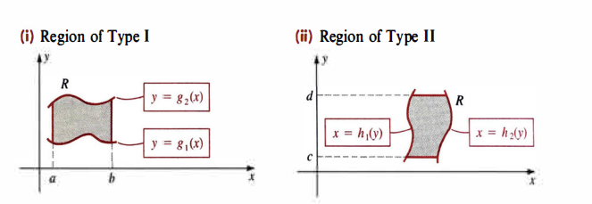
The two types of regions in which we will be most interested are illustrated in below figures, the functions $g_{1},g_{2}$ and $h_{1},h_{2}$are continuous on the intervals $[a,b]$and $\left[c,d\right],$ respectively, with $g_{1}(x)≤g_{2}(x)$ for every $x$ in $[a,b]$, and $h_{1}(y)≤h_{2}(y)$ for every $y$in $\left[c,d\right]$.

Slide 11
An iterated double integral may be defined over a nonrectangular region. In particular, suppose $f$ is continuous on a region $R$ of Type I or II.
We define iterated integrals off over the regions illustrated in (I) and (II) of the figure as follows.
Definition 4
Iterated Integrals:

Slide 12
Example 5: Find the volume of the solid under the surface$z=x^{2}+y^{2}$ and lying above the region $R=\left\{\left(x,y\right):0≤x≤1 and x^{2}≤y≤\sqrt{x}\right\}.$
Example 5: Let $f\left(x,y\right)=x^{2}y$. Calculate the integral of $f$ over the region bounded by the $x$-axis and the semicircle$x^{2}+y^{2}=4$ and $y≥0.$

Slide 13
REVERSING THE ORDER OF INTEGRATION
Gener­ally, the choice of the order of integration $dydx$ or $dxdy$ often depends on the form of $f(x,y)$ and the region $R$. Sometimes it is extremely dif­ficult, or even impossible, to evaluate a given iterated double integral.
However, by reversing the order of integration from $dydx$ to $dxdy$, or vice versa, it may be possible to find an equivalent iterated double in­tegral that can be easily evaluated.
Example 6: Evaluate $\int_{1}^{2}{\int_{1}^{x^{2}}{\frac{x}{y}dydx.}}$
Example 7: Compute $\int_{0}^{2}{\int_{y}^{2^{ }}{e^{x^{2}}dxdy.}}$
Example 8: Reverse the order of integration in the iterated integral $\int_{0}^{1}{\int_{\sqrt{y}}^{2^{ }}{e^{x^{2}}dxdy.}}$

Slide 14
Example 9: Evaluate $\iint_{R}^{ }{(4x+2)dA}$ where $R$ is the region enclosed by the curve $y=x^{2}$ and $y=2x$.

