Slide 1
Salahaddin University – Erbil
College of engineering / Mechanic & Mechatronic department
Electrochemical Machining
Prepared By : Dr. Gawhar Ibraheem Khidhir

Slide 2
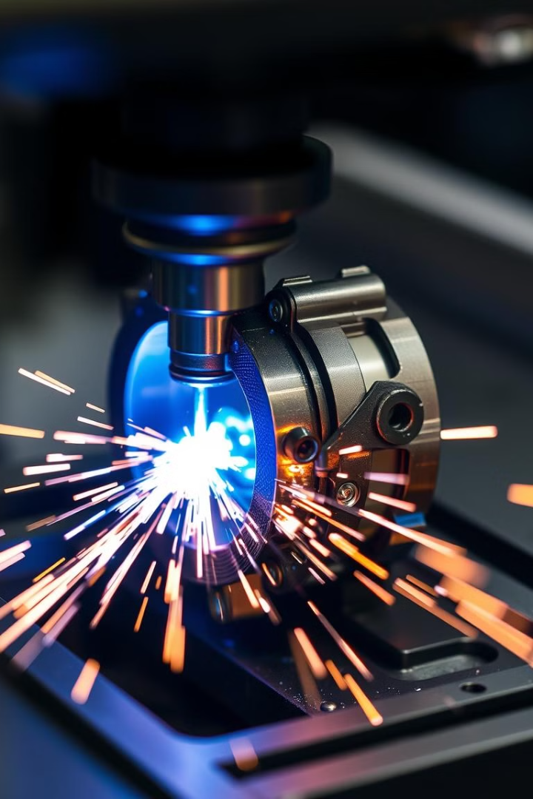
Electrochemical Machining: Precision Manufacturing at the Atomic Level
Electrochemical machining (ECM) is a cutting-edge manufacturing process that harnesses the power of electrochemistry to shape and finish metals with unprecedented precision. This non-traditional machining method offers unique advantages in producing complex geometries, working with hard-to-machine materials, and achieving superior surface finishes. As we delve into the world of ECM, we'll explore its principles, applications, and the transformative impact it's having on industries ranging from aerospace to medical device manufacturing.
by Ramadhan Salih

Slide 3
Fundamental Principles of Electrochemical Machining
1
Anodic Dissolution
The workpiece (anode) is connected to the positive terminal of a DC power supply. As current flows, metal atoms at the surface lose electrons and dissolve into the electrolyte solution.
2
Electrolyte Flow
A carefully controlled electrolyte solution is pumped between the workpiece and the tool (cathode). This electrolyte carries away the dissolved metal ions and maintains the electrochemical reaction.
3
Controlled Material Removal
The shape of the tool electrode and the path of its movement determine the final geometry of the workpiece. Precise control of current density, electrolyte composition, and flow rate ensures accurate material removal.
4
Finishing
As the process continues, the surface of the workpiece is smoothed to a high degree of finish, often eliminating the need for additional polishing steps.

