Slide 1
Casting Tecnology) Paert 1
Lecturer: Dr. Gawhar Ibraheem Khidhir
1.9.2022

Slide 2
Casting Processes
Casting is a process in which molten metal flows by gravity or other force into a mold where it solidifies in the shape of the mold cavity. The term casting is also applied to the part that is made by this process. It is one of the oldest shaping processes, dating back 6000 years. The principle of casting seems simple: melt the metal, pour it into a mold, and let it cool and solidify; yet there are many factors and variables that must be considered in order to accomplish a successful casting operation. Casting includes both the casting of ingots and the casting of shapes. The term ingot is usually associated with the primary metals industries; it describes a large casting that is simple in shape and intended for subsequent reshaping by processes such as rolling or forging. Ingot casting was discussed in Chapter 6. Shape casting involves the production of more complex geometries that are much closer to the final desired shape of the part or product. It is with the casting of shapes rather than ingots that this chapter and the next are concerned.
Fig.1
Classification of solidification processes.

Slide 3
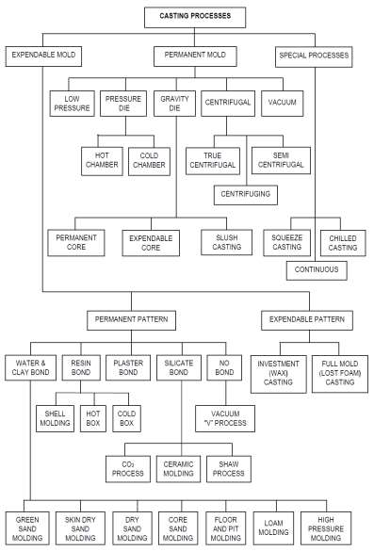
Fig.14 Hierarchical classification of various casting processes

Slide 4
Among its capabilities and advantages are the following:
1- Casting can be used to create complex part geometries, including both external and internal shapes.
2- Some casting processes are capable of producing parts to net shape. No further manufacturing operations are required to achieve the required geometry and dimensions of the parts. Other casting processes are near net shape, for which some additional shape processing is required (usually machining) in order to achieve accurate dimensions and details.
3- Casting can be used to produce very large parts. Castings weighing more than 100 tons have been made. The casting process can be performed on any metal that can be heated to the liquid state.
4-Some casting methods are quite suited to mass production.
Disadvantages:
There are also disadvantages associated with casting—different disadvantages for different casting methods. These include limitations on mechanical properties, porosity, poor dimensional accuracy and surface finish for some casting processes, safety hazards to humans when processing hot molten metals, and environmental problems.

Slide 5
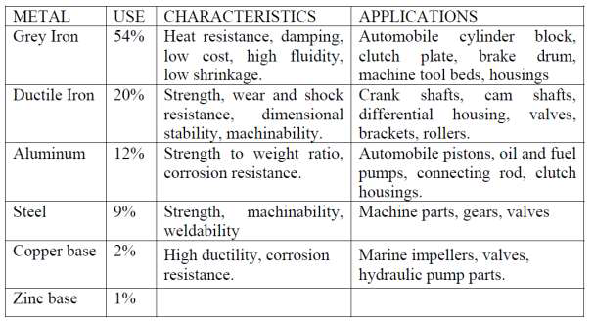
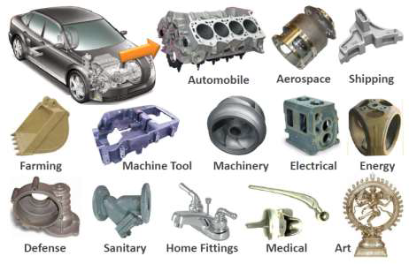
Applications, Metals
Parts made by casting processes range in size from small components weighing only a few ounces up to very large products weighing tons. The list of parts includes dental crowns, jewelry, statues, wood-burning stoves, engine blocks and heads for automotive vehicles, machine frames, railway wheels, frying pans, pipes, and pump housings. All varieties of metals can be cast, ferrous and nonferrous.
Casting can also be used on other materials such as polymers and ceramics; however,
the details are sufficiently different that we postpone discussion of the casting processes for these materials until later chapters. This chapter and the next deal exclusively with metal casting. Here we discuss the fundamentals that apply to virtually all casting operations. In the following chapter, the individual casting processes are described, along with some of the product design issues that must be considered when making parts out of castings.
Fig.1: Typical metal cast part

