Slide 1
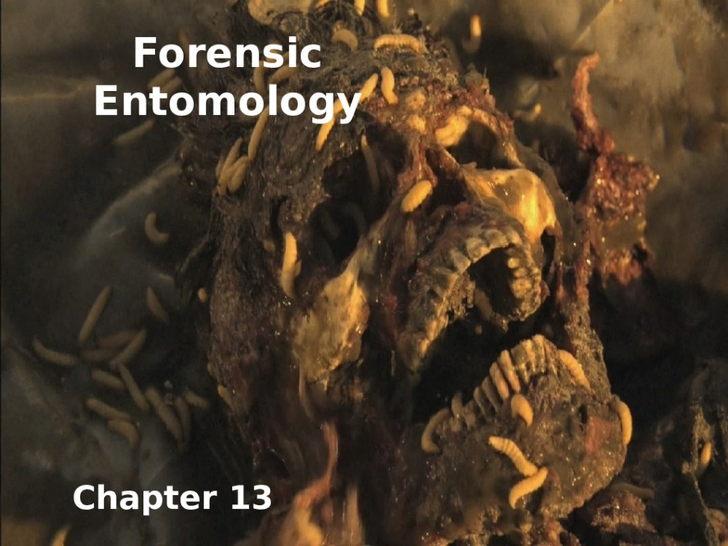
Plant protection
Elective - Forensic insects
Stage- 4th
Lecture 7
12/5/2021
Dr. Gazang Tahier Omar

Slide 2
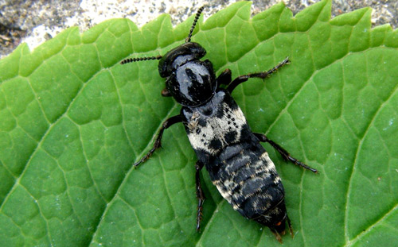
Early to Late Stage Decomposition
Family:
1- Staphlinidae
The rove beetles are a family (Staphylinidae) of beetles primarily distinguished by their short elytra (wing covers) that typically leave more than half of their abdominal segments exposed. With roughly 63,000 species in thousands of genera, the group is currently recognized as the largest extant family of organisms. It is an ancient group, with fossilized rove beetles known from the Triassic, 200 million years ago.
Examples of family
The hairy rove beetle, Creophilus maxillosus (Linnaeus)
Distribution
Hairy rove beetles are globally distributed and occur primarily in the Northern Hemisphere, where they occupy various habitats, including open fields, forests, coastal areas, and occasionally residential areas . Creophilus maxillosus occurs on nearly every continent. New populations have recently been confirmed in Peru and Iraq, and tropical islands such as . They are commonly encountered throughout Europe and parts of Asia . Hairy rove beetles can generally be found wherever carcasses containing maggots appear in suitable habitats.

Slide 3
Description:
Eggs: Eggs are typically laid on carrion. They are milky white in color, and approximately 2 -3 mm in length. Eggs usually take three days to hatch.
Larvae: passes through three instars for an entire larval stage lasting approximately 14 days. Body length third instars are 15 to 25 mm(slightly longer than the adult) . Hairy rove beetle larvae are brown to black with stout, cylindrical bodies Like most other rove beetles, hairy rove beetle larvae are active predators and have well-developed legs for walking. In addition, the head, thorax, and first few abdominal segments of the larva’s body are highly sclerotized, while the distal portion of the abdomen is weakly sclerotized .
Adult:
a-Vary between 12-23 mm in length and is therefore.
b-Yellowish gray setae found on the second and third (and sometimes fourth) abdominal segments, as well as on the elytra where they form wide bands that encircle the abdomen.
c-The antennae are composed of eleven antennomeres. In addition.
d- Has a strong pair of mandibles, which it utilizes for preying on maggots and scavenging on carrion.
e- Dorso-ventrally flattened.
f-Short elytra leave the distal 6 to 7 segments of the abdomen exposed.
g- The abdomen is very muscular and flexible, which is useful for quickly rolling into a defensive posture.

Slide 4
Figure 1. Dorsal view of adult hairy rove beetle, Creophilus maxillosus (Lin
Forensic Importance:
Carrion-feeding rove beetles, are valuable tools in forensics. Knowledge of the hairy rove beetle’s life cycle allows forensic entomologists to determine
1-ecological succession,
2- subsequently, the post-mortem interval (PMI) of a cadaver depending on the geospatial location, environmental conditions (i.e. temperature and humidity), and type of dead organism. During warm summer months, adult hairy rove beetles can inhabit a corpse as early as two days after death, with incubation time lasting five days. The presence of larvae, in conjunction with adult absence, indicates a much later PMI.

Slide 5
2-Family :Histeridae
Is a family of beetles commonly known as clown beetles or Hister beetles. This very diverse group of beetles contains 3,900 species found worldwide. They can be easily identified by their 1-Shortened elytra that leaves two of the seven tergites exposed
2- Geniculate (elbowed) antennae with clubbed ends. These predatory feeders. Hister beetles have proved useful during forensic investigations to help in time of death estimation.
Distribution:
Hister beetles are found throughout the world in various habitats. Histeridae have been located in North America, Central America, Europe, Asia, and Australia. The beetles live in dung, carrion, dead vegetation, sandy areas, under tree bark, mammal burrows, and ant/termite colonies. Characteristics of the Hister beetle are dependent upon its habitat. For example, the flat Hister beetles are found under bark, while the cylindrical beetles are not.
Importance in forensics:
Flesh eating insects arrive at the dead body within a few hours. Certain species of the Hister beetles follow shortly behind and prey on the maggots and other arthropods present. The Hister beetle is more prevalent in Spring and Summer.The family, Histeridae, is very diverse, so different species can be found on the body at different times because of their various feeding habits. This needs to be noted when examining a dead body. They are predacious beetles and arrive when there is material to feed on, like other beetles or maggots. They do not actually feed on the carrion. For example, Hister quadrinotatus and arrive to feed when the carrion is bloat to dry (full of maggots to no maggots). In contrast, Saprinus pennsylvanicus arrive at the body first, when it is fresh to late (beginning of decomposition to advanced decomposition).

Slide 6
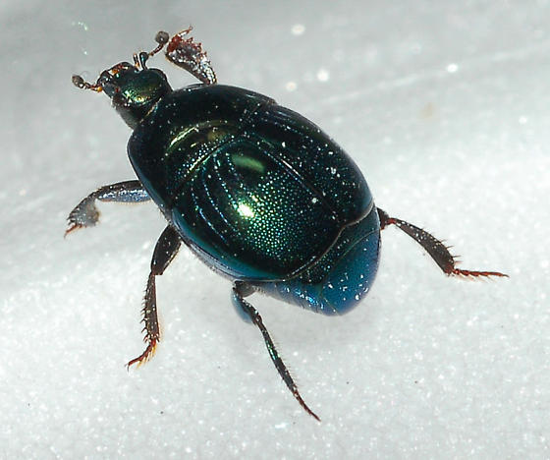
General Description:
Egg: The eggs of most species are off-white and oval in shape.
Larval:The larval stage of the beetle typically goes through two instars, the second instars the longest stage of its entire development, taking up 39% of the overall development time. The larval form of the insect will range in length from three millimeters to several centimeters. There is some pigmentation around the body and it is horizontally segmented. The legs are short and do not help much in locomotion. They move mostly through muscular contraction.
Pupal;
The pupal form of the beetle is similar in appearance to the adult form. They have outer cells produced in the larval stages. While they pupate they breathe through spiracles on the abdomen. The beetle is non-feeding and immobile in this stage, as their internal structure is breaking down and rebuilding to its adult form. Under good temperature conditions the Hister beetle will stay in the pupal stage for about a week.
Saprinus pennsylvanicus

Slide 7
Late Stage Decomposition
1-Family: (Cleridae)
Ham & Checkered Beetles (Cleridae)
They are commonly known as checkered beetles. The family Cleridae has a worldwide distribution, and a variety of habitats and feeding preferences. Most genera are predaceous and feed on other beetles and larvae; however other genera are scavengers or pollen feeders.
Example for the Family: red-legged ham beetle, Necrobia rufipes
Description:
Egg: banana-shaped, slightly curved, smooth, shiny, somewhat translucent and stick to the surface. After a few days, the pigmentation of the embryonic eyes and mouthparts and the ends of the body becomes visible.
larva: elongated and moderately hairy. You have three jointed pairs of legs. Only the head, the legs, the upper side of the first breast segment and the first abdomen segment and part of the last abdomen segment are sclerotized and brown,. The end of the abdomen has a pair of pincers-shaped appendages., In the last stage, the larva reaches a length of ten millimeters. larvae can move relatively quickly. As a rule, three to four larval stages can be distinguished.
Pupa: the larvae crawl into crevices in the substrate or they leave the substrate and crawl nearby. Then they make a cocoon, which takes about a day. Pre-pupal stage and pupal stage are about the same length, together an average of 13 days

Slide 8
Adult: a species of predatory beetle, 3.5–7.0mm long, convex, straight sided, and the surface has indentations called punctures. They are shiny metallic green or greenish blue. The legs and antennae are red (dark clubs). They feed on the meat-infesting larvae of Calliphora or blow flies, Dermestidae and Piophilidae. The adults are surface feeders; the larvae bore into dry or smoked meats and do most damage. The red-legged ham beetle also attacks bones, hides, copra, dried egg, cheese, bone meal, dried figs, Necrobia rufipes has been recorded in Egyptian mummies and were once known as Necrobia mumiarum
Distribution: The species is distributed worldwide today. Originally it probably comes from the tropics. The specimen for the first description comes from Suriname in South America.
Importance in forensics: Since clerids are predaceous in nature, they have been found feeding on fly larvae as well as the skin and bones of carrion Most clerids are not useful in forensics because of their food choice, but some species such as Necrobia rufipes can be useful. Necrobia rufipes is attracted towards carrion in the later stages of decomposition, so its arrival on carrion can help provide an estimate for the post-mortem interval or PMI.

Slide 9
2- Family: Dermestidae
Commonly referred to as skin beetles. Other common names include larder beetle, hide or leather beetles, carpet beetles, and khapra beetles. Dermestids have a variety of habits; most genera are scavengers that feed on dry animal or plant material, such as skin or pollen, animal hair, feathers, dead insects and natural fibers. Members of Dermestes are found in animal carcasses, while others may be found in mammal, bird, bee, or wasp nests. These beetles are significant in forensic entomology. Some species are associated with decaying carcasses
Example for family:
Hide beetle Dermestes maculatus DeGeer1
Distrbution:Cosmopolitan , native throughout the continental United States and Canada, and also Hawaii. It is also known to occur in Oceania, southeast Asia, and Erop.
Description:
Eggs Dermestes maculatus eggs are typically laid in batches of three to 20
Larvae The bodies of the larvae are covered in rows of hairs of different lengths, called setae. Ventral is typically yellowish-brown, dorsal surface is typically dark brown, usually with a central yellow line. Two long horn-like protrusions are located on the upper surface of the last segment.
Pupae :The pupae are an oval shape, usually smaller than the larvae, and do not have the many long hair-like projections
Adults: Length 5.5 to 10.0 mm. Each side of the thorax has a band of white hairs. The underside of the abdomen is primarily white with black spots at the sides, and a large black patch on the last segment. The elytra are dark brown or black, with black, yellow, or white hairs. The antennae are short, with a club segmente at the tip.

