Slide 1
Insect Structures
Lect. 11-Grade 2-Dr. Gazang T. Omar
Circulatory system:
Insects, like all other arthropods, have an open circulatory system which blood (usually called hemolymph) spends much of its time flowing within body cavities which is know as the haemocoel.
where it makes direct contact with all internal tissues and organs. Insect blood (called hemolymph) has no respiratory pigment or hemoglobin. Respiration is carried out by the tracheal system.
Circulatory System Function
1-Move circulatory fluid (blood) around body
2-Gas Transport
3-Nutrient Transport
4-Excretory Product Transport
5-Cell Signal Transport
6-Hydraulic Force
7-Heat Conductance
8-Defense
9-Wound healing

Slide 2
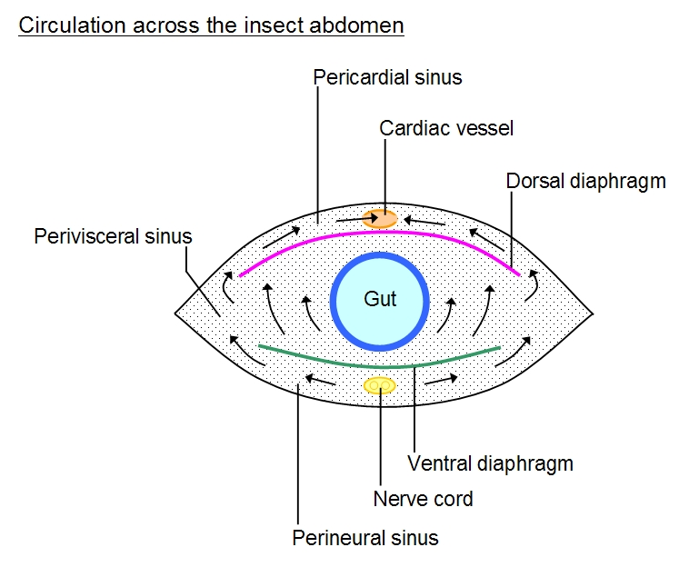
Circulatory System Function
Move circulatory fluid (blood) around body
Gas Transport
Nutrient Transport
Excretory Product Transport
Cell Signal Transport
Hydraulic Force
Heat Conductance
Immunity
Defense
- Wound healind
Structure
Insects have an open blood system with the blood occupying the general body cavity, which is known as a hemocoel. Blood is circulated mainly by the activity of a contractile dorsal longitudinal vessel which opens into the hemocoel. The hemocoel is often divided into three major sinuses; (called blood sinuses)
by two thin sheets of muscle and/or membrane known as the dorsal and ventral diaphragms. The dorsal diaphragm is formed by alary muscles of the heart and related structures
1- Dorsal pericardial sinus,
2- Perivisceral sinus,
3- a ventral perineural sinus . The pericardial and perineural sinuses are separated from the visceral sinus by the dorsal and ventral diaphragms, respectively. In most insects, the visceral sinus occupies most of the body cavity.
.

Slide 3
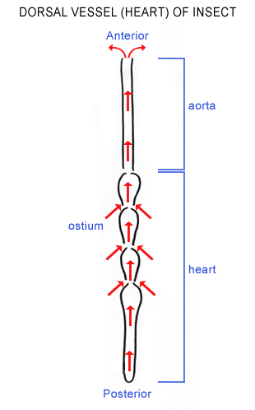
1. Dorsal vessel
dorsal vessel The only closed portion of the circulatory system is a tube that extends the length of the body from the posterior end of the abdomen into the head . Within the head, it passes under the brain just above the digestive tract, and then opens anteriorly. The dorsal vessel is not a uniform tube but consists of two segments, the heart and aorta, which are formed during embryogenesis from the cardioblasts of the embryonic mesoderm .
1- In the abdomen, the dorsal vessel is called the heart. It is divided segmentally into chambers that are separated by valves (ostia) to ensure one-way flow of hemolymph
2-The aorta, the anterior portion of the dorsal vessel, extends from the thorax into the head. It is a simple unbranched tube that is thinner than the heart and lacks ostia. It is often attached to the brain and pharynx by connective tissue, passing underneath the brain and opening behind the pharynx.

Slide 4
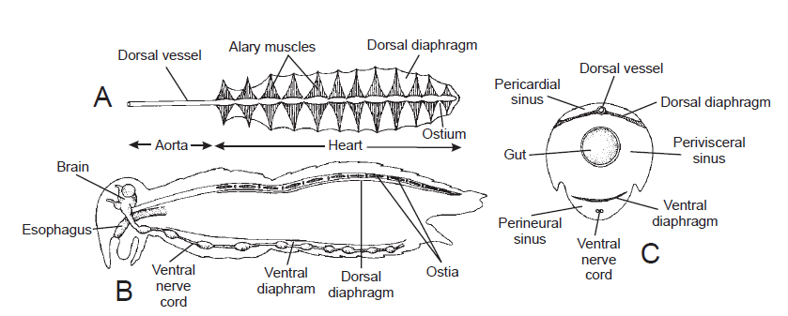
Alary muscles and dorsal diaphragm
The dorsal diaphragm is a fenestrated connective tissue membrane. It is usually incomplete laterally, so that the pericardial sinus above it is broadly continuous with the perivisceral sinus below. The lateral limits of the diaphragm are indefinite and are determined by the presence of muscles, tracheae or the origins of the alary muscles which form an integral part of the diaphragm. The alary muscles stretch from one side of the body to the other just below the heart. They usually fan out from a restricted point of origin on the tergum and meet in a broad zone in the midline. Some of the connective tissue fibers form a plexus which extends to the heart wall. Orthopteroids may have as many as ten abdominal and two thoracic pairs of alary muscles, but in other insects the number is reduced. Most terrestrial Heteroptera, for instance, have from four to seven pairs. The alary muscles are visceral muscles with 10–12 thin filaments to every thick filament

Slide 5
Ventral diaphragm
-The ventral diaphragm is a horizontal septum just above the nerve cord cutting off the perineural sinus from the main perivisceral sinus .
-It is present in both larvae and adults of Odonata, Blattodea, Orthoptera, Neuroptera (lacewings) and Hymenoptera, but is only found in adults of Mecoptera (scorpion flies), Lepidoptera and nematocerous Diptera. In Lepidoptera.
-The structure of the diaphragm varies. For instance, in the thorax of grasshoppers it is a delicate membrane with little or no muscle, but in the abdomen it becomes a solid muscular sheet.
-Laterally it is attached to the sternites, usually at one point in each segment .

Slide 7
Hemolymph Composition:
Plasma is about 90% of insect hemolymph, a watery fluid -- usually clear, but sometimes greenish or yellowish in color. It contains relatively high concentrations of amino acids, proteins, sugars, and inorganic ions. It’s important in transporting nutrients, hormones, and wastes. It's an important site for storage of metabolites, Heat transfer and protection (produces or sequesters distasteful compounds).
Hemocytes are the remaining 10% of hemolymph volume is made up of various cell types;
With the exception of a few aquatic midges, insect hemolymph does NOT contain hemoglobin (or red blood cells). Oxygen is delivered by the tracheal system, not the circulatory system.
Hemocytes functions:
1-Coagulation: rapid formation of fine granular ppt that can enmesh cells
2-Wound Healing: plasmocytes undergo mitosis with wounds
3-Detoxification: some have ability to detoxify metabolites
4-Phagocytosis: ability to ingest foreign particles
5-Encapsulation: flatten out and surround (encapsulate) object in several layers of hemocytes

Slide 8
Types of hemocytes
the following types are recognized inmany insects:
1- The prohemocyte: the stem cell, from which other hemocytes are derived. The prohemocyte is a small cell with very little cytoplasm.
2- The granulocyte: a phagocytically active, adherent cell type that contains large numbers of intracellular granules.
3- The plasmatocyte: a large cell type that is strongly adherent and spreads across foreign surfaces (for example, to glass slides).
4-The oenocytoid: a non-adherent cell that is defined functionally as constitutively containing phenoloxidase activity.
5- The spherule: cells with large, refractile spherules in the cytoplasm and that contain cuticular components.

Slide 10
Accessory pulsatile organs
In addition to the dorsal vessel, insects have other pulsating structure connected with the haemocoel that maintain circulation through the appendages. The haemolymph is circulated to the appendages unidirectionally with the aid of muscular pumps or accessory pulsatile organs which are usually found at the base of the antennae or wings and sometimes in the legs. Pumping rate accelerates due to periods of increased activity
1-Wing pulsatile organ
A blood space, beneath the posterior part of the tergum which is completely isolated from the remaining hemocoel of the thorax. It connect with the posterior veins of the wing via the axillary cord of the wing. The ventral wall of the reservoir forms a muscular pump. It may be derived from the heart, or maybe a separate structure. The pulsatile organs work with the heart beat in some insects, so when heart pump blood forward the pulsatile organ pump the blood through the wing veins and verse versa.
2-Antennal pulsatile organ
A pulsatile organ is also found at the base of each antenna. It consists of an ampulla from which a fine tube extends almost to the tip of the antenna. In most insects, compression , which derives hemolymph into antenna, results from the activity of muscle on both side of the wall of the ampulla.
3-Leg pulsatile organ
Most insects have a longitudinal septum in the legs which divide the lumen into two sinuses and permits a bidirectional flow of blood within the leg. When muscle contracts, it compresses one sinus, forcing hemolymph into the thorax, and at the same time enlarge. In insect lacking leg pulsatile organ, the flow of blood through the legs is thought to be maintained by pressure difference.

Slide 11
The Nervous System
An insect's nervous system is a network of specialized cells (called neurons). These cells generate electrical action that travel as waves of depolarization along the cell's membrane. Every neuron has a nerve cell body and filament-like processes (dendrites, axons) that propagate the action potential. Signal transmission is always unidirectional: moving toward the nerve cell body along a dendrite and away from the nerve cell body along an axon.
Neurons are usually divided into three categories, depending on their function within the nervous system:
1-Afferent (sensory) neurons: these bipolar or multipolar cells have dendrites that are associated with sense organs, always carry information toward the central nervous system.
2-Efferent (motor) neurons: unipolar cells that conduct signals away from the central nervous system and stimulate responses in muscles and glands.
3-Internuncial (association) neurons: unipolar cells that conduct signals within the central nervous system.
Individual nerve cells connect with one another through special junctions, called synapses. When a nerve impulse reaches the synapse, it releases a chemical messenger (neurotransmitter substance) that diffuses across the synapse such as Acetylcholine, dopamine, and noradrenaline. Nerve cells are typically found grouped in bundles.
-A nerve is simply a bundle of dendrites or axons that serve the same part of the body.
A ganglion is a dense cluster of interconnected neurons that process sensory information or control motor outputs.

Slide 12
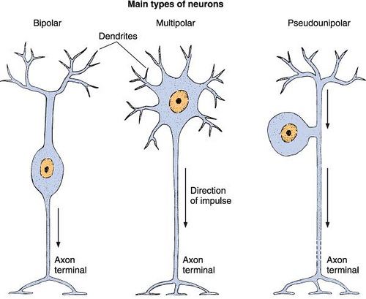
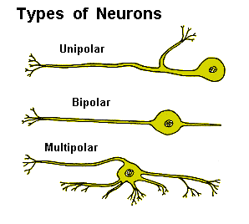

Slide 13
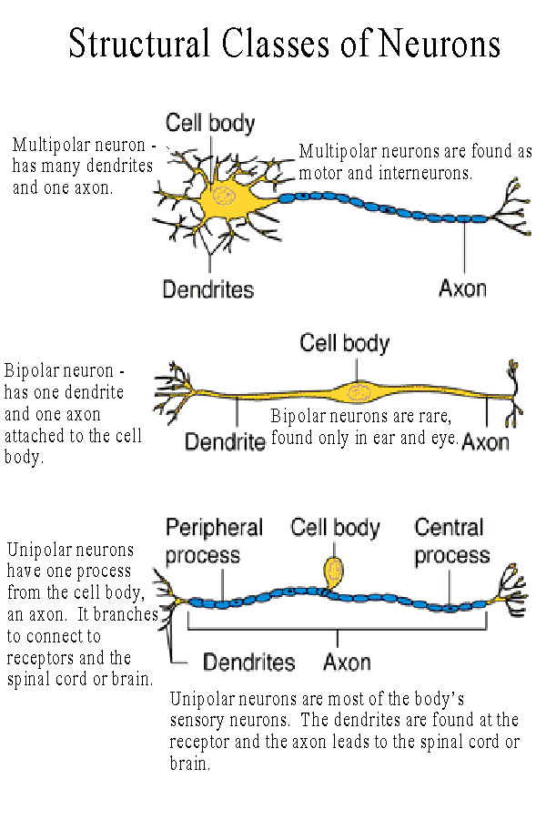

Slide 14
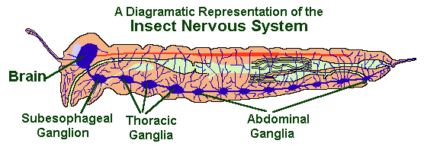
The Central Nervous System
Like most other arthropods, insects have a relatively simple central nervous system with a dorsal brain linked to a ventral nerve cord that consists of paired segmental ganglia running along the ventral midline of the thorax and abdomen.
brain is a complex of six fused ganglia (three pairs) located dorsally within the head capsule.
Dorsally Fused ganglia 1-Protocerebrum:The first pair of ganglia are largely associated with vision; they innervate the compound eyes and ocelli. 2-Deutocerebrum:The second pair of ganglia process sensory information collected by the antennae. 3-Tritocerebrum: The third pair of ganglia innervates the labrum and integrates sensory inputs from proto- and deutocerebrums.

Slide 15
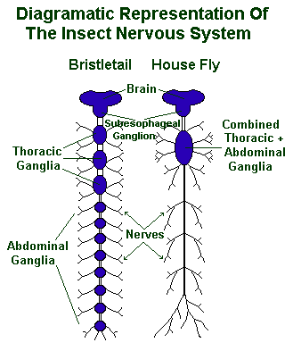
ventrally in the head capsule (just below the brain and esophagus) there is another complex of fused ganglia (called the subesophageal ganglion. In modern insects, the subesophageal ganglion innervates not only mandibles, maxillae, and labium, but also the hypopharynx, salivary glands, and neck muscles.
1-Thoracic ganglia In the thorax, three pairs (sometimes fused) control locomotion by innervating the legs and wings. Thoracic muscles and sensory receptors are also associated with these ganglia.
2- abdominal ganglia control movements of abdominal muscles. Spiracles in both the thorax and abdomen are controlled by a pair of lateral nerves that arise from each segmental ganglion.
caudal ganglion: A pair of terminal abdominal ganglia, innervate the anus, internal and external genitalia, and sensory receptors and cerci, and located on the insect's back end.
In the most basic design there are usually 3 thoracic ganglia and 8 abdominal ganglia but in most of the higher insects some of abdominal ganglia have been lost, or become fused with those nearer the head.

Slide 16
The Stomodaeal Nervous System:
An insect's internal organs are largely innervated by a stomodaeal (or stomatogastric) nervous system.
1-A pair of frontal nerves: arises near the base of the tritocerebrum link the brain with a frontal ganglion (unpaired) on the anterior wall of the esophagus. This ganglion innervates the pharynx and muscles associated with swallowing.
2- A recurrent nerve: along the anterio-dorsal surface of the foregut connects the frontal ganglion with a hypocerebral ganglion that innervates the heart, corpora cardiaca, and portions of the foregut.
3-Gastric nerves: arising from the hypocerebral ganglion run posteriorly to ingluvial ganglia (paired) in the abdomen that innervates the hind gut.
In comparison to vertebrates, an insect's nervous system is far more de-centralized. Most overt behavior (e.g. feeding, locomotion, mating, etc.) is integrated and controlled by segmental ganglia instead of the brain. In some cases, the brain may stimulate or inhibit activity in segmental ganglia but these signals are not essential for survival. Indeed, a headless insect may survive for days or weeks (until it dies of starvation or dehydration).

