Slide 1
Insect Structures
Lect. 9-Grade 2-Dr. Gazang T. Omar
Digestive system:
Insects may be phytophagous, entomophagous, wood borers, wool feeders or saprophytic, mainly feeding on the solid food material which may be a plant part or host tissue or wood etc.
If the food ingested in a liquid form, it may be a plant sap or nectar or blood
Based on the food material ingested, there are structural modifications in the digestive system of insects
Insects having the habit of feeding on the solid food material, possess the biting and chewing type of mouth parts where as sap feeding ones have sucking type. Sap suckers possess a filter chamber and solid feeders have well developed gizzard.
-The alimentary canal in insects extends from mouth to anus which is divided in to an anterior stomodaeum (foregut), middle midgut (mesenteron or stomach or ventriculus) and posterior hindgut (proctodaeum).
- The foregut and hindgut are ectodermal in origin where as the midgut is endodermal in origin.
- Compared to the carnivores (or) sap suckers, the phytophagous solid feeders possess longer alimentary canal. Alimentary canal is divided into 3 parts.

Slide 2
1) Foregut: It is the anterior part of the alimentary canal which starts with the mouth cavity and ends with the gizzard (or) proventriculus. The mouth cavity is formed by the labrum as upper lip, labium as lower lip with mandibles and maxillae laterally and hypopharynx at the center. At the base of the hypopharynx, salivary glands open into the mouth cavity. It is divided in to.
1-Pharynx: It is the region between the mouth and oesophagus.
2-Oesophagus: it is a narrow part of the foregut through which the food get transported from pharynx into the crop.
3-Crop: It is a sac like structure which is a dilated form and mainly serves the purpose of storage of food material.
4-Gizzard (proventriculus): It is a small constricted part of the alimentary canal which consists of the cuticular intima layer modified in to a teeth like denticles that help for grinding the food material. After gizzard the foregut forms into a stomodeal valve which is surrounded by gastric (or) hepatic caeca, which may vary from 5-6 in number.Internally foregut consists of the following layers.
1- Inner most intima layer
2- Epithelial cells
3- Basement membrane
4- Longitudinal muscles and Circular muscles

Slide 3
Fig. Proventriculus (Foregut)

Slide 4
2) Midgut (Mesenteron or stomach)
Midgut is a short, straight tube in case of primitive insects or a sac or may be piriform or fusiform in shape in caterpillars.Structurally midgut consists of
1-Inner peritrophic membrane: secreted by the epithelial cells , The peritrophic membrane protects the tender epithelial cells of the midgut from abrasion by hard food particles as no mucous is secreted in insects that feed on the solid food material. forms a coat over the food particles.This layer is said to be permeable to the digestive enzymes and the products of digestion. It is absent in case of sap sucking insects
2-A layer of epithelial cells: The epithelial layer of midgut consists of 3 types of cells
1) Columnar cells: These are columnar in shape, arranged in a brush border (or) honey comb border.
2) Regenerative cells: These epithelial cells are involved in the production of new cells to replace the whole columnar cells involved in holocrine secretion of enzymes.
3) Goblet cells: Mainly serve for storage and excretion.
3-Basement membrane
4- Circular muscles and Longitudinal muscles
.

Slide 5
3. Hindgut
It is also known as proctodaeum which is lined inside by intima. It is more permeable than that of the foregut. Anterior end of the hindgut can be marked by the presence of a set of malpighian tubules and a pyloric valve. Internally hindgut has same structure as that of the foregut.
Hind gut consists of :
1.Ileum :is a small intestine (or) tube like structure and appears as a pouch in scarabids.
2.Colon: may (or) may not be present and if present, it leads to rectum.
3.Rectum:The epithelial cells of the rectum may sometimes get differentiated into rectal papillae (or) pads which vary in number from 3-6. These are involved in reabsorption of water, salts from the fecal matter.

Slide 6
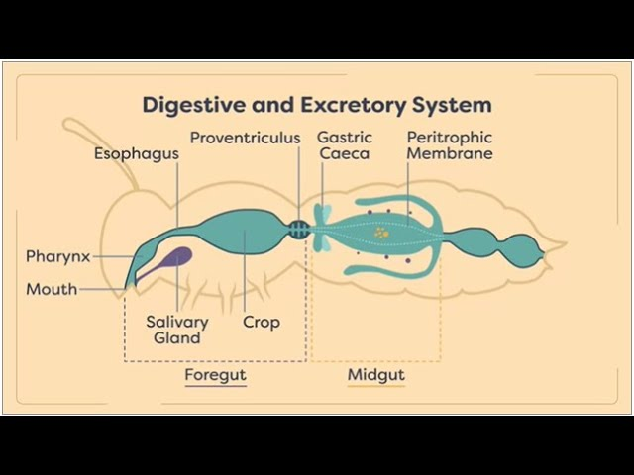

Slide 7
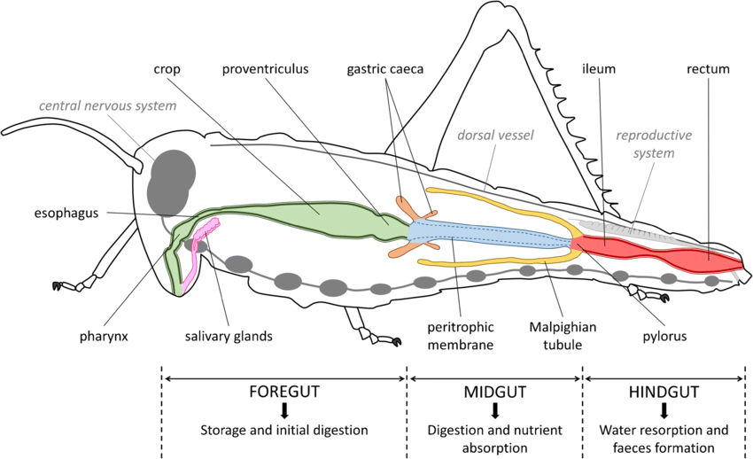

Slide 8
Process of digestion:
The food ingested by the insects through the mouth cavity enters into the alimentary canal, get digested and the undigested waste material is excreted through anus. During this process, food material is broken down into small particles that can be readily absorbed by the cells of the midgut and hindgut. Digestion mainly takes place in 5 steps.
1. Ingestion : Food is partially digested in the oral cavity with the help of salivary enzymes. In insects like fluid feeders, carnivorous blowfly larvae etc, digestion occurs outside the intestine by a process called extra intestinal (or) extra oral digestion .
2. Transportation : The food material entered in to the oesophagus is transported in to the crop by muscular activity i.e. by peristatic movements. Food moves continuously from oesophagus in to the crop where it is stored. From the crop, food enters in to the gizzard where it is still broken in to very minute particles with the help of denticles or the cuticular teeth.
3. Digestion: From the gizzard through the stomodeal valve, food passes in to the midgut where actually digestion starts. The epithelial cells produce enzymes

Slide 9
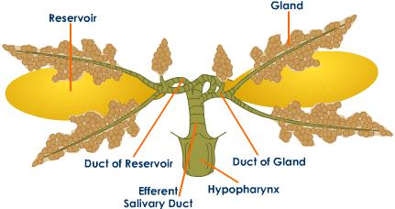
4. Absorption: Midgut epithelial cells absorb the nutrients from the digested food and pass the fecal matter and undigested food material in to the hindgut.
The Malpighian tubules maintain ionic balance by absorbing Na and K salts from the blood. The cells of the hindgut are also involved in the re absorption of water, salts and other metabolites from the fecal matter.
5. Egestion: The waste food material is discharged through the anus due to the action of the anal muscles.
Digestive glands:
A-Salivary Glands: Pair of salivary glands is outside and lying below the crop. Each salivary gland is branched, the secretions of all the branches being poured into a common duct(salivarium). For either pair of salivary glands there is a thin walled salivary receptacle or reservoir which is like a bladder. It stores the salivary secretions. This common salivary duct opens into the mouth cavity at the labium. Movements of the mouthparts help mix saliva with food in the buccal cavity.

Slide 10
Functions of saliva
1-To moisten and to dissolve food.
2- To lubricate mouthparts.
3- To add flavor to gustatory receptors.
4-In cockroach the saliva contains amylase for the digestion of starch.
5- In honey bee saliva contains inveretase for sucrose digestion.
6-In Jassid saliva contains lipase and protease for lipids and protein digestion.
7-In plant bug saliva contains pectinase which helps in stylet penetration and extra intestinal digestion.
8- In mosquito, saliva contains anticoagulin which prevents blood clotting.
9- In gall midge saliva contains, Indole Acetic Acid (IAA) which produces galls on plant parts.
10-In disease transmitting insects (vectors) the saliva paves way for the entry of pathogens.
(B) - Hepatic caecae and midgut epithelial cells: It secretes most of the digestive Juices. Two types of cells were involved in the enzyme secretion.
1-Holocrine : Epithelial cells disintegrate in the process of enzyme secretion.
2-Merocrine : Enzyme secretion occurs without cell break
.

Slide 11
Head Glands
Many glands are associated with mouthparts, these are:
1- Mandibular glands:
They are sac- like structure in the head opening near the bases of mandibles. In the honey bee queen they produce the pheromones concerned with colony control.
2- Maxillary glands:
They are sac- like structure in the head opening near the bases of maxillae. They concerned with the lubrication of mouthparts.
They play a part in producing the toxin which kills the prey.
3- Pharyngeal glands
The pharyngeal glands are found in worker honeybees. The glands produce brood food with which young larva are feed and which plays some part in cast determination and provides a major part of queens diet.
4- Labial glands:
In larval Lepidoptera labial glands produce silk which is used in cocoon.

Slide 12
Types of enzymes:
1. Proteases: which break proteins in to amino acids. Protease and lipase use for digest the prey.
2. Carbohydrases :breaking carbohydrates in to mono & disaccharides.
3.Amylase: converting starch to sugar.
4. Inveretase: converting sucrose to glucose and fructose.
5.Lipases :breaking lipids in to fatty acids and glycerol.
6. Micro organisms: In termites, digestion takes place in colon of hindgut where mycetomes (group of cells which harbor the micro organisms like protozoans;( Trichonympha sp.) secrete the enzyme cellulase which can digest the wood material rich in cellulose.
7-Bacteria :In scarabidae beetle larvae, bacteria are involved in digestion.
8. Alkaline pH of midgut: In wood feeders, keratin digestion is facilitated by alkaline pH of midgut.
9. Protozoans: In Tineola (cloths moth), keratinase secreted by protozoans.

