Slide 1
Insect Structures
Lect. 10-Grade 2- Dr. Gazang T. Omar
Respiratory System:
The respiratory system is responsible for delivering sufficient oxygen to all cells of the body and for removing carbon dioxide (CO₂) that is produced as a waste product of cellular respiration.
The respiratory system of insects is separate from the circulatory system. It is a complex network of tubes (called a tracheal system) that delivers oxygen-containing air to every cell of the body.
1- Spiracles are valve-like openings in the exoskeleton and locate laterally along the thorax and abdomen of most insects, usually one pair of spiracles per body segment.
2- Longitudinal tracheal trunk: there is a pair of lateral trunks on each side, in addition to dorsal and ventral longitudinal trunks may be also present. These trunks are connected to other trachea by transverse tubes.
3- Tracheal tubes: are subdividing into smaller and smaller diameters and reaches every part of the body. Each tracheal tube develops as an invagination of the ectoderm during embryonic development. A thin layer of cuticle (the taenidia) runs spirally through the membranous wall to prevent it trachea collapse under pressure

Slide 2
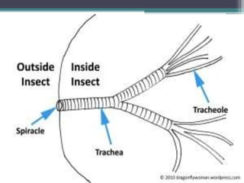
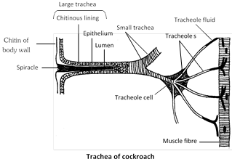
.4- The tracheole: is a special cell at the end of each tracheal branch, provides a thin, moist interface for the exchange of gasses between atmospheric air and a living cell.
5- Air sacs: are balloon-like structures that may store a reserve of air and formation of collapsible in the absence of taenidia.
Oxygen in the tracheal tube first dissolves in the liquid of the tracheole and then diffuses into the cytoplasm of an adjacent cell. At the same time, carbon dioxide, produced as a waste product of cellular respiration, diffuses out of the cell and, out of the body through the tracheal system.
Small insects rely almost on passive diffusion and physical activity for the movement of gasses within the tracheal system. However, larger insects may require active ventilation of the tracheal system.

Slide 3
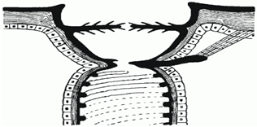
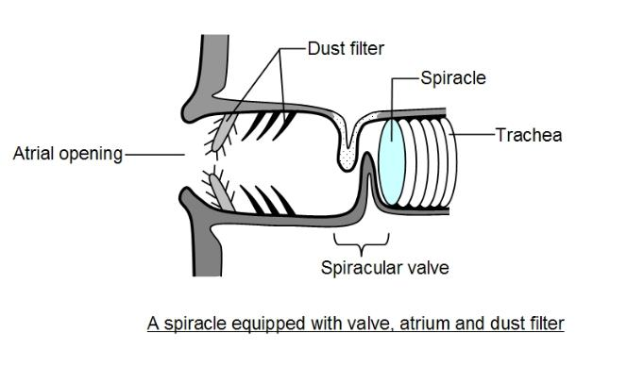
Spiracles
Spiracles are located at the transition between external cuticle and the tracheal system. insects had spiracles at each side of every segment. Because spiracles connect the internal air space of the tracheal system with the external air space of the environment, they serve several important functions:
1-Valves control respiratory gas exchange.
2-With valves closed, insect are independent from the atmosphere for a limited time.
3- Filter hairs protect the tracheal system from intruders.
Evolution of valves:
Spiracular valves evolved
1. From "simple holes in the wall" (Springtails, Collembola)
2.To external valves, like the thoracic spiracles of the grasshopper Schistocerca
3. and finally to internal valves with a complex mechanism and additional structures such as filter hairs and an atrium (like in butterflies)

Slide 4
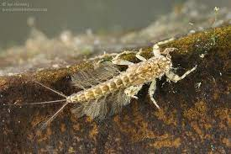
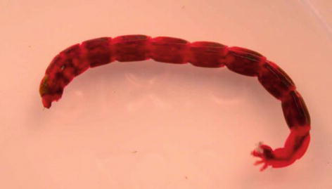
Respiration in Aquatic Insects
1. Cutaneous respiration: When the spiracles are absent, respiration occurs through body wall e.g. Protura, Collembola and endoparasitic insects.
2. Tracheal gills: e.g.: larva of Trichoptera, nymphs of Ephemeroptera
Also called as abdominal gills which occur as the outgrowths of the trachea in the form of gills distributed on the lateral sides of the body.
3. Blood gills: These are tubular or digitiform structures present at the anal end of body ranging from 4-6 in larva of Trichoptera. In chironomid larva of Diptera. These are called blood gills as they contain blood but some times have trachea. Function of these structures is the
A- Absorption of water
B- Inorganic ions rather than respiration.

Slide 5
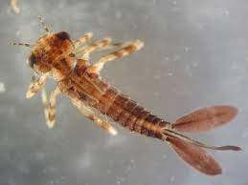
4. Rectal gills: In dragonfly nymphs (naids), the rectum modifies in to a barrel like chamber where the rectal wall forms in to basal thick pads and distal gill filaments which are richly supplied with tracheoles. They help in respiration.
5. Air sacs: In many winged insects, the trachea get dilated at some points to form thin walled air sacs which do not contain the taenidia. These can be seen as glistening sac like structures mainly function as storage structures of air which change their volume with respiratory movement .e.g. Dytiscus beetles carry a bubble or store of air at their posterior ends.
6. Plastron respiration: e.g.: aquatic beetles.
The plastron is a special type of air store in the form of a thin film held by a system of hydrofuge hairs, scales or other cuticular processes whose volume remains constant.

Slide 6
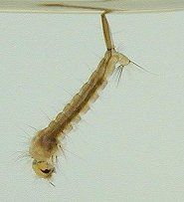
7.Directly by siphons: is adapted to aquatic life, it has respiratory siphon which ended with hairs.The role of hydrofuge hairs in breaking surface tension and preventing water from entering the spiracle of the siphon of various aquatic insects or from air dissolved in the water by body wall e.g. Mosquito
8. Via the tissue of aquatic plants.

Slide 7
Classification of tracheal system based on number and arrangement of
functional spiracles:
In most insects, 10 pairs of spiracles are present. Some of the modifications are as follows
1-Holopneustic : These are primitive type with 2 pairs of spiracles on thorax and 8 pairs on abdomen . All the spiracles are functional. 1 + 1 + 8. e.g. dragonflies, grasshoppers and cockroach
2-. Hemipneustic : One or more pairs of spiracles become non-functional. They are
a) Peripneustic : Metathoracic spiracle is closed. 1 + 0 + 8. e.g.: larvae of Lepidoptera, Hymenoptera, Coleoptera.
b) Amphipneustic : Only mesothoracic and last pair of abdominal spiracles are open. 1 + 0 + 1
c) Propneustic : Only one pair Mesothoracic spiracles are open, 1 + 0 +0 e.g.: Mosquito pupa
d) Metapneustic : Only last pair of abdominal spiracles are open. 0 + 0 + 1. e.g.: mosquito larvae
e) Apneustic: No functional spiracles. e.g: mayfly larva, nymph of Odonata
3-Hypopneustic: 1 or 2 pairs of spiracles may completely disappear or absent e.g.: Mallophaga
4-Hyperpneustic: More than 10 pairs of spiracles are present
e.g.: Japyx sp. (Dipluran) .

Slide 8
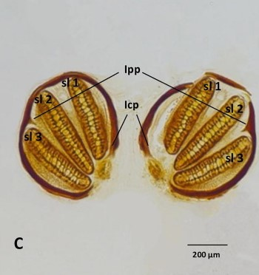
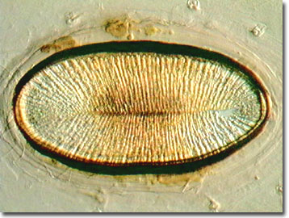
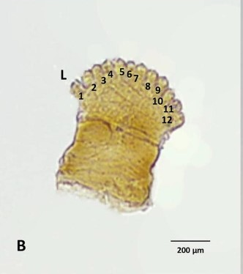
Types of Spiracle:
1.Lipped Spiracle
2.Sinous Spiracle ( in Calliphoridae)
3-Simple spiracle or non- Atriate:
4-Sieve Spiracle : In some beetles
5-Digitate Spiracle
Spiracles
.Lipped Spiracle
.Sinous Spiracle
-Digitate Spiracle

Slide 9
Reproductive System in Insects
1. Male Reproductive System
Functions of the male reproductive system
1-Include production
2- Storage of sperm and delivery to the female.
It includes a pair of
A-Testes: The testes embedded in the fat bodies above or below the gut in the abdomen. Each testis is composed of a number of globular follicles.
B-Vas deferens: From each testis, a lateral, short duct called vas deferens arises which leads to the seminal vesicles
C- Seminal vesicles: The two seminal vesicles are long enlarged ducts, which stores the sperm.
D- Median ejaculatory duct: Both the seminal vesicles unite to form the ejaculatory duct which opens out through the male gonopore. Male gonopore is surrounded by chitinous plates which aid in copulation.
E- accessory glands.

Slide 10
Fig . Male Reproductive System

Slide 11
Spermatogenesis
At the distal end of each testis follicle is the germarium, in which the germ cells divide to produce spermatogonia.
First: a zone of growth cells which divide mitotically to produce spermatocytes
Second: a zone of maturation and reduction spermatocytes divide meiotically to produce spermatids.
Third: a zone of transformation spermatozoon
.
Structure of an insect spermatozoon
1-acrosome
2-nucleus
3-centroile
4-mitochondrial element
5-axial filament
.

Slide 12
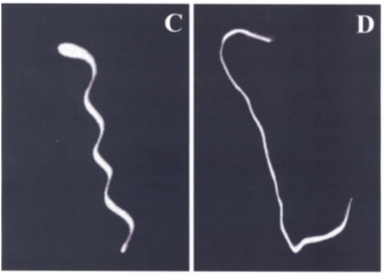
Sperm types
Eupyrene
Apyrene

Slide 13
2. Female Reproductive System
This reproductive system consists:
1. Pair of ovaries: are laterally located; each ovary consists of number of ovarioles or egg tubes.
2. Lateral oviduct: arises from the base of each ovary as a short duct. The two lateral oviducts unite to form a common oviduct, which opens out through the female gonopore through vagina.
3. Spermathe­ca: opens into the vagina ; some times found as a pair: one is sac like and the other is filamentous. Sperms received during copulation are stored in spermatheca.
4. Accessory glands: arise from the vagina; Function
1- they produce the materials required for the formation of eggs and of cementing them.
2- sperm maintenance.
3- fertilizing.
4- poison to paralyses their prey and defense.
Between the vagina and the anus are chitinous processes called gonapophyses for laying of the eggs.

Slide 14
Functions of the Female reproductive system
1-Egg production
2-Egg fertilization
3-Includes sperm storage
4-Egg placement oviposition
Oogenesis
The distal germarium contains prefollicular cells and the stem line oogonia which derived from the germ cells, oogonium grow into an oocyte. As the oocyte grows the nucleus also increases in size, so the oocyte pass down the ovariole. Each oocyte leaves the germarium it is clothed by the prefollicular tissues which form the follicular epithelium. The number of follicles in a mature ovariole is variable between species.
Female Reproductive System

Slide 15
Types of Ovariole:
There are two categories of ovarioles:
A. Panoistic Ovarioles
Which have no specialized nurse cells, are found in the more primitive orders of insects.
B.Merostic Ovarioles :Which have specialized nurse cells, are found in the more evaluated insects , Hemiptera , Coleoptera …..etc., this divide into:-
1. Telotrophic Ovarioles
2. Polytrophic ovarioles

Slide 16
Reproductive Strategies upon “To Lay Eggs or Not To Lay Eggs
1-Oviparity:Egg laid shortly after fertilization
2-Ovoviviparity:Eggs retained until embryogenesis complete. Female deposits nymph/larva
3-Viviparity
-Eggs retained
-Embryo fed by mother
-Immatures may complete development before deposition Examples: Tsetse fly
Reproductive Strategies upon to Who Reproduces?”
1-Paedogenesis: Reproduction by larval insects
2-Parthenogenesis: Development without fertilization. Unfertilized eggs produce
3-Polyembryony
-Found in some endoparasitic groups only
-Single egg results in 2 to ‘several thousand’ larvae
-Some larvae may be ‘defender morphs’
-Remaining larvae become ‘reproductive morphs’ that complete development and reproduce to carry on the species

