Slide 1
Balanced Cantilever Method
Dr. Ghassan

Slide 2
The superstructure is erected by cantilevering out from opposite sides of the pier.
The segments are added either at the same time or alternately to each cantilever to maintain a relatively balanced system.
After the cantilevers from each adjacent pier reach mid-span, a cast-in-place closure segment is placed followed by additional post-tensioning.

Slide 3
Segments are lifted into place using ground- or water-based cranes, deck mounted lifters at the end of each cantilever.

Slide 4
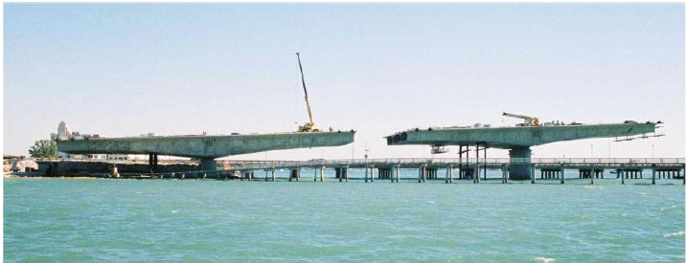
Balanced Cantilever Method

Slide 5
The balanced cantilever method is most economical for span lengths greater than about 50m.
For span lengths greater than about 140m, the weight of the segments near the piers reduces the feasibility of using precast segments in balanced cantilever construction.
The success of this method relies heavily on accurate geometry control during match casting, whereas the size and weight of precast segments are limited by the capacity of transportation and placing equipment.

Slide 6
Casting of Segments
Dr. Ghassan

Slide 7
Two method used for casting of segments
Short Line Method
In this rate of segment production is slow. Three or four segments cast at a time.
Long Line Method
In this rate of segment production is fast. Segments equal to one span cast at a time.

Slide 8
Casting of Segments

