Slide 1
Segmental Bridges
Dr. Ghassan

Slide 2
Segmental Bridge
Used for the long bridges.
It is economical when there is large number of spans.
This method involves the following steps.
Casting of Precast segments in casting yard.
Transporting the precast segments at the site.
Erection of the precast segment.
Prestressing.
Grouting.

Slide 3
Span-by-Span Method
Balanced Cantilever Method
Progressive Placement Method

Slide 4
Span-by-Span Method
In the span-by-span method, an entire span is assembled, posttensioned, and erected so that it is self-supporting before the next span is erected.
The method is appropriate for span lengths up to about 45m.
Beyond 45 to 55m, the method is less cost effective.
In one variation of this method, all the segments are supported by an erection truss before the segments are post-tensioned together. The erection truss may be located either above or below the segments.

Slide 5
Balanced Cantilever Method
The superstructure is erected by cantilevering out from opposite sides of the pier.
The segments are added either at the same time or alternately to each cantilever to maintain a relatively balanced system.
After the cantilevers from each adjacent pier reach mid-span, a cast-in-place closure segment is placed followed by additional post-tensioning.
Segments are lifted into place using ground- or water-based cranes, deck mounted lifters at the end of each cantilever.

Slide 6
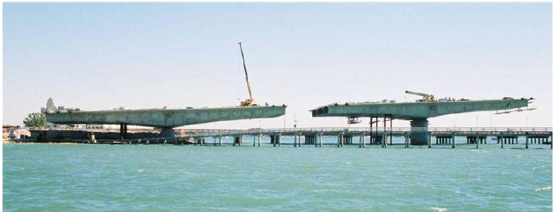
Balanced Cantilever Method

Slide 7
Balanced Cantilever Method
The balanced cantilever method is most economical for span lengths greater than about 50m.
For span lengths greater than about 140m, the weight of the segments near the piers reduces the feasibility of using precast segments in balanced cantilever construction.

Slide 8
Progressive Placement Method
The progressive placement method involves starting at one end of the bridge and erecting segments in sequential order.
This method of construction is particularly suitable where construction access is limited.
The method usually requires the placement of temporary piers at about the middle of each span.
Suitable for span lengths of 30 to 90m.

Slide 9
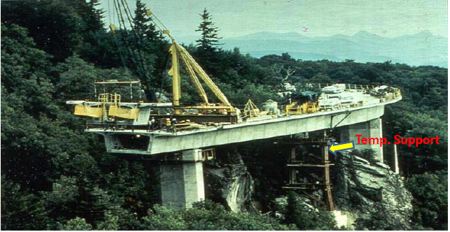
Progressive placement Method

Slide 10
Casting of Segments
Two method used for casting of segments
Short Line Method
In this rate of segment production is slow. Three or four segments cast at a time.
Long Line Method
In this rate of segment production is fast. Segments equal to one span cast at a time.

