Slide 1
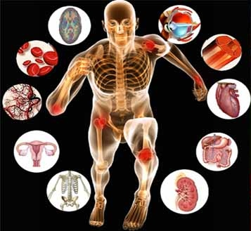
Introduction to Animal Physiology
05/10/2020

Slide 2
Physiology
The study of how living organisms function including such processes as nutrition, movement, and reproduction.
The word "function" is important to the definition of physiology because physiology traditionally had to do with the function of living things while anatomy had to do with morphology, the shape and form, of things.
Some physiological studies are concerned with processes that go on within cells such as phagocytosis, the process by which cells engulf and usually digest particles, bacteria and other microorganisms, and even harmful cells.

Slide 3
Physiology
Other physiological studies deal with how tissues and organs work, how they are controlled and interact with other tissues and organs and how they are integrated within the individual.
Yet other physiological studies deal with how we respond to our environment.

Slide 4
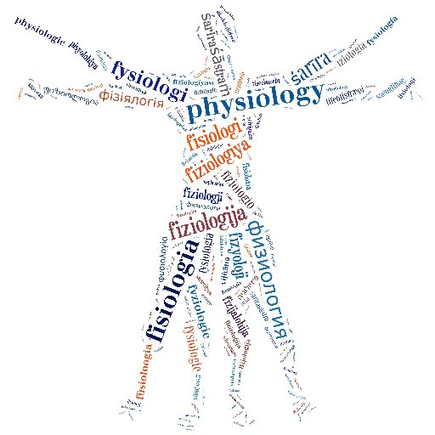
Physiology
from the Greek
physis = nature;
logos = study
Is the study of biological function—of how the body works, from cell to tissue, tissue to organ, organ to system, and of how the organism as a whole accomplishes particular tasks essential for life.

Slide 5
Physiology
Cell physiology: examines the processes occurring in cells.
Systemic physiology: considers the functions of organ systems.
Neurophysiology: focuses on the nervous system and,
Cardiovascular physiology deals with the heart and blood vessels.
Pathology: is the medical science dealing with all aspects of disease, with an emphasis on the cause and development of abnormal conditions as well as the structural and functional changes resulting from disease.
Exercise physiology: focuses on changes in function, but also structure, caused by exercise.

Slide 6
Physiology
Physiology: Is the study of the functions of living organisms
whole organisms
organ systems
organs
tissues
Cells

Slide 7
About Cell Membranes
All cells have a cell membrane
Functions:
Controls what enters and exits the cell to maintain an internal balance called homeostasis
Provides protection and support for the cell Structure of cell membrane.
Lipid Bilayer -2 layers of phospholipids
Phosphate head is polar (water loving)
Fatty acid tails non-polar (water fearing)
Proteins embedded in membrane

Slide 8
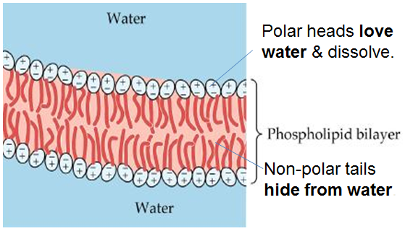
4. Cell membranes have pores (holes) in it
Selectively permeable: Allows some molecules in and keeps other molecules out.

Slide 9
Cellular transport mechanisms
Types of cellular transport
Substances can enter or leave a cell in two ways:
1. Passive transport:
Cell does not use energy.
Molecules move randomly.
Molecules spread out from an area of high concentration to an area of low concentration (High→Low).

Slide 10
Types:
Diffusion: Random movement of particles from an area of high concentration to an area of low concentration (High to Low).
Facilitative diffusion: Diffusion with the help of transport proteins.
Osmosis: Diffusion of water through a selectively permeable membrane. Water molecules move from a higher concentration of water to a lower concentration of water.

Slide 11
Cellular transport mechanisms
2. Active transport:
Cell uses energy in the form of ATP.
Active Transport: requires capable of moving solute particles against the concentration gradient (from low concentration to high concentration).

Slide 12
Types:
Protein pumps: transport proteins that require energy to do work (e.g.: Sodium/Potassium pumps are important in nerve responses).
Endocytosis: a process of taking material into the cell by means of infoldings, or pockets, of the cell membrane (usually putting them into a vacuole) such as phagocytosis process.
Exocytosis: results in secretion – materials exiting the cell.

