Slide 1
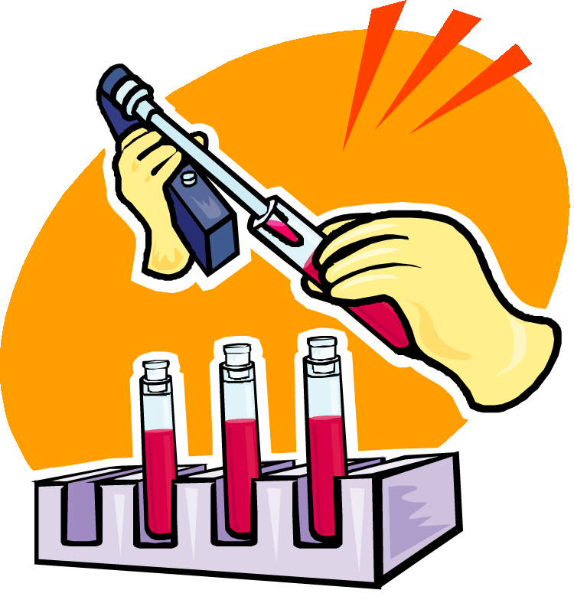
Glucose Tolerance Test (GTT)
Cellular Processes:
Notes:
CONTENTS
Section One: Background to type 2 diabetes, the metabolic syndrome and cardiovascular disease
Type 2 diabetes
The metabolic syndrome – definition and components
Cardiovascular disease
Section Two: The argument for intensive management and prevention
Diabetes – A Growing Threat
The cost of diabetes
Managing diabetes and diabetic complications
Prevention and management of micro and macrovascular complications.

Slide 2
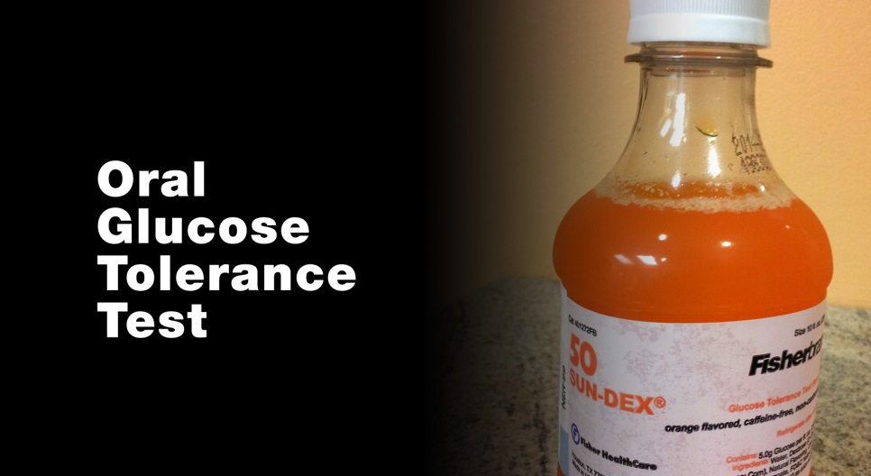
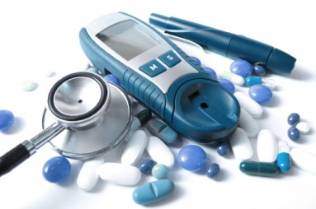
Purpose
A glucose tolerance test determines how quickly glucose is cleared from the blood. The test is usually used to diagnose prediabetes, diabetes, and is used to check for diabetes that occurs with pregnancy (gestational diabetes).
GTT
Notes:
CONTENTS
Section One: Background to type 2 diabetes, the metabolic syndrome and cardiovascular disease
Type 2 diabetes
The metabolic syndrome – definition and components
Cardiovascular disease
Section Two: The argument for intensive management and prevention
Diabetes – A Growing Threat
The cost of diabetes
Managing diabetes and diabetic complications
Prevention and management of micro and macrovascular complications.

Slide 3
Background
The amount of glucose which circulates in the blood of a healthy body is dependent upon several digestive and hormonal conditions and is usually between 80-120mg/dl of blood. The plasma sugar level is maintained by hormones released from the pancreas.
GTT
Notes:
CONTENTS
Section One: Background to type 2 diabetes, the metabolic syndrome and cardiovascular disease
Type 2 diabetes
The metabolic syndrome – definition and components
Cardiovascular disease
Section Two: The argument for intensive management and prevention
Diabetes – A Growing Threat
The cost of diabetes
Managing diabetes and diabetic complications
Prevention and management of micro and macrovascular complications.

Slide 4
Background
The hormone glucagon, which is released by pancreatic alpha cells, increases blood sugar by stimulating the conversion of glucose from glycogen. As the blood sugar rises, the beta cells of pancreas stimulate the production and released of insulin which acts to increase the cellular uptake of glucose as well as the conversion of the glucose to glycogen.
GTT
Notes:
CONTENTS
Section One: Background to type 2 diabetes, the metabolic syndrome and cardiovascular disease
Type 2 diabetes
The metabolic syndrome – definition and components
Cardiovascular disease
Section Two: The argument for intensive management and prevention
Diabetes – A Growing Threat
The cost of diabetes
Managing diabetes and diabetic complications
Prevention and management of micro and macrovascular complications.

Slide 5
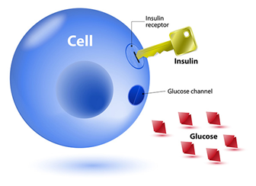
Background
Failure of the pancreas to produce either of these hormones results in abnormally low or high levels of plasma glucose and the respective serious conditions of hypoglycemia or diabetes mellitus.
GTT
Notes:
CONTENTS
Section One: Background to type 2 diabetes, the metabolic syndrome and cardiovascular disease
Type 2 diabetes
The metabolic syndrome – definition and components
Cardiovascular disease
Section Two: The argument for intensive management and prevention
Diabetes – A Growing Threat
The cost of diabetes
Managing diabetes and diabetic complications
Prevention and management of micro and macrovascular complications.

Slide 6
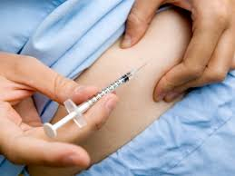
Background - What is diabetes?
Diabetes mellitus is a group of diseases that cause high blood sugar levels. Type 1 diabetes was called insulin-dependent diabetes or juvenile diabetes and develops when the body’s immune systems destroy the cells that make the hormone insulin that controls blood sugar levels.
GTT
Notes:
CONTENTS
Section One: Background to type 2 diabetes, the metabolic syndrome and cardiovascular disease
Type 2 diabetes
The metabolic syndrome – definition and components
Cardiovascular disease
Section Two: The argument for intensive management and prevention
Diabetes – A Growing Threat
The cost of diabetes
Managing diabetes and diabetic complications
Prevention and management of micro and macrovascular complications.

Slide 7
Diabetes
Diabetes mellitus type 2 was previously called non-insulin diabetes or adult-onset diabetes.
GTT
Notes:
CONTENTS
Section One: Background to type 2 diabetes, the metabolic syndrome and cardiovascular disease
Type 2 diabetes
The metabolic syndrome – definition and components
Cardiovascular disease
Section Two: The argument for intensive management and prevention
Diabetes – A Growing Threat
The cost of diabetes
Managing diabetes and diabetic complications
Prevention and management of micro and macrovascular complications.

Slide 8
Body Mass Index (BMI) and Diabetes
BMI, or body mass index, is an indirect measurement of the amount of fat in a person's body. A high BMI predicts the development of several diseases, including type 2 diabetes.
GTT
Notes:
CONTENTS
Section One: Background to type 2 diabetes, the metabolic syndrome and cardiovascular disease
Type 2 diabetes
The metabolic syndrome – definition and components
Cardiovascular disease
Section Two: The argument for intensive management and prevention
Diabetes – A Growing Threat
The cost of diabetes
Managing diabetes and diabetic complications
Prevention and management of micro and macrovascular complications.

Slide 9
Calculating BMI
Body mass index (BMI), which is calculated as:
BMI =Weight in kg/Height m²
Normal weight ranges: The body mass index (BMI)
Underweight: BMI is less than 18.5
Normal weight: BMI is 18.5 to 24.9
Overweight: BMI is 25 to 29.9
Obese: BMI is 30 or more
GTT
Notes:
CONTENTS
Section One: Background to type 2 diabetes, the metabolic syndrome and cardiovascular disease
Type 2 diabetes
The metabolic syndrome – definition and components
Cardiovascular disease
Section Two: The argument for intensive management and prevention
Diabetes – A Growing Threat
The cost of diabetes
Managing diabetes and diabetic complications
Prevention and management of micro and macrovascular complications.

Slide 10
Procedure
The subject should have been fasting for the previous 8-14 hours (water is allowed).
Determine each subject's normal blood glucose level, using a glucose meter.
The subject is then given a glucose solution to drink. The quantity of solution will be based on a quantity of 1g of glucose per kilogram of body weight. It should be drunk within 5 minutes.
GTT
Notes:
CONTENTS
Section One: Background to type 2 diabetes, the metabolic syndrome and cardiovascular disease
Type 2 diabetes
The metabolic syndrome – definition and components
Cardiovascular disease
Section Two: The argument for intensive management and prevention
Diabetes – A Growing Threat
The cost of diabetes
Managing diabetes and diabetic complications
Prevention and management of micro and macrovascular complications.

Slide 11
Procedure
After ingesting the glucose, the subject will repeat the glucose test every 30 minutes. Testing will continue in this manner for 2 hours or until the end of the lab period.
Record and graph the results of the blood glucose tests and then compare with the normal glucose tolerance test curve.
GTT
Notes:
CONTENTS
Section One: Background to type 2 diabetes, the metabolic syndrome and cardiovascular disease
Type 2 diabetes
The metabolic syndrome – definition and components
Cardiovascular disease
Section Two: The argument for intensive management and prevention
Diabetes – A Growing Threat
The cost of diabetes
Managing diabetes and diabetic complications
Prevention and management of micro and macrovascular complications.

Slide 12
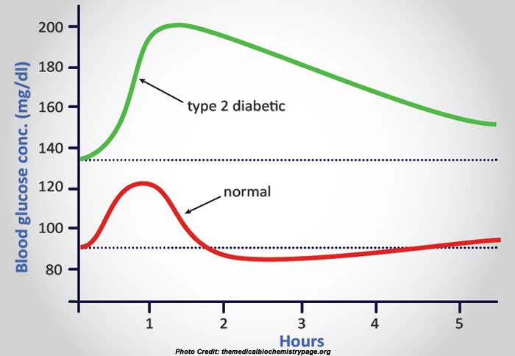
Procedure
Figure: Glucose Tolerance curve in a normal person and in a person with diabetes
GTT
Notes:
CONTENTS
Section One: Background to type 2 diabetes, the metabolic syndrome and cardiovascular disease
Type 2 diabetes
The metabolic syndrome – definition and components
Cardiovascular disease
Section Two: The argument for intensive management and prevention
Diabetes – A Growing Threat
The cost of diabetes
Managing diabetes and diabetic complications
Prevention and management of micro and macrovascular complications.

