Slide 1
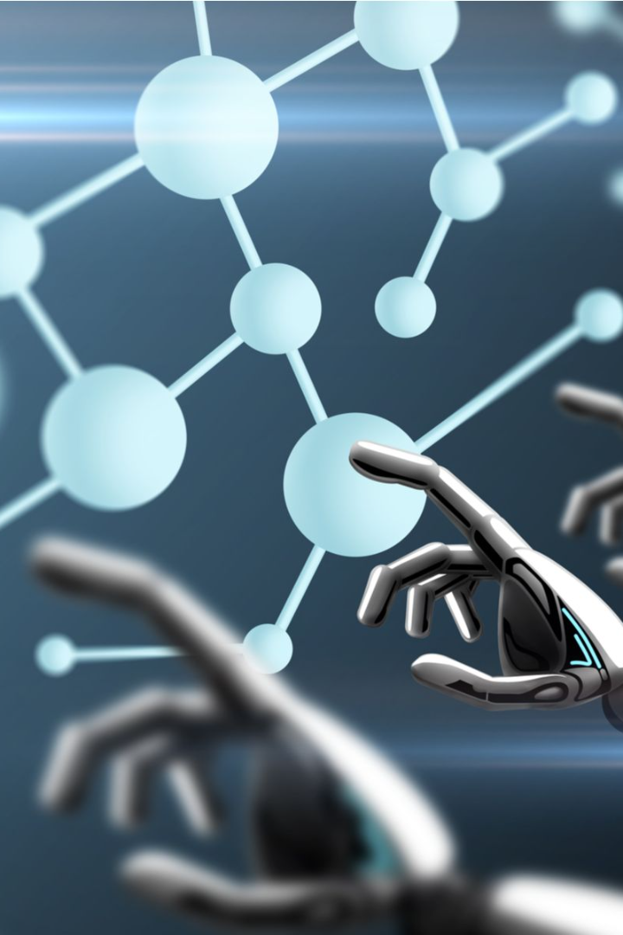
Introduction to Machine Learning
Discover the world of machine learning and its impact on various industries. Learn about the different types of algorithms, applications, benefits, challenges, and emerging trends.

Slide 2

Defining Machine Learning
Machine learning is an artificial intelligence (AI) technique that enables computers to learn from data and improve performance without being explicitly programmed. It is a powerful tool with vast applications.
1
Explanation of the Concept
2
Difference from Traditional Programming
Understand how machine learning algorithms work and the underlying principles that drive their learning capabilities.
Explore why machine learning is distinct from traditional programming methods and how it allows computers to adapt and improve over time.

Slide 3
Types of Machine Learning Algorithms

Slide 4
Supervised Learning
The supervised learning algorithms use labeled data for training the models deployed for learning intelligent behavior.
Most of the real-world data collected are unlabeled and need to be annotated carefully if supervised learning algorithms are utilized.
It is generally more manageable for the models to learn patterns and create distinctions between various data classes if labels are provided. The labels serve as teachers and therefore guide the model to learn what is what precisely.
Supervised learning is similar to teaching a child to walk. You will hold the child's hand, show him how to take his foot forward, and demonstrate walking to let the child understand, and you will continue the same process until the child learns to walk on himself.
The supervised learning algorithms can be used to achieve two tasks:
1. Regression
2. Classification
Examples of supervised learning algorithms include fraudulent activity detection, spam detection, face detection algorithm, etc.
In all these examples, the input data used for learning is already annotated as fraudulent, non-fraudulent, spam, non-spam, face, and non-face.

Slide 5
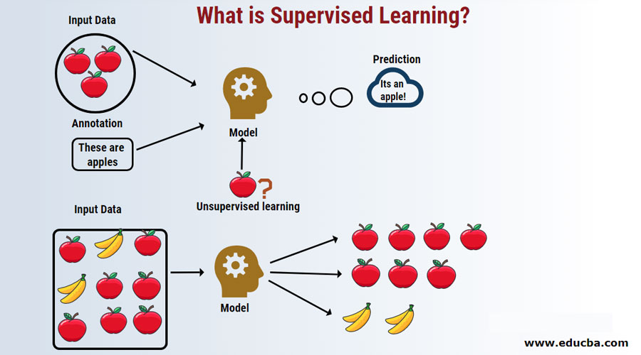
Supervised Learning

Slide 6
Unsupervised Learning
This type of learning algorithm makes use of unlabelled data for training the models deployed for intelligent behavior. When the data at hand is unlabelled.
the algorithm tries to find out similar patterns and places data with relevant features into one group.
Unsupervised learning is a type of learning where no teacher is present, and the system learns without any supervision.
Here the system learns based on experience.
Clustering is an example of unsupervised learning.
Examples of unsupervised learning algorithms include customer market segmentation, clustering, image restoration, drug discovery, etc.

Slide 7
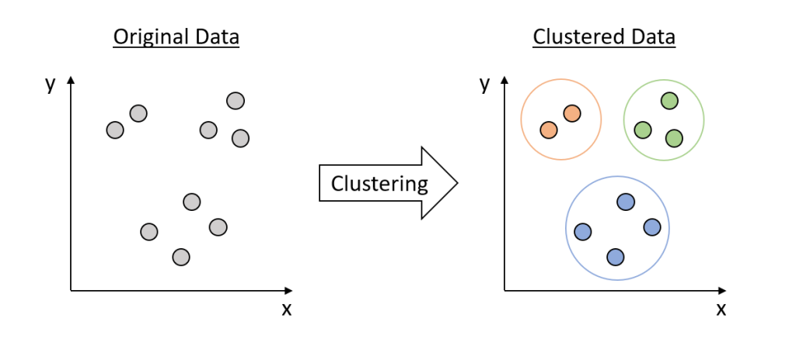
Unsupervised Learning

Slide 8
Reinforcement Learning
Reinforcement learning is utilized when we are not given enough training data.
Lack of training data means the model has no expertise in the problem at hand and therefore learns gradually by experience.
It tries random moves, in the beginning, to learn from its environment and then finds out what is the best strategy to solve the problem.
There is an iterative feedback loop between the agent and its environment that helps it learn more interactively.
Unlike the traditional machine learning algorithms, reinforcement learning algorithms like SARSA (State-Action-Reward- State-Action), Monte Carlo methods, and Q- learning are more dynamic in their behavior.

Slide 9
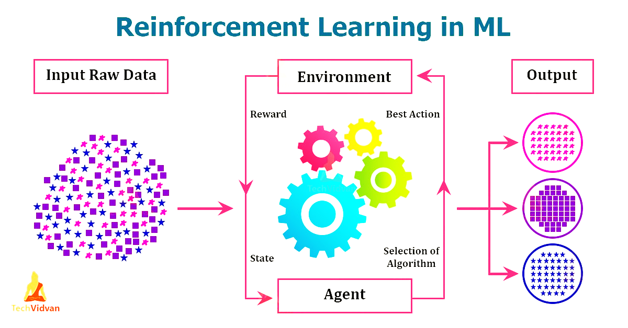
Reinforcement Learning

Slide 10
Deep Learning
Neurons in the human brain are stimulated as artificial neural networks in our binary computers to solve problems.
Deep learning eliminates some of data pre-processing that is typically involved with machine learning. These algorithms can ingest and process unstructured data, like text and images, and it automates feature extraction, removing some of the dependency on human experts.
Deep neural networks consist of multiple layers of interconnected nodes, each building upon the previous layer to refine and optimize the prediction or categorization. This progression of computations through the network is called forward propagation.

Slide 11
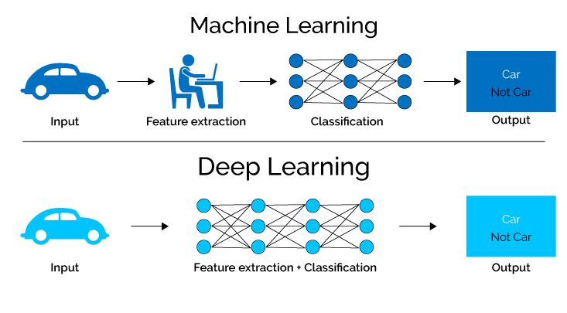
Deep Learning

Slide 12
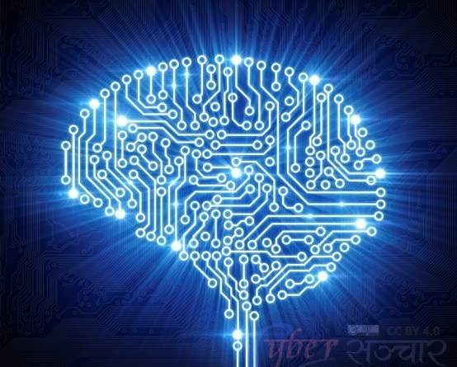
Applications of Machine Learning
1
Industry Examples
See how machine learning is transforming finance, healthcare, and other sectors, revolutionizing processes and decision-making.
2
Real-World Use Cases
From personalized recommendations to fraud detection, uncover a range of practical applications enhancing various aspects of our lives.

Slide 13
Benefits and Challenges of Machine Learning
1
Advantages of Using Machine Learning
Experience improved accuracy, efficiency, automation, and scalability by harnessing the power of machine learning.
2
Potential Limitations and Pitfalls
Understand the ethical considerations, bias, interpretability challenges, and potential risks associated with machine learning applications.

Slide 14
The Future of Machine Learning
1
Emerging Trends and Technologies
Delve into cutting-edge advancements such as deep learning, natural language processing, and explainable AI, shaping the future of machine learning.
2
Impact on Various Industries
Explore how machine learning will drive innovation, transform industries, create new job opportunities, and reshape our future.

Slide 15
Conclusion
Summarize the key concepts covered in the presentation and emphasize the importance of machine learning as a powerful tool for solving complex problems and driving innovation.

