Slide 1
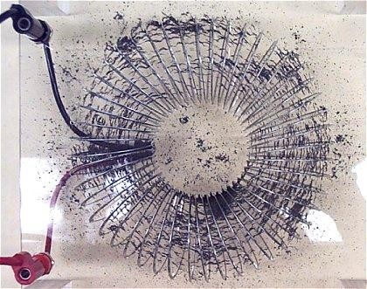
Magnetic Field of a Toroid

Slide 2
Magnetic Flux Density
Electric flux density and Electric field intensity are related by D=ε₀ E
in free space.
Similarly, the magnetic flux density B is related to the magnetic
field intensity H by:
B = μ H
0
Where μ₀ is known as the permeability of free space.
μ₀ = 4π ×10 H/m
−7
The magnetic flux through a surface is given by
Ψ=∫B⋅ dS
S
Where Ψ is in webers (Wb), B is in (Wb/m²) or teslas (T).

Slide 3
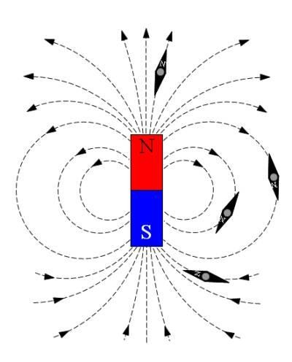
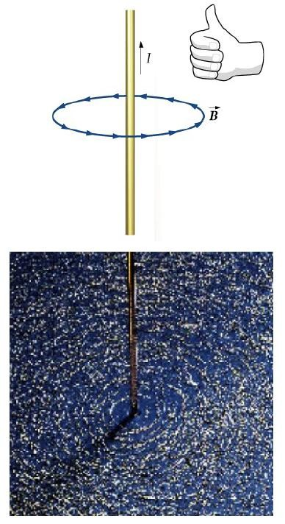
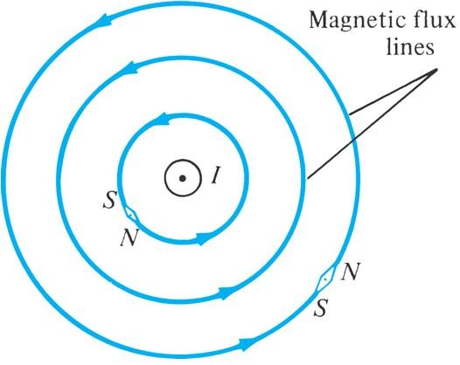
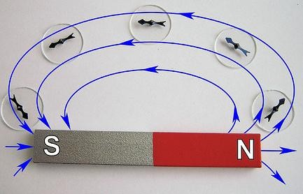
Magnetic Flux Lines
Magnetic flux line is a path to which B is tangential at every point on the line.
Each flux line is closed and has no beginning or end.

Slide 4
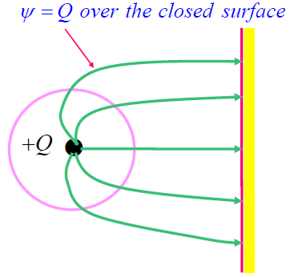
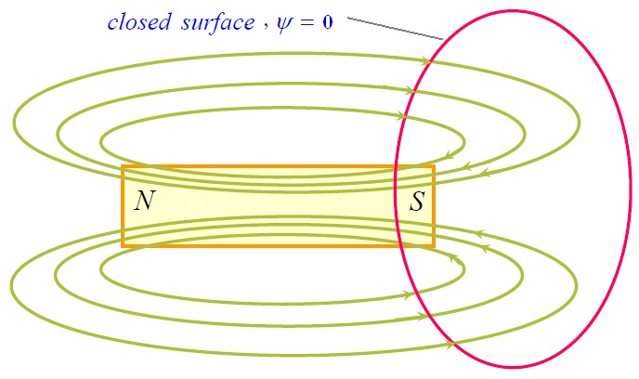
In an electrostatic field the flux crossing a closed surface is the same as the charge enclosed.
Ψ = ∫ D⋅ dS = Q
S
So it is possible to have an isolated electric charge and the flux lines produced by it need not be closed.
Unlike electric flux lines, magnetic flux lines always close upon themselves.
This is because it is not possible to have
isolated magnetic poles (or magnetic charges).
Ψ = ∫ B⋅ dS = 0
S

Slide 5
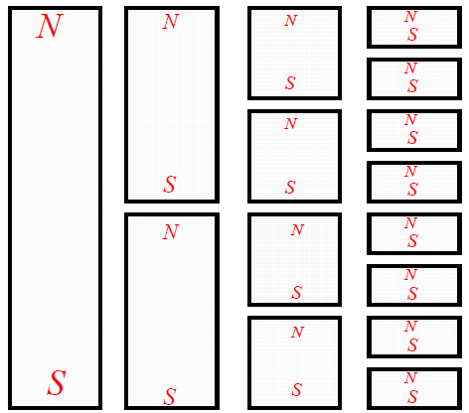
It is not possible to isolate the north and south poles of a magnet.
42

Slide 6
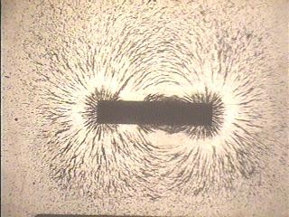
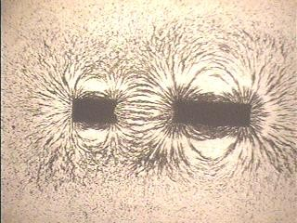
Broken Magnet

Slide 7
Gauss’s Law for magnetostatic fields
The total flux through a closed surface in a magnetic field is zero.
∫ B⋅ dS = 0
Applying divergence theorem,
∫ B⋅ dS = ∫∇⋅ B dv =0
S v
Or
∇⋅ B = 0
This is the Maxwell’s fourth equation. It states that magnetostatic fields have no sources or sinks.

Slide 8
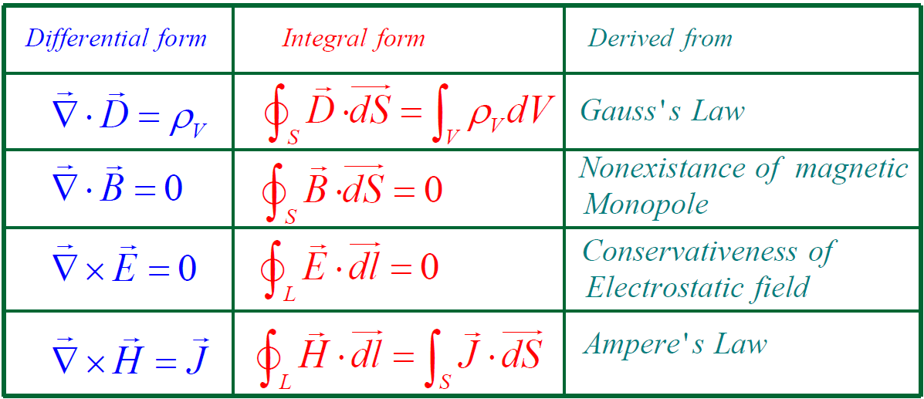
Maxwell’s Equations for Static Fields

Slide 9
Magnetic Scalar and Vector Potentials
*In electrostatics electric field intensity and potential are related by:
E = −∇V
*Similar to this we can relate magnetic field intensity with two magnetic potentials:
Magnetic scalar potential (V_{m})
Magnetic vector potential (A)
*Magnetic scalar potential V_{m} is related to H by the relation:
H = −∇V_{m}
if J=0
J=∇ × H=∇ × (−∇V_{m} ) = 0 (since for any scalar, ∇ × (∇V ) = 0)
so the magnetic scalar potential V_{m} is only defined in the region where J=0.
V satisfies Laplace's equation ∇²V = 0 (J=0)
m m

Slide 10
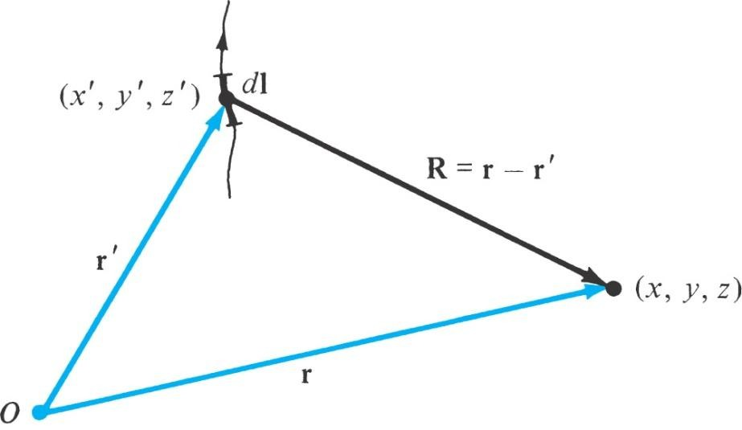
Magnetic Vector Potential
Since for a magnetostatic field ∇⋅B=0 For any vector ∇ ⋅ (∇× A)=0 we can define magnetic vector potential A such that B=∇× A In many EM problems it is more convenient to first find A and then find B from it. A = ∫ ^{μ0 Idl} for line current _{L} 4π R A = ∫ ^{μ0 KdS} for surface current _{S} 4π R
 | _{A = ∫} μ₀Jdv _{v} 4π R | for volume current 47

Slide 11
Magnetic flux from vector potential
The magnetic fluc through a given area can be found from
Ψ=∫B⋅ dS
S
Applying Stoke's theorem, we obtain,
Ψ=∫B⋅ dS = ∫ (∇ × A) ⋅ dS = ∫ A ⋅ dl
S S L
Ψ = ∫ A ⋅ dl
L

Slide 12
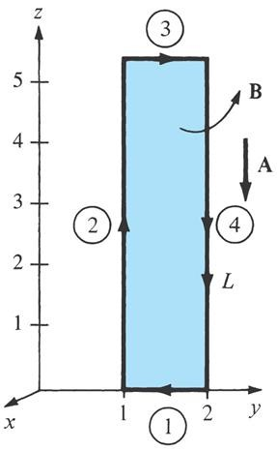
Example 7.7
Given the magnetic vector potential A=-ρ²/4 a_{z} Wb/m, calculate the total magnetic flux crossing the surface Ф=π/2, 1≤ρ≤2 m, 0≤z≤5 m.
Example 7.7 Solution
Method 1
B = ∇× A= − ^{∂Az} a = ^{ρ} a ,
dS=dρ dz a
∂ρ
φ φ
φ
2
Hence,
Ψ = ∫B⋅ dS=
Ψ = 3.75 Wb
1
5 2
1
4
_{ρ} 2
2
15
∫ ∫ ρdρ dz =
(5) =
² z =0 ρ =1
4
1

Slide 13
Example 7.7 Solution Continued
A=-ρ²/4 a_{z}
Method 2
Ψ = ∫ A ⋅ dl=Ψ₁ + Ψ₂ + Ψ₃ + Ψ₄
L
where L is the path bounding surface S.
Since A has only z-component,
Ψ₁ = 0 = Ψ₃
1 ⎡ ⎤
5 0
2
Ψ = Ψ₂ + Ψ₄ = −
⎢(1)
∫
∫
dz + (2)² dz⎥
4
⎣
5 ⎦
0
= − ¹ (1− 4)(5) = ¹⁵ = 3.75 Wb
4 4

