Slide 1
5.9 Boundary conditions
When the field exists in a medium consisting of two different media, the conditions the field must satisfy are called boundary conditions.
For the electrostatic field the following boundary conditions are
important:
Dielectric – dielectric interface.
Conductor – dielectric.
Conductor – free space.
∫ E ⋅ dl=0, ∫ D⋅ dS=Q_{enc}
We will use Maxwell Equations:

Slide 2
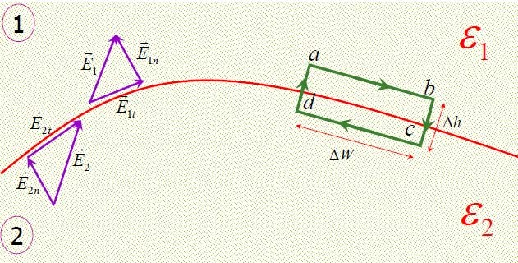
Dielectric-dielectric Boundary conditions
Consider the boundary between two dielectrics with permittivities

Slide 3
Dielectric-dielectric Boundary conditions
The fields in the two media can be expressed as: E₁ = E_{1t} + E_{1n} E₂ = E_{2t} + E_{2n}
Apply the equation ∫ E ⋅ dl = 0 to the path abcda in the figure
L
Δh _{− E} Δh _{+ E} Δh ₌ ₀
∫
E ⋅ dl = E Δw − E
^{Δh} − E Δw + E
1t
1n
2n 2t 2n 1n
2 2 2 2
abcda
E_{1t} Δw − E_{2t} Δw = 0
→ E_{1t} = E_{2t}
^{E}1t ^{= E}2t
Tangential components of E are equal at the boundary.
E_{t} undergoes no change on the boundary and it is continuous across the boundary.

Slide 4
Dielectric-dielectric Boundary conditions
^{D}1t ₌ ^{D}2t
→ ε₂ D_{1t} = ε₁D_{2t}
^{E}1t ^{= E}2t →
ε ε
1 2
The tangential component of D under goes some change across the boundary.
So D is said to be discontinuous across the boundary.
The boundary conditions for the normal components are obtained by applying Gauss’s law on a small pill box shaped volume as in the next figure.
∫ D⋅ dS = Q
S
D_{1n} ΔS − D_{2n} ΔS = ΔQ = ρ_{S} ΔS
Assuming Δh → 0
^{D}1n
D_{2n} = ρ_{S}
D_{1n} − D_{2n} = ρ_{S}

Slide 5
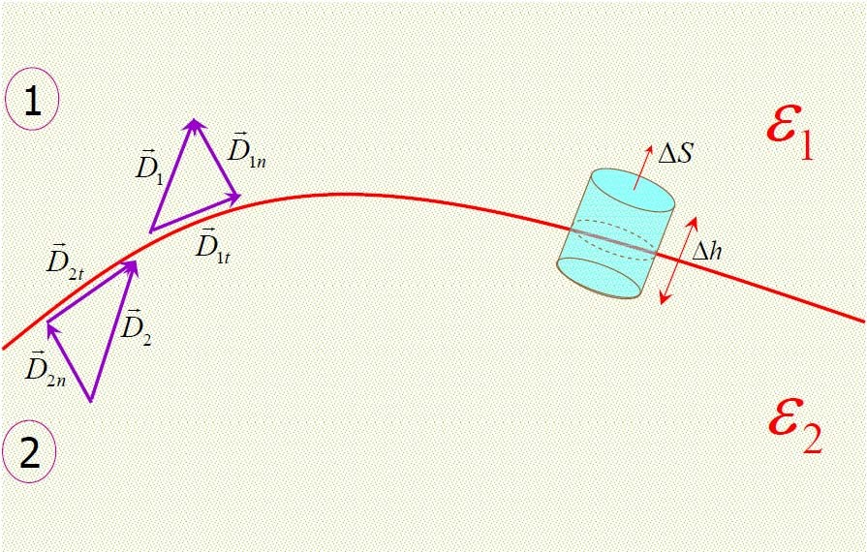
Dielectric-dielectric Boundary conditions

Slide 6
Dielectric-dielectric Boundary conditions
^{D}1n
D_{2n} = ρ_{S}
If no free charge exists at the boundary, ρ_{S} =0
^{D}1n ^{= D}2n
^{D}1n ^{= D}2n
Normal components of D are equal at the boundary.
D_{n} undergoes no change on the boundary and it is continuous across the boundary.
^{E}1n
₌ ε₂
^{ε}1E1n ^{= ε}2 ^{E}2n
→
^{D}1n ^{= D}2n →
E ε
2n 1
The normal component of E undergoes some change across the boundary.
So E_{n} is said to be discontinuous across the boundary.

Slide 7
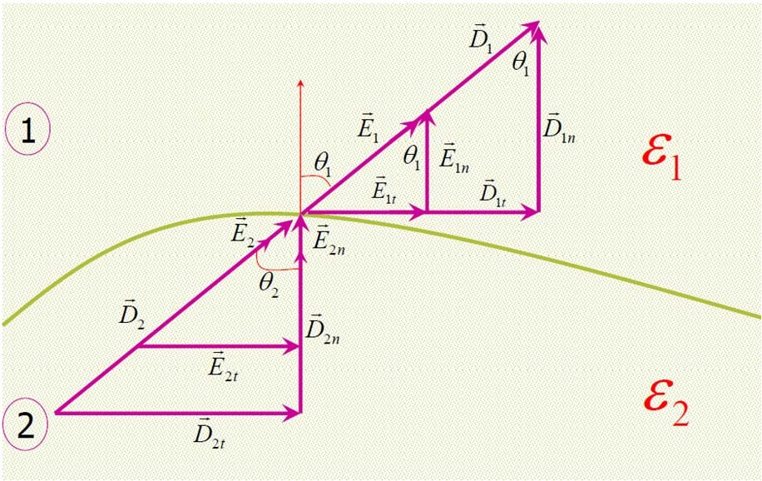
Dielectric-dielectric Boundary conditions
If the field on one side is known, we can find the field on the other side.
θ1 : angle between E1 and normal.
θ2 : angle between E2 and normal.

Slide 8
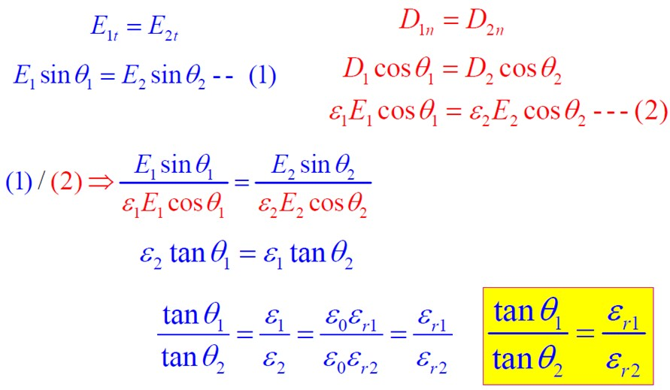
Dielectric-dielectric Boundary conditions
This is called law of refraction

Slide 9
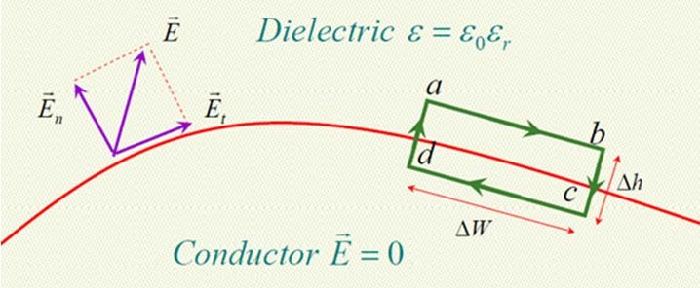
Conductor-dielectric Boundary conditions
Apply the equation ∫ E ⋅ dl=0 to the path abcda in the figure
∫
E ⋅ dl=E Δw − E ^{Δh} − 0 ⋅ ^{Δh} − 0 ⋅ Δw + 0 ⋅ ^{Δh} + E ^{Δh} = 0
t n
2 2 2
→ D_{t} = 0 →
2
n
abcda
→ E_{t} Δw = 0
→ E_{t} = 0
D_{t} = ε₀ε_{r} E_{t} = 0
D_{t} = ε₀ε_{r} E_{t} = 0
44

Slide 10
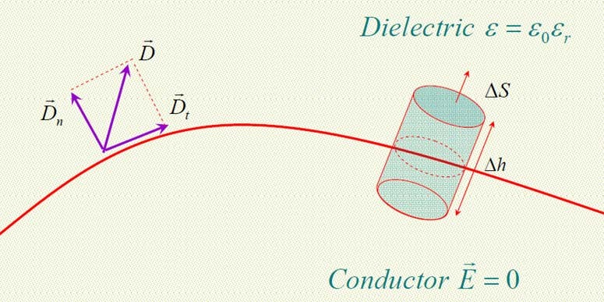
Conductor-dielectric Boundary conditions
To find boundary conditions for normal components, apply gauss law:
∫ D ⋅ dS = Q
S
D_{n} ΔS − 0 ⋅ ΔS = ΔQ Assuming Δh → 0
ΔQ ρ_{S} ΔS
ΔS ΔS
D_{n} = ε₀ε_{r} E_{n} = ρ_{S}
D =
=
= ρ
n
S
45

Slide 11
Conductor-dielectric Boundary conditions
Notes
No electric field exists inside a conductor.
Since E = −∇V , there is no potential difference between any two points in the conductor.
The electric field must be external to the conductor and must be
normal to its surface.
46

Slide 12
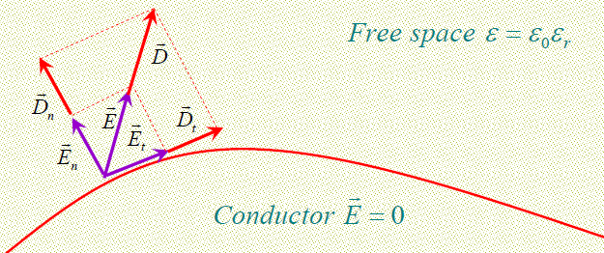
Conductor-Free space Boundary conditions
Special case of Conductor-Dielectric conditions.
Replacing ε_{r} = 1:
D_{n} = ε ₀ E_{n} = ρ_{S}
D_{t} = ε₀ E_{t} = 0
D_{n} = ε₀ε_{r} E_{n} = ρ
S
D_{n} = ε₀ E_{n} = ρ
S
As in the earlier case
D_{t} = ε₀ E_{t} = 0
47

Slide 13
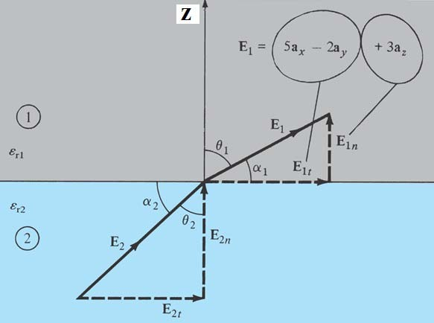
Example 5.9
Two extensive homogeneous isotropic dielectrics meet on plane z=0. for z>0, εr1 =4 and for z<0, εr2 =3. a uniform Electric field E₁=5a_{x}-2a_{y}+3a_{z} kV/m exists for z ≥0. Find:
(a) E₂ for z≤0.
(b) The angles E₁ and E₂ make with the interface.
(c) the energy densities (in J/m³) in both dielectrics.
(d) the energy with a cube of side 2 m centred at (3,4,-5).
48

Slide 14
Example 5.9 - solution
E₁ =E_{1n} +E_{1t}
^{E}1n
= E₁.a_{n} = E₁.a _{z} = 3 → E_{1n} = 3a _{z}
E_{1t} = E₁ -E_{1n} = 5a _{x} -2a _{y}
E_{2t} = E_{1t} = 5a_{x} -2a_{y}
^{D}2n ^{= D}1n ^{→ ε}0^{ε}r 2E2n ^{= ε}0^{ε}r1E1n
E
₌ ^{ε}r1 _{E}
= ⁴ E = ⁴ 3a = 4a
2n 1n
1n z
z
ε
3 3
r 2
E₂ =E_{2t} +E_{2n} = 5a_{x} -2a_{y} + 4a _{z} kV/m
−−−−−−−−−−−−−−−−−−−−−−−
(b) α₁ =90-θ₁ ,α₂ =90-θ₂
E
3
3
tan α =
1n
→ α = 29.1 , θ = 60.9
= =
∘
∘
1
E
25 + 4 29
1
1
1t
E
4
tanθ
1 ₌ ^{ε}r1
tan α =
2n
→ α = 36.6 , θ
=
∘
∘
= 53.4 . (Note:
is satisfied)
49
2
E
29
2
2
tanθ ε
2t
2 r 2

Slide 15
Example 5.9 - solution
(c) The energy densities in (J/m³ ) in both dielectrics:
2
( )
w_{E1} = ¹ ε E =
2 1 1
=
−9
6
3
4μ×J/m
× (25 + 4 + 9) ×10 = 672
1
2
10
36π
2
( )
w_{E 2} = ¹ ε E
2 2 2
−9
6 3
3 ×μJ/m
× (25 + 4 + 16) ×10 = 597
1
2
10
36π
− − − − − − − − − − − − − − − − − − − − − − − − − − − − − − −
(d) The energy with a cube of side 2 m centred at (3, 4, −5).
{2 ≤ x ≤ 4, 3 ≤ y ≤ 5, -6 ≤ z ≤ −4}, z=-5 (Region 2)
W_{E} =∫ w_{E 2}dv = ∫ ∫ ∫ (w_{E 2} )dzdydx = w_{E 2} (2)(2)(2) = 4.776 mJ
x=2 y=3 z=−6
4 5 −4
50

Slide 16
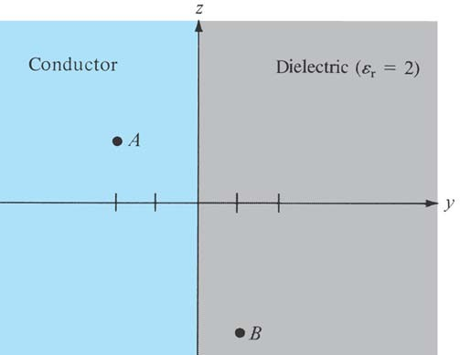
Example 5.10
Region y<0 consists of a perfect conductor while region y>0 is a dielectric medium (εr1 =2). If there is a surface charge 2 nC/m² on the conductor, determine E and D at:
(a) A(3,-2,2)
(b) B(-4,1,5)
Solution
Point A(3,-2,2) is in the conductor since y=-2<0 at A. Hence: E=0=D
B(-4,1,5) is in the dielectric medium since y=1>0 at B.
D_{n} =ρ_{s} = 2 nC/m
2
D 2×10⁻⁹
E=
=π a₋₉ a_{y} =36 _{y} =113.1 a _{y} V/m
ε₀ε_{r} ¹⁰ (2)
36π
51

