Slide 1
The Study of Meiosis Division

Slide 2
Meiosis is a process of reductional division in which the number of chromosomes per cell is cut in half.
In animals, meiosis always results in the formation of gametes, while in other organisms it can give rise to spores.
Meiosis is a mechanism for diversity: The parent nucleus produces four different haploid daughter nuclei.

Slide 4
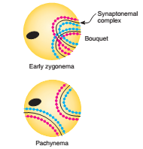

Slide 9
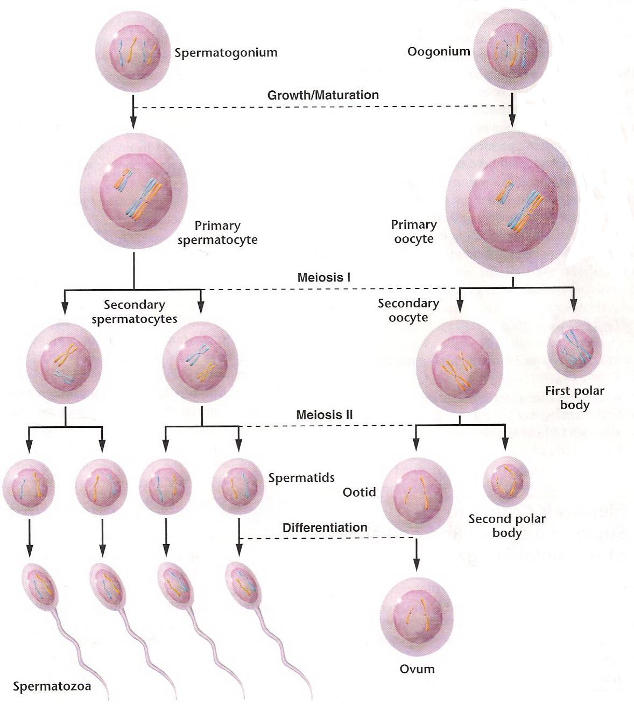

Slide 10
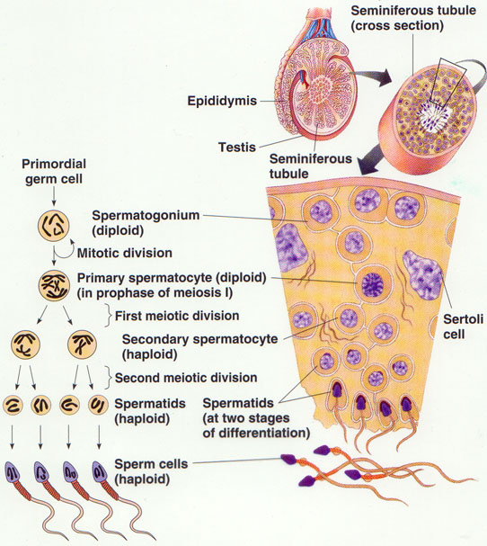

Slide 11
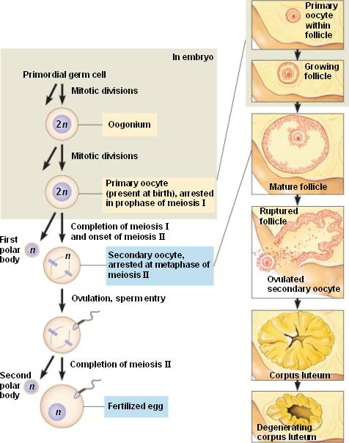

Slide 12
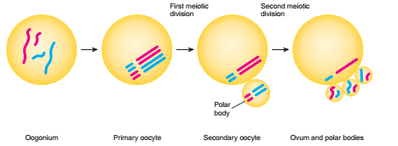

Slide 13
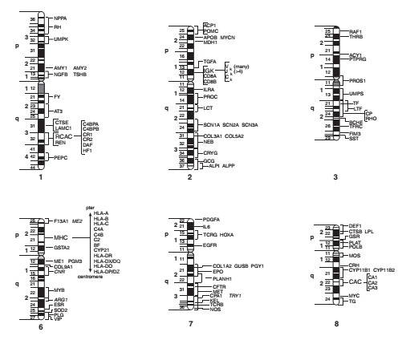

Slide 14
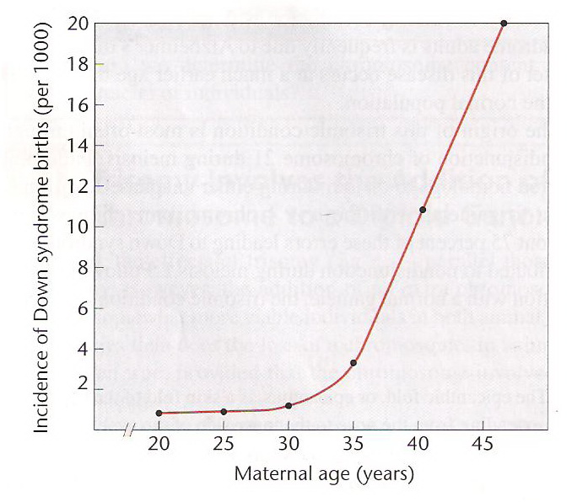
Relation of Maternal age to incidence of Down syndrome births

Slide 15
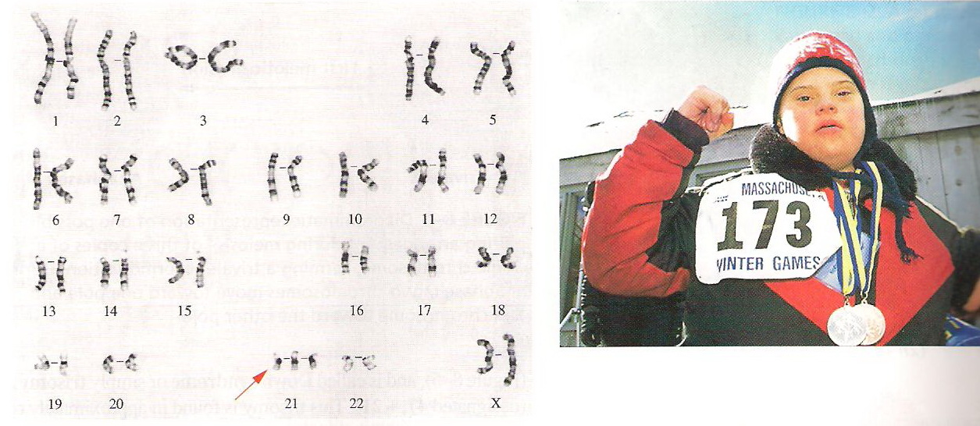
Karyotype of a person with Down syndrome

Slide 17
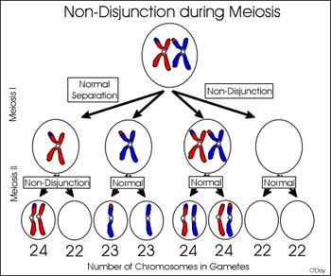

Slide 18
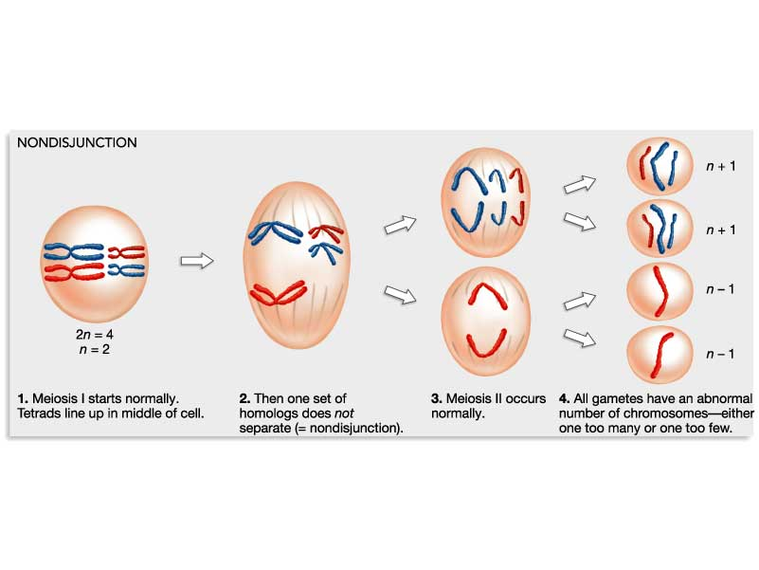

Slide 19
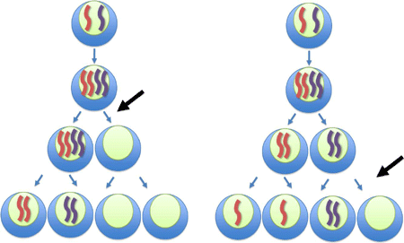

Slide 20
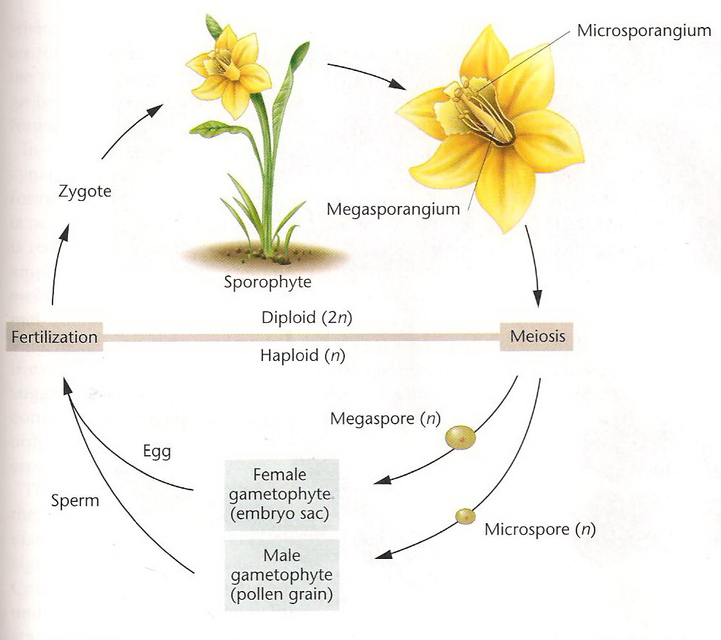

Slide 21
