Slide 1
Simple Human Non - Metric Traits

Slide 2
Simple and Multiple Gene Inheritance
Many normal human traits appear to have a genetic base because they "run in families." They do not, however, fit into a simple Mendelian mode of inheritance. Examples include body size and shape, skin color, facial features, and color of the eyes. These cannot easily be attributed to the action of a single gene locus. When two or more gene loci contribute to a trait, that trait is known as polygenic. There are many traits, such as adult standing height, where environment interacts with the genes to produce the final result. This pattern of inheritance is known as multifactorial.

Slide 3
Darwin Tubercle
Sometimes called Darwin's point, it is a projection on the helix of the ear resulting from a thickening of the cartilage. It varies in size. The tubercle is inherited as a dominant, but the expression (size) is quite variable. Its absence is inherited as a recessive. Some individuals may have it only on one ear. This feature has been known for a long time.

Slide 4
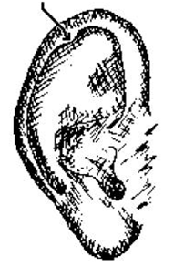
Darwin tubercle

Slide 5
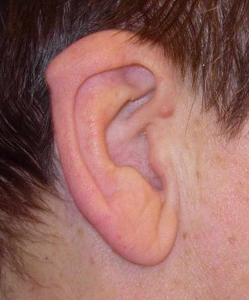
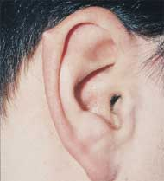
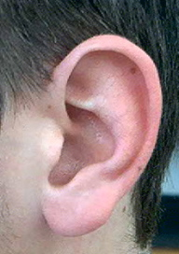

Slide 6
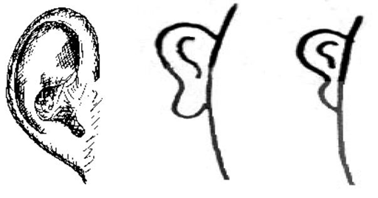
Earlobe attachment
The free-hanging earlobe is inherited as a dominant. The attached earlobe, or lack of a free-hanging earlobe is inherited as a recessive. Individuals with attached earlobes are characterized by the attachment of the lower part of the ear directly onto the head.

Slide 7
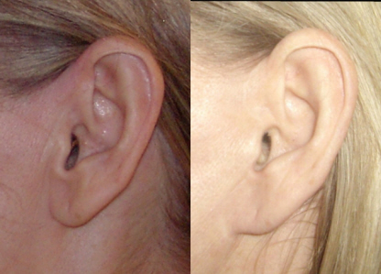

Slide 8
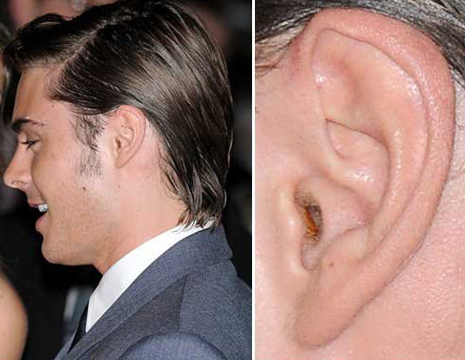
Ear wax (Cerumen)
Earwax occurs in two forms. The dominant type is sticky and yellow to brown in color. The recessive form is gray and brittle.

Slide 9
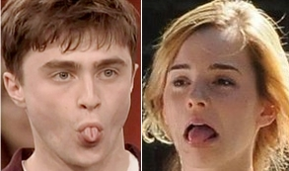
Tongue rolling
This trait is the ability to roll the tongue longitudinally into a U-shape. Many people are not able to do this, even with practice. Some with the ability to do it need to practice a bit to perform the feat. The ability to roll the tongue is an autosomal dominant. Those who cannot are recessive homozygotes.

Slide 10
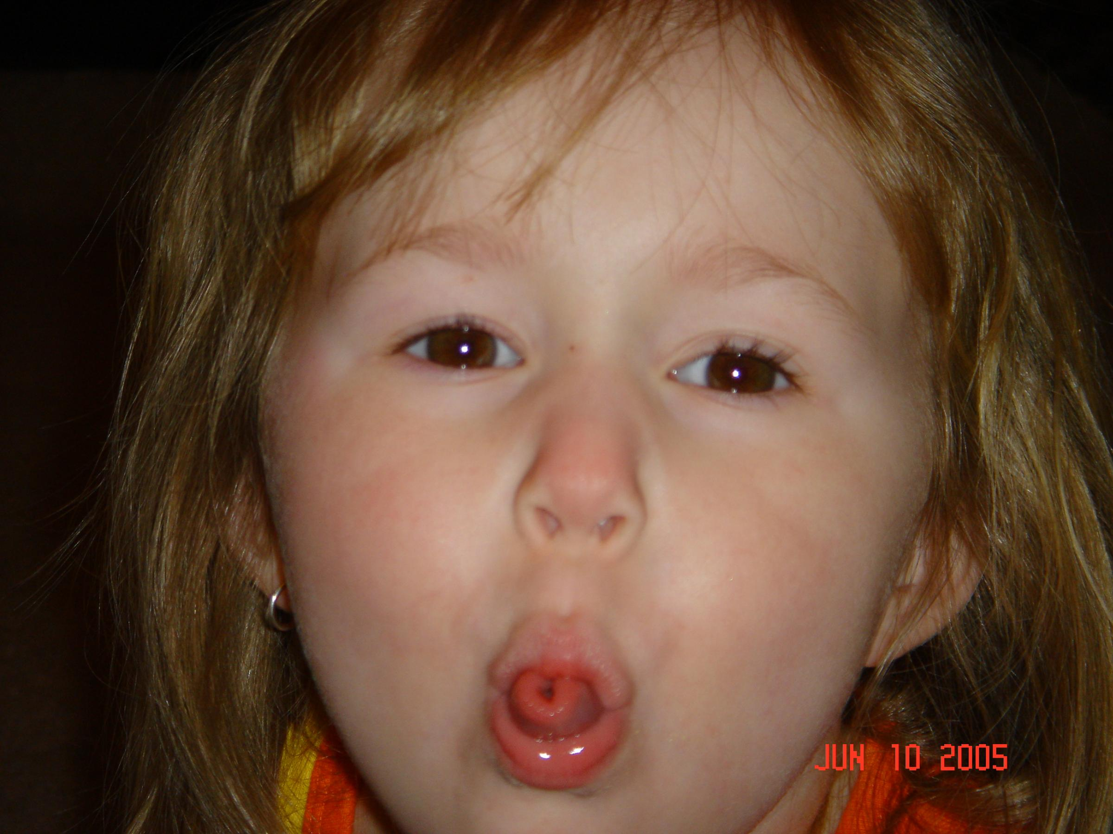
Tongue rolling

Slide 11
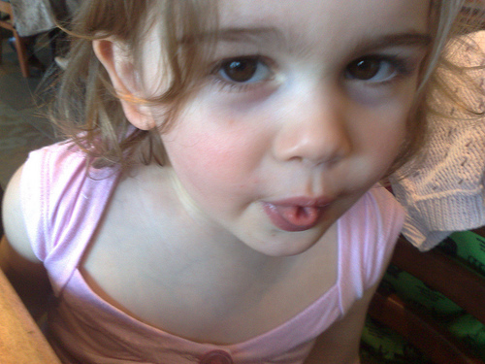

Slide 12
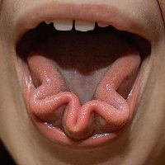
Tongue rolling

Slide 13
Hitchhiker′s thumb
Some individuals can bend the last joint of the thumb backwards at about a 45º angle. These individuals are homozygous for a recessive gene hi, but there is considerable variation in the expression of the gene.
For our purposes we shall consider those who cannot bend at least one thumb backwards about 45o as carrying the dominant gene Hi.

Slide 14
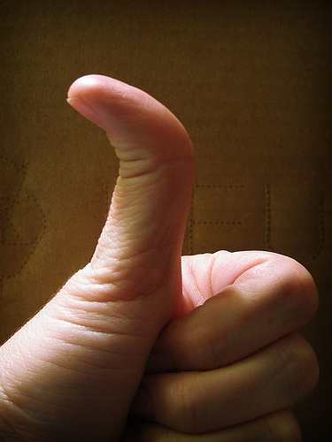
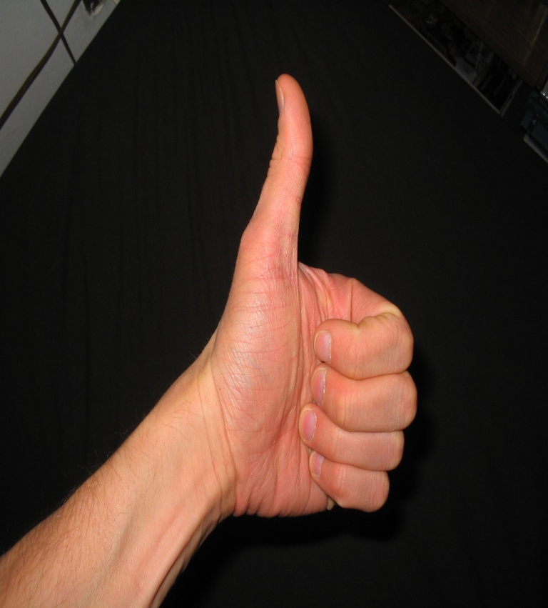
Hitchhiker′s thumb

Slide 15
PTC tasting
For some people (and some chimpanzees also), the chemical phenylthiourea tastes very bitter. For others, it is tasteless. PTC is a harmless compound that tastes bitter to those who have the dominant phenotype. Those with the recessive do not taste the bitterness. PTC-like chemicals are found in the Brassica-family of vegetables, such as cabbages and kale. Some researchers think that tasters have a lower incidence of deciduous dental caries, suggesting that there might be a substance in the saliva of tasters that inhibits bacterial destruction of the teeth. Others think that it may be in some way connected with thyroid function.

Slide 16
Middigital hair
It is easy to look for the presence or absence of hair on the middle segment of the fingers. If hair is present, that expression is a dominant. Even if just a small amount of hair is present, it qualifies as expression of the trait. The absence of hair is recessive. If hair is not present, the person is homozygous recessive.

Slide 17
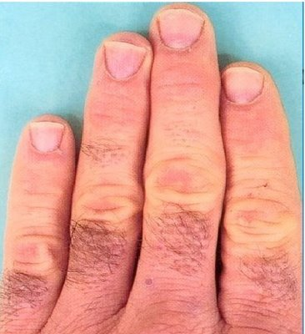
Middigital hair

Slide 18
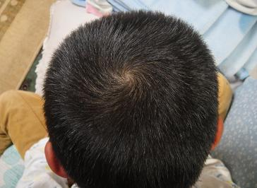
Hair whorl
This is observed by looking down at the top of a subject's head. A pattern which is clockwise is dominant. A pattern which is counterclockwise is recessive.

Slide 19
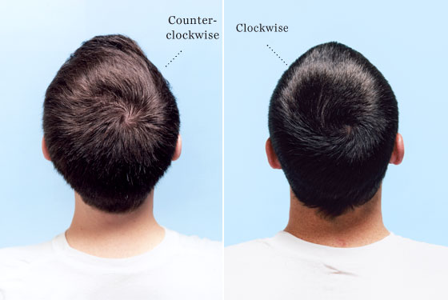
Hair whorl

Slide 20
Widow's Peak
A dominant gene W causes the hairline to form a distinct downward point in the center of the forehead. Of course, baldness can mask the presence of this gene. By looking in a mirror or with the help of a classmate, determine whether or not you have a widow's peak.

Slide 21
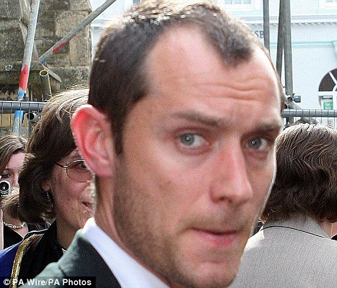
Widow's Peak

