Slide 1
Lab 2 20/02/2018
Practical Microbial Genetics
Gene Regulation:
Induction
Govand Musa Qader
M.Sc. In Molecular Genetics

Slide 2
Objectives:
To understand the concepts of induction.
To understand the lac operon and the use of ONPG.
Perform a carbohydrate and β-galactosidase fermentation test.

Slide 3
How does the cell control inducible enzymes?
In bacteria, this takes place on the level of transcription.
Inducible enzymes can be found in an operon, which has a promoter and operator followed by the genes involved in the enzymatic activity.
The repressor binds to the operator gene blocking transcription if the substrate for the enzyme is not present.
When the substrate is present, it binds to the repressor allowing the RNA polymerase to transcribe the genes for β-galactosidase.

Slide 4
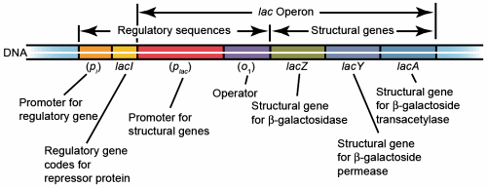
How does the cell control inducible enzymes?

Slide 6
Materials:
2MacConkey broth or neutral phenol red.
4ml of ONPG (Ortho Nitrophenyle β-galactoside)
Overnight cultures of Escherichia coli (cultures of Enterobacter and Klebsiella might also be tested) and Pseudomonas ( or Salmonella).

Slide 7
Procedure:
Experiment 1:
Label and inoculate each plate loopful E.coli and the other with Pseudomonas.
Incubate at 37⁰C for 48 hours.
Record the result:
Examine the plate for growth and record the results ( lac+ and lac-).
The part which turns into pink is Lac + and the part which do not is Lac-.
Experiment 2:
1-Add 1-2ml of distilled water into two sterile test tubes.
2-Label each tube with the microorganism to be inoculated. Add your name and the date.
3-Suspend a loopful of paste (concentrated microorganisms) into each tube. Place an 1-2 ml ONPG (ortho-Nitrophenyl-β-galactoside) into each tube and incubate at 35°C.
4-Incubate at room temperature and check for 30 minutes and 4 hours.
Record the results.

Slide 8
Experiment 3:
1- Dispense (0.2-0.5)ml of normal Saline or PBS into two sterile test tubes.
Label each tube with the microorganism to be inoculated. Add your name and the date.
2-Suspend a heavy loopful of a fresh culture of bacteria to be tested in the solution.
3-Introduce an ONPG disc (ortho-Nitrophenyl-β-galactoside) into the tube and swirl.
4-Incubate for 1 to 6 hours at 37°C examine every 15 minutes for a color change ,If there is no color change snap the cap down tight and incubate for 24 hours.Record the results.
A positive reaction will be indicated by the formation of a yellow color { positive β-galactosidase test} ………..(Lac+)
no color change indicates a negative reaction ………(Lac -).

Slide 9
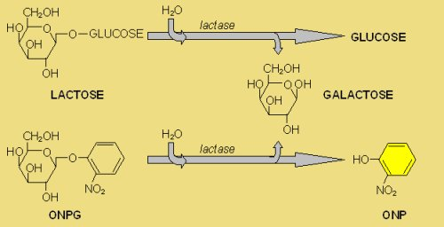

Slide 10
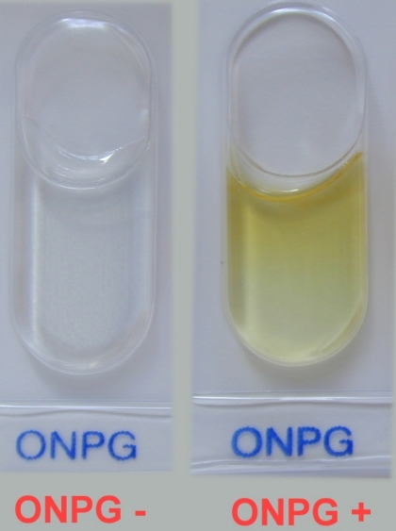

Slide 11
Questions:
Which substrates induced β-galactosidase?
What reaction produced the yellow color?
What is the Other compound serve as colorful indicators of β-galactosidase activity.

