Slide 1
Lab 3 20/02/2018
Practical Microbial Genetics
Gene Regulation:
Repression
Govand Musa Qader
M.Sc. in Molecular Genetics

Slide 2
Objectives:
To understand the operon
To understand the mechanism of repression.
3. To understand the trp operon.

Slide 3
Background:
A bacterial cell has all the genetic information to produce and operate a new cell.
This includes the enzymes necessary for obtaining energy and synthesizing the necessary cellular components.
A cell must work as efficiently as possible and carefully utilize the available nutrients without investing energy in enzymes not needed.
Some enzymes are utilized in the basic energy pathways of the cell and are continually synthesized. These are called constitutive enzymes.

Slide 4
Others termed inducible enzymes are only needed when their specific substrate is available. For example, E. coli can break down the sugar lactose with an enzyme called β-galactosidase.
If lactose were not present in the environment, it would be a waste of energy and of intermediate compounds to synthesize this enzyme. Therefore, these kinds of enzymes are called inducible enzymes because the presence of the substrate induces synthesis.

Slide 5
Typical bacterial operon structure

Slide 6
The tryptophan (trp) operon is an operon—a group of genes that are transcribed together that codes for the components for production of tryptophan.
Discovered in 1953 by Jacques Monod and colleagues, the trp operon in E. coli was the first repressible operon to be discovered.
the tryptophan (Trp) operon is inhibited by a chemical (tryptophan).
This operon contains five structural genes: trp E, trp D, trp C, trp B, and trp A, which encode tryptophan synthetase.

Slide 7
It also contains a promoter where RNA polymerase binds to begin transcription of the opern.
The protein that is synthesized by trp R then binds to the operator which then causes the transcription to be blocked.
The trp operon contains a leader peptide and an attenuator sequence which allows for graded regulation.

Slide 9
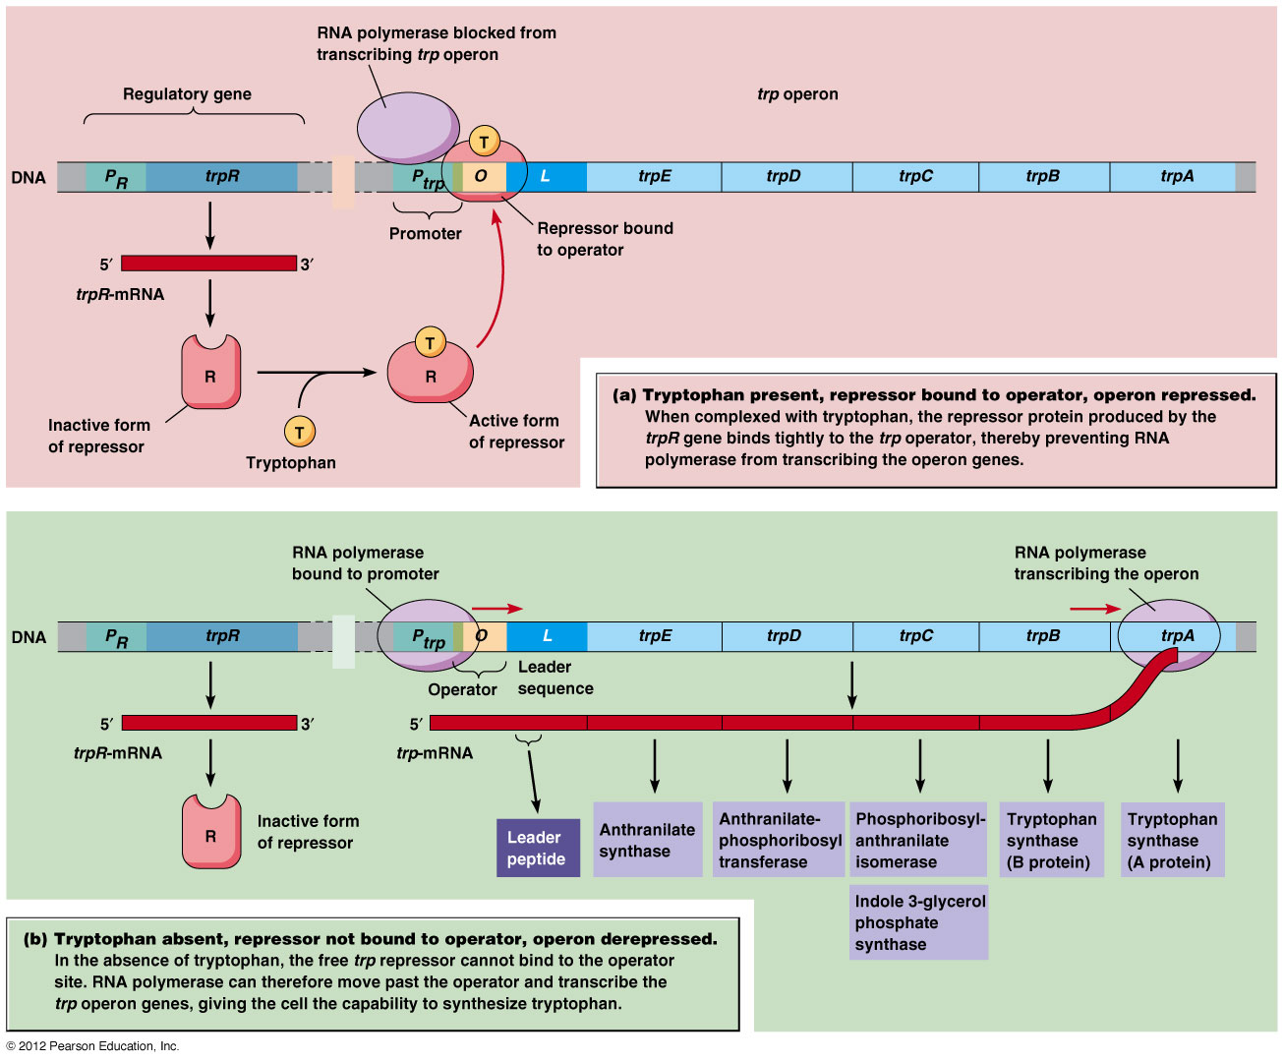

Slide 10
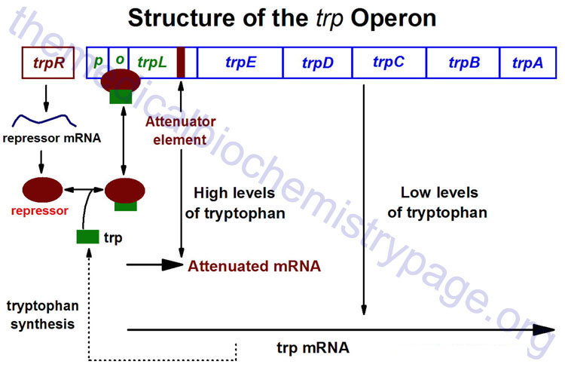

Slide 11
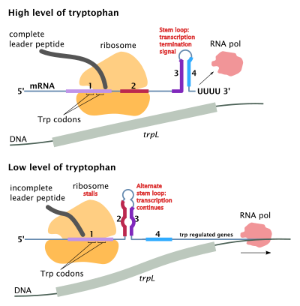

Slide 12
Definitions:
Constitutive enzymes: enzymes continually produced by the cell.
Inducible enzymes: enzymes produced only when substrate is present.
Operon: a series of genes that is controlled by one control region .
Substrate: the molecule reacting with an enzyme.

Slide 13
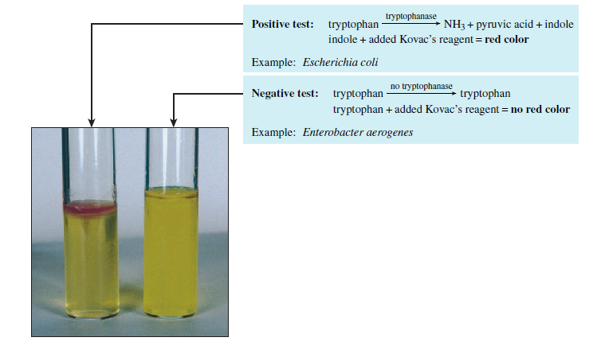

Slide 14
Question:
What are the differences between the lac operon and trp operon.

