Slide 1
Lab 5 Microbial Genetics 5-6/04/ 2015
Selection of Mutant Bacteria Resistant to Antibiotics
(Spontaneous mutation)
M. Govand Musa

Slide 2
Objectives:
To define mutation and understand that mutations are random events.
To count the number of an antibiotic-resistant mutant bacteria (Spontaneous mutation) that occurs in an overnight culture of a sensitive strain.

Slide 3
Background:
A Mutations is the result of a stable, heritable change in the nucleotide sequence of DNA.
Mutations occur in one of two ways: (1) Spontaneous, & (2) Induced mutations are the result of exposure to a Mutagen.
Mutagen is a physical , chemical or biological agent that cause mutation.
Mutations frequently results in changes in the quantity or structure of a gene product like enzyme.

Slide 4
There are two types of mutation that can be described on level of gene expression:
A selective mutation confers on the cell a clear advantage like survival or growth under certain unsuitable environmental conditions like mutation resulting in resistance of M.O. to an antibiotic.
non selectable mutation gives no such advantage.

Slide 5
All the bacterial cells in a pure culture are derived from a single cell. These cells, however, may not be identical, why?
The spontaneous mutation rate of genes varies between 1 in 10⁴ to 1 in 10¹² divisions, and even though that is quite a rare event.
It is important to understand that the mutation is a random event :
the cell cannot direct a mutation.
No matter how useful a mutation might be in a certain situation,
it just happens to the cell, randomly conferring an advantage or disadvantage to it.

Slide 6
In this exercise, you select organisms resistant to Ciprofloxacin by adding a population of sensitive bacteria to a TS agar containing Ciprofloxacin.
Only organisms that already had a random mutation for Ciprofloxacin resistance will be able to survive and multiply.
.

Slide 7
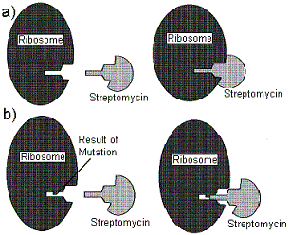

Slide 8
Definitions:
Antibiotic: a substance produced by one organism, usually a microorganism, which kills or inhibits other organisms.
Mutation: an inheritable, stable change in the base sequences of DNA.
Mutation rate: the number of mutations per cell division
Sensitive: an organism killed or inhibited by a particular antibiotic.
Wild type: the organism as it is isolated from nature.

Slide 9
Materials:
Overnight TS broth culture of Escherichia coli (sensitive to Streptomycin).
TS broth tube (9.9 ml).
TS agar petri dishes containing Streptomycin (0.1, 0.5, and 1mg/ml) and one without streptomycin (control).
1ml pipettes, loop glass spreader and gas burner.

Slide 10
Homework
What are Superbugs.
How bacteria can acquire (exchange) resistance to antibiotics.

Slide 11
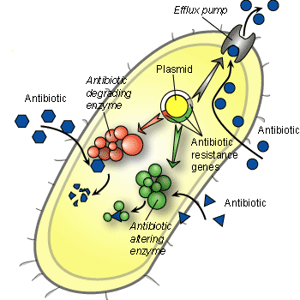

Slide 12
Alteration of metabolic pathway: for example, some sulfonamide-resistant bacteria do not require para-aminobenzoic acid (PABA), an important precursor for the synthesis of folic acid and nucleic acids in bacteria inhibited by sulfonamides.
Reduced drug accumulation: by
a- decreasing drug permeability or
b- increasing active efflux (pumping out) of the drugs across the cell surface.

Slide 13
Bacterial mechanisms of antibiotic resistance
Drug inactivation or modification: for example, enzymatic deactivation of penicillin G in some penicillin-resistant bacteria through the production of β-lactamases.
Alteration of target site: for example, alteration of PBP—the binding target site of penicillins.

