Slide 1
General chemistry
First stage

Slide 2
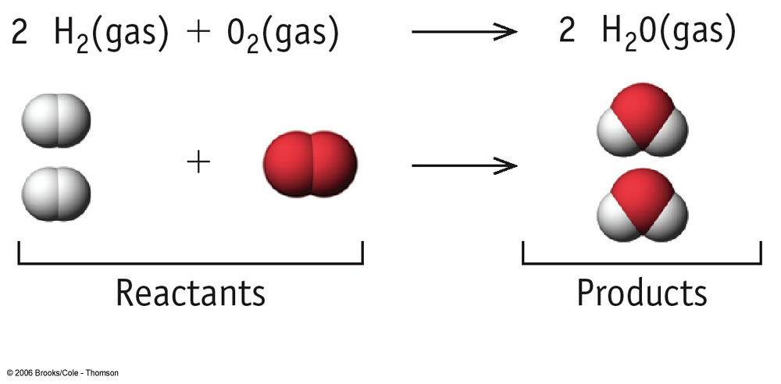
Chemistry
Chemistry is a branch of physical science that studies
the composition, structure, properties and change of matter.
Chemistry is chiefly concerned with atoms and
molecules and their interactions and transformations, for example, the properties of the chemical bonds formed between atoms to create chemical compounds.

Slide 3
Chemistry
chemistry studies the involvement of electrons and various forms of energy in photochemical reactions, oxidation-reduction reactions, changes in phases of matter, and separation of mixtures. Preparation and properties of complex substances, such as alloys, polymers, biological molecules, and pharmaceutical agents are considered in specialized fields of chemistry
Chemistry is sometimes called the central science because it bridges other natural sciences like physics, geology and biology.^{[3][4]}Chemistry is a branch of physical science but distinct from physics.^{[5]}

Slide 4
Chemistry
Chemistry is sometimes called the central science
because it bridges other natural sciences like physics,
geology and biology Chemistry is a branch of physical
science but distinct from physics.

Slide 5
Introduction of chemistry sciences
Definition :- Chemistry is the study of matter and energy and the interactions between them.
Chemistry is the study of the properties of materials and the changes that materials undergo .
or Chemistry is the study of the properties and behavior of matter

Slide 6
Matter
anything that has mass and occupies space is called matter.
Classification of Matter
Matter classified according to its physical state
to (gas , liquid , solid)
and according to its composition as
(elements ,compound , or Mixtures)
Mixture:- combination of two or more substances in which each substance retains its own chemical identity.

Slide 7
Matter
Homogeneous mixture: - composition of this mixture is consistent throughout. Ex . Solution (Air, gasoline)
Heterogeneous mixture : - composition of this mixture varies throughout the mixture. ex. (rocks + wood )

Slide 9
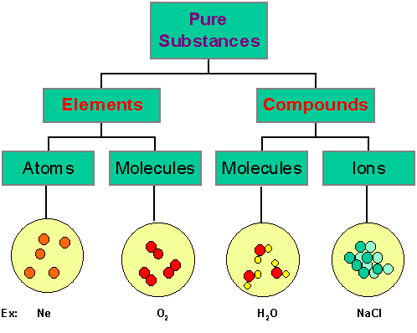

Slide 10
Matter
pure substance :- It is also possible for a homogeneous substance to be composed of a single substance
Element – A substance that can not be separated into simpler substances by chemical means.
Atom – the smallest unit of an element that retains a substances chemical activity.

Slide 11
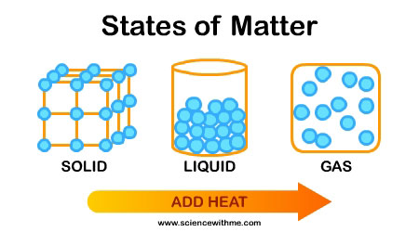
Properties of Matter
Physical and Chemical Changes
Physical Property – A property that can be measured without changing the identity of the substance. Example: color, odor, density
Water (ice) → Water (liquid)

Slide 12
Properties of Matter
Chemical Properties
are the characteristics that determine how the composition of matter changes as a result of contact with other matter or the influence of energy.
example:-
When pure hydrogen and pure oxygen react completely, they form pure water.

Slide 13
Chemical Changes

Slide 14
Physical and Chemical Changes
Classify Each of the following as Physical or Chemical Properties
The boiling point of ethyl alcohol is 78°C.
Physical property – describes inherent characteristic of alcohol – boiling point
Diamond is very hard.
Physical property – describes inherent characteristic of diamond – hardness
Sugar ferments to form ethyl alcohol.
Chemical property – describes behavior of sugar – forming a new substance (ethyl alcohol)

Slide 15
Physical and Chemical Changes
The basic difference between these states is the distance between the “bodies.”
Gas – bodies are far apart and in rapid motion.
Liquid – bodies closer together, but still able to move past each other
Solid – bodies are closer still and are now held in place in a definite arrangement.

Slide 16
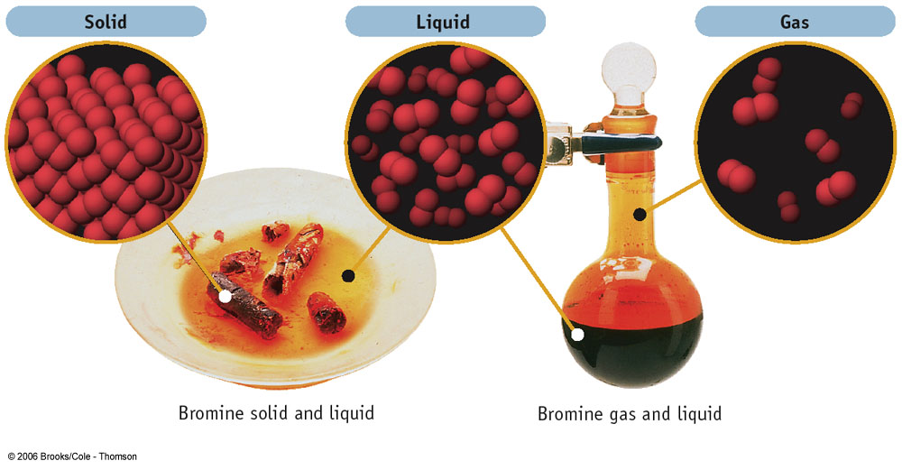
Physical and Chemical Changes

