Slide 1
Agricultural Terms
Prepared by:
--For First Year Students of Agriculture College/ --All Depts
2023-2024

Slide 2
Our country needs agricultural investment.
Agricultural investment الاستثمار الزراعى

Slide 3
We faced a lot of plant disease this year.
Plant diseases امراض النبات

Slide 4
We use the best fertilizer.
Fertilizer

Slide 5
There are a lot of cows in the cattle.
Cattle

Slide 6
Our rural location is ideal for farming activities.
Rural

Slide 7
Chickens and turkeys are also known as poultry.
Poultry

Slide 8
Last year's harvest was excellent.
Harvest

Slide 9
Our horses are out grazing.
Grazing

Slide 10
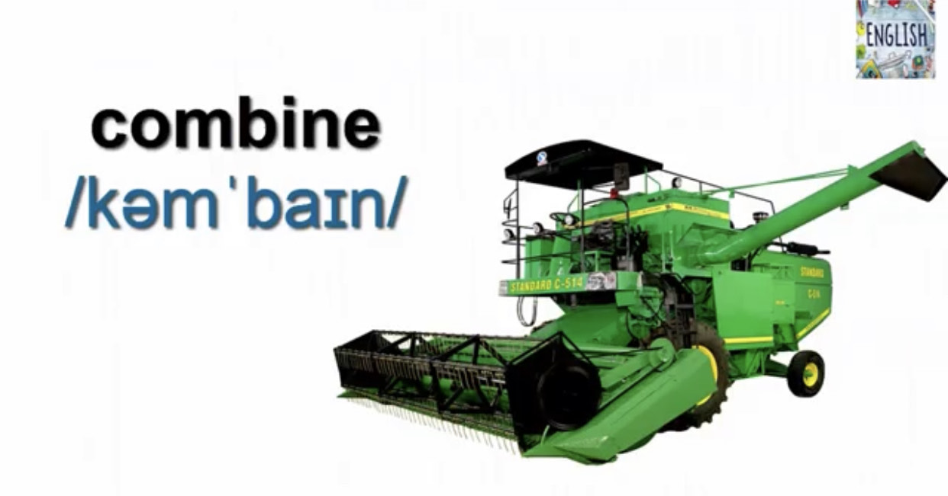
We see many combines in street these days.

Slide 11
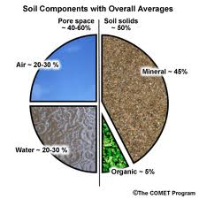
Soil components are very important in agriculture.
Soil components عناصر التربة

Slide 12
Soil fertility affects the harvest.
Soil fertility خصوبة التربة

Slide 13
The Scarecrow is necessary in the field.

Slide 14
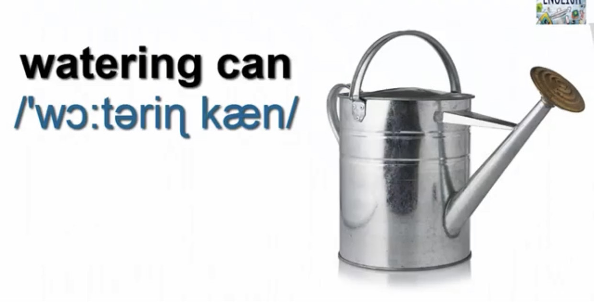
We need to have watering cans at home.

Slide 15
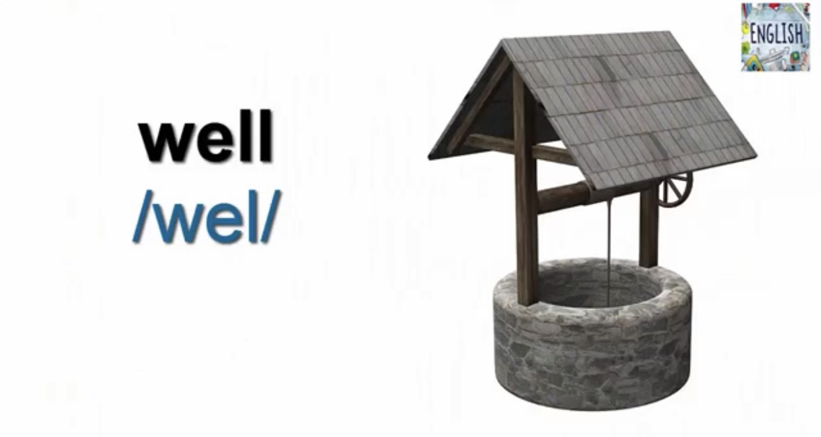
There is a well in the field.

Slide 16
The fence is really strong.

Slide 17
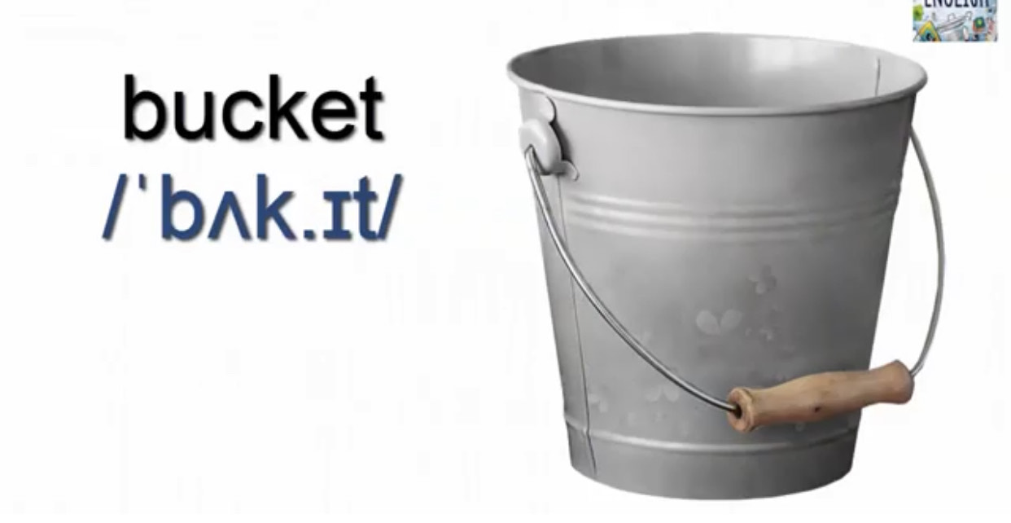
The bucket is full of water.

Slide 18
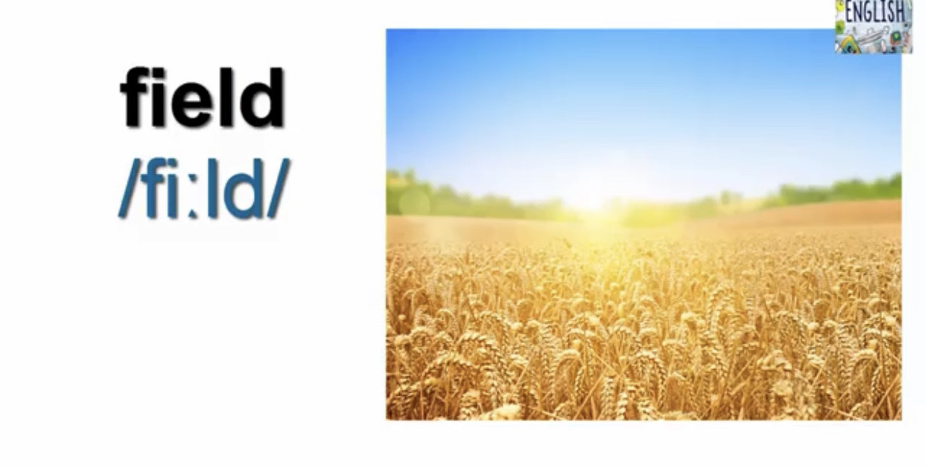
The field is very fertile.

Slide 19
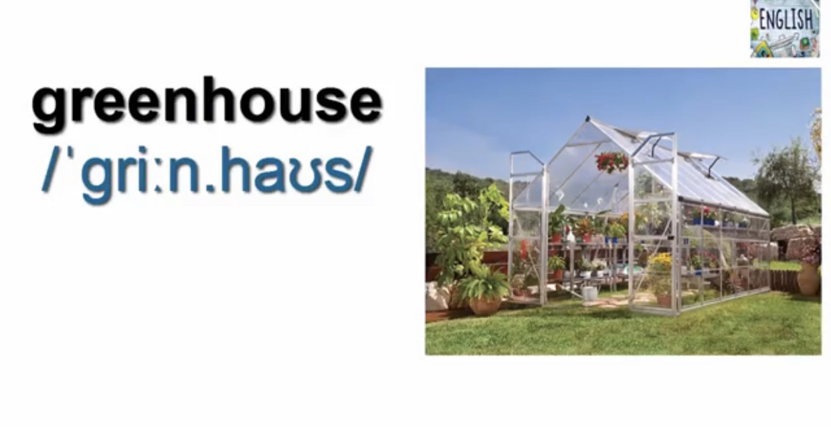
The greenhouse is very warm.

Slide 20
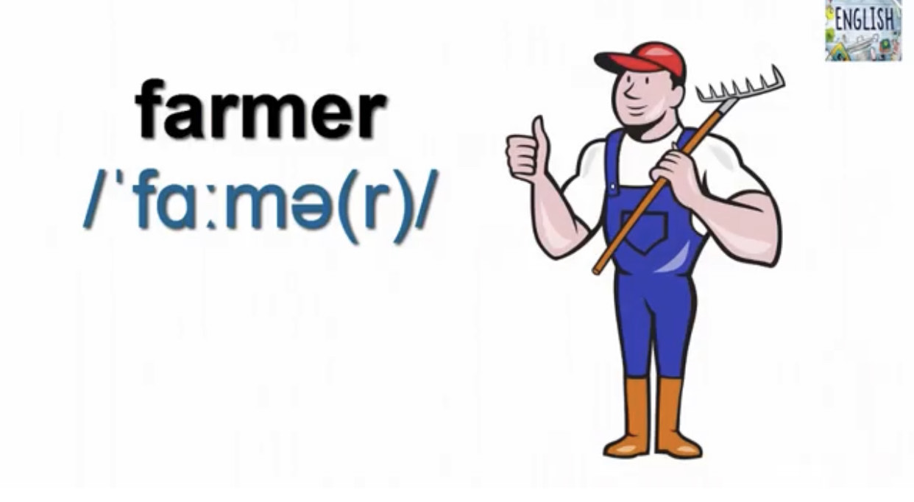
This farmer is a hard worker.

Slide 21
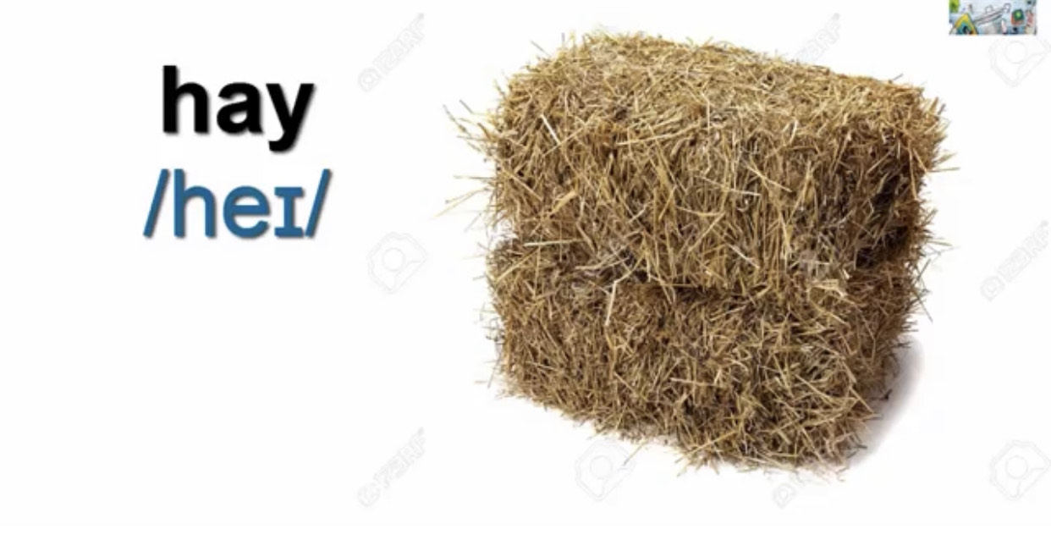
A bale of hey is there.

Slide 22
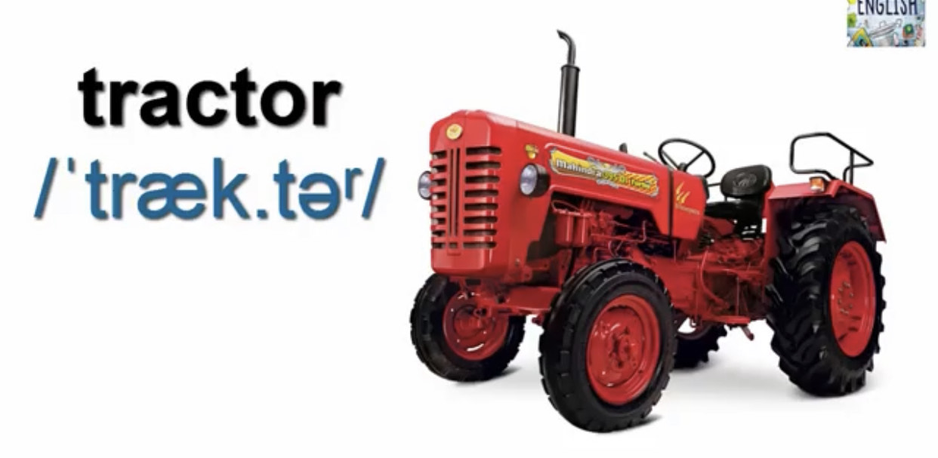
Many Farmers use Tractors

