Slide 1
Principle and Measurement of Electrical conductivity (EC)
8th lecture Soil, Plant and Water Analysis / post graduation Dr. Haifa Akrawi

Slide 2
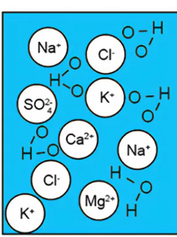
Electrical conductivity (EC)
The electrical conductivity (EC) measurement gives the total amount of soluble salts present in the soil and is expressed as milli mhos cm⁻¹ or dS m⁻¹.
EC is the measurement of the ability of a substance to conduct electrical current over a defined area

Slide 3
Principle
As the amount of the soluble salts in a solution increases the electrical conductivity also increases. This electrical conductivity is measured in terms of the resistance offered to the flow of current using a conductivity bridge. It is known that solutions offer some resistance to the passage of electric current through them, depending upon the concentration of salts present.
Hence EC is measured in terms of electrical resistance between parallel electrodes immersed in the soil suspension of water. In such a system, the solution between the electrodes becomes the electrical conductor to which the physical laws relating to resistance are applicable.

Slide 4
The electrical resistance “R” is directly proportional to the distance “L” between the electrodes and inversely proportional to the cross sectional area “A” of the conductor. Hence R = L/ A or R= r x L/ A Where r = proportionality constant known as electrical resistivity If
L = 1 cm and A = 1 cm²
then R = r.
Where, r is called specific resistivity.
Hence specific resistance is the resistance of a conductor 1 cm in length and 1 cm² in area.

Slide 5
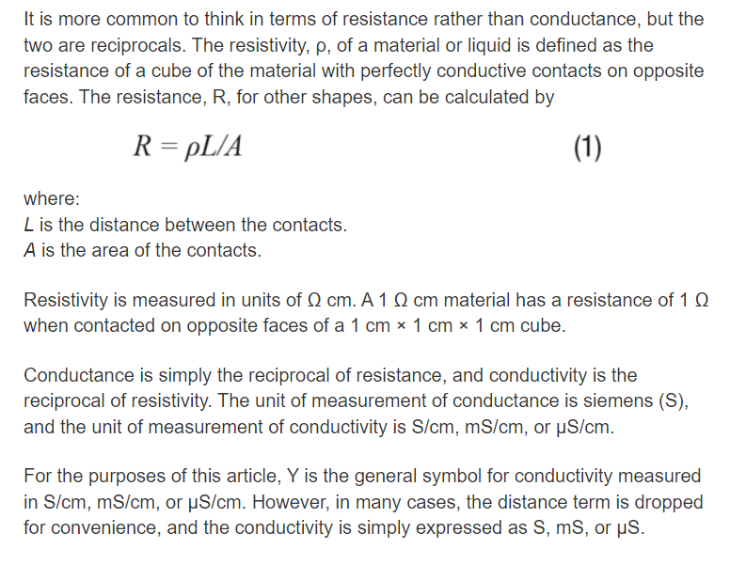

Slide 7
Higher the salt content, higher the passage of current and lesser the resistance to the flow of the current. Hence the reciprocal of specific resistivity is called as specific conductivity.
Therefore specific conductivity is defined as the conductivity of a solution enclosed in a cell whose electrodes are exactly 1 cm and possess a surface area of 1 cm². The resistance is expressed as ohms cm⁻¹ and the conductivity is expressed in reciprocal ohms or mhos per cm. It is not possible to make a conductivity bridge having electrodes 1 sq.cm. in area and place exactly 1 cm apart. Hence, the factor called the cell constant is determined for the given cell. Modern conductivity meters are calibrated to read directly the electrical conductance with given cell.

Slide 8
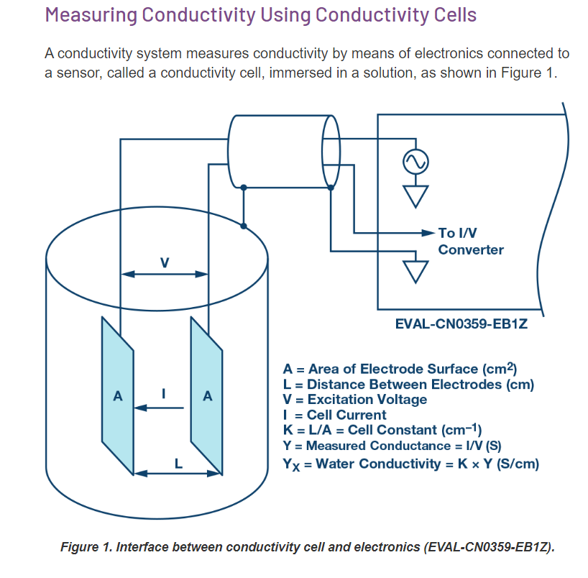

Slide 9
Materials required
Conductivity bridge
100 ml beaker
Glass rod
0.01 N KCl solution and
Saturated CaSO₄ solution

Slide 10
Procedure
Switch on the conductivity bridge and wait for 10 minutes.
Check the instrument, with saturated CaSO₄ solution and 0.01 N KCl solutions. •
The EC of saturated CaSO₄ and 0.01 N KCl solutions should be 2.2 and 1.41 dSm⁻¹ respectively.
Use the same soil water suspension used for measuring pH for the determination of EC.
Stir the contents and allow the soil to settle for 15 minutes. Wash the electrodes carefully and immerse them into soil solution.
Adjust the temperature correction.
Adjust the meter knob until the magic eye of the null indicator is at the widest in width.
The readings on the scale at this position indicate the electrical conductivity.
Multiply this by the cell constant (noted on the cell itself) to get specific conductivity.

Slide 11
How to convert electrical conductivity to Total dissolved solids (TDS)?

