Slide 1

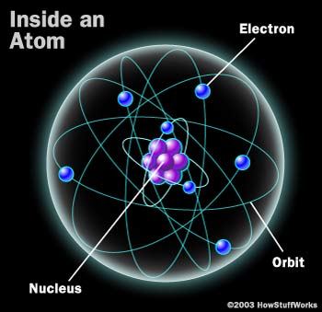
University of Salahaddin-Erbil
College of Education Shaqlawa
Department of Physics
4th Year
Chapter one
Types of Radiation and their interaction with Matters
M.Sc. Hallo Mahmud Kaka Abdullah
Email: hallo.sallay@su.edu.krd
2023
Notes:
In the first I would like to introduce myself my name is Halllo I do my master in Nuclear physics in college of science physics department
Today we will taking about Atomic Structure,
Any one here have any idea about Atom????
this lecture will help to understand the meaning of Atomic Structure so please pay u attention to me

Slide 2
  1 Introduction
Radiation is defined as energy that travels through space or matter in the form of a particle or wave.

Slide 3
It can be produced in one of two ways:
radioactive decay of an unstable atom (radionuclide)
by the interaction of a particle with matter. artificial
Notes:
the type of radiation emitted depends on the specific radionuclide.
Radiation emission as the result of an interaction, on the other hand, depends on both the incoming particle and the material it hits

Slide 4
The types of radiation fall into two main categories
Particulate radiation consists of particles that have mass and energy, and may or may not have an electric charge (alpha particles, protons, beta particles, and neutrons)
Electromagnetic radiation,, consists of photons that have energy, but no mass or charge (X- Ray and Gamma Ray)

Slide 5
A photon, as described by quantum theory, is a "particle" or "quantum" that contains a discrete quantity of electromagnetic energy which travels at the speed of light, or 3 x 10⁸ meters per second.
A photon is sometimes described as a “packet of light”. Visible light, ultraviolet light, x-rays, and gamma rays are all photons.

Slide 6
  2 Classification of Radiation
Radiation
Ionizing
Directly ionizing (charged particles)
electrons, protons, alpha particles
Indirectly ionizing (neutral particles)
X rays, gamma rays, neutrons
Non-Ionizing
ultraviolet (UV), visible light, infrared

Slide 7
Directly ionizing radiation
Deposits energy in the medium through direct coulomb interactions between the directly ionizing charged particle and orbital electrons of atoms in the medium.

Slide 8
Indirectly ionizing radiation
deposits energy in the medium through a two step process:
In the first step a charged particle is released in the medium (photons release electrons or positrons, neutrons release protons or heavier ions);
In the second step the released charged particles deposit energy to the medium through direct Coulomb interactions with orbital electrons of the atoms in the medium

Slide 9
Applications of Both directly and indirectly ionizing radiations
The branch of medicine that uses radiation in the treatment of disease is called radiotherapy, therapeutic radiology or radiation oncology
Diagnostic radiology and nuclear medicine are branches of medicine that use ionizing radiation in the diagnosis of disease

Slide 10
Classification of ionizing photon radiation
Characteristic X rays: resulting from electron transitions between atomic shells.
Bremsstrahlung: resulting from electron–nucleus Coulomb interactions.
gamma-rays: resulting from nuclear transitions.
Annihilation quanta: resulting from positron–electron annihilation.

Slide 11
  1.3 Basic definitions for atomic structure
The atomic structure of an element is denoted as
where:
X : is the chemical symbol of the element.
Z : is the atomic number, defined as the number of protons in the
nucleus. This determines the chemical identity of the element.
A : is the mass number, defined as the sum of the number of protons
and neutrons in the nucleus. Thus, A minus Z gives the number of
neutrons

Slide 12
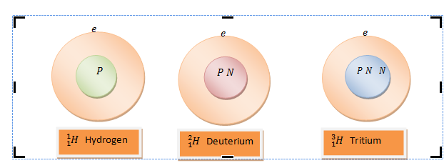
different numbers of neutrons and still be chemically the same.
Each individual arrangement of protons and neutrons is referred to as a nuclide. Nuclides which have the same number of protons are called isotopes. Shown below are examples of isotopes of hydrogen:

Slide 13
1.4The Units of Energy
electron-volt (eV)
Joule (J)
Erg
1 eV = 1.6x10⁻¹⁹ J
1 J = 10⁷ Erg
it is more common to use kilo-electron-volts (1 keV = 1000 eV) or mega-electron-volts (1 MeV = 1,000,000 eV).
An Electron-Volt is the amount of kinetic energy an electron gains when accelerated through a potential difference of one volt.

Slide 14
1.5 Radioactivity
Radioactive decay is the process in which an unstable atom releases matter and/or energy during a transition to a more stable form.
The original, radioactive atom is known as the parent. The new nucleus (after decay) is known as the daughter.

Slide 15
1.5.1 Stability and Instability
nuclides remain intact indefinitely and are said to be stable. For other atoms, the numbers of nucleons are less favorable and the atom is unstable (radioactive).
The rules of stability are complex. Some of the factors influencing stability include:
The mass of the atom.
The ratio of neutrons to protons.
Even versus odd numbers of nucleons.
“Magic numbers” of nucleons (exceptionally stable combinations).

Slide 16
The optimum ratio of neutrons to protons varies from 1:1 for light nuclei to more than 1.5:1 for heavy nuclei. Atoms lacking these ratios are not stable. If an atom has an even number of protons and neutrons, it is more likely to be stable. Atoms are particularly likely to be stable if the number of protons and/or neutrons corresponds to one of the following integers: 20, 28, 50, 82 and 126.

Slide 17
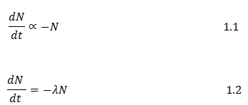
1.5.2 Rate of Decay
Radioactive decay is a random process and has been observed to follow Poisson distribution. What this essentially means is that the rate of decay of radioactive nuclei in a large sample depends only on the number of decaying nuclei in the sample. Mathematically this can be written as:

Slide 18

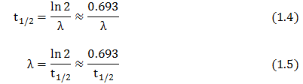
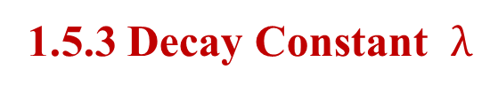
Starting with an initial number N₀ of radioactive atoms, the number, , of atoms present at time will be:
1.5.3 Decay Constant $λ$
The decay constant is expressed in units of probability per unit time.
1.5.4 Half-Life (t_{½})
The half-life (t_{½}) is the amount of time required for 50% of the parent atoms to undergo radioactive decay.

Slide 19
1.5.5Activity
It is easy to see that a radionuclide with a short half-life will undergo radioactive decay at a very rapid rate, while a radionuclide with a long half-life will have a much smaller rate of decay. If you have a sample of one billion (10⁹) sodium-25 atoms, you would expect about 11 million of these to decay during the next second.

Slide 20
On the other hand, if you have sample of one billion tritium atoms, you would expect only 1 or 2 of these atoms to decay during the next second. For convenience, radioactivity is measured in units of activity, or the number of decays taking place each second.

Slide 21

The traditional unit of activity is the curie, named after Marie and Pierre Curie (the discoverers of radium). One curie, abbreviated Ci, is equal to 3.7 x 10¹⁰ disintegrations per second (dps).
Exponential Decay
If the activity of a particular radionuclide is measured as a function of time, it can be seen that radioactive decay is exponential:

Slide 22


A(t) is the activity at time t, and A₀ is the initial activity. Since the activity is proportional to the number of radioactive atoms, the equation can also be written:

Slide 23
1.6 Radioactive Decay Modes.
1.6.1- Beta Minus Decay
1.6.2- Positron/Beta Plus Decay
1.6.3- Alpha Decay
1.6.4- Electron Capture
1.6.5- Nuclear/Isomeric Transition

Slide 24
Beta Minus Decay
The neutron to proton ratio is too high
Neutron "transforms" into a proton and electron, with the electron being ejected from the nucleus
Beta particles are not emitted with a single energy but are emitted with a spectrum of energies up to some maximum value. This is due to a division of the total energy of each disintegration between the beta particle and a antineutrino.

Slide 25
The generalized atomic equation for beta minus decay is :

Slide 26
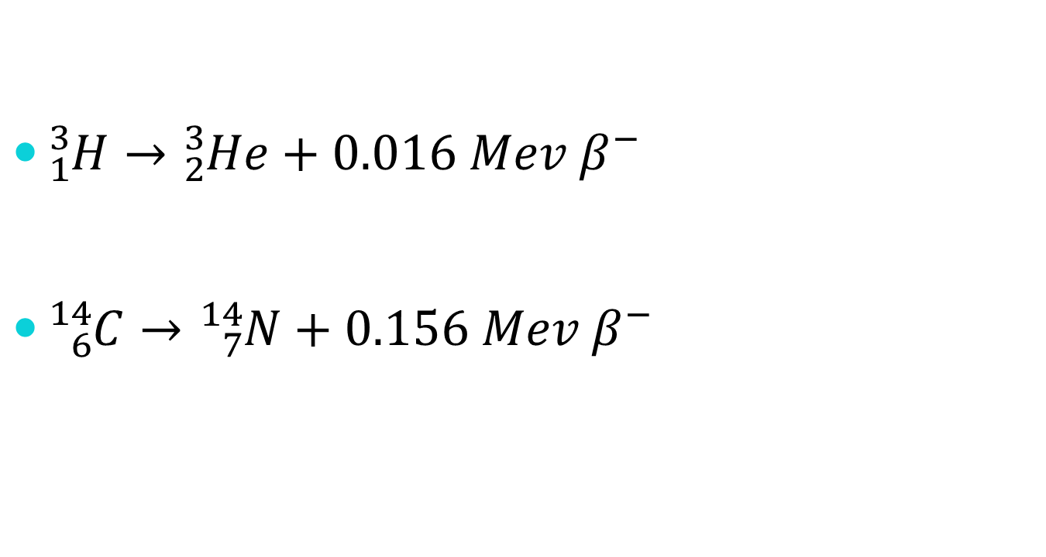
:
Examples of Beta Minus decay
${}_{1}^{3}{H→{}_{2}^{3}{He+0.016 Mev β^{−}}}$
${}_{6}^{14}{C→{}_{7}^{14}{N+0.156 Mev β^{−}}}$

Slide 27
Positron/Beta Plus Decay
When the neutron to proton ratio is too low
proton transforms into a neutron and a positron (beta plus particle), and the positron is ejected from the atom
positron has a positive charge and the same mass as an electron
Like beta minus decay, the energy released in the decay is split between the positron and a neutrino, so positrons are emitted with a spectrum of energies.

Slide 28
The generalized atomic equation for positron decay is

Slide 29
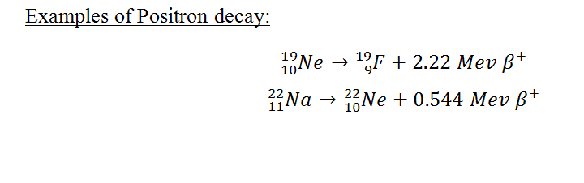

Slide 30
Alpha Decay
Alpha decay occurs for those nuclides which have an atomic number greater than 82. Such heavy nuclides have no stable configuration of neutrons and protons, and as a result, emit an alpha particle consisting of 2 protons and 2 neutrons. Generally, a series of alpha (as well as beta) decays are required until a lighter, stable element is reached. Unlike beta particles, alpha particles are emitted with a discrete energy.

Slide 31
The generalized atomic equation for alpha decay is

Slide 32
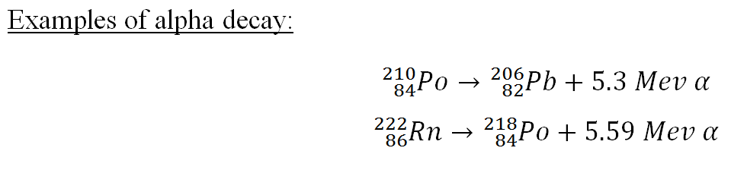

Slide 33
Electron Capture
In this decay mode, one of the orbital electrons is captured by the nucleus and combines with a proton to form a neutron
Electron capture competes with positron decay when there is a low neutron to proton ratio.
Whenever an atom decays by electron capture, x-rays are emitted that are characteristic of the newly formed nuclide. No particles are emitted during electron capture decay.

Slide 34
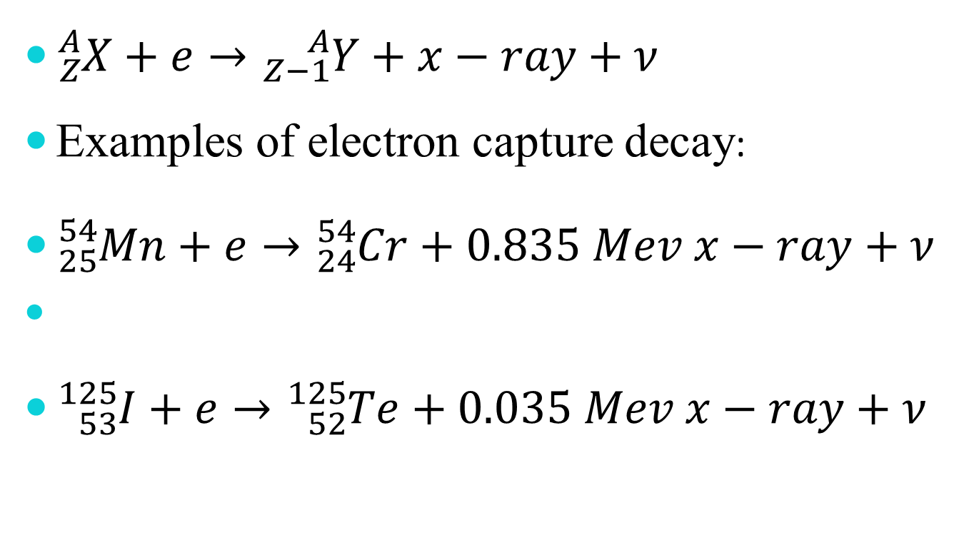
The generalized atomic equation for electron capture is

Slide 35
Nuclear/Isomeric Transition
When the emission of a particle leaves the product nucleus in a partially excited or "metastable" state , gamma rays are emitted.
The gamma rays carry away the excess energy of the partially excited nucleus after a decay event.
The gamma rays are of a discrete energy and are characteristic of the particular nuclide involved.
No particles are emitted, and the nucleus does not change atomic number.

Slide 36

The generalized atomic equation for nuclear transition is
${}_{Z}^{Am}{X→{}_{Z}^{A}{X+γ}}$

Slide 37
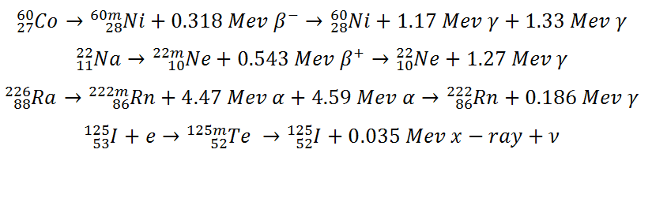

Example:
${}_{27}^{60}{Co→{}_{28}^{60m}{Ni+0.318 Mev β^{−}→{}_{28}^{60}{Ni+1.17 Mev γ+1.33 Mev γ}}}$
${}_{11}^{22}{Na→{}_{10}^{22m}{Ne+0.543 Mev β^{+}→{}_{10}^{22}{Ne+1.27 Mev γ}}}$
${}_{88}^{226}{Ra→{}_{86}^{222m}{Rn+4.47 Mev α+4.59 Mev α→{}_{86}^{222}{Rn+0.186 Mev γ}}}$
${}_{53}^{125}{I+e→{}_{52}^{125m}{Te →{}_{52}^{125}I+0.035 Mev x−ray+ν}}$

Slide 38
1.7 Interactions of Radiations with Matter
The particles or rays that are emitted during radioactive decay are emitted with certain energy, and they may or may not have charge.
All of them interact with the environment into which they are released, transferring energy to that medium, and eventually dissipating all of their energy
such transfers of energy will have important implication for radiation biology, radiation shielding , radiation detection and almost every practical application of radiation protection.

Slide 39
1.7.1 Interaction of charged particle with matter
A charged particle is surrounded by its Coulomb electric force field that interacts with orbital electrons (collision loss) and the nucleus (radiative loss)
The energy transfer from the charged particle to matter in each individual atomic interaction is generally small, so that the particle undergoes a large number of interactions before its kinetic energy is spent.

Slide 40
Interaction of charged particle with matter
Stopping power is the parameter used to describe the gradual loss of energy of the charged particle as it penetrates into an absorbing medium.
Two classes of stopping powers are known: collision (ionization) stopping power that results from charged particle interaction with orbital electrons of the absorber and radiative stopping power that results from charged particle interaction with nuclei of the absorber.

Slide 41
Stopping powers depend on the :
properties of the charged particle such as its mass, charge, velocity and energy.
properties of the absorbing medium such as its density and atomic number

Slide 42
1.8 Stopping Power
As a charged particle travels through an absorber, it experiences Coulomb interactions with the nuclei and the orbital electrons of the absorber atoms. These interactions can be divided into three categories depending on the size of the classical impact parameter b compared to the classical atomic radius a:

Slide 43
Stopping Power
Coulomb force interaction of the charged particle with the external nuclear field (radiative collision or bremsstrahlung production) for b << a.
Coulomb force interaction of the charged particle with orbital electron for b ≈ a (hard collision).
Coulomb force interaction of the charged particle with orbital electron for b >> a (soft collision).

Slide 45
Stopping Power
The rate of energy loss per unit of path length by a charged particle in a medium is called the linear stopping power (dE/dx).
The stopping power is typically given in units MeV.cm²/g and then referred to as the mass stopping power S_{m} equal to the linear stopping power divided by the density ρ of the absorbing medium.
The stopping power is a property of the material in which a charged particle propagates.

Slide 46
Stopping Power
Two types of stopping powers are known:
Radiative stopping power that results from charged particle Coulomb interaction with the nuclei of the absorber. Only light charged particles (electrons and positrons)
Collision (ionization) stopping power that results from charged particle Coulomb interactions with orbital electrons of the absorber. (heavy and light charged particles)
S_{tot} = S_{rad} + S_{col}

Slide 47
1.8.1 Collision Stopping Power for Heavy Charged Particles
In the energy range below 10 MeV, the energy transfer from energetic heavy charged particles to a medium (absorber) they traverse occurs mainly through Coulomb interactions of the charged particle with orbital electrons of the absorber atoms.
1. soft collisions for b >> a
2. hard collisions for b ≈ a

Slide 48
1.6.1.1 Momentum Transfer from Heavy Charged Particle to Orbital Electron
The classical derivation of the mass collision stopping power S_{col} of a heavy charged particle, such as a proton, is based on the calculation of the momentum change Δp of the heavy charged particle colliding with an orbital electron. The Coulomb interaction between the heavy charged particle (charge ze and mass M) and the orbital electron (charge e and mass m_{e}) is shown schematically in Fig. 1.2.

Slide 50
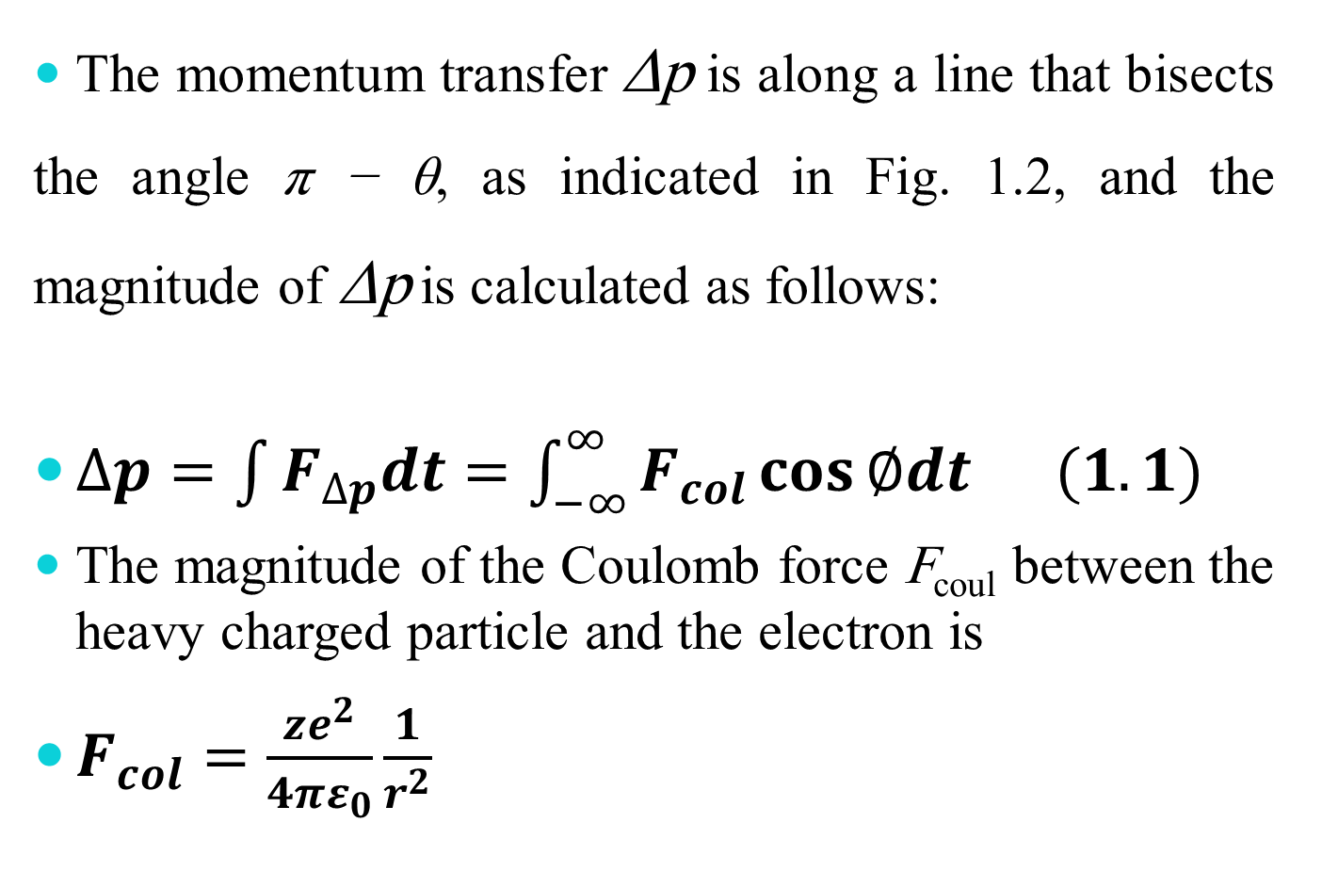
The momentum transfer Δp is along a line that bisects the angle π − θ, as indicated in Fig. 1.2, and the magnitude of Δp is calculated as follows:
$∆p=\int{F_{∆p}dt=\int_{−∞}^{∞}{F_{col}\cos{∅dt (1.1)}}}$
The magnitude of the Coulomb force F_{coul} between the heavy charged particle and the electron is
$F_{col}=\frac{ze^{2}}{4πε_{0}}\frac{1}{r^{2}}$
4

Slide 51
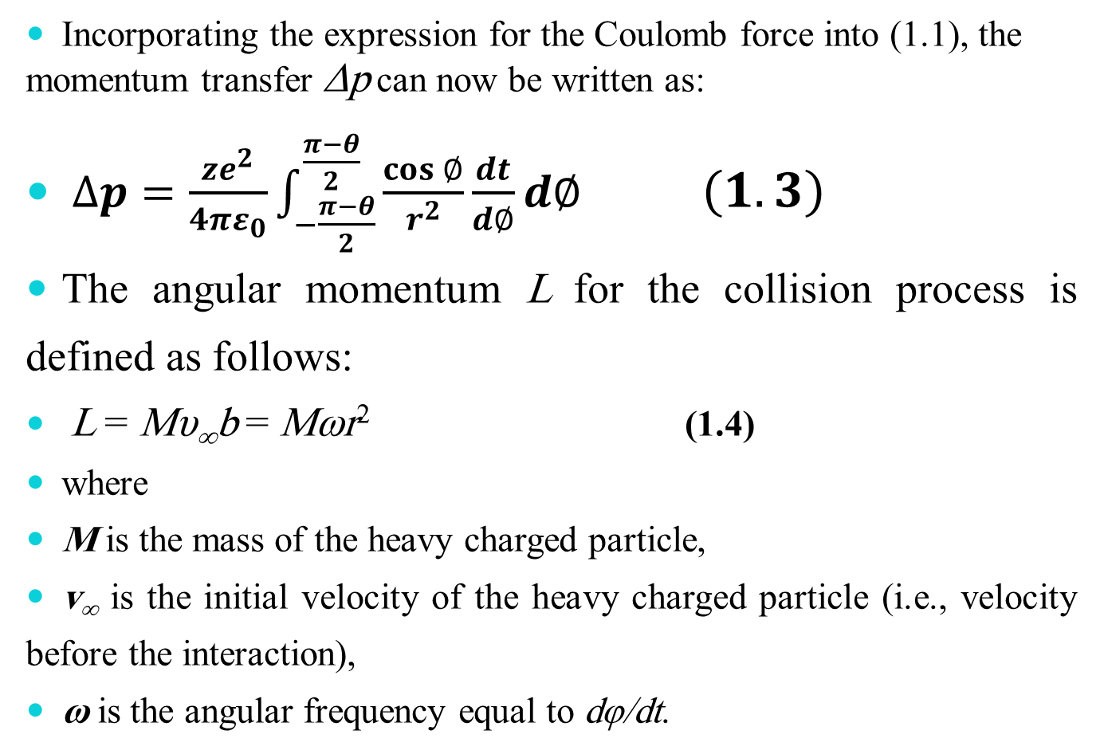
Incorporating the expression for the Coulomb force into (1.1), the momentum transfer Δp can now be written as:
$∆p=\frac{ze^{2}}{4πε_{0}}\int_{−\frac{π−θ}{2}}^{\frac{π−θ}{2}}{\frac{\cos{∅}}{r^{2}}\frac{dt}{d∅}d∅} \left(1.3\right)$
The angular momentum L for the collision process is defined as follows:
L = Mυ∞b = Mωr² (1.4)
where
M is the mass of the heavy charged particle,
v∞ is the initial velocity of the heavy charged particle (i.e., velocity before the interaction),
ω is the angular frequency equal to dφ/dt.

Slide 52
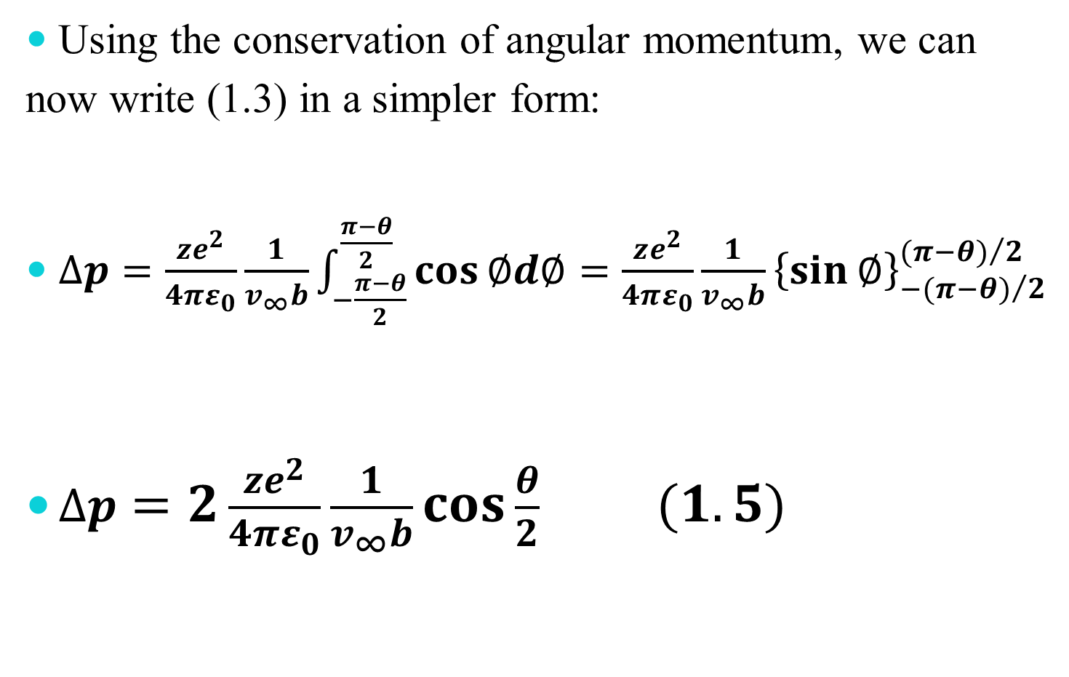
Using the conservation of angular momentum, we can now write (1.3) in a simpler form:
$∆p=\frac{ze^{2}}{4πε_{0}}\frac{1}{v_{∞}b}\int_{−\frac{π−θ}{2}}^{\frac{π−θ}{2}}{\cos{∅d∅=\frac{ze^{2}}{4πε_{0}}\frac{1}{v_{∞}b}{\left\{\sin{∅}\right\}}_{−{(π−θ)}/2}^{{(π−θ)}/2}}}$
$∆p=2\frac{ze^{2}}{4πε_{0}}\frac{1}{v_{∞}b}\cos{\frac{θ}{2}} (1.5)$

Slide 53
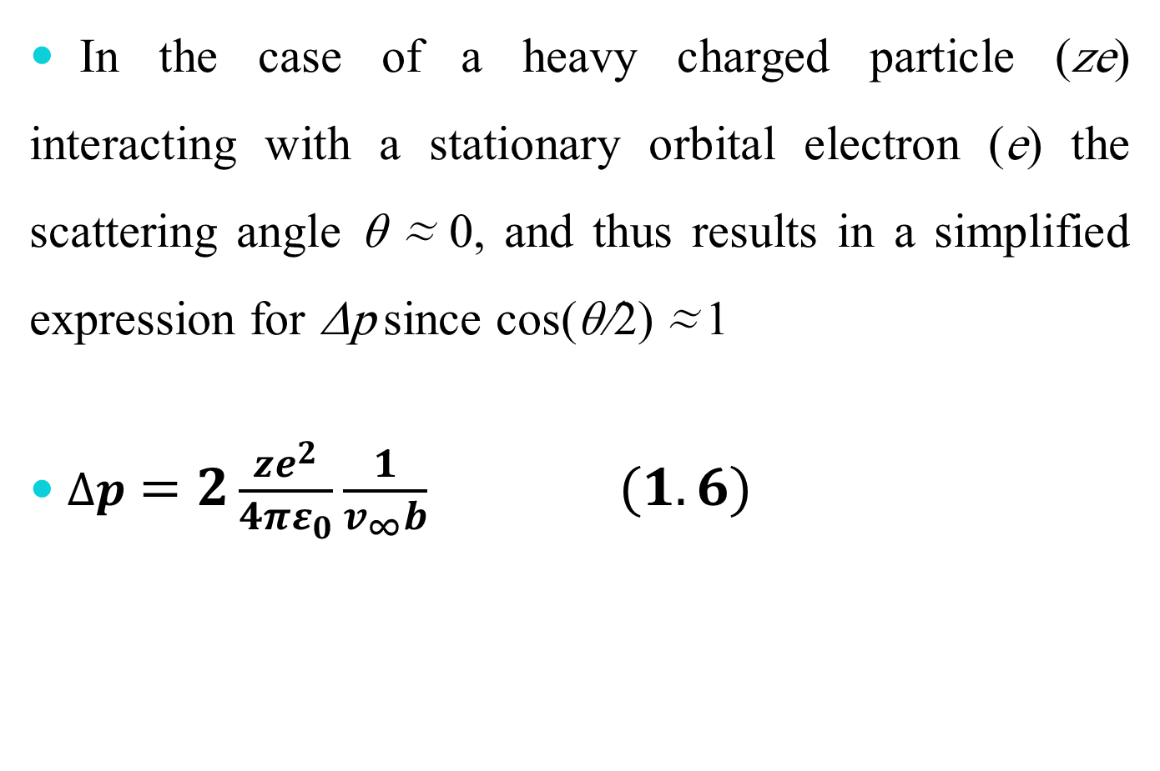
In the case of a heavy charged particle (ze) interacting with a stationary orbital electron (e) the scattering angle θ ≈ 0, and thus results in a simplified expression for Δp since cos(θ/2) ≈ 1
$∆p=2\frac{ze^{2}}{4πε_{0}}\frac{1}{v_{∞}b} (1.6)$

Slide 54
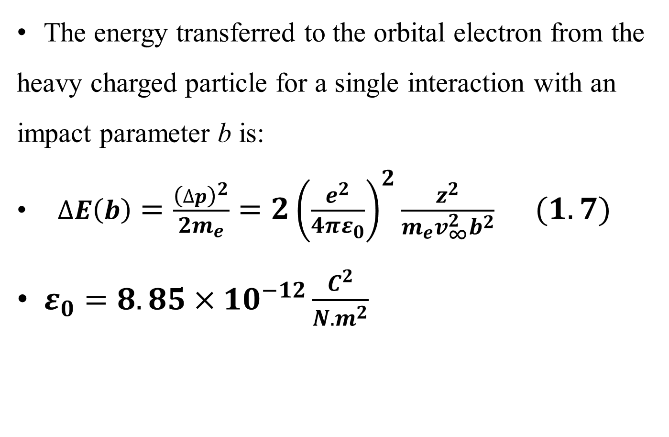
The energy transferred to the orbital electron from the heavy charged particle for a single interaction with an impact parameter b is:
$∆E\left(b\right)=\frac{{\left(∆p\right)}^{2}}{2m_{e}}=2{\left(\frac{e^{2}}{4πε_{0}}\right)}^{2}\frac{z^{2}}{m_{e}v_{∞}^{2}b^{2}} (1.7)$
$ε_{0}=8.85×{10}^{−12}\frac{C^{2}}{N.m^{2}}$

Slide 55
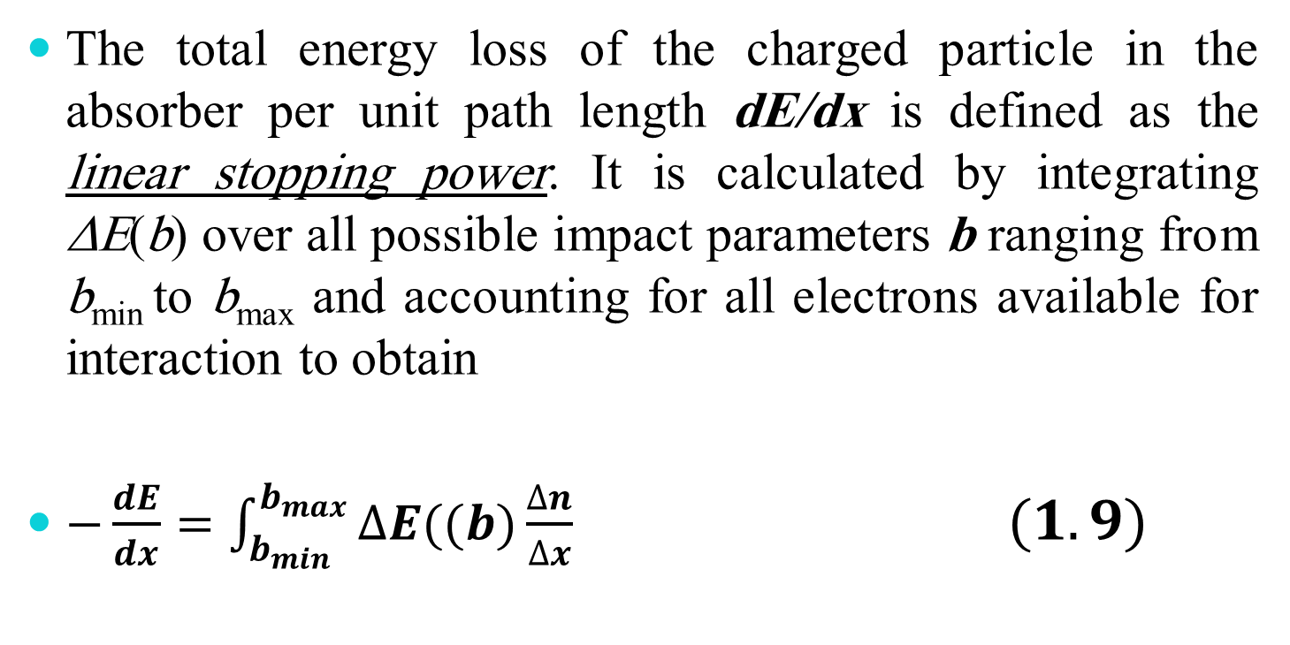
1.8.1.2 Linear Collision Stopping Power
The total energy loss of the charged particle in the absorber per unit path length dE/dx is defined as the linear stopping power. It is calculated by integrating ΔE(b) over all possible impact parameters b ranging from b_{min} to b_{max} and accounting for all electrons available for interaction to obtain
$−\frac{dE}{dx}=\int_{b_{min}}^{b_{max}}{∆E((b)\frac{∆n}{∆x} (1.9)}$

Slide 56
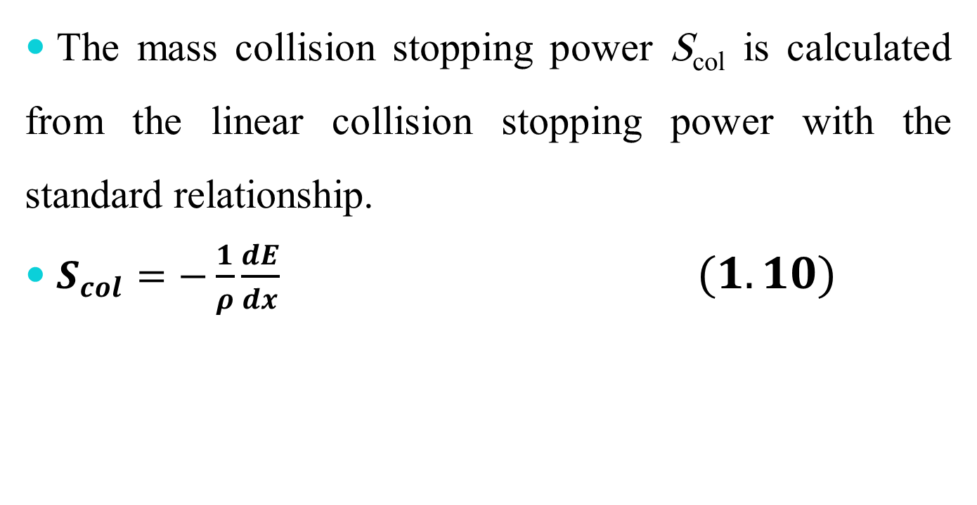
Linear Collision Stopping Power
The mass collision stopping power S_{col} is calculated from the linear collision stopping power with the standard relationship.
$S_{col}=−\frac{1}{ρ}\frac{dE}{dx} (1.10)$

Slide 57
In (1.9) Δn/Δx is the number of electrons per unit path length in a thin annual cylinder with inner radius b and outer radius b + db. The cylinder’s axis is aligned with the trajectory of the heavy charged particle.
1. Minimum possible energy transfer is governed by the ionization and excitation potentials of orbital electrons resulting in a maximum impact parameter b_{max} beyond which energy transfer becomes impossible.
2. Maximum possible energy transfer in a head-on collision between the heavy charged particle and the orbital electron and results in a minimum impact parameter b_{min}.

Slide 58
The number of electrons Δn contained in the annual cylinder with radii b and b + db is
Δn = N_{e}dm = (ZN_{A}/A)dm ( 1.11)
N_{e} is the number of electrons per unit mass (ZN_{A}/A) in the absorber, dm is the mass contained in the annual cylinder between b and b+db equal to
dm = ρdV = ρπ(b + db)²Δx − ρπb²Δx
= ρπΔx[b² + 2b(db) + (db)² − b²] ≈ 2π ρ b dbΔx (1.12)

Slide 59
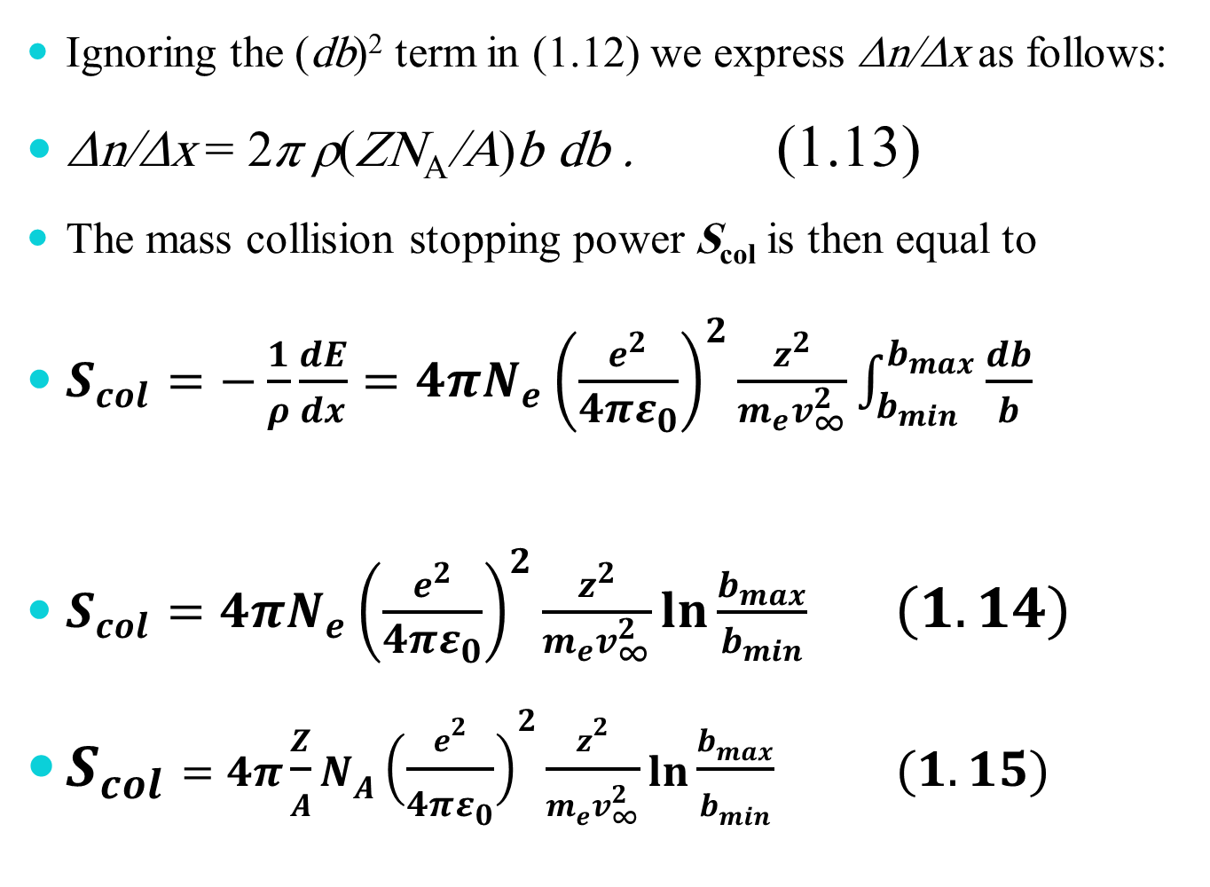
Ignoring the (db)² term in (1.12) we express Δn/Δx as follows:
Δn/Δx = 2π ρ(ZN_{A}/A)b db . (1.13)
The mass collision stopping power S_{col} is then equal to
$S_{col}=−\frac{1}{ρ}\frac{dE}{dx}=4πN_{e}{\left(\frac{e^{2}}{4πε_{0}}\right)}^{2}\frac{z^{2}}{m_{e}v_{∞}^{2}}\int_{b_{min}}^{b_{max}}{\frac{db}{b} }$
$S_{col}=4πN_{e}{\left(\frac{e^{2}}{4πε_{0}}\right)}^{2}\frac{z^{2}}{m_{e}v_{∞}^{2}}\ln{\frac{b_{max}}{b_{min}}} (1.14)$
$S_{col}=4π\frac{Z}{A}N_{A}{\left(\frac{e^{2}}{4πε_{0}}\right)}^{2}\frac{z^{2}}{m_{e}v_{∞}^{2}}\ln{\frac{b_{max}}{b_{min}}} (1.15)$

Slide 60
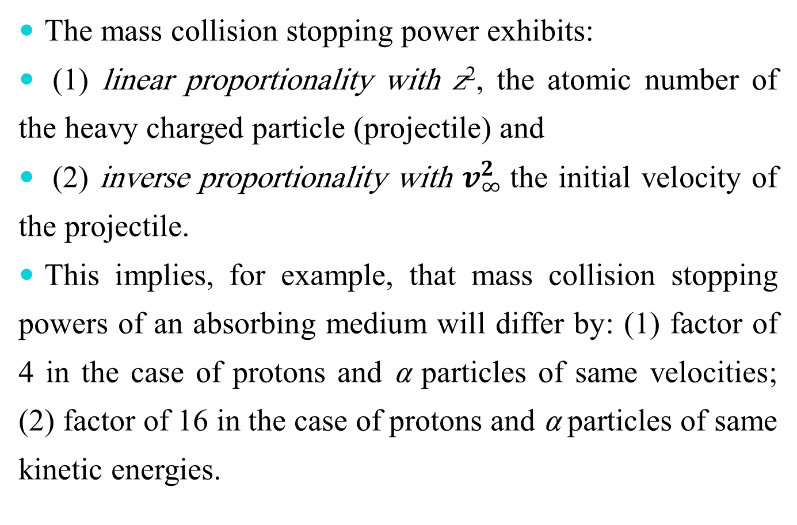
The mass collision stopping power exhibits:
(1) linear proportionality with z², the atomic number of the heavy charged particle (projectile) and
(2) inverse proportionality with $v_{∞}^{2}$the initial velocity of the projectile.
This implies, for example, that mass collision stopping powers of an absorbing medium will differ by: (1) factor of 4 in the case of protons and α particles of same velocities; (2) factor of 16 in the case of protons and α particles of same kinetic energies.

Slide 61
References
E.B. Podgorsak, Radiation physics for Medical Physicists, Springer-Verlag Berlin Heidelberg Printed in Germany 2006.
E.B. Podgorsak, Radiation Oncology Physics: A Handbook for Teachers and Students, Printed by the IAEA in Austria July 2005.
Bushong, S.C., Radiologic Science for Technologists Physics, Biology, and production. Seventh Edition. 2001.

