Slide 1
1.7 Interactions of Radiations with Matter
The particles or rays that are emitted during radioactive decay are emitted with certain energy, and they may or may not have charge.
All of them interact with the environment into which they are released, transferring energy to that medium, and eventually dissipating all of their energy
such transfers of energy will have important implication for radiation biology, radiation shielding , radiation detection and almost every practical application of radiation protection.

Slide 2
1.7.1 Interaction of charged particle with matter
A charged particle is surrounded by its Coulomb electric force field that interacts with orbital electrons (collision loss) and the nucleus (radiative loss)
The energy transfer from the charged particle to matter in each individual atomic interaction is generally small, so that the particle undergoes a large number of interactions before its kinetic energy is spent.

Slide 3
Interaction of charged particle with matter
Stopping power is the parameter used to describe the gradual loss of energy of the charged particle as it penetrates into an absorbing medium.
Two classes of stopping powers are known: collision (ionization) stopping power that results from charged particle interaction with orbital electrons of the absorber and radiative stopping power that results from charged particle interaction with nuclei of the absorber.

Slide 4
Stopping powers depend on the :
properties of the charged particle such as its mass, charge, velocity and energy.
properties of the absorbing medium such as its density and atomic number

Slide 5
1.8 Stopping Power
As a charged particle travels through an absorber, it experiences Coulomb interactions with the nuclei and the orbital electrons of the absorber atoms. These interactions can be divided into three categories depending on the size of the classical impact parameter b compared to the classical atomic radius a:

Slide 6
Stopping Power
Coulomb force interaction of the charged particle with the external nuclear field (radiative collision or bremsstrahlung production) for b << a.
Coulomb force interaction of the charged particle with orbital electron for b ≈ a (hard collision).
Coulomb force interaction of the charged particle with orbital electron for b >> a (soft collision).

Slide 8
Stopping Power
The rate of energy loss per unit of path length by a charged particle in a medium is called the linear stopping power (dE/dx).
The stopping power is typically given in units MeV.cm²/g and then referred to as the mass stopping power S_{m} equal to the linear stopping power divided by the density ρ of the absorbing medium.
The stopping power is a property of the material in which a charged particle propagates.

Slide 9
Stopping Power
Two types of stopping powers are known:
Radiative stopping power that results from charged particle Coulomb interaction with the nuclei of the absorber. Only light charged particles (electrons and positrons)
Collision (ionization) stopping power that results from charged particle Coulomb interactions with orbital electrons of the absorber. (heavy and light charged particles)
S_{tot} = S_{rad} + S_{col}

Slide 10
1.8.1 Collision Stopping Power for Heavy Charged Particles
In the energy range below 10 MeV, the energy transfer from energetic heavy charged particles to a medium (absorber) they traverse occurs mainly through Coulomb interactions of the charged particle with orbital electrons of the absorber atoms.
1. soft collisions for b >> a
2. hard collisions for b ≈ a

Slide 11
1.6.1.1 Momentum Transfer from Heavy Charged Particle to Orbital Electron
The classical derivation of the mass collision stopping power S_{col} of a heavy charged particle, such as a proton, is based on the calculation of the momentum change Δp of the heavy charged particle colliding with an orbital electron. The Coulomb interaction between the heavy charged particle (charge ze and mass M) and the orbital electron (charge e and mass m_{e}) is shown schematically in Fig. 1.2.

Slide 13
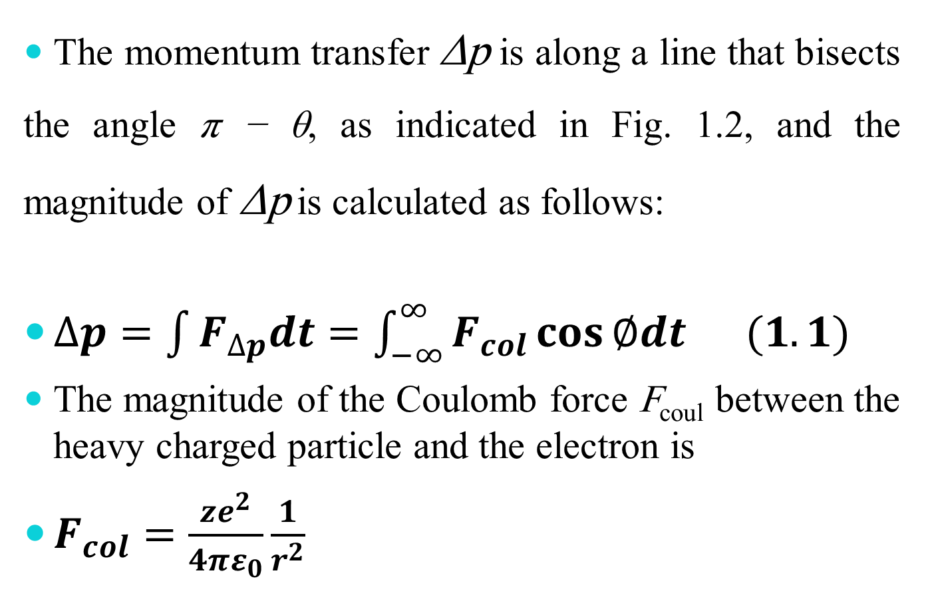
The momentum transfer Δp is along a line that bisects the angle π − θ, as indicated in Fig. 1.2, and the magnitude of Δp is calculated as follows:
$∆p=\int{F_{∆p}dt=\int_{−∞}^{∞}{F_{col}\cos{∅dt (1.1)}}}$
The magnitude of the Coulomb force F_{coul} between the heavy charged particle and the electron is
$F_{col}=\frac{ze^{2}}{4πε_{0}}\frac{1}{r^{2}}$
4

Slide 14
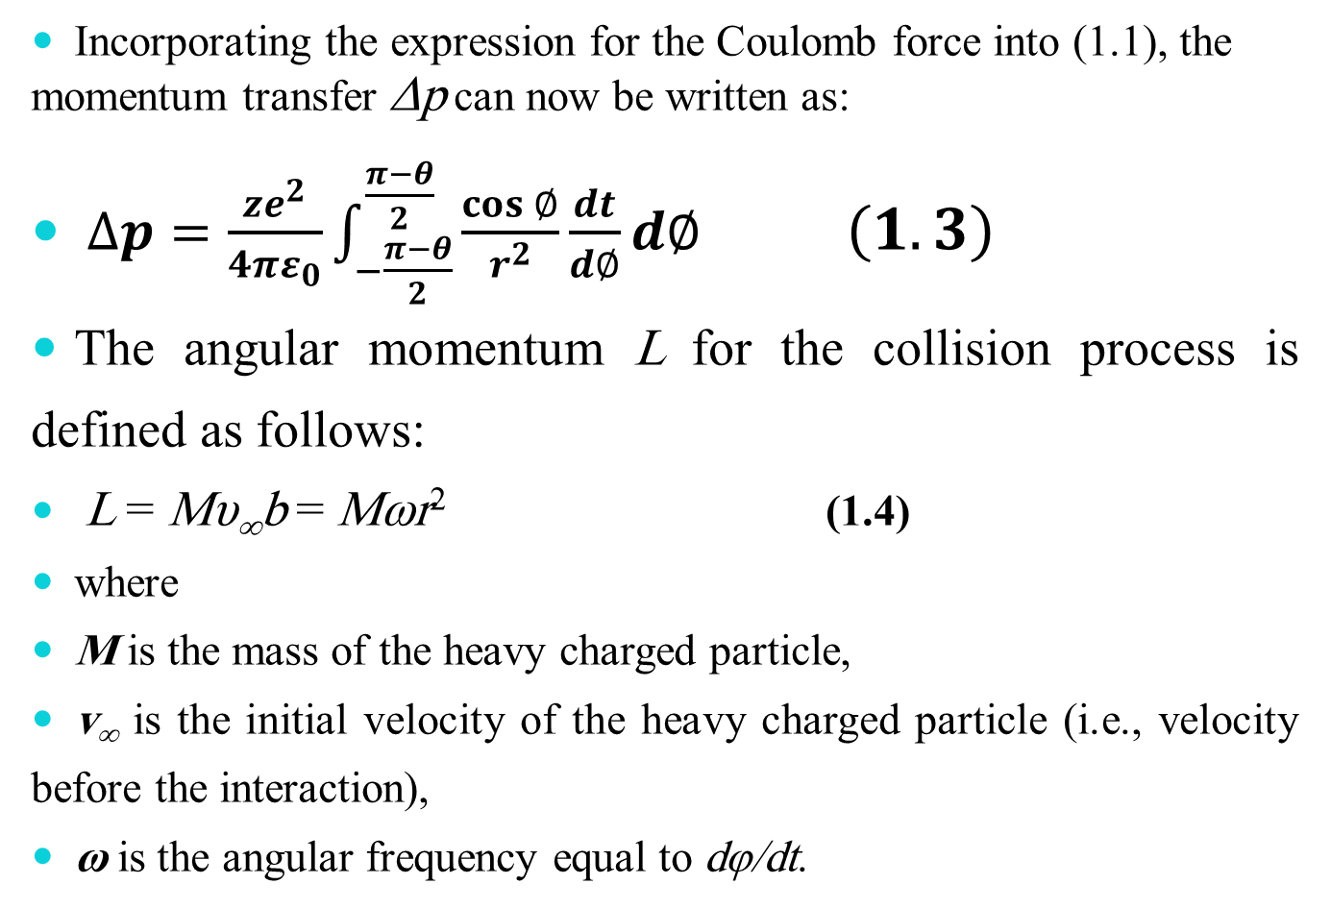
Incorporating the expression for the Coulomb force into (1.1), the momentum transfer Δp can now be written as:
$∆p=\frac{ze^{2}}{4πε_{0}}\int_{−\frac{π−θ}{2}}^{\frac{π−θ}{2}}{\frac{\cos{∅}}{r^{2}}\frac{dt}{d∅}d∅} \left(1.3\right)$
The angular momentum L for the collision process is defined as follows:
L = Mυ∞b = Mωr² (1.4)
where
M is the mass of the heavy charged particle,
v∞ is the initial velocity of the heavy charged particle (i.e., velocity before the interaction),
ω is the angular frequency equal to dφ/dt.

Slide 15
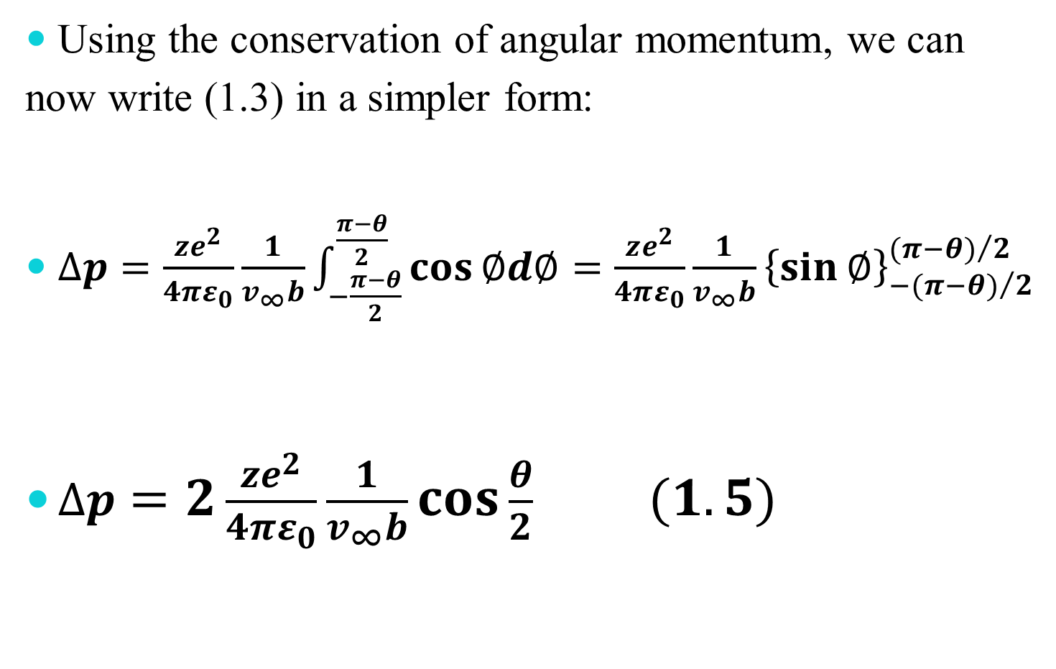
Using the conservation of angular momentum, we can now write (1.3) in a simpler form:
$∆p=\frac{ze^{2}}{4πε_{0}}\frac{1}{v_{∞}b}\int_{−\frac{π−θ}{2}}^{\frac{π−θ}{2}}{\cos{∅d∅=\frac{ze^{2}}{4πε_{0}}\frac{1}{v_{∞}b}{\left\{\sin{∅}\right\}}_{−{(π−θ)}/2}^{{(π−θ)}/2}}}$
$∆p=2\frac{ze^{2}}{4πε_{0}}\frac{1}{v_{∞}b}\cos{\frac{θ}{2}} (1.5)$

Slide 16
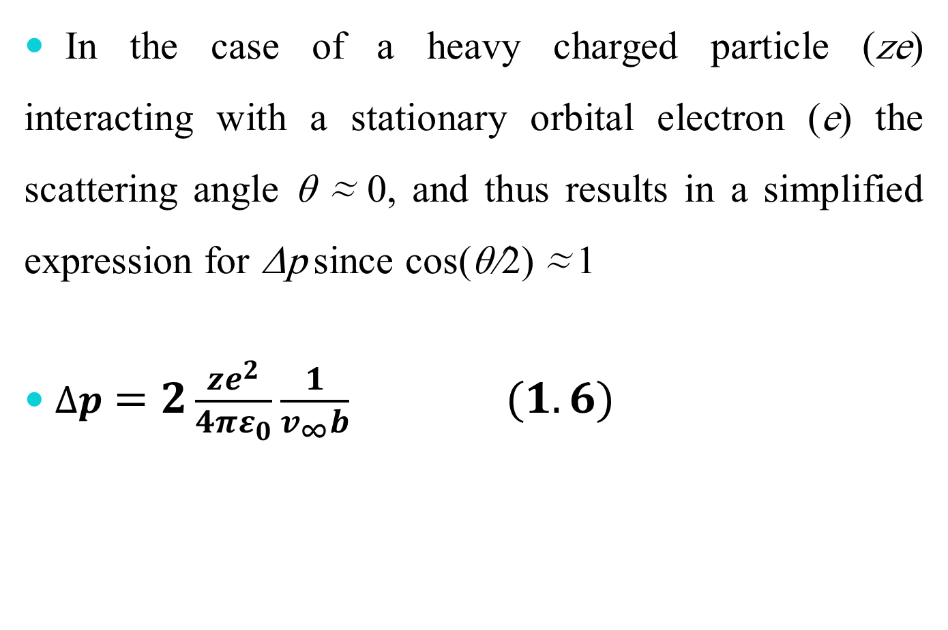
In the case of a heavy charged particle (ze) interacting with a stationary orbital electron (e) the scattering angle θ ≈ 0, and thus results in a simplified expression for Δp since cos(θ/2) ≈ 1
$∆p=2\frac{ze^{2}}{4πε_{0}}\frac{1}{v_{∞}b} (1.6)$

Slide 17
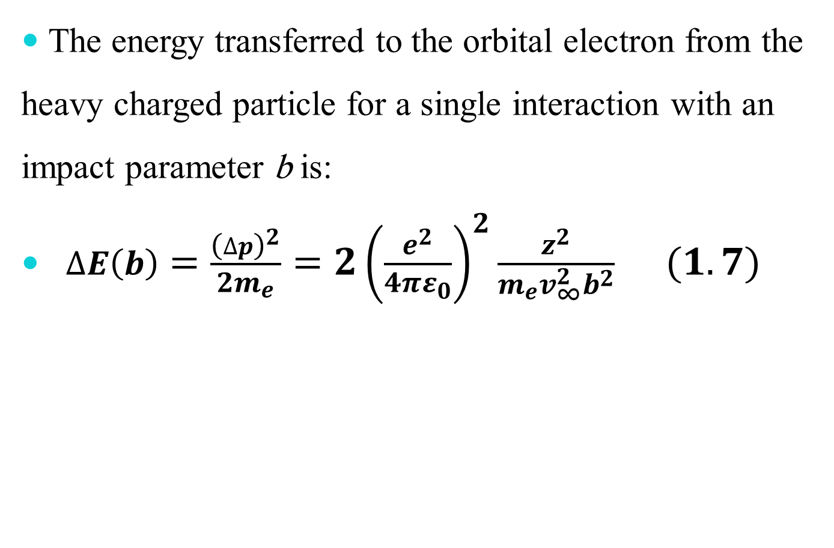
The energy transferred to the orbital electron from the heavy charged particle for a single interaction with an impact parameter b is:
$∆E\left(b\right)=\frac{{\left(∆p\right)}^{2}}{2m_{e}}=2{\left(\frac{e^{2}}{4πε_{0}}\right)}^{2}\frac{z^{2}}{m_{e}v_{∞}^{2}b^{2}} (1.7)$

Slide 18
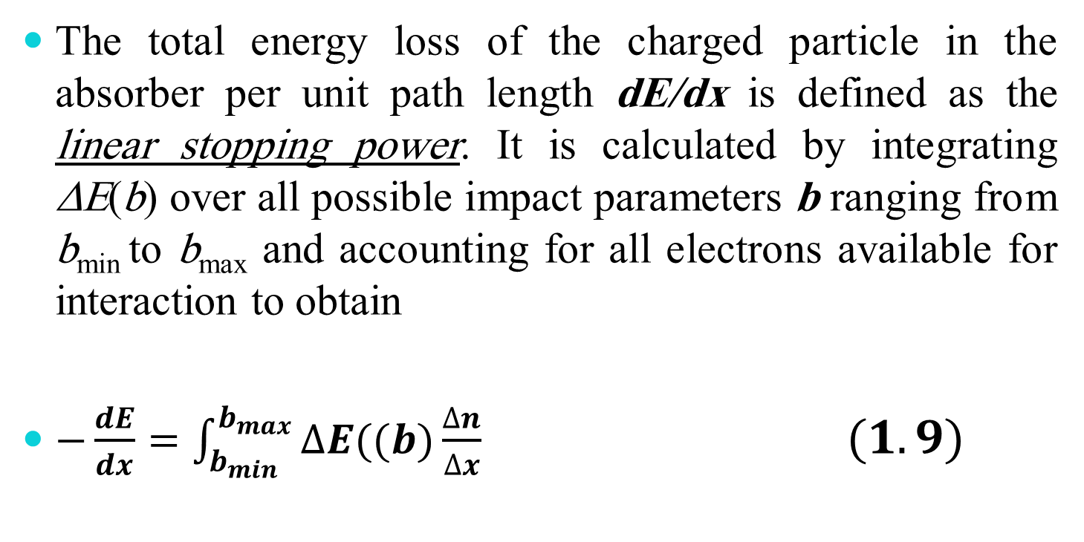
1.8.1.2 Linear Collision Stopping Power
The total energy loss of the charged particle in the absorber per unit path length dE/dx is defined as the linear stopping power. It is calculated by integrating ΔE(b) over all possible impact parameters b ranging from b_{min} to b_{max} and accounting for all electrons available for interaction to obtain
$−\frac{dE}{dx}=\int_{b_{min}}^{b_{max}}{∆E((b)\frac{∆n}{∆x} (1.9)}$

Slide 19
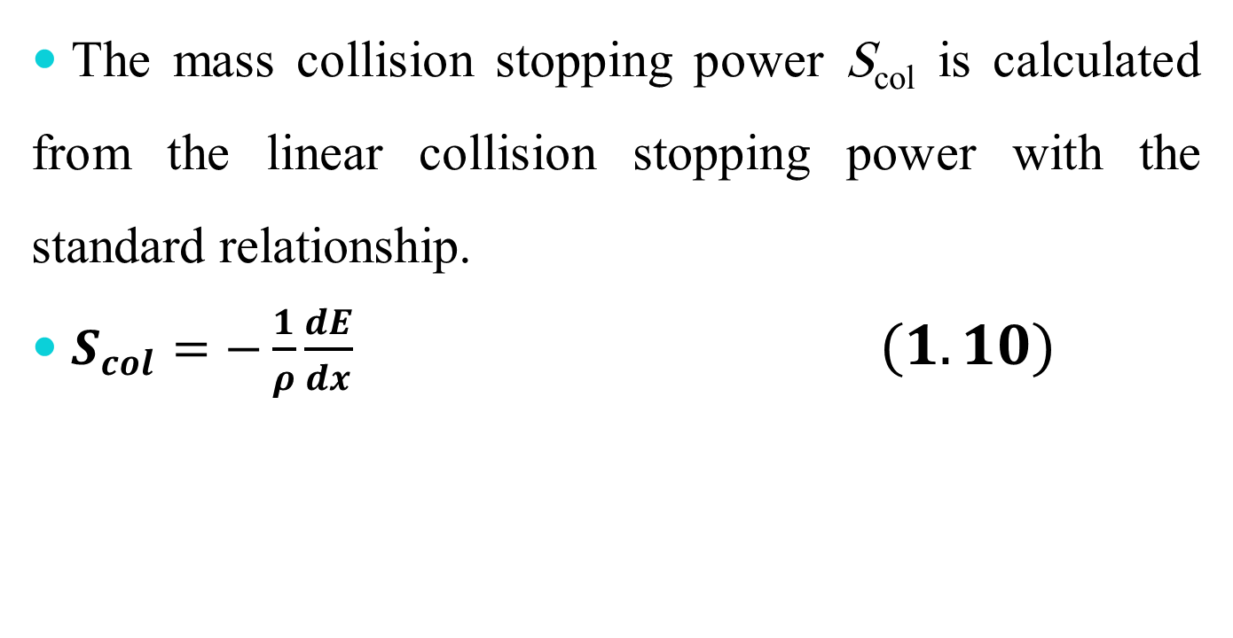
Linear Collision Stopping Power
The mass collision stopping power S_{col} is calculated from the linear collision stopping power with the standard relationship.
$S_{col}=−\frac{1}{ρ}\frac{dE}{dx} (1.10)$

Slide 20
In (1.9) Δn/Δx is the number of electrons per unit path length in a thin annual cylinder with inner radius b and outer radius b + db. The cylinder’s axis is aligned with the trajectory of the heavy charged particle.
1. Minimum possible energy transfer is governed by the ionization and excitation potentials of orbital electrons resulting in a maximum impact parameter b_{max} beyond which energy transfer becomes impossible.
2. Maximum possible energy transfer in a head-on collision between the heavy charged particle and the orbital electron and results in a minimum impact parameter b_{min}.

Slide 21
The number of electrons Δn contained in the annual cylinder with radii b and b + db is
Δn = N_{e}dm = (ZN_{A}/A)dm ( 1.11)
N_{e} is the number of electrons per unit mass (ZN_{A}/A) in the absorber, dm is the mass contained in the annual cylinder between b and b+db equal to
dm = ρdV = ρπ(b + db)²Δx − ρπb²Δx
= ρπΔx[b² + 2b(db) + (db)² − b²] ≈ 2π ρ b dbΔx (1.12)

Slide 22
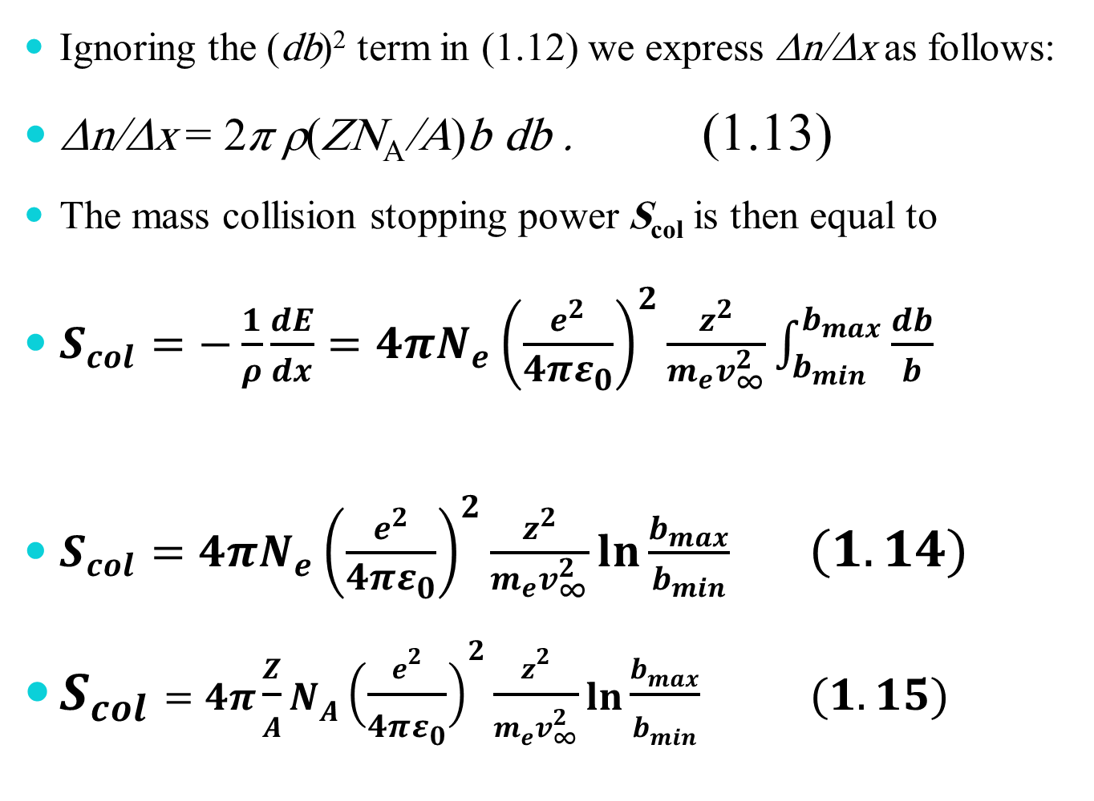
Ignoring the (db)² term in (1.12) we express Δn/Δx as follows:
Δn/Δx = 2π ρ(ZN_{A}/A)b db . (1.13)
The mass collision stopping power S_{col} is then equal to
$S_{col}=−\frac{1}{ρ}\frac{dE}{dx}=4πN_{e}{\left(\frac{e^{2}}{4πε_{0}}\right)}^{2}\frac{z^{2}}{m_{e}v_{∞}^{2}}\int_{b_{min}}^{b_{max}}{\frac{db}{b} }$
$S_{col}=4πN_{e}{\left(\frac{e^{2}}{4πε_{0}}\right)}^{2}\frac{z^{2}}{m_{e}v_{∞}^{2}}\ln{\frac{b_{max}}{b_{min}}} (1.14)$
$S_{col}=4π\frac{Z}{A}N_{A}{\left(\frac{e^{2}}{4πε_{0}}\right)}^{2}\frac{z^{2}}{m_{e}v_{∞}^{2}}\ln{\frac{b_{max}}{b_{min}}} (1.15)$

Slide 23
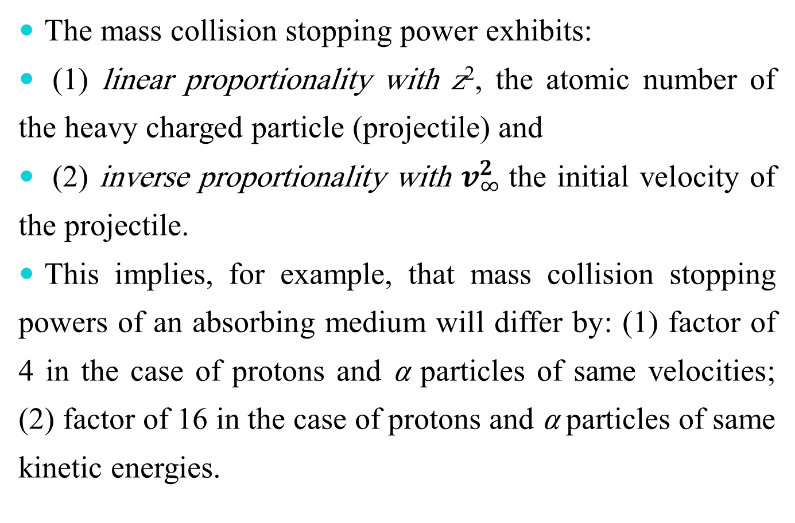
The mass collision stopping power exhibits:
(1) linear proportionality with z², the atomic number of the heavy charged particle (projectile) and
(2) inverse proportionality with $v_{∞}^{2}$the initial velocity of the projectile.
This implies, for example, that mass collision stopping powers of an absorbing medium will differ by: (1) factor of 4 in the case of protons and α particles of same velocities; (2) factor of 16 in the case of protons and α particles of same kinetic energies.

