Slide 1
Urban Design Compendium

Slide 2
Chapter 5 Detailing the Place

Slide 3
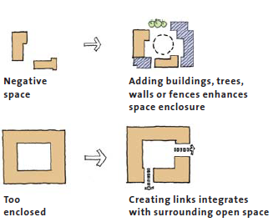
General Preview
One of the most important tenets of good urbanism is the detailed design of urban space and buildings to give positive definition to the shape and function of outdoor space.
The detailed design of urban space means attending to the building line and three-dimensional mass that helps create the character of streets and squares, later brought to life with planting, street furniture, public art and the whole host of other ingredients that give these spaces their warmth and vitality
The approach tend to return to the pre-eminence of the quality of the urban space - whether the avenue, street, square, mews or local park.

Slide 4
5.1.1 positive and negative space
Open space should be designed positively, with clear definition and enclosure. There should be no ambiguity or left over space.
Go to places
The appropriate primary function of the space will depend on the facilities it contains in relation to demand, the characteristics of surrounding uses, users and circulation patterns.
Go through spaces
Go past spaces

