Slide 1
University of Salahaddin
College of Agriculture Engineering Science
Food Technology Department
Harvesting or Picking 2nd stage students
Food Technology Department
Assist. Lecture: Mrs. Hanan fazil Khalil
Hanan.khalil@su.edu.krd

Slide 2
Harvesting or Picking
It means collection of crop products in a timely manner, whether for direct consumption (exporting or domestic market), manufacturing and storage. Harvest operations need experience and skill especially by farmers to determine the maturity stage for each crop (fruit and vegetables) and upon this determine the date of harvesting.

Slide 3
Methods of Harvesting or Picking
There are two main methods of fruit harvesting:
1- Manual method 2- Mechanical method

Slide 4
Methods of fruit harvesting or picking depending on the several factors, including:
1. Type of fruit and cultivars. 2. The usage of fruits. 3. Harvesting costs. 4. The amount of the crops or fruits. 5. Agriculture method and distance between rows of trees. 6. The availability of the requirements of different methods for picking. 7. The nature of the farm or the orchard slope.

Slide 5
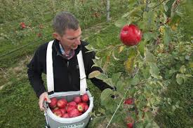
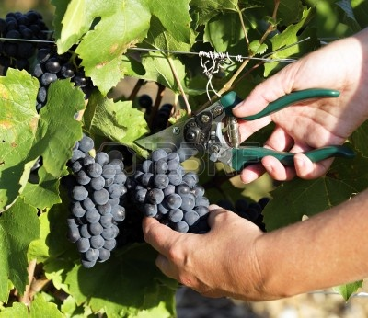
1- Manual Method This method depends on picking or harvesting by hand with or without assisting tools, it used in harvesting of many fruits for fresh consumption such as; apple, pear, peach, apricot ....... etc.

Slide 6
Manual harvesters should be trained in the proper way for fruit harvest to minimize the damage, and should be recognize the proper maturity stage. Pickers should harvest with care, by cutting or pulling the fruit or vegetable from the plant in the least damaging manner. Pickers should be trained to empty their picking bags or baskets with care, never dumping or throwing produce into field containers. Rough handling during preparation for market will increase bruising and mechanical damage and limit the benefits of cooling.
Roads between the field and the packinghouse should be graded and free from large ruts and holes. Transport speeds must be suited to the quality and conditions of the roads.

Slide 7
Advantages of this method:
1. Selective picking.
2. High quality of the fruits.
Disadvantages of this method:
1. High costs. 2. Need more time to harvesting.

Slide 8
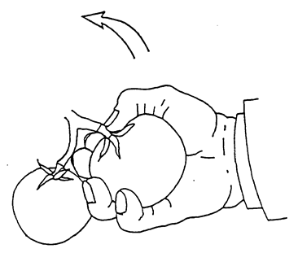
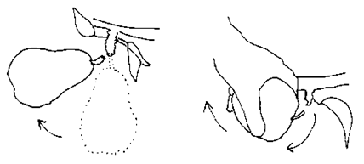
Harvesting practices
Harvesting practices should cause as little mechanical damage to produce as possible. Gentle picking and handling will help reduce crop losses. Pick carefully to avoid damage:

Slide 9
For some crops, a natural break point forms at the junction of the stem and the stalk when produce is mature. Harvesters should grasp the product firmly but gently and pull upward. Wearing cotton gloves, trimming fingernails, and removing jewelry such as rings and bracelets can help reduce mechanical damage during harvest.
There are harmful and primitive cases to harvest fruits such as beating with a stick, as in nut fruits and olive. It prefers to harvest fruits early in morning, because fruits contain the largest amount of water and the temperature is low.

Slide 10
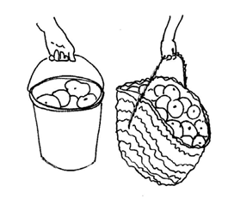
Harvesting containers
Picking baskets, bags and buckets come in many sizes and shapes. Buckets are better at baskets in protecting produce, since they do not collapse and squeeze produce.

Slide 11
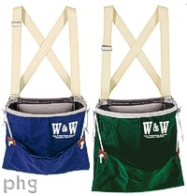
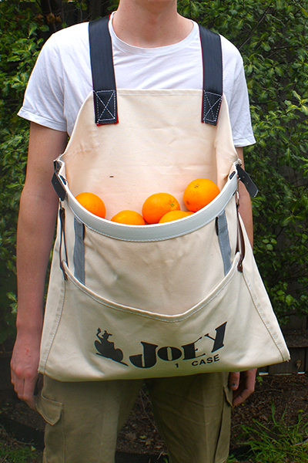
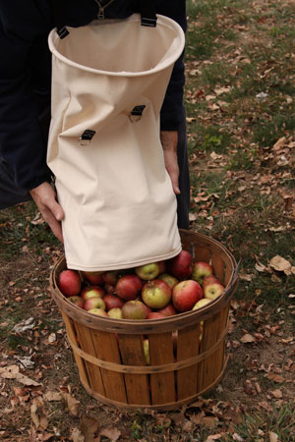
These harvesting containers can be made by sewing bags with openings on both ends.

Slide 12
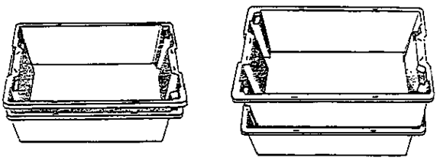
Plastic crates are relatively expensive but are durable, reusable and easy to clean. When empty, they can be nested to save space in storage or transport.
If plastic crates are well vented along the sides and bottom, they can also be used to wash and cool produce after harvests.

Slide 13
Harvesting tools
Some fruits need to be clipped or cut from the mother plant. Clippers or knives should be kept well sharpened. Woody stems should be trimmed as close as possible to prevent fruit from damaging neighboring fruits during transport. Pruning clippers are often used for fruit harvesting, a variety of styles is available.

Slide 14
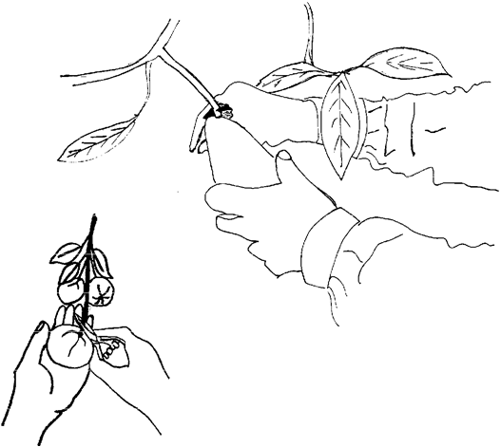
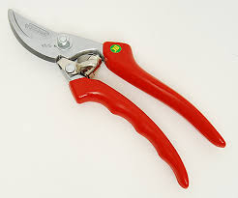

Slide 15
The ladder is essential in the manual picking for fruits which cannot be accessed because its presence on high branches beyond the reach of hands, such as mango fruit. Most of nut crops like pistachio, plastic sheet must be spread under the tree being harvested, not fall on the ground during harvesting because of their open covers and relatively high moisture content.

Slide 16
2- Mechanical Method
This method is used for some types of fruit by private harvesters, which be either shake the branches or whole tree, this private harvesters works by mechanical strength to remove the fruit from the tree and the fruit fall on the privet receivers to reduce injury and easily to collection. Fruits which cut mechanically usually used for manufacturing purposes, because some of fruits injury at the falling on the ground. This method is very convenient to pick the nut fruits and olive which the purpose is to extracting olive oil and for manufacturing purposes.

Slide 17
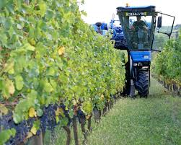

Slide 18
Advantages of this method:
1. An easy way.
2. Low-costs.
3. Harvesting fruits in one in batch.

Slide 19
Disadvantages of this method:
1. Do not allow the selective picking.
2. Some fruits may remain stuck on the tree.
3. Trees could be damaged by a beating or shaking.
4. It is difficult to sort the good fruits among the damage fruits, leaves and branches that fall with it.

