Slide 1
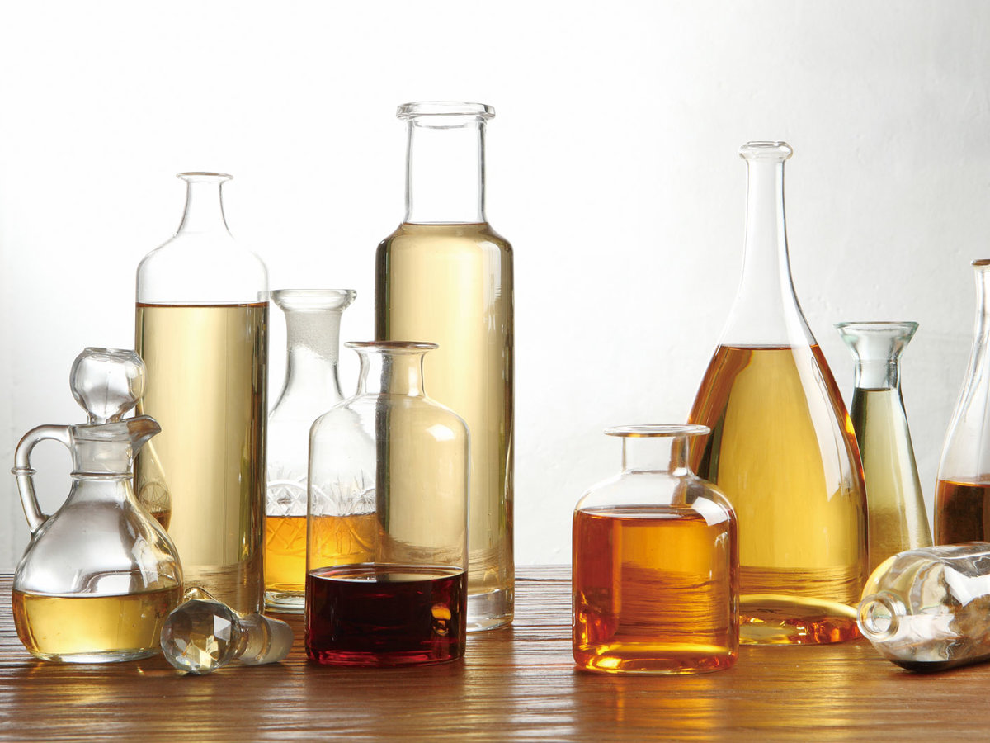
Determination of Acetic Acid content Vinegar

Slide 2

What is Vinegar ?
is formed by aerobic bacteria oxidizing grain alcohol to acetic acid and water.
More generally, vinegar can be defined as a solution composed of acetic acid [ CH₃COOH], water and perhaps other substances.
this solution must contain at least four grams of acetic acid per 100 ml solution.

Slide 3
The objective of this experiment is to measure the total acid concentration in a specific brand of vinegar.

Slide 4
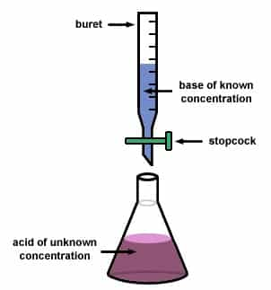
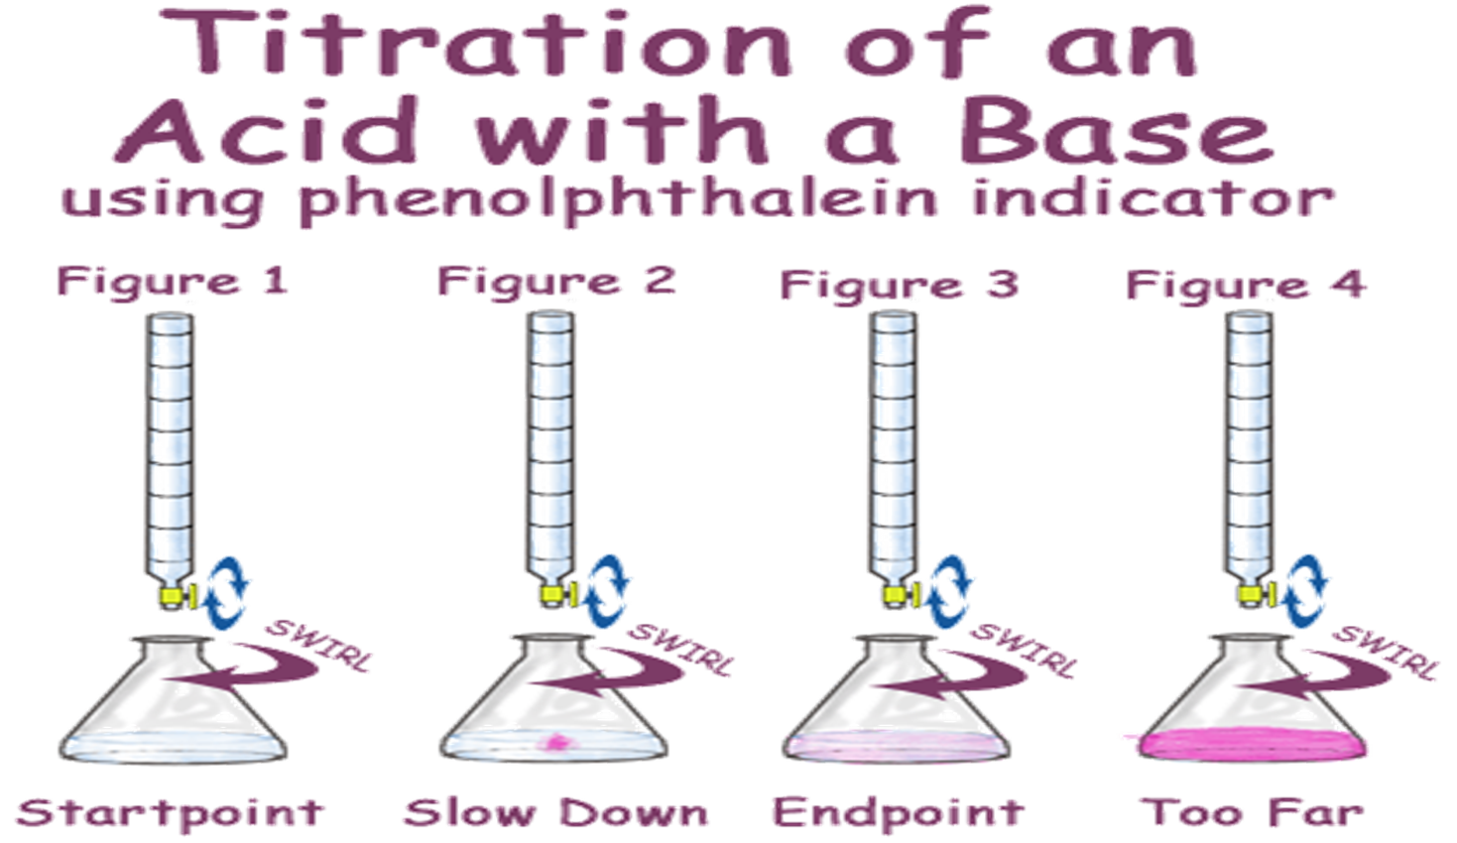

Slide 5
Procedure:
Fill the burette with 0.1N of NaOH solution to be used as a titrant.
Pipette 25 ml of commercial vinegar into the 250 ml volumetric flask and complete the volume by distilled water.
Put 10 ml of solution (vinegar solution) in a conical flask and add 2 drops of phenolphthalein indicator.

Slide 6
4.Titer with NaOH solution until formed pink color.
5.Repeat the titration process.
6.Calculate the concentration of acetic acid in 250 ml
( N x V ) _{CH3COOH} = ( N x V) _{NaOH}
N_{CH3COOH} x eq.wt = wt. of CH₃COOH in 1 liter
N_{CH3COOH} x eq.wt x (250/1000) = wt. of CH₃COOH in 250 ml
7.Calculate the % acetic acid in vinegar
%(w/w) = (wt. acetic acid / wt. of vinegar ) x 100

Slide 7
Example
( N x V ) _{CH3COOH} = ( N x V) _{NaOH}
N *10 = 0.1 * 14
N=0.14 eq/L
N_{CH3COOH} x eq.wt x (250/1000) = wt. of CH₃COOH in 250 ml
0.14 * 60* 0.25 = wt. of CH₃COOH in 250 ml
wt. of CH₃COOH in 250 ml = 2.1 gm.
%(w/w) = (wt. acetic acid / wt. of vinegar ) x 100
%(w/w) = (2.1/ 25) * 100
%(w/w) =8.4

Slide 8



