Slide 1
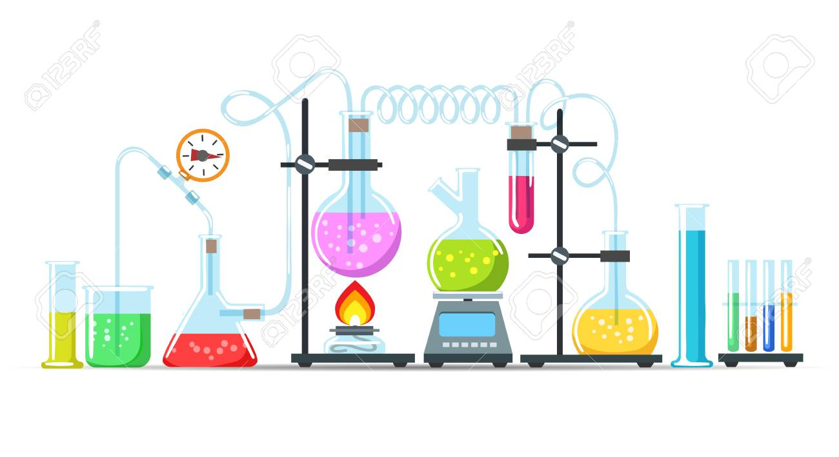
Practical Analytical chemistry /First classes
Laboratory Equipment
(Apparatus)

Slide 2
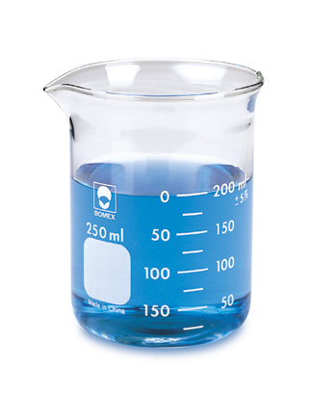
Beaker
Beakers are used for holding various chemicals.
Not for measuring precisely.
Sizes vary.

Slide 3
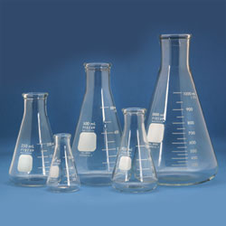
conical Flask
Used to approximately measure the volume various liquids.
Useful for mixing by swirling
Sizes vary.

Slide 4
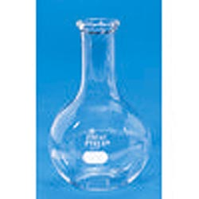
Florence Flask
Used to boil liquids.
Also used to collect gases, if applicable.
Sizes vary.

Slide 5
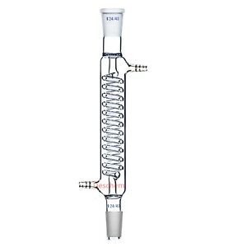
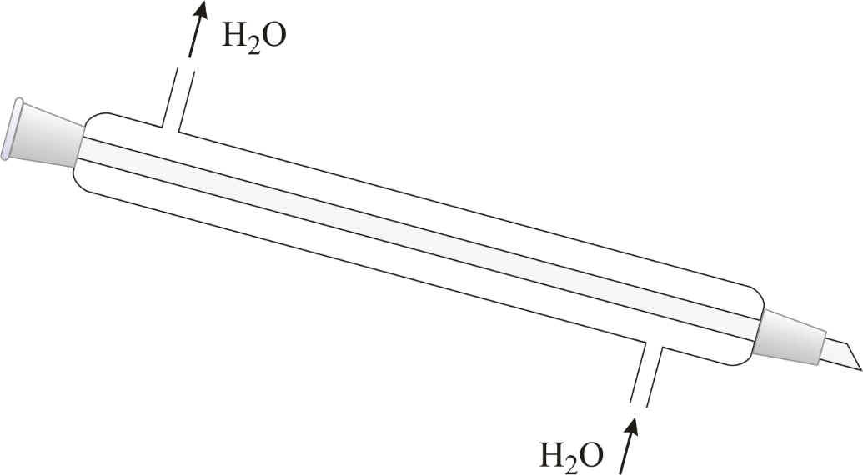
Condenser
condenser is used for condensing of vapours that pass trough the centre tube. It is cooled with water that passes in the outer tube .

Slide 6
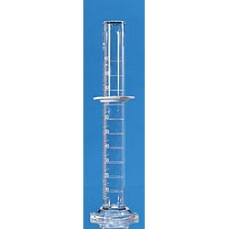
Graduated Cylinder
Used to measure the volume of liquids.
Plastic ring always on top if applicable.
Sizes vary.

Slide 7
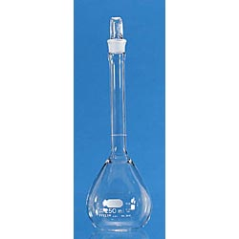
Volumetric Flask
Used to prepare precise standard solutions.
They are only good for 1 specific volume.
Comes in many sizes

Slide 8
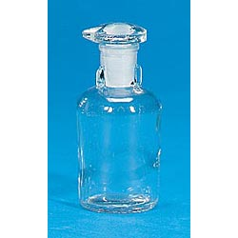
Reagent Bottle
Used to store, transport, or view reagents such as acids or bases.

Slide 9
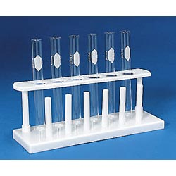
Test Tubes and Rack
Used to hold chemicals/tubes while experimenting.
Not for measuring precisely.
Sizes vary.

Slide 10
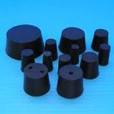
Rubber Stoppers
Used to close flasks and test tubes.

Slide 11
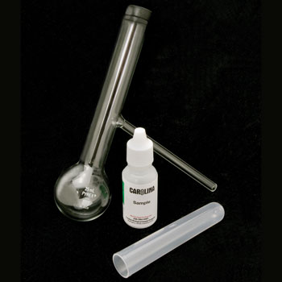
Distillation Flask
Used to separate liquids based on boiling point.

