Slide 1
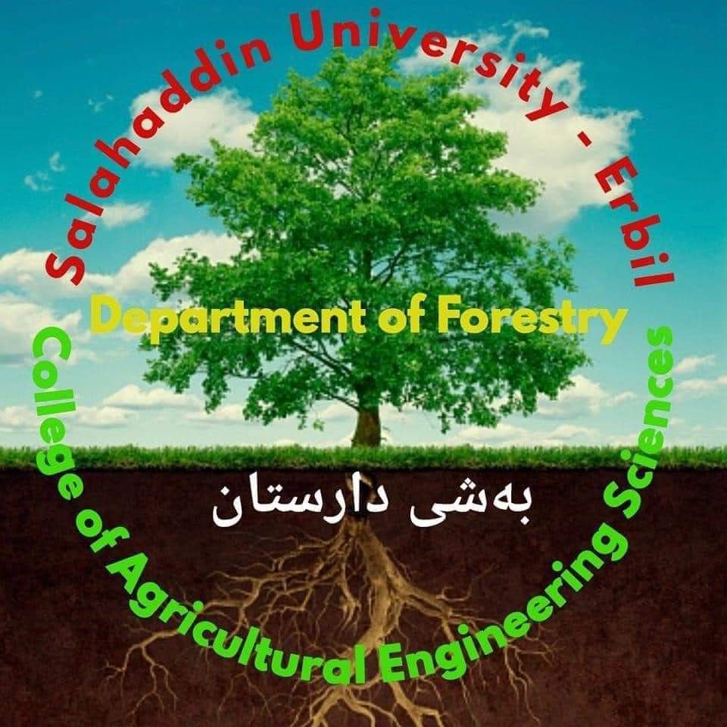
Salahaddin University – Erbil
College of Agricultural Engineering Sciences
Department of Forestry / 4th Class
Urban Forest /Theory
Dr. Hardy Kakakhan Awla Shekhany
BSc Forest Science (Koya University - College of Agriculture, Forestry Department, 2008).
MSc Forest Trees Physiology (University of Salahaddin-Erbil / College of Agriculture, Forestry and Horticulture Department, 2014).
PhD Forest Engineering - GIS and Remote Sensing, Saint Petersburg State Forest Technical University, 2024
2024 - 2025

Slide 2
URBAN FORESTRY
A Manual for the State Forestry Agencies in the Southern Region
Site and Tree Selection
The Urban Forestry Manual is being developed by the USDA Forest Service, Region and Southern Research Station, and the Southern Group of State Foresters as an educational tool for State forestry agency employees and others who work with communities on urban forestry. It can be used for self-guided learning, finding specific information on a topic and developing workshops and presentations.

Slide 3
Using this Manual
The Urban Forestry Manual provides the scientific, technical, and practical information needed to work with communities on urban forestry. There are 16 units (listed below) that address specific topics in the practice of urban forestry. These units have been developed as a series, each building upon the information in previous ones. The units may also be used individually to gain information about a specific topic.
Benefits and Costs of the Urban Forest
The Role of the State Forestry Agency in Urban Forestry
Tree Biology
Dendrology
Urban Soils
Site and Tree Selection
Tree Planting
Tree Maintenance
Tree Diagnosis and Treatment
Trees and Construction

Slide 4
Guidelines for selecting the right planting site and tree:
First, the reasons for planting a tree are discussed.
Second, important factors to consider when selecting a planting site and some common types of urban planting sites are covered.
Third, information is provided that will help in selecting the right tree for the site, which includes factors to consider when selecting a species and tree stock.
This unit emphasizes the importance of planning when selecting a site and tree to avoid mistakes and future costs. It will also help you communicate more effectively with people in your community about selecting planting sites and finding the best types of trees for those sites.

Slide 5
Table 1. Examples of ways to provide site and tree selection assistance and potential recipients.
Technical/Educational | Technical/Educational | Technical/Educational
· Site selection · Tree selection · Unique planting sites · Planting requirements · Identification of healthy tree stock · Construction site evaluations · Tree inventories · Benefits and costs · Workshops and presentations | · Construction site planning · Soil management · Land-use management plans · Urban forestry management and planning · Urban wildlife management · Urban habitat management · Urban landscape programs | · Tree Boards · Individual homeowners · Business owners · Related professionals · Utility companies · Policy makers and elected officials

