Slide 1
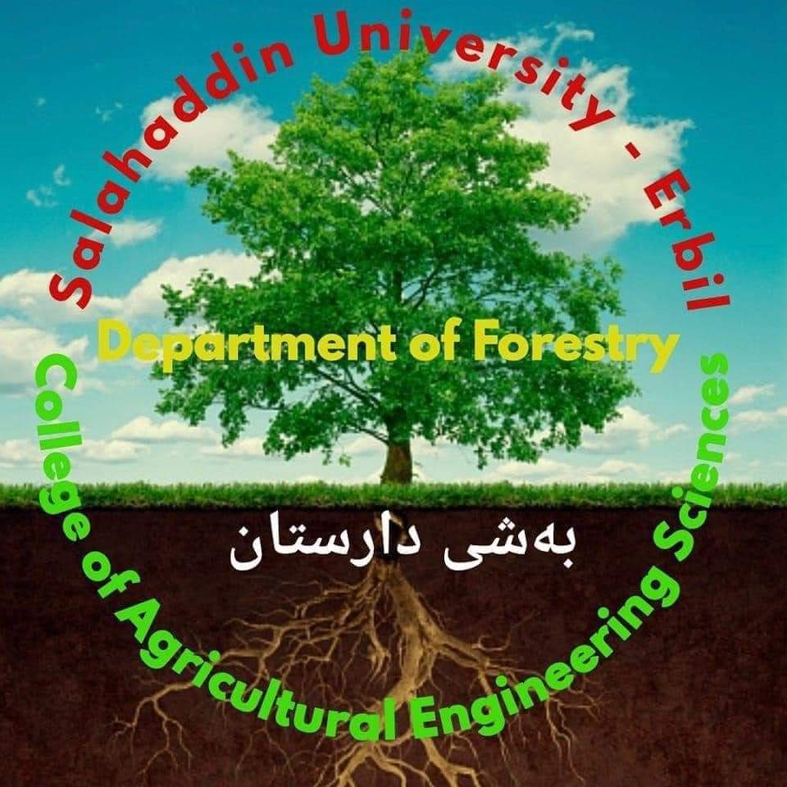
Salahaddin University – Erbil
College of Agricultural Engineering Sciences
Department of Forestry / 4th Class
Urban Forest /Theory
Dr. Hardy Kakakhan Awla Shekhany
BSc Forest Science (Koya University - College of Agriculture, Forestry Department, 2008).
MSc Forest Trees Physiology (University of Salahaddin-Erbil / College of Agriculture, Forestry and Horticulture Department, 2014).
PhD Forest Engineering - GIS and Remote Sensing, Saint Petersburg State Forest Technical University, 2024
2024 - 2025

Slide 2
Urban Heat
The urban trees or forests provide the reflective surface to the solar radiations and through the cooling shade effect maintain the temperature of the surface. Thus, planting the trees is an effective strategy for urban heat island mitigation.

Slide 3
Urban Floods
The rain water is the only source to replenish the fresh water stock on the earth. The hydrological cycle maintains the ecological flows so that the underground water gets recharged, surface reservoirs get filled and streams maintain their flows pattern. The green cover plays important role in the water retention and percolation of the rainwater. Tree crowns intercept rain and reduce the intensity of the rainfall, thus decide the fate of rainwater as per the nature of the surface – pervious or impervious.

Slide 4
Urban Pollution
The urban or peri-urban or urban environment (air, water and soil) frequently experience pollution due to different anthropogenic interventions which affect the natural characteristics of the atmosphere, hydrosphere and lithosphere. The pollution load causes the catastrophe in one or the several ways by enhancing the toxicity of the spheres. The nutrient enrichment of the urban lakes or water reservoirs, presence of the chemicals and heavy metals in soil and water, the smog in the urban atmosphere, etc. are some of the examples of the catastrophes commonly observed in urban environment.

Slide 5
Urban Forests: Livelihood
This is provided by the urban forest in following manner:
1- Recreation and well-being;
2- Aesthetics;
3- Nature and landscape conservation;
4- Biodiversity preservation;
5- Climate and hygiene;
6- Wood production;
7- Food production.

Slide 6
The Vegetation Resource The management of the vegetation resource in the urban context require following criteria.
1. Canopy cover
2. Age distribution of trees in the community
3. Species mix
4. Native vegetation
5. The condition of publicly owned trees
6. Publicly owned natural areas
7. Native vegetation

Slide 7
The Resource Management Approach The approach includes physical resource management as well as public and administrative perceptions under the following criteria,
1- Tree inventory
2- Canopy cover inventory
3- Citywide management plan
4- Citywide funding
5- City staffing
6- Tree establishment planning and implementation
7- Tree habitat suitability
8- Maintenance of publicly owned, intensively managed trees
9- Tree risk management
10- Tree protection policy development and enforcement
11- Publicly owned natural areas management planning and implementation

