Slide 1
Freshers’ Week
1.3 Learning new listening skills “ Waiting for spoken definitions”
Prepared by: Harem H. Qadir Date: Nov. 21st,2018

Slide 2
What is a syllable?
A syllable is the sound of a vowel (A, E, I, O, U) that is created when pronouncing the letters A, E, I, O, U, or Y.
The letter "Y" is a vowel only if it creates an A, E, I, O, or U sound.
examples: fry, try, cry, & dry
The number of times that you hear the sound of a vowel is the number of syllables in a word.

Slide 3
What is a syllable?
When two (or more) vowels are next to each other, the number of syllables depends on the number of vowel sounds.
examples: free (1 syllable), eat (1 syllable), & chicken (2 syllables)
If a vowel is silent, it is not counted as a syllable.
example: fire (1 syllable)
environmental
How many syllables in environmental? 5 syllables
Divide environmental into syllables:
en-vi-ron-men-tal

Slide 4
Stressed Syllable
The part of a word that you give the most emphasis to. For example, the following capitalized syllables are stressed: SOfa TELephone celEBrity comPUter aWARD maTURE

Slide 5
Objectives of the Lecture:
Listen for and understand spoken definitions in short extracts;
Discriminate between the consonants/p/ and /b/;
Discriminate between the vowel sounds/I/ and /i:/.

Slide 6
Vowel & Consonants
You already know that vowels in the English alphabet are a, e, i, o, u, and sometimes y, while the rest of the letters are called consonants. But did you ever ask yourself why the letters were divided into two separate groups?
Basically, a vowel is a sound that is made with the mouth and throat not closing at any point. In contrast, a consonant is a sound that is made with the air stopping once or more during the vocalization. That means that at some point, the sound is stopped by your teeth, tongue, lips, or constriction of the vocal cords.
The difference explains why “y” is only “sometimes” a vowel. Depending on which word “y” is being used in, it can represent different sounds. In words like “myth” or “hymn,” the letter takes on a sound like a short “i” and the mouth and throat don’t close when the sound is made. However, in words like “beyond,” it acts as a bridge between the “e” and the “o,” and there is some partial closure, making “y” a consonant.
Another forgotten letter that has the same qualities as “y” is “w.” While “w” is almost always a consonant, it is considered a vowel at the end of words like “wow” or “how.” You can see for yourself when saying these words that your mouth doesn’t fully close while pronouncing the letter.

Slide 7
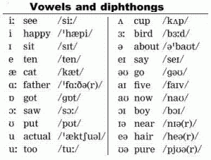
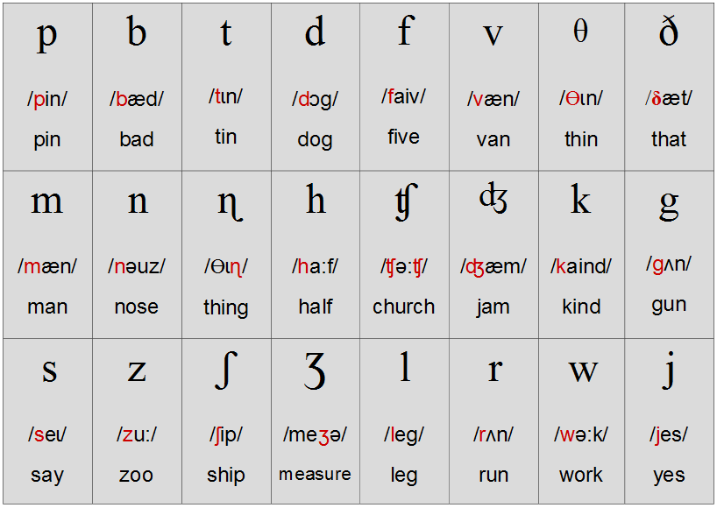

Slide 8
A. Reviewing key words
schedule | 6
bursar | 2
campus | 3
education | 1
lecture | 4
library | 5
accommodation | 7
responsible | 8
semester | 9
union | 10
resources | 11
faculty | 12

Slide 9
B. Identifying a new skill
Assignment | A piece of work to do on your own
Deadline | The time to give in an assignment
Research | Reading articles
Journals | Academic magazine
Tutorial | A small discussion

Slide 10
C. Listening for definitions
Food court | Place with lots of different restaurants.
Vending machines | which are machines with food and drink.
Launderette | can wash your clothes there.
Crèche | place to leave your children for a few hours.
Gym | It’s a place to do exercise..

Slide 11
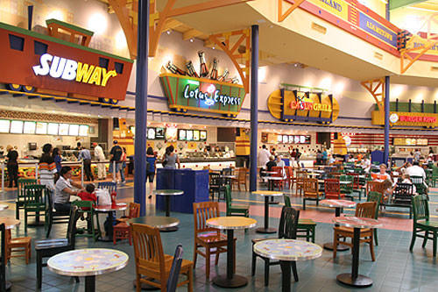
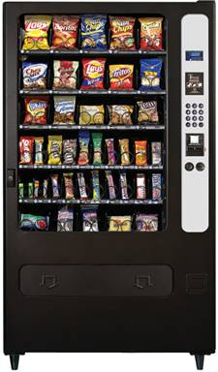

Slide 12
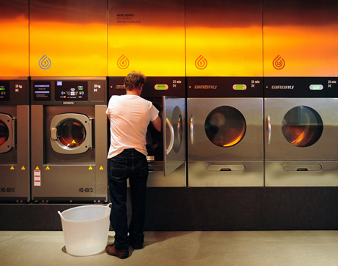
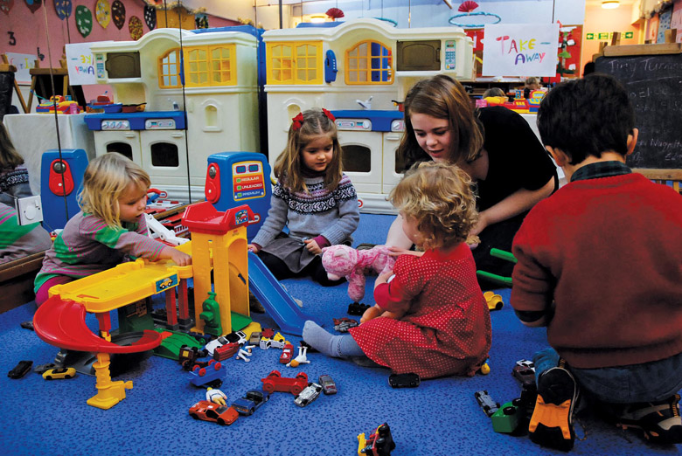

Slide 13
D. Identifying consonant sounds
Answers
1. both
2. campus
3. club
4. explain
5. job
6. pay
7. responsible
8. bursar
9. people
10. personal
11. place
12. problem

Slide 14
E. Identifying vowel sounds
Short vowel sound /I/
Long vowel sound /i:/ “comes with ea, ee”

Slide 15
Minimal pair
a pair of words, as pin and bin, or bet and bed, differing only by one sound in the same position in each word.
Minimal Pairs /b/ and /p/ buy pie
Minimal Pairs /ɪ/ and /i:/ sit seat

